Slide 1
fit Market Expansion
December 11th, 2019
Data Analytics Team

Slide 2
To Preface
Data is from Q4 / 2016 – 01 / 2017
4-month span

Slide 3
Consideration #1: Android vs iOS?

Slide 4
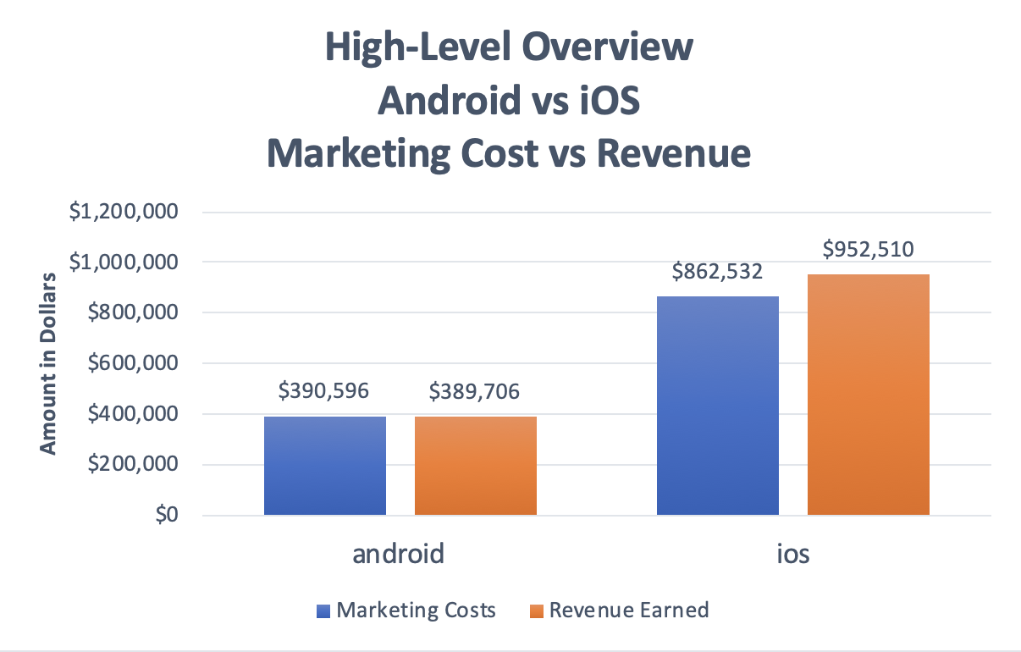

Slide 5
Android vs iOS: Digging Deeper

Slide 6
Appendix

