Slide 1
fit Market Expansion
December 12th, 2019
Data Analytics Team

Slide 2
Preface:
Data is from Q4 / 2016 – 01 / 2017
4-month span

Slide 3
Consideration #1: Android vs iOS?

Slide 4
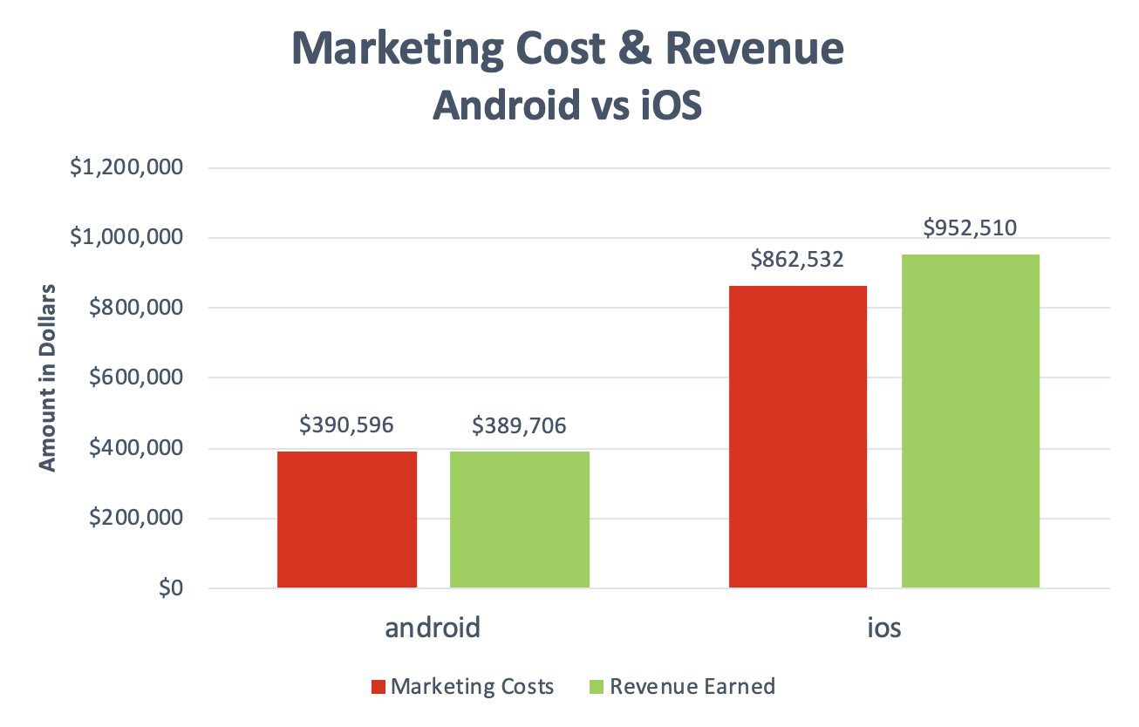
Android vs iOS: Financial Overview
Android costs & revenue balance out → ad-spend return ratio = ~1.0
iOS revenue exceeds costs → ad-spend return ratio = ~1.1
money actually being earned with iOS!

Slide 5
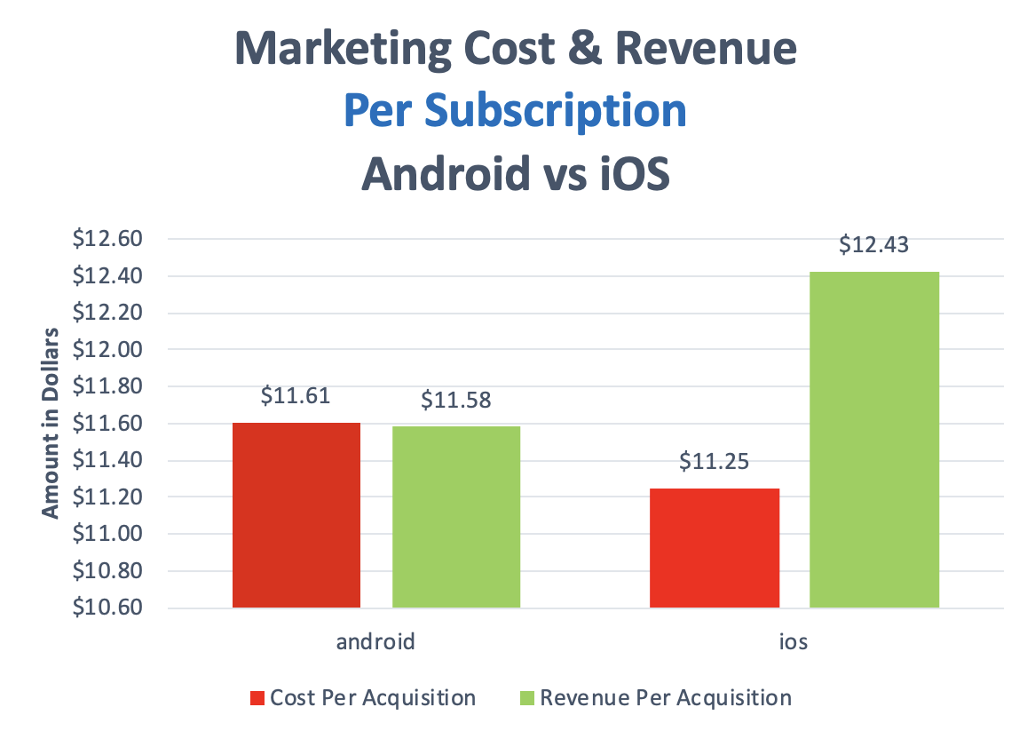
Android vs iOS: Per Subscription Level
Android costs & revenue balance out (again)
iOS cheaper & more earned per subscription than Android!
WINNER: IOS

Slide 6
Consideration #2: Marketing Channels?

Slide 7
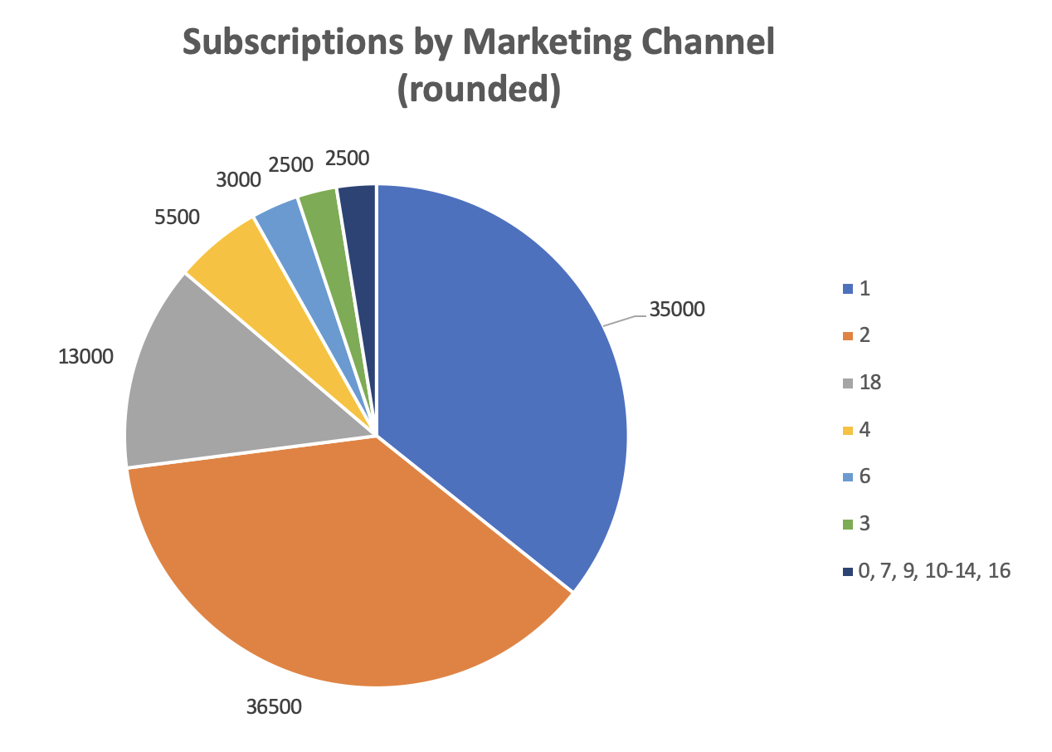
Marketing Channels: Getting Subscriptions
Channels 1 and 2 dominate subscription count
Though, Channel 1 not paid
Channels 18, 4, 6, and 3 have a good foundation
great potential for subscriber growth

Slide 8
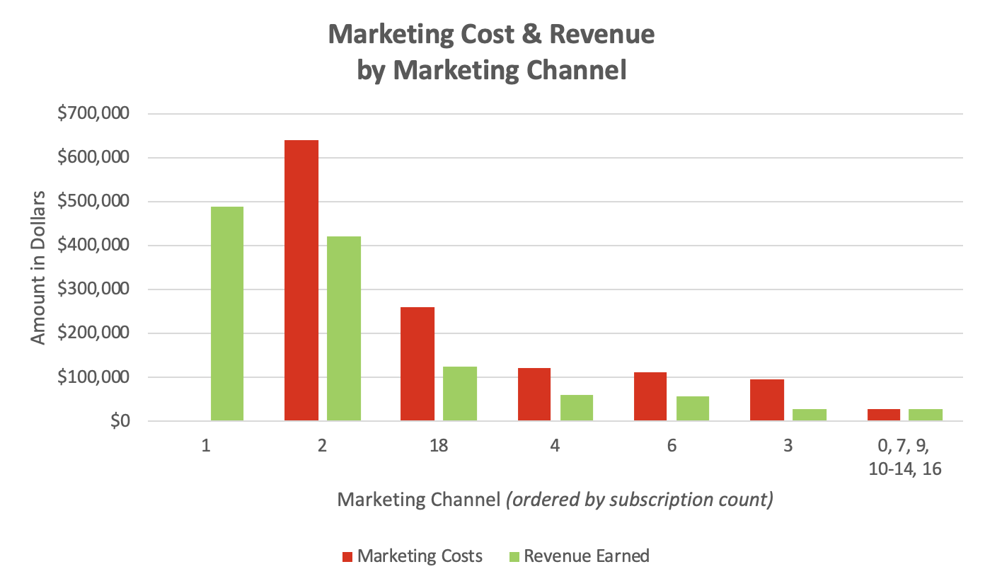
Marketing Channels: Revenue vs Cost
Aside from Channel 1, all major channels cost more than their revenue
Ad-spend return ratio:
Channel 2 = ~ 0.66
Channel 18 = ~ 0.49
Channel 4 = ~ 0.50
Channel 6 = ~ 0.52
Channel 3 = ~ 0.30

Slide 9
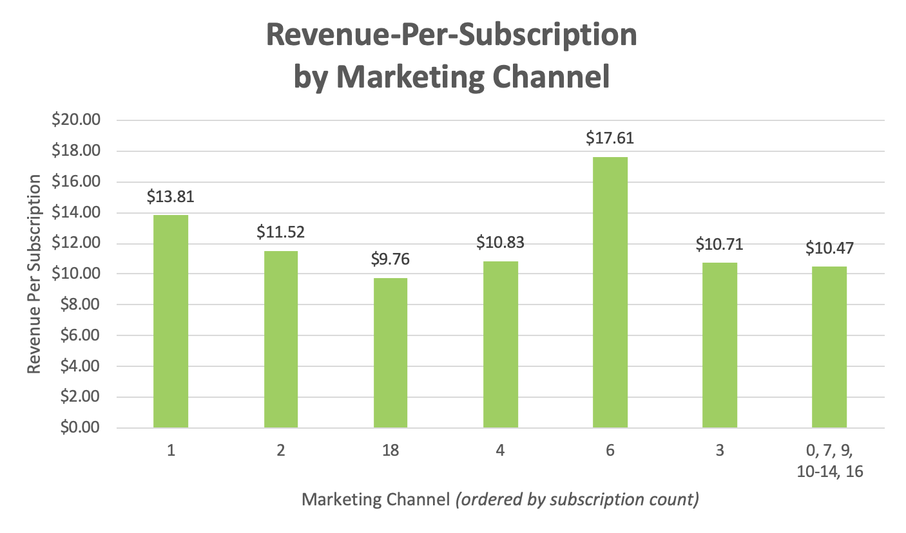
Marketing Channels: $ Per Subscription
Channel 6 earns the most, per subscription
Indication: it has more potential to earn $ vs Channel 4
Note: not necessarily more potential to grow subscription count

Slide 10
Marketing Channels: Conclusion
Channel 4 definitely has potential for improvement
However, by comparison, Channel 6:
has similar subscription count
has better ad-spend return ratio
earns more per subscription
Recommendation:
Focus on growing Channel 6 over Channel 4

Slide 11
Consideration #3: United Kingdom?

Slide 12
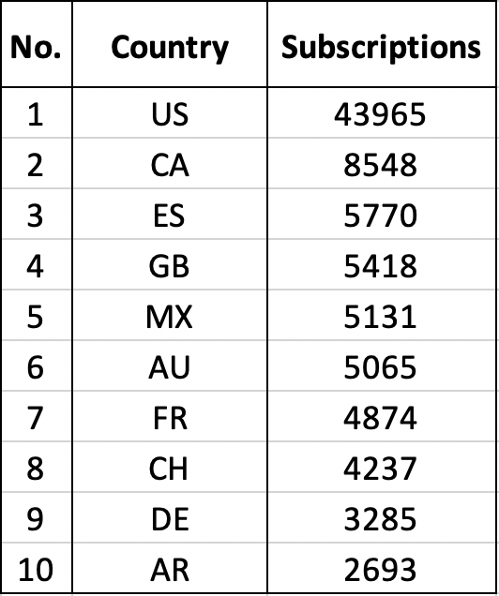
Countries: Top 10 By Subscribers
United Kingdom currently #4 by new-subscriber count
Room for growth, esp. to catch up to US!

Slide 13
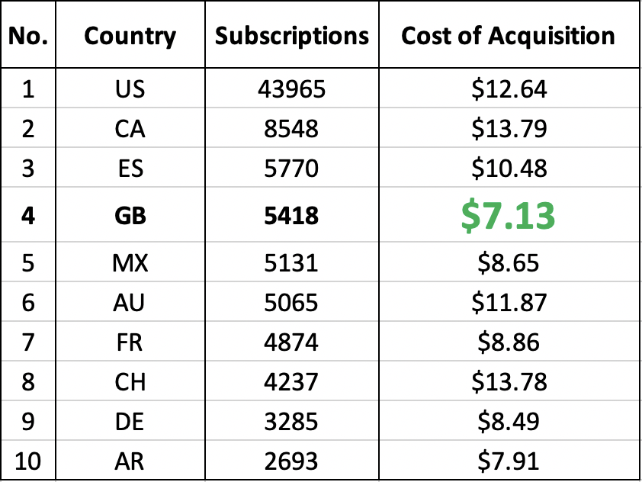
Countries: Top 10 By Subscribers
And in fact, United Kingdom is actually the cheapest in terms of acquisition cost.
(Actually, it’s the absolute cheapest even out of the TOP 20 COUNTRIES!)

Slide 14
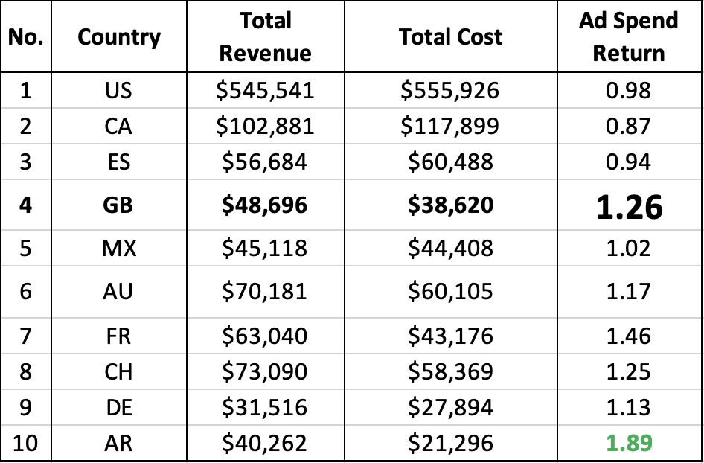
Countries: Top 10 By Subscribers
In addition to all that, United Kingdom even has one of the highest ad-spend return ratios
Lots of “bang-for-buck”, esp. lots more than Top 3
Recommendation:
United Kingdom is a
GOOD INVESTMENT!

Slide 15
Questions?

