Slide 1
自我介紹
(Using nizima Live)

Slide 2
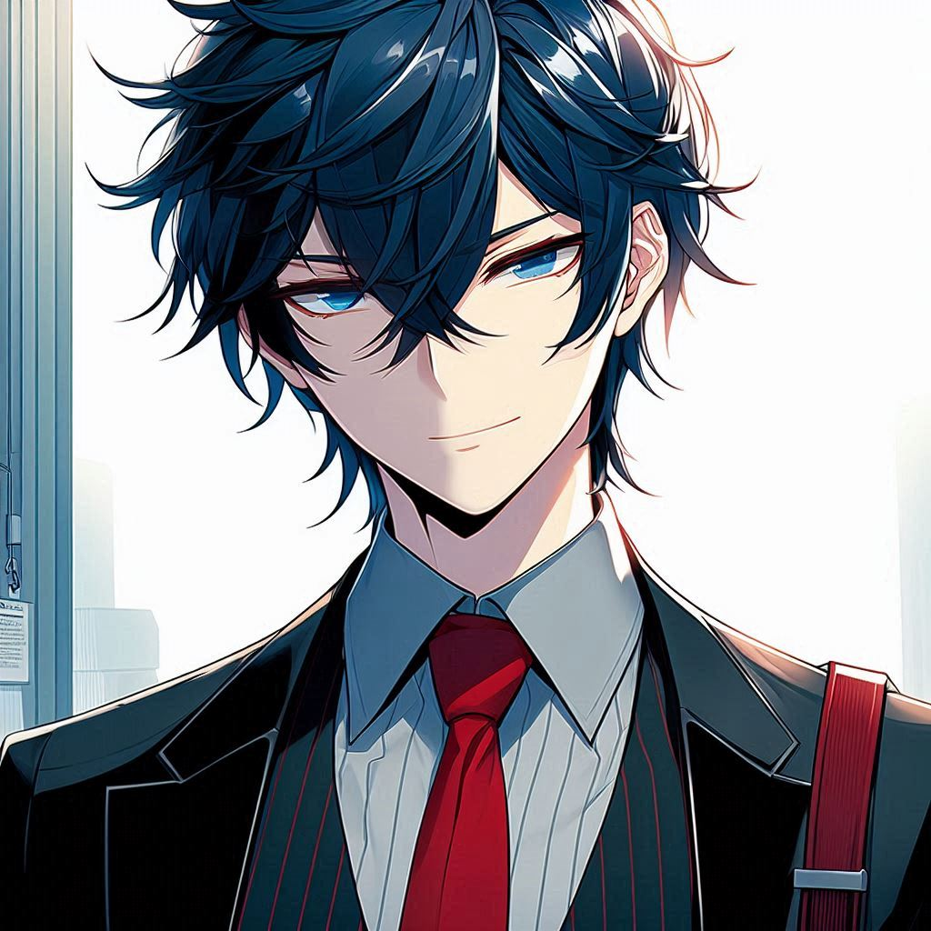
目標
Notes:
I want to tell a story and need a corresponding image that allows viewers to easily immerse themselves in the scene. The style should be Japanese anime, featuring a male character in a black suit with a red tie and deep blue hair. The story is as follows: My goal is simple – I want to be a wise man who changes the world, the kind that wears a suit, not a white robe. So, I chose the path of postgraduate studies, hoping to solve problems with my intellect and hard work, rather than relying on luck

Slide 3
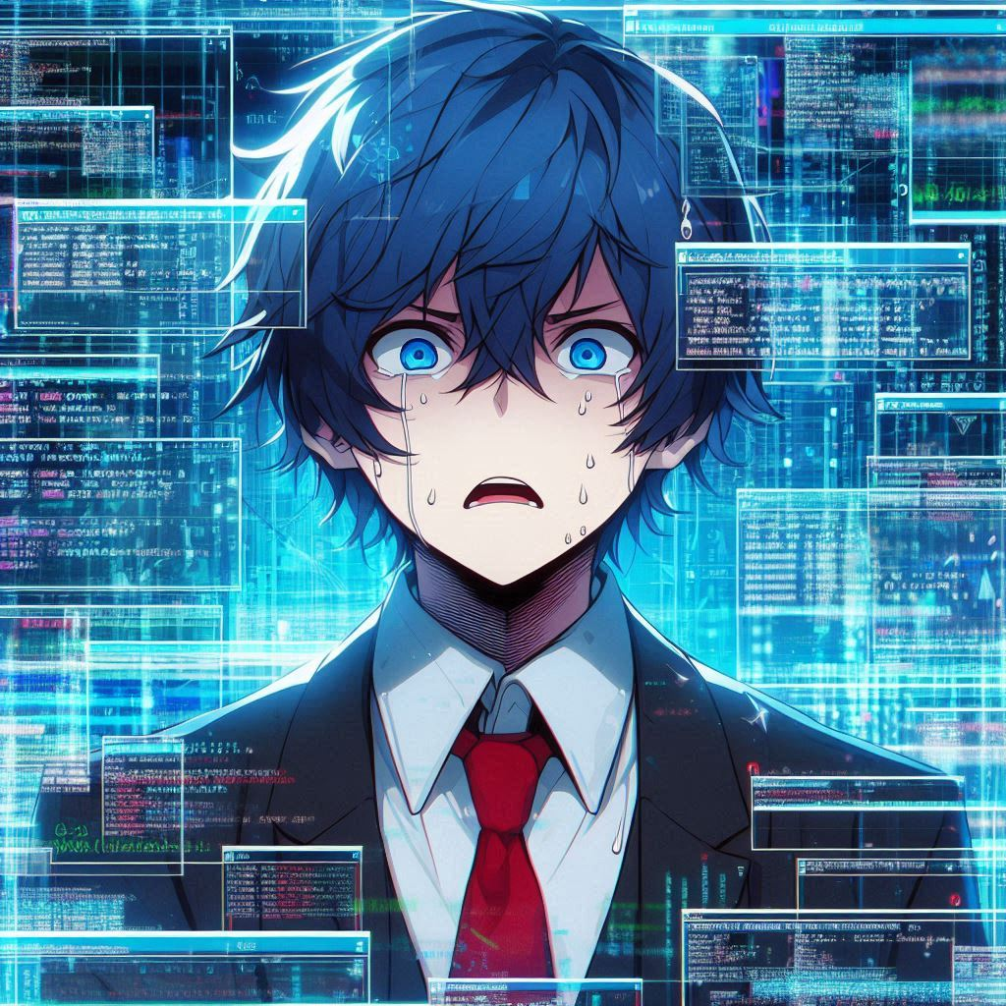
阻礙
Notes:
I want to tell a story and need a corresponding image that allows viewers to easily immerse themselves in the scene. The style should be Japanese anime, featuring a male character in a black suit with a red tie, a white shirt underneath, and deep blue hair. The story is as follows: 'But reality gave me a harsh lesson: wearing a suit doesn't mean you won't be overwhelmed by pressure and setbacks. Facing incomprehensible data and malfunctioning code every day, I started to doubt whether I had chosen the wrong path.’ Continue with this character, but the background should evoke a feeling of being overwhelmed by incomprehensible data and malfunctioning code. The main character should appear to be doubting himself and struggling to breathe.

Slide 4
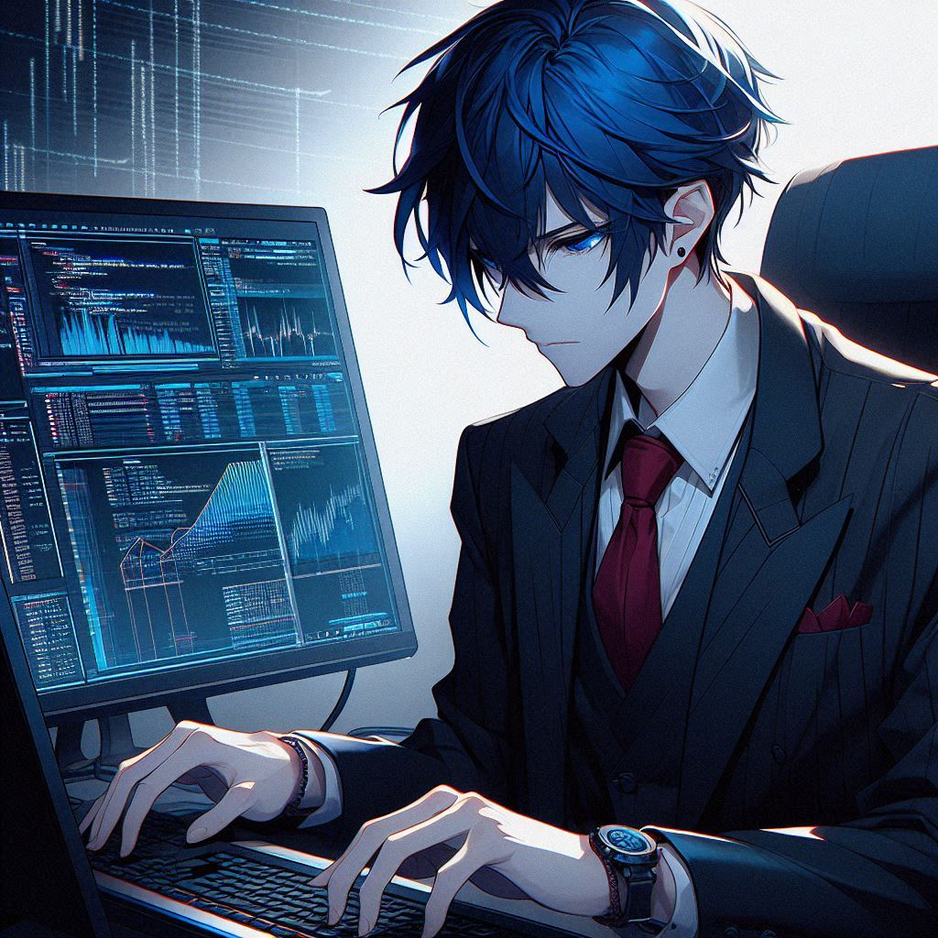
努力
Notes:
Continue with this character, but the background and the character should convey the feeling that: The main character is adjusting data and writing code.

Slide 5
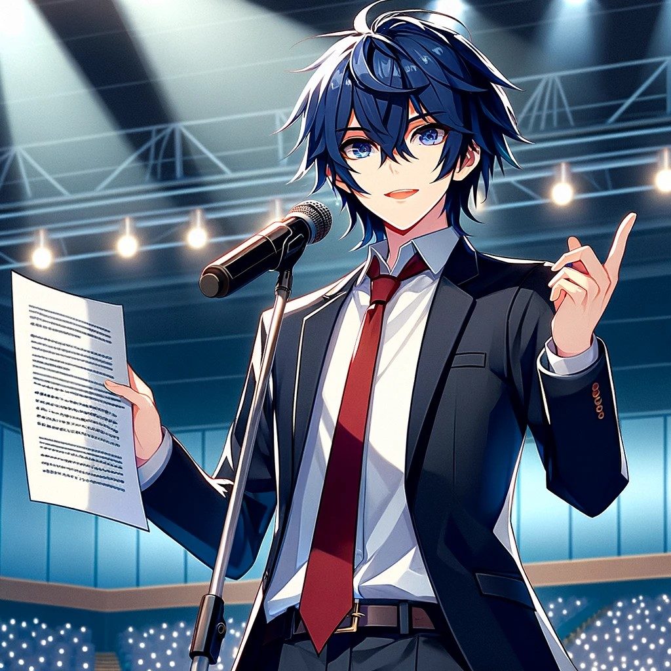
結果
Notes:
I want to tell a story and need a corresponding image that allows viewers to easily immerse themselves in the scene. The style should be Japanese anime, featuring a male character in a black suit with a red tie, a white shirt underneath, and deep blue hair. The story is as follows: His hard work has paid off, and he has successfully published his first paper.
可以一手拿著麥克風，一手拿著論文，然後在台上演講

Slide 6
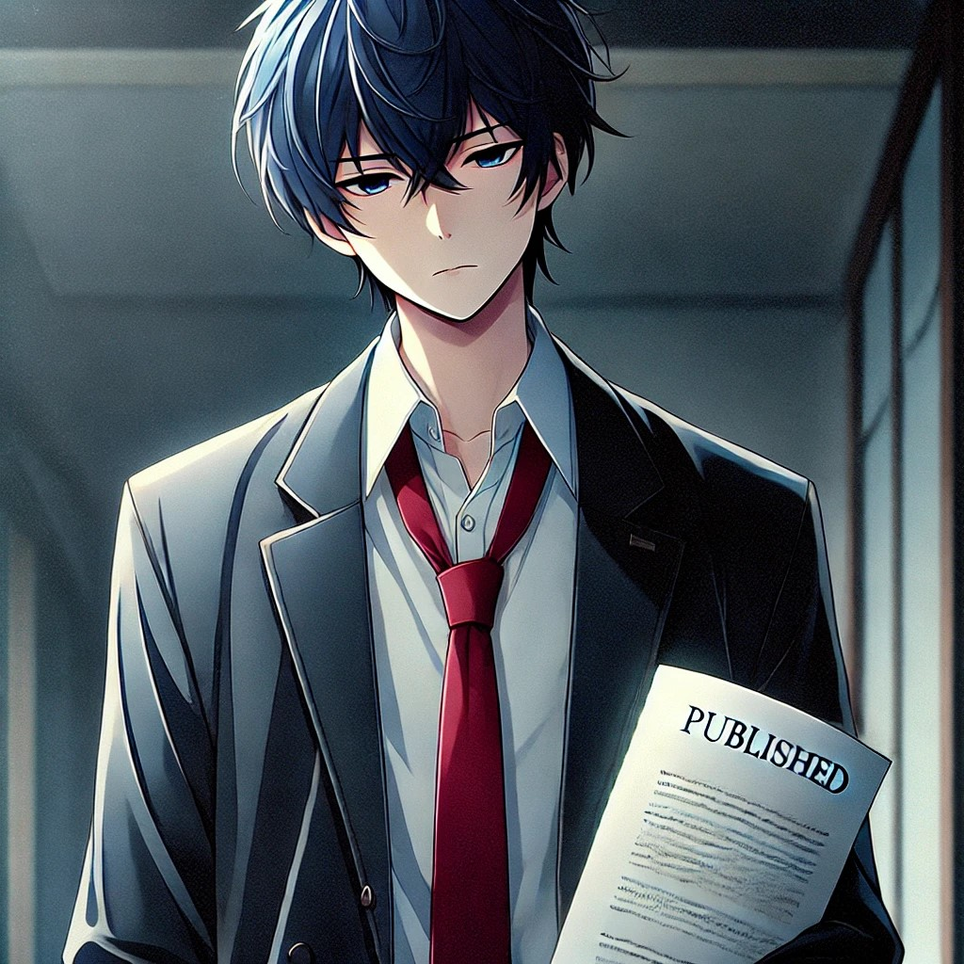
意外
Notes:
意外： 「在過程中，我意外發現了一件事：原來成功的瞬間，並沒有我想像中那麼耀眼，相反，更多的是一種疲憊和空虛。我開始懷疑，難道這就是我一直追求的終點嗎？」 生成對應圖片

Slide 7
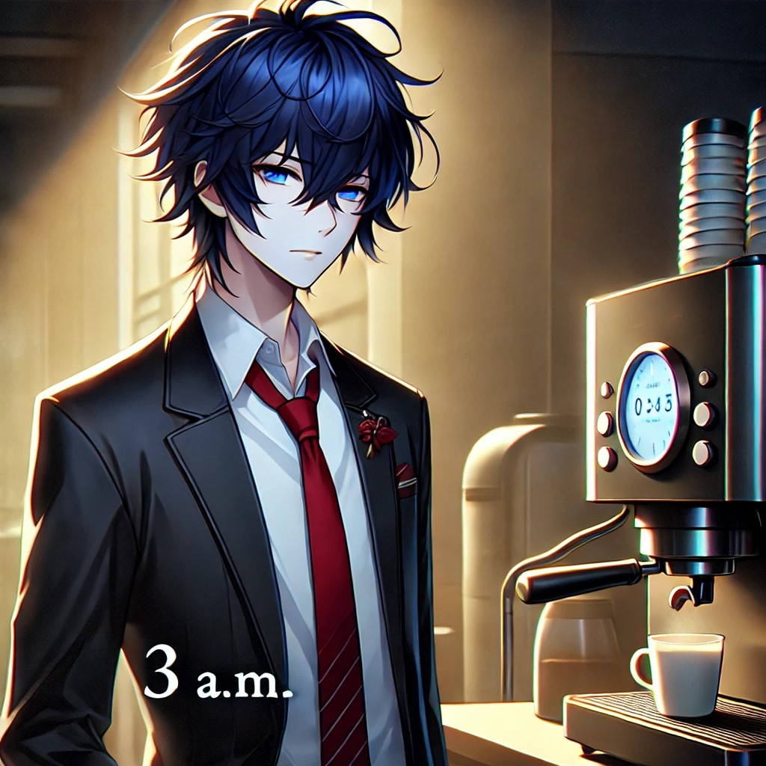
轉彎
Notes:
I want to tell a story and need a corresponding image that allows viewers to easily immerse themselves in the scene. The style should be Japanese anime, featuring a male character in a black suit with a red tie, a white shirt underneath, and deep blue hair. The story is as follows: One day at 3 a.m., standing in front of the coffee machine

Slide 8
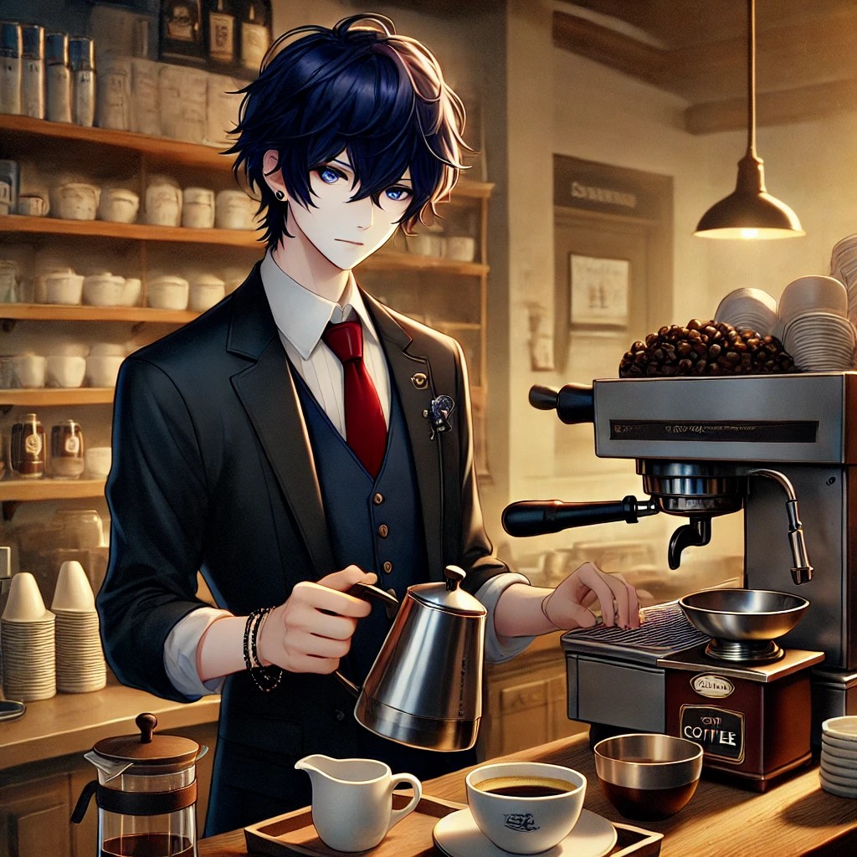
結局
Notes:
站在一間小小的咖啡館裡，為客人們沖出一杯又一杯的咖啡。

