Slide 1
IowaMove Project
By James Tapp

Slide 2
Business Case
IowaMove are an estate agency operating in Iowa USA.
They are under pressure to provide comparative market analysis on houses prices across the area, while making sure their estimates are both accurate and precise.
For this reason the company is looking at implementing an automated machine learning solution for their business in order for their estate agents to focus on other tasks.
Notes:
Expanding client base, and goals of business expansion. Current estimates must be made by expert estate agents, and are too broad and inaccurate.
Our solution will allow an more accurate prediction off only a couple of data points gathered, which can be done by anyone. Could save the business an estimated $40,000 in the first year.

Slide 3
Objectives
Create a machine learning program to predict house prices to ±10%
A simple User Interface to allow values to be entered and a prediction to be given
A database used to store house prices which can be added to over time
Host the application on the cloud

Slide 4
My Approach
R and RStudio for implementing my machine learning algorithm
SQL and MySQL for building a relational database
Google Cloud Platform for hosting the application online
Notes:
Also built some documentation around my R functions

Slide 5
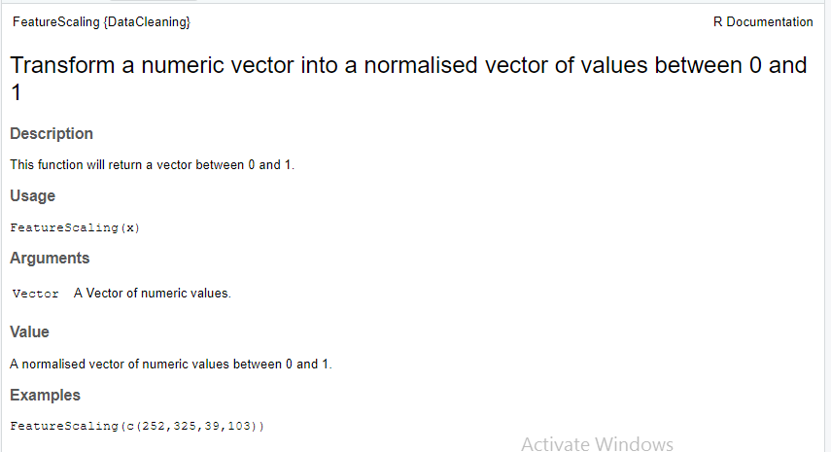
R documentation
Link to github

Slide 6
Machine Learning
What is the K-Nearest-Neighbour(KNN) algorithm?
What might the drawbacks be?
How accurate can we make it?
Notes:
Draw on Whiteboard

Slide 7
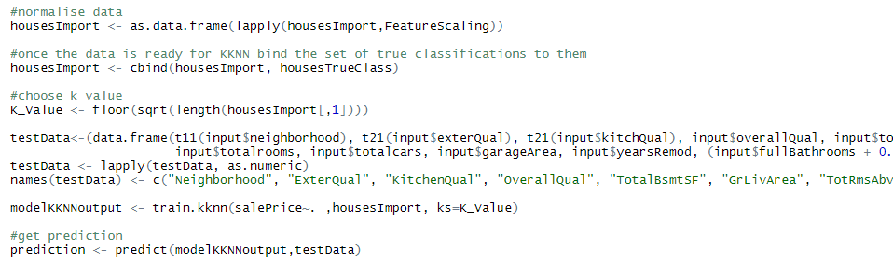
Machine Learning

Slide 8
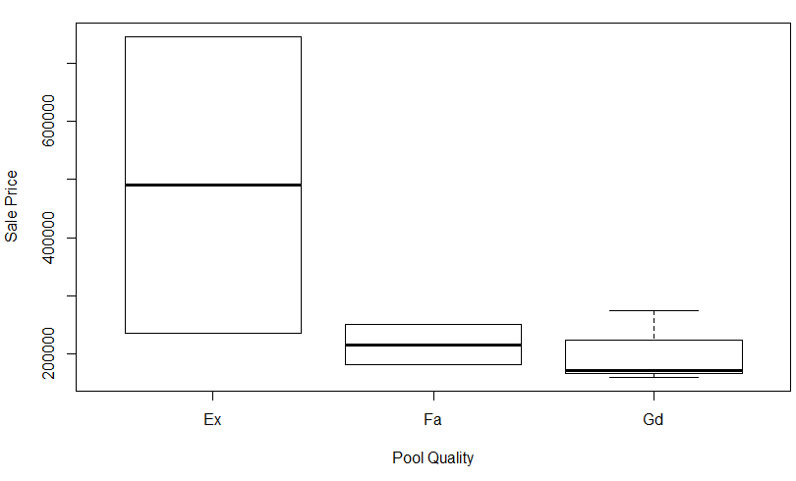
Data Cleaning (Categorical)
Pool Quality | Frequency
Excellent | 2
Fair | 2
Good | 3
No Pool | 1453
Notes:
What data is relevant, what data is useable?

Slide 9
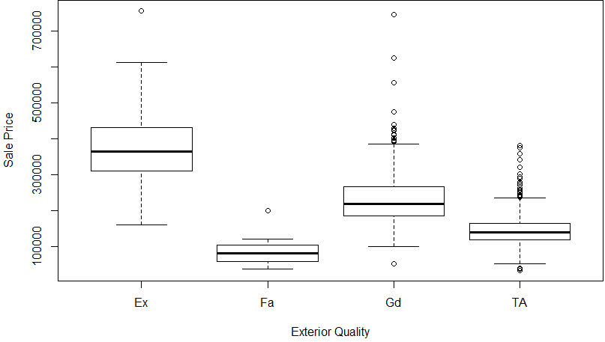
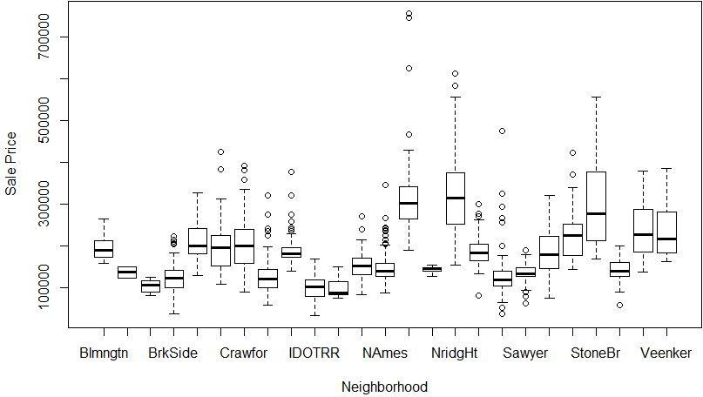
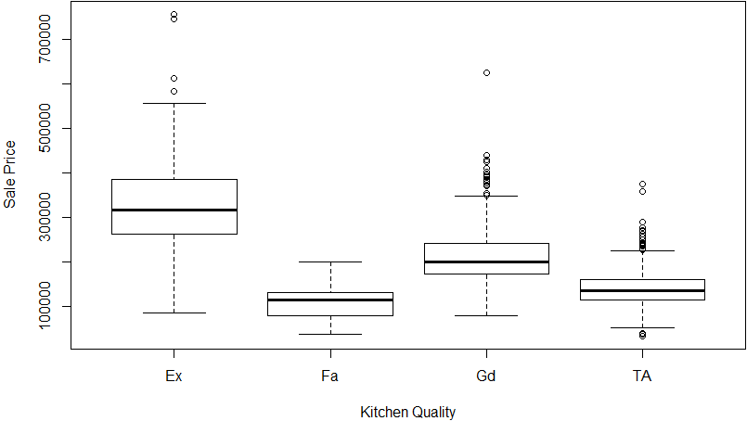
Data Cleaning (Categorical)

Slide 10
Data Cleaning (Numeric)
Pearsons Product Moment Correlation Coefficient to get an idea of Correlation
Fields Used | Correlation Test
Basement Full Bathroom | 0.2271222
Basement Half Bathroom | -0.01684415
Full Bathroom Above Grade | 0.5606638
Half Bathroom Above Grade | 0.2841077

Slide 11
Data Cleaning (Numeric)
Pearsons Product Moment Correlation Coefficient to get an idea of Correlation
Fields Used | Correlation Test
Full Bathrooms | 0.5606638
Full Bathrooms + Half Bathrooms Above Grade | 0.5682665
Full Bathrooms + Basement Full Bathrooms | 0.5829341
Full Bathrooms + Half Bathrooms Above Grade + Basement Full Bathroom | 0.6184735
Fulll Bathrooms + Basement Full Bathrooms + 0.75 × Half Bathrooms | 0.6280088

Slide 12
Demonstration
Please feel free to load my application by visiting:
http://35.242.172.133/
Notes:
Visit IP address, demonstrate product

Slide 13
Future Improvements
More aesthetic user interface
Option to add to the database through the application
Using different algorithms to obtain a better result
Ability to predict price with one field null
Functionality to predict fields with a given price

Slide 14
Thank you for listening

