Slide 1
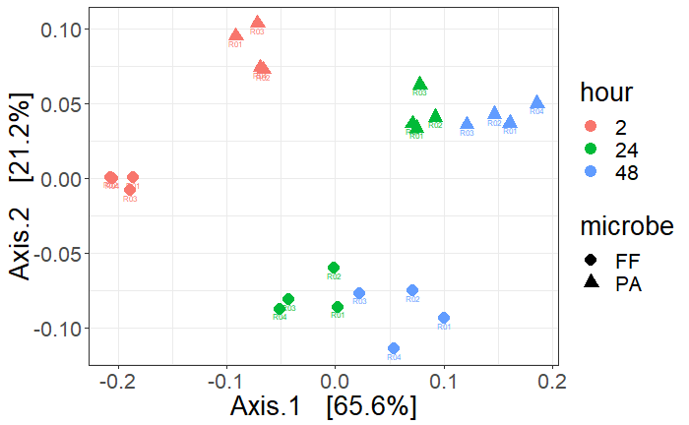
Multidimensional scaling (MDS) using principal coordinates analysis (PCoA) of a Bray-Curtis distance matrix comparing the volatile composition between Frigoribacterium faeni and Pantoea agglormerans. Microbes were inoculated into liquid LB broth and 10% blueberry juice and each solution contained only one microbe species. Marker shapes represent the microbes and colors represent the hour when volatiles were collected. Axis.1 explained 66.48% of the variance and Axis.2 explained 18% of the variance.

