Slide 1
UC Berkeley-Enel Wind Turbine Health Monitoring
06/03/23

Slide 2
Background
Wind Turbines have
ODH3
Φ-OTDR
Luna Innovations
OFDR

Slide 3
Background
Big picture idea
Statistically correlate with SCADA data
Extract features that are able to

Slide 4
Instrumentation
Location
Wind Farm
Type of tower
Some basic attributes

Slide 5
Instrumentation
How can we capture the behavior of the wind turbine tower?
Dynamic

Slide 6
Monitoring Plan
When is wind the greatest?
Local conditions for Hobart, Oklahoma: ~11 am
15-minute recording intervals for both ODH3 and Luna

Slide 7
Installation
Wind Turbine

Slide 8
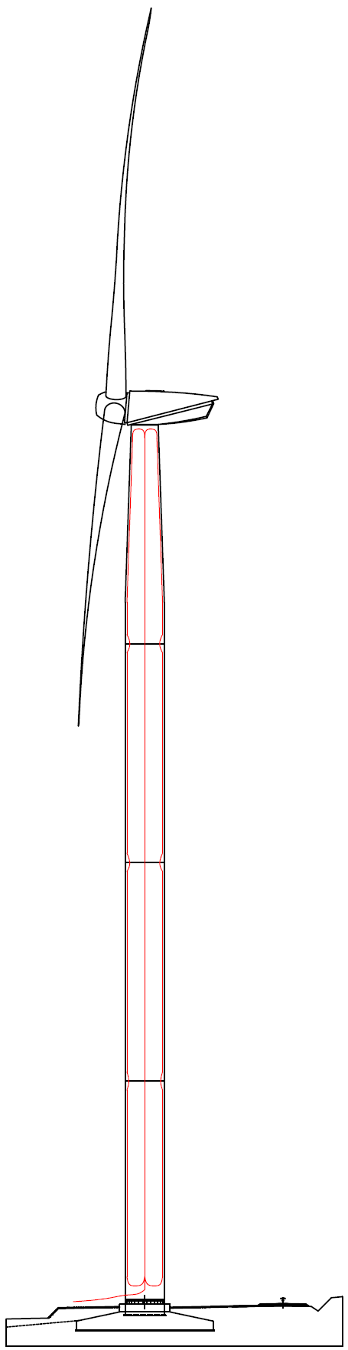
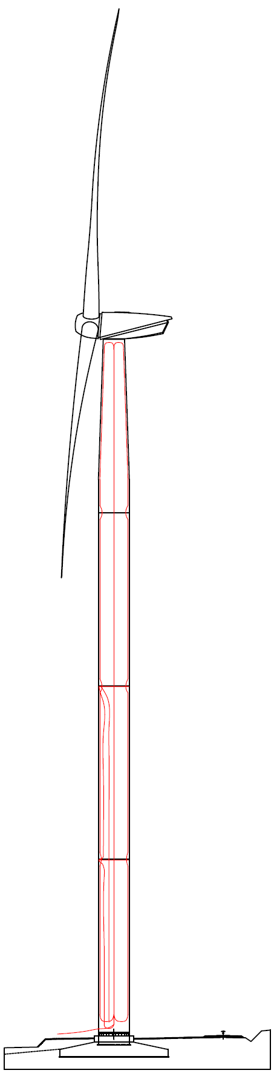
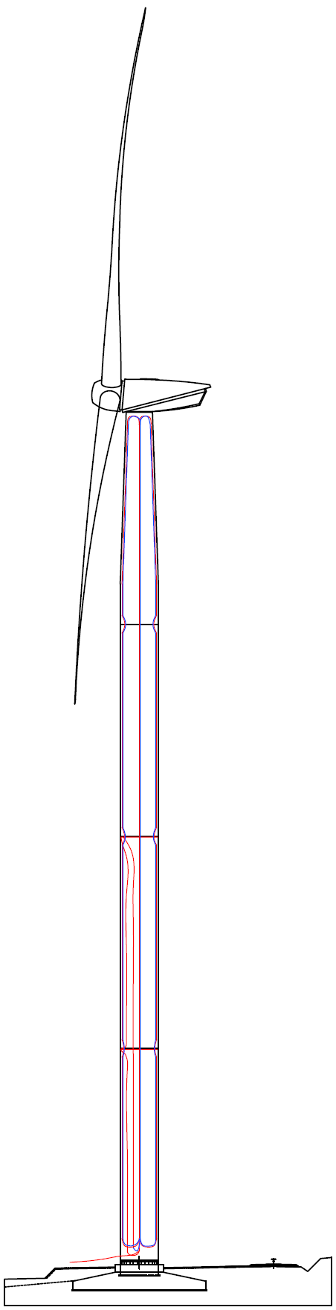
Installation
Wind Turbine was
Initial installation took place from 10/17/22 – 10/21/22
Second installation took place from 12/19/22-12/23/22

Slide 9
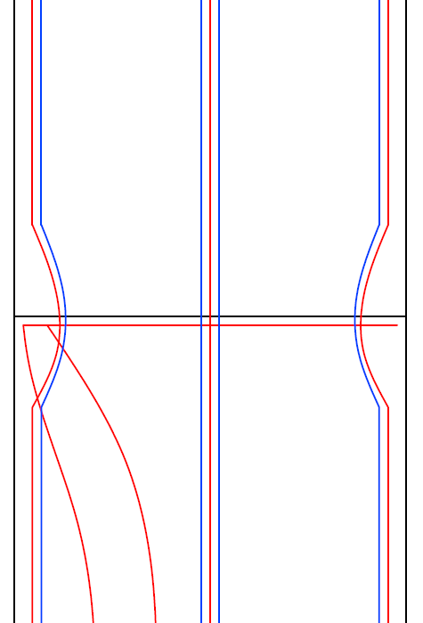
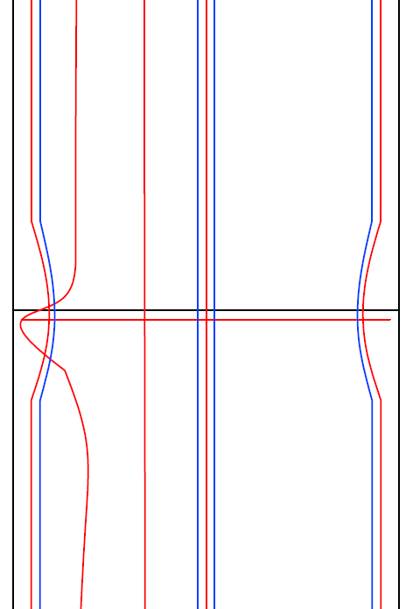
Installation
Wind Turbine

Slide 10
Installation
Wind Turbine

Slide 11
Some Preliminary Results
Wind Turbine

Slide 12
Some Preliminary Results
Wind Turbine

Slide 13
Future Work
Wind Turbine

