Slide 1
Enel Short Term Experiment Planning
10/18/23

Slide 2
Overview
Turbine B06
Want to try to detect differences in signals from sensors when different bolts are loosened
Need to loosen bolts on the first flange
We also need to have the turbine in operation, so that we have better signal to noise ratio
i.e. need the turbine to be vibrating

Slide 3
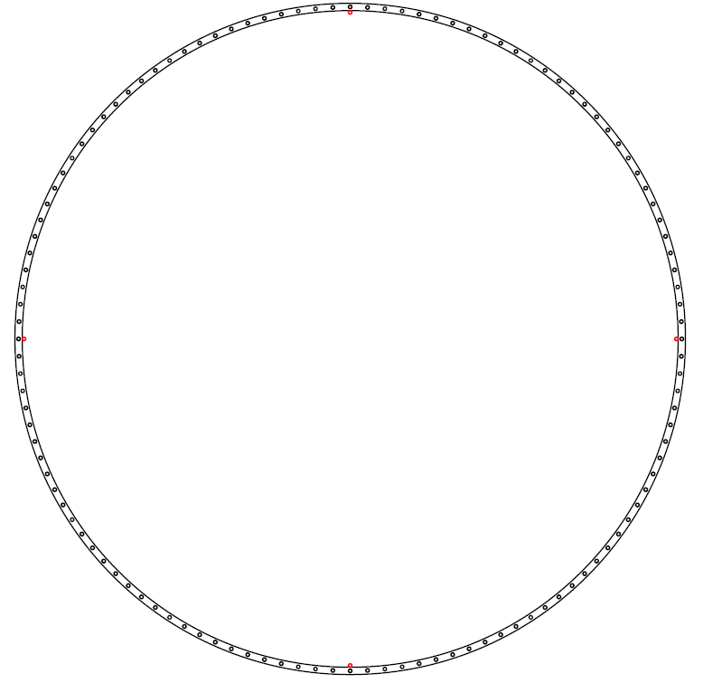
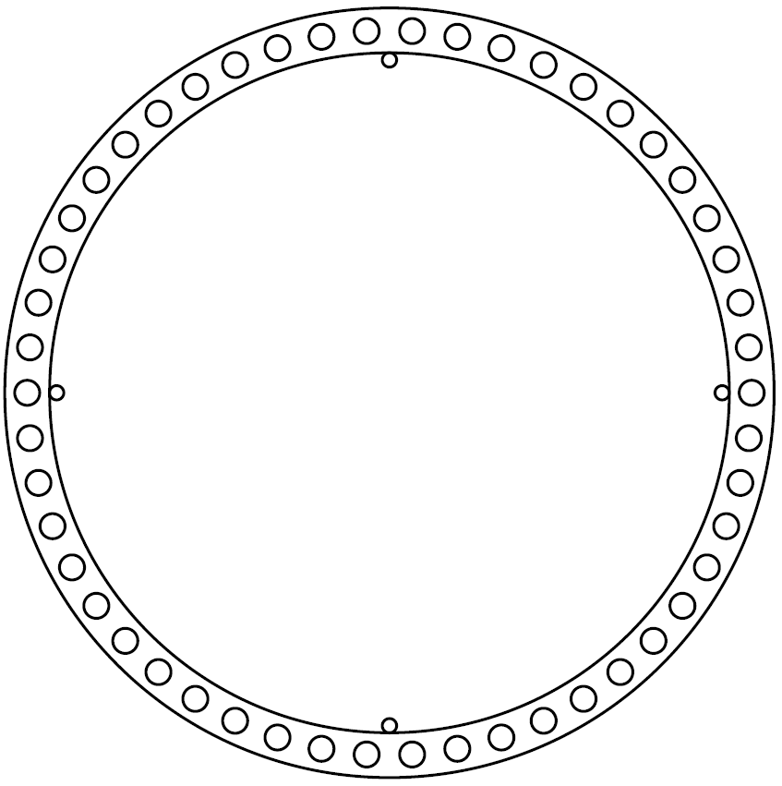
Plan overview
Turbine operating settings
10 different bolt configurations
1 bolt configuration as-is
2 bolt configurations, 15 bolts away from longitudinal cable (45 degrees away)
Bolt loosened 60 degrees (Is this possible?)
Bolt loosened 30 degrees
2 bolt configurations, bolts away from longitudinal cable (22.5 degrees away)
Bolt loosened 60 degrees
Bolt loosened 30 degrees
2 bolt configurations, 0 bolts away from longitudinal cable (Directly under longitudinal cable)
Bolt loosened 60 degrees
Bolt loosened 30 degrees
1 bolt configuration with fully loosened bolt
Leave this for a month
Loosen Bolt
Cables

Slide 4
Plan overview
For each bolt configuration
Turbine off, we measure static strain (5 minutes)
Hammer test at first flange (Need support for this, takes roughly 30 minutes)
We will provide a map of where to hammer
Turbine on, normal operation (30 minutes)
Dependent on weather conditions (We want the blades to be spinning)
Braking test, turn turbine off (10 minutes)
Dependent on weather conditions, need turbine to be in operation
We measure static strain again (5 minutes)
Next bolt configuration (Torque/Un-torque bolt ? minutes)
Roughly 2 hours each bolt configuration

Slide 5
Timeline
Time needed on site is dependent on the weather, and how many bolt configurations we can do (Is controlling 60 and 30 degree loosening possible)
Under ideal weather conditions (Enough wind for turbine operation)
(# Bolt configurations) * (Time per Bolt configuration) * 1.5
For 10 configurations, and 2 hours each, roughly 30 hours
Need a windy week!
Some days have 8 hours of continuous wind
Some days have 0!
What time frames work for the team? Before December?

Slide 6
Support needed
Torque and un-torque bolts
How many people are needed for this?
Tools needed for torquing
Are there tools that we can already use on site?
If so, can we use them for the duration of the experiment?
Someone to help perform hammer tests at the first flange
One-time indexing our cables (Have to climb the tower 1 time)
NEED SCADA DATA
We will do everything that we can to make the process easier, please let us know your concerns!

