Slide 1
Project # 2
Extract, Transform and Load (ETL)
9 December, 2021

Slide 2
Agenda
ETL Overview
TEAM
1
Abishua Prashanth
Wesley Watkins
Anthony Ndungu
Thea James
Beverly Phillips (Scout)
Sidney Henry
Di Gibson
Elsa Hernandez
Harsh Patel
Jason Degrace
Mark Alford
Randy Weaver
2
Database Design
3
Challenges
4
Questions

Slide 3



ETL Overview
Extract
Transform
Load
Data Sources
Clean and Transform
Data Load
List of data sources where the team was able to extract the data for the ETL process, the data is centered around residential rentals and eviction rate among the population
High level steps involving the data cleaning and transformation into a state where the data can be saved into the data base
Team decided to load the data in an RDBMS instead of a document DB
Zillow Rent Data from Kaggle
https://www.kaggle.com/zillow/rent-index
Eviction data set from eviction lab
https://data-downloads.evictionlab.org/
State and Counties master list
https://simplemaps.com/data/us-counties
State, State Code and State Abbreviations data
https://worldpopulationreview.com/states/state-abbreviations
Analyze each data set to understand the fields and the information in the data
Drop data that is not relevant or has nulls in the fields
Determine the key that maps the different dataset – In this case it was the State and County
Determine the columns to keep and drop in each dataset
Rename the columns to conform to the DB column names and are descriptive
Standardize the State and County fields across the datasets for consistency
PostgreSQL was the database of choice
Database was designed with State and County as the composite key
Data was loaded using sqlalchemy package
~400K records were loaded into the DB

Slide 4
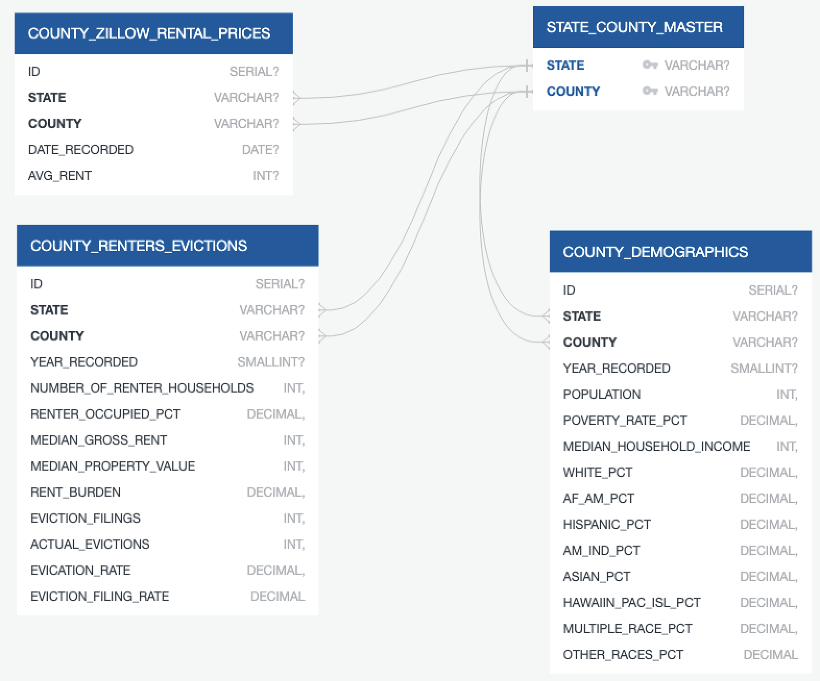
Database Design
STATE_COUNTY_MASTER
Master table with all the counties by state in the US
https://simplemaps.com/data/us-counties
COUNTY_ZILLOW_RENTAL_PRICES
Rental data from Zillow with a reference back to the State-County Master table, the rent is captured by month starting from 2010 November
https://www.kaggle.com/zillow/rent-index
COUNTY_DEMOGRAPHICS
Demographics by county and also includes information on income and poverty rate
https://www.kaggle.com/zillow/rent-index
https://data-downloads.evictionlab.org/
COUNTY_DEMOGRAPHICS
Eviction rate data by county in the US
https://www.kaggle.com/zillow/rent-index
https://data-downloads.evictionlab.org/

Slide 5
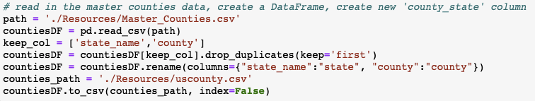
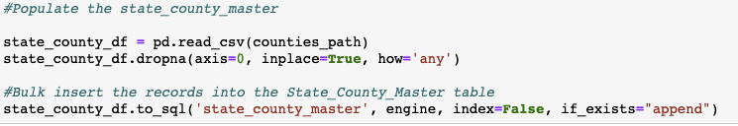
Challenges (State-County Master)
With the state and county dataset , the original csv file could not be used due to receiving an error
There were also duplicates in the original csv file which had to be dropped

Slide 6
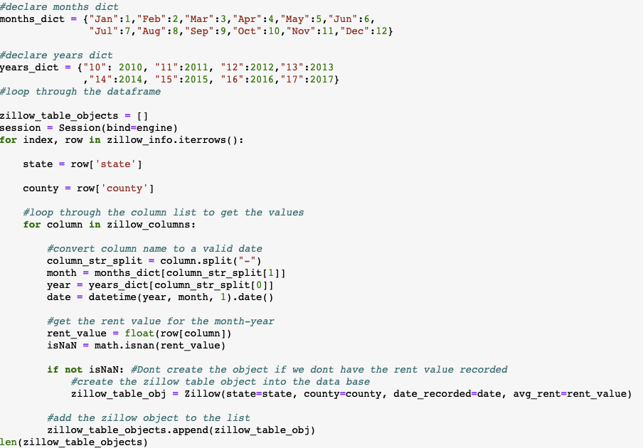
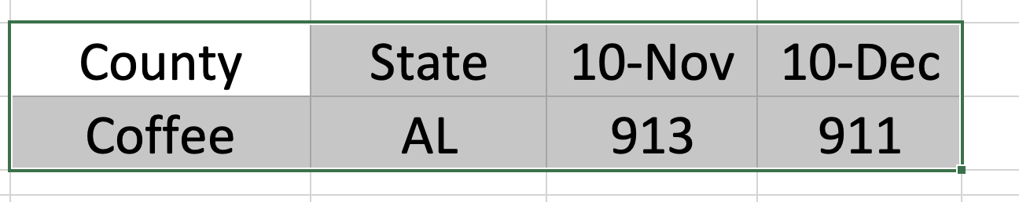

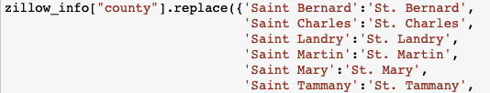
Challenges (Zillow)
Zillow had the rental data by month across the columns, which had to be stored in the tables as rows
Transform and Load
Standardization of the county names across the dataset

Slide 7
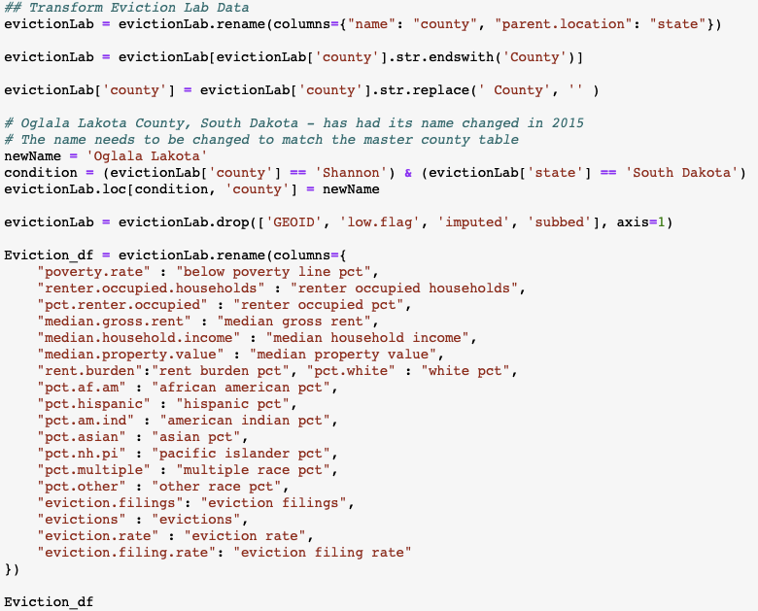
Challenges (Eviction)
The eviction lab column headers needed to be standardized
Burroughs, Census tracts, etc were removed so that only counties remained
The county names were formatted to match the master county table by removing “ County”
Shannon County, South Dakota changed to Oglala Lakota County, South Dakota in 2015.

Slide 8
QUESTIONS?

