Slide 1







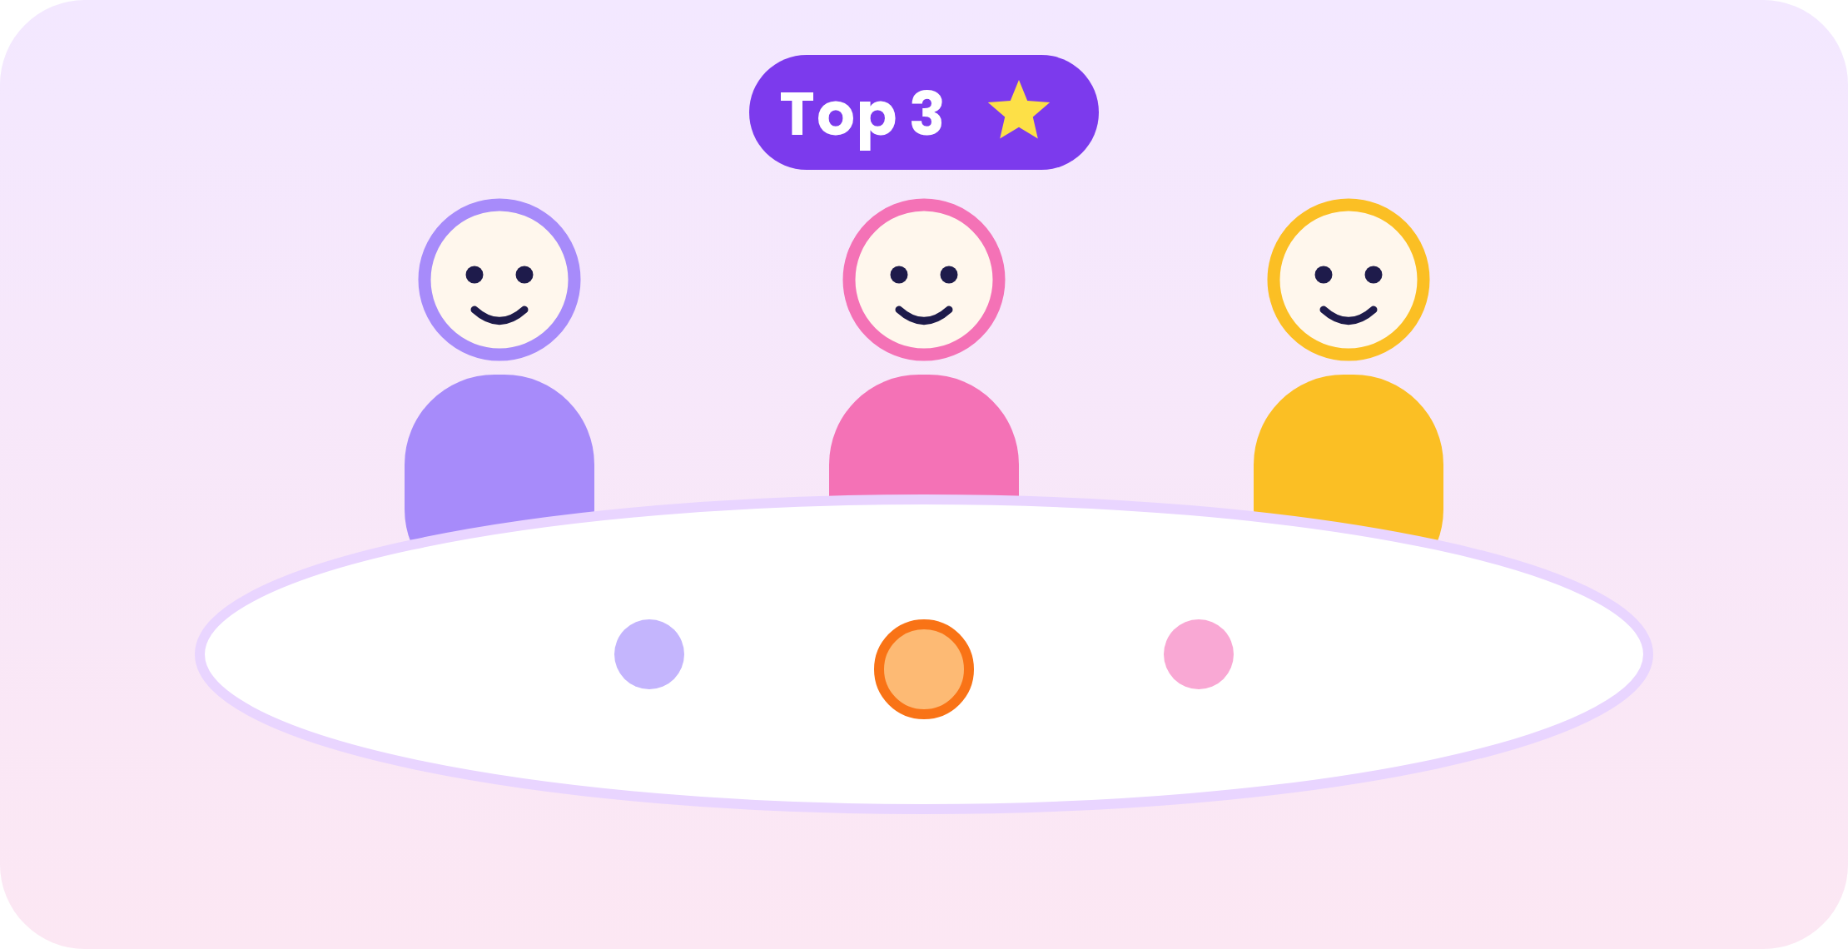





CommonGround
Business Model Canvas
Business Name:
CommonGround
Date:
10 Oct 2026
Prepared By:
CommonGround Team
Version:
Food-only MVP · V3
A one-page view of how CommonGround creates, delivers and captures value.
Key Partners
Key Activities
Value Propositions
Customer Relationships
Customer Segments
Who helps us deliver value?
What must we do well?
Why do groups choose us?
How do we keep users?
Who do we serve?
• Ad network (e.g. Google AdSense)
• Map & place-data providers
• BINUS student organisations
• Campus & Festival organisers
• Build the 7-screen decision flow
• Filter > score > fairness > Top 3
• Verify 30–50 venues near campus
• Run the 10-group pilot
• Fair: hard limits first, nobody below 60
• Private: nobody sees your limits
• Fast: one link, no sign-up
• Advertisers: brand-safe 18–25 audience
• Self-service, no sign-up
• Automated timer, Top 3 & veto
• In-app feedback & venue flags
• Campus student communities
• Users (free): BINUS students & friend groups of 4–8
• Payers: advertisers via ad network – games, apps, e-commerce
• Later: frequent hosts (CommonGround+)
Key Resources
Channels
What do we need?
How do we reach users?
• Rules-based matching engine
• Verified venue database
• Product team
• Traffic from shared room links
• Room links: WhatsApp, LINE, Discord
• Campus QR codes & Festival demo
• Social media
• Every room brings 3–7 new people
“Satu link. Semua jawab. Tiga pilihan pas.”
THE RIGHT GROUP,
THE RIGHT PLACE
Partners bring reach & data.
Kumpulkan preferensi tanpa debat.
Cost Structure
Revenue Streams
What does it cost to run?
How do we make money?
• Development & hosting
• Data / API use
• Venue checks & updates
• Campus marketing
• Phase 1: free pilot, no ads
• Phase 2: in-app ads (CPM / CPC) on 2 screens only
• Phase 3: CommonGround+ for hosts, ~Rp15–25k / month
• Never food ads – picks stay neutral
Lean build. Verified data.
Free for users. Ads first, subscription later.
Source: CommonGround Team Brief, Food-only MVP · V3 – all figures are hypotheses to validate. Based on the Business Model Canvas by Strategyzer (CC BY-SA 3.0).

