Slide 1
/JAVA WORKSHOP
Not to be confused with Javanese
JAMES RAPHAEL TIOVALEN

Slide 2
/TABLE OF CONTENTS
/01
/BASICS OF JAVA
/02
/OOP
/03
/NINETY NINE
EXPOSE SUTD CS
Variables, I/Os, Conditionals, Loops, ArrayLists
Classes, Objects, Methods, Attributes
Introduction to the minigame that we’re making

Slide 3
/01
/BASICS OF JAVA
EXPOSE SUTD CS
System.out.println(“Hello World!”);

Slide 4
/WHAT IS JAVA
EXPOSE SUTD CS
Programming language
Portable (across different computer/devices) with Java Virtual Machine

Slide 5
/VARIABLES
EXPOSE SUTD CS
Used to store values.
Examples:
int number = 5;
String message = “hello!”;
String anotherMessage = “hello” + “jello”;

Slide 6
/VARIABLES: DECLARING VARIABLES
EXPOSE SUTD CS
Two ways to declare a (primitive) variable:
<type> <name>;
<type> <name> = <value>;

Slide 7
/VARIABLES: PRIMITIVE TYPES
EXPOSE SUTD CS
Primitive Types in Java:
/TYPE | /USAGE | /EXAMPLE
int | integer | int answer = 5;
float | decimals | float fraction = 1.5;
char | letter/symbol | char ampersand = ‘&’;
String | Letters and/or symbols | String message = “hello!”;
boolean | true/false | boolean isFinished = false;

Slide 8
/VARIABLES: NAMING VARIABLES
EXPOSE SUTD CS
In Java, a variable:
Cannot start with a number
Cannot have symbols, except for _ (underscore)
Is named using camelCase by convention

Slide 9
/EXERCISE: VARIABLES
EXPOSE SUTD CS
Which of the following variables follow proper naming convention?
Option1
option2
Some-variable
anotherVariable
1st_message
message_2

Slide 10
/EXERCISE: VARIABLES
EXPOSE SUTD CS
Which of the following variables follow proper naming convention?
Option1
option2
Some-variable
anotherVariable
1st_message
message_2

Slide 11
/ARITHMETIC OPERATORS
You can do mathematics in Java. Usual PEMDAS rule applies, but best practice would be to use proper explicit parentheses.
Examples:
age = age + 10;
money = money - 50;
speed = speed * 3;
chocolate = chocolate / 2;
remainder = dividend % divisor; (7 % 5 = 2)

Slide 12
/LOGICAL OPERATORS
You can also use the following operators for logical comparisons:
Examples:
number1 == number2
number3 != number4
number3 < number4
number3 >= number4
!condition
condition1 && condition2
condition1 || condition2
Logical operators return Boolean values.
Notes:
If participants ask about chaining, let them know to be careful.

Slide 13
/IO
EXPOSE SUTD CS
To make your program more interactive, we could use some inputs and outputs.

Slide 14
/IO: SCANNER
EXPOSE SUTD CS
Scanner is Java’s built-in class to get user input.
Declaring Scanner: Scanner scannerObj = new Scanner(System.in)
Getting Input: String name = scannerObj.nextLine();
Depending on the type of variable that we want to get, there are nextBoolean(), nextInt(), etc.

Slide 15
/IO: SYSTEM.OUT
EXPOSE SUTD CS
System.out is Java’s class to print output to the console: String name = “James”;
System.out.println(“Hello “ + name); Will print out: “Hello James”
Notes:
Remember to explicitly mention about the string concatenation involved here.

Slide 16
/EXERCISE: I/O
EXPOSE SUTD CS
Exercises to practice standard I/O:
exercises/Name.java
Notes:
Initializing scanner:
https://github.com/jamestiotio/expose/blob/main/ninetynine/NinetyNine.java#L89
Reading input:
https://github.com/jamestiotio/expose/blob/main/ninetynine/NinetyNine.java#L106
Writing output:
https://github.com/jamestiotio/expose/blob/main/ninetynine/NinetyNine.java#L118
Standalone exercise: Name.java

Slide 17
/CONDITIONALS
EXPOSE SUTD CS
Conditionals are important for …
if (condition) {
// something will happen
}
else if (differentCondition) {
// something else will happen
}
else {
// another different thing
}

Slide 18
/CONDITIONALS: EXAMPLE
EXPOSE SUTD CS
Example:
int score = 90;
if (score >= 60) {
System.out.println(“Kamu lulus!”);
} else {
System.out.println(“Kamu nggak lulus.”);
}

Slide 19
/LOOP
EXPOSE SUTD CS
What if you want to do something multiple times without doing it manually?
int n = 0;
for (int i=0; i<=100; i++) {
n += i;
} while (i<=100) {
n += i;
i++;
}

Slide 20
/EXERCISE: LOOPS & CONDITIONALS
EXPOSE SUTD CS
Some simple exercise to try out loops and conditionals:
exercises/FizzBuzz.java
Notes:
Condition (who to remove)
https://github.com/jamestiotio/expose/blob/main/ninetynine/NinetyNine.java#L207-L211
Standalone exercise: FizzBuzz.java

Slide 21
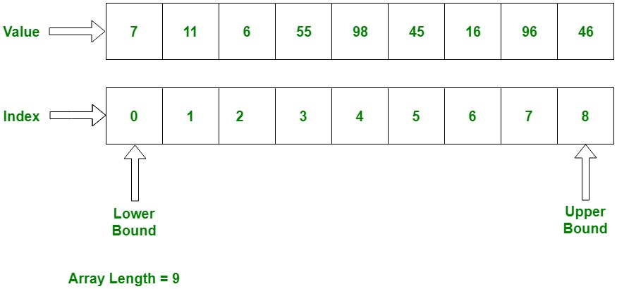
/ARRAYS AND LISTS
EXPOSE SUTD CS
Arrays/lists are sequences that you can use to store values or objects.
Arrays/lists are characterized by their lengths
Elements are characterized by their index (position)
Indexes start from 0
Notes:
Image source(s):
https://media.geeksforgeeks.org/wp-content/uploads/C-Arrays.jpg

Slide 22
/ARRAYS AND LISTS
EXPOSE SUTD CS
There at at least 3 types of sequences:
Type | Arrays | ArrayList | LinkedList
Can you change the length after creation? | No | Yes | Yes
Are elements stored in sequence in memory? (affects access speed) | Yes | Yes | No
Can it hold primitive data types (eg. int)? | Yes | No (use wrapper classes) | No (use wrapper classes)

Slide 23
/ARRAYLIST
EXPOSE SUTD CS
A type of list
Stores objects in a sequence
Can have variable length
To create a new ArrayList:
ArrayList<objectType> name = new ArrayList<objectType>();
Note that an ArrayList requires an object type to be declared in between arrow brackets

Slide 24
/ARRAYLIST OPERATIONS
EXPOSE SUTD CS
Method | What it does | Example (given some ArrayList<Integer> a)
add(Object o) | Increase length by 1, then add object as last element | a.add(new Integer(-1));
remove(int index) | Remove object at specified index | a.remove(0);

Slide 25
/ARRAYLIST OPERATIONS
EXPOSE SUTD CS
Method | What it does | Example (given some ArrayList<Integer> a)
get(int index) | Get element at specified index | Integer c = a.get(0);
size() | Return number of elements in list | boolean isListEmpty = a.size()==0

Slide 26
/EXERCISE: LOOPS & ARRAYLIST
EXPOSE SUTD CS
Some simple exercise to try out loops and ArrayList operations.
Notes:
Standalone exercise: Average.java

Slide 27
/02
/OOP
EXPOSE SUTD CS
oop

Slide 28


/CLASSES
EXPOSE SUTD CS
Classes are templates for objects.
An object is an instance of a class.
Class | Object(s)
Statue
Notes:
Image source(s):
https://upload.wikimedia.org/wikipedia/commons/5/5c/Heroic_Monument_Surabaya.jpg
https://www.straitstimes.com/multimedia/graphics/2021/08/singapore-merlion-real-anatomy/assets/images/intro-proposed/1.jpg?v=62dce0b6

Slide 29
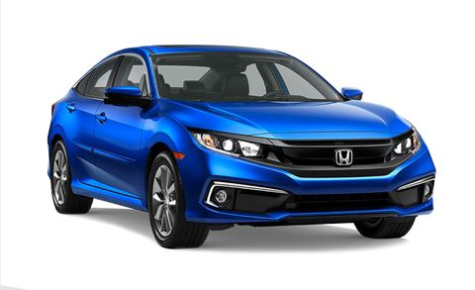
/ATTRIBUTES AND METHODS
EXPOSE SUTD CS
Classes and objects can have:
Attributes -> properties of a class/object
Methods -> actions done by or on a class/object
Attributes and methods can belong to a class rather than object - these are called static attributes/methods
Object | Attribute(s)/Method(s)
 | Attributes: Color: Blue License plate: A0000E Weight: 2 tonnes Methods: Move forward Honk Break down
Notes:
Image source(s):
TODO

Slide 30
/HOW DO YOU MAKE A CLASS?
EXPOSE SUTD CS
public class ClassName {
// Your methods and
// attributes here
}
Using the declaration on the left
Class names are written in title case by convention
Anything within the brackets belongs to the class

Slide 31
/HOW DO YOU MAKE A CLASS?
EXPOSE SUTD CS
public class ClassName {
// Your methods and
// attributes here
}
public is an access modifier such that the class can be used anywhere in your program (not covered today)
Public classes must be declared in their own file with the same name

Slide 32
/HOW DO YOU MAKE AN OBJECT?
EXPOSE SUTD CS
You need 3 things:
A class (the template)
A constructor method (aka how to make the object)
A call to the class constructor (actually get the constructor to make the object)

Slide 33
/CONSTRUCTOR
EXPOSE SUTD CS
The method telling the program how to create an object of a class
Method always has the same name as the class
This is where you perform initialization eg. set some initial values
Constructor can have access modifiers too
public class Car {
public Car() {
// Constructor here
}
}

Slide 34
/CREATING THE OBJECT
EXPOSE SUTD CS
Declare a variable to store your object, then set it to the result of your construction call.
Notice how your class is now a variable type
Car hond_ = new Car()

Slide 35
/ATTRIBUTES
EXPOSE SUTD CS
Variables belonging to an object/class
Unlike variables declared in a function, they don’t disappear when a method/function is completed
Can be associated with an object (non-static) or a class (static)
public class Car {
// Static attribute
public static int speed =
0;
// Non-static attribute
public char name = ‘a’;
public Car() {
// Not an attribute
int cost = 0;
}
}

Slide 36
/METHODS
EXPOSE SUTD CS
Functions belonging to an object/class; see example on right
Implements commonly-used operations
Constructors are methods too
Also has access modifiers
Can be static or non-static
In maths:
f(x) = x²
Equivalently in Java:
float square(float x) {
return x*x;
}

Slide 37
/DECLARING METHODS
EXPOSE SUTD CS
To declare a function, you need:
A return type (or void if nothing is returned) describing the type of output
Arguments and their types (if any) aka inputs
Return statement (if returning anything) returning the output
float square(float x) {
return x*x;
}

Slide 38
/USING METHODS
EXPOSE SUTD CS
To use a method, call the method (see right side)
If method returns a value and you want to keep it, use it to set a variable
System.out.println(“Hello world”);
float result = square(2.0);

Slide 39
/03
/NINETY NINE
EXPOSE SUTD CS
What we are making as our last exercise!

Slide 40
/RULES OF THE GAME
EXPOSE SUTD CS
A simple turn-based multiplayer card game.
Each player takes a turn playing a card from their hand, and adds the value of the card to the running total. The player who causes the total to go over 99 loses the round (or game).
- There are N players. The user is one of them (with ID 0), while the other N-1 players would be operated by the CPU. CPU players would play in a random manner (instead of in an optimized manner).
- Each player is dealt M cards.

Slide 41
/RULES OF THE GAME
EXPOSE SUTD CS
- The point total starts at zero and each card adds its face value in points (example: a 5 is worth five points, a face card is worth 10 points) except for certain cards that have special values or meanings:
A 4 reverses play (and does not change the total number of points)
A 9 is a pass (and does not change the total number of points)
A 10 subtracts 10 points from the total
A King takes the point total to 99 (or keeps it 99 if the total is already 99)
An Ace adds either 1 or 11 points, chosen by the player who plays it
Notes:
Can mention that these special cards have been kindly implemented for them, so no need to worry too much about this.

Slide 42
/RULES OF THE GAME
EXPOSE SUTD CS
- After each card is played, the new total is updated accordingly and the player draws a random replacement card from an infinite card pool/stack.
- Each player must play a card without sending the total number of points higher than 99.
- If a player sends the total number of points higher than 99, that player loses and the current running total number of points is reset to 0.
- Once N-1 players are eliminated, the remaining sole player wins that game round.

Slide 43
/EXERCISE: CLASS ATTRIBUTES AND METHODS
EXPOSE SUTD CS
Let’s try:
Declaring a class
Declaring attributes
Declaring methods
Calling a method
Complete all of the TODO tasks
Check the TODOs in the Tasks window.
Notes:
Complete Card.java (both constructors, attributes, methods (involving calling methods of another class))
Complete all of the TODO tasks in the ninetynine package folder/directory

Slide 44
/THANKS!
EXPOSE SUTD CS
/DO YOU HAVE ANY QUESTIONS?
https://github.com/jamestiotio/expose
Singapore University of Technology and Design

