Slide 1

sentiENTERPRIZE
TEAM 3-1
SUTD 2020 ISTD 50.001 Infosys 1D Project

Slide 2
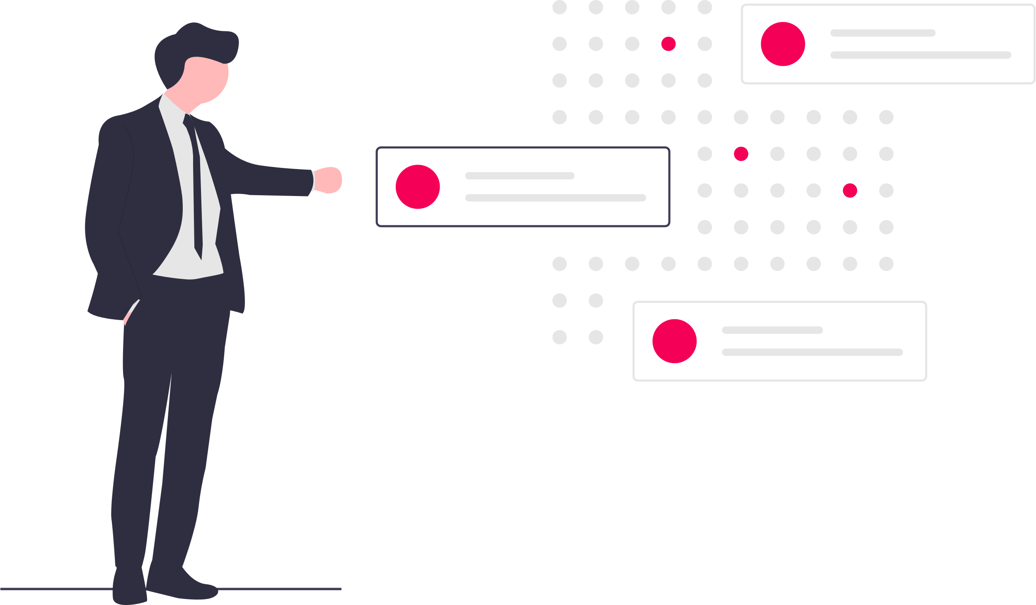
-[
PROBLEM FRAMING
]-
Problem Area: Business Management.
Context: Current solutions have disjointed points-of-sale and manual inventory management. They also utilize third-party services which causes costs to be high. Based on an article on Grab’s blog, current estimation of commission rate of such services hover around 25-30%, causing some distress. Current traditional POS solutions are also very costly without any decent cheaper alternatives.
Innovation Points: Mobile app is a convenient and cheap alternative to conduct resource tracking an inventory management. Big data and machine learning can be utilized in alignment with the collected data to run demand prediction.

Slide 3


Needs & Constraints of Stakeholders
Suppliers
Tight Margins & High Fees
Time as Externality
Consumers
Accessibility
Ease of Use

Slide 4

-[
INITIAL SOLUTION
]-
sentiENTERPRIZE
sentiENTERPRIZE addresses the aforementioned problems by centralizing the point-of-sale onto an Android tablet (much cheaper alternative) and automating inventory management. Using the inventory data, it would also be able to conduct demand prediction to assist suppliers and industry partners to maximize utility lower inventory costs and optimize cash flow.
A Telegram bot would also be developed as the front-facing interface used by customers to interact with the system.
Notes:
Our mobile app can be utilized in different industries, from retail to industrial partners and supply chain logistics.

Slide 5


Intended Features
Point of Sale (Android Tablet)
Inventory Management
Demand Prediction
Legend:
Essential Features
Good-to-Haves
Telegram Bot

Slide 6


Backend
Frontend
Analysis & Database
Dashboard & User Input
Store data points either locally or on the cloud and execute predictive analysis on the data to predict demand.
Beautiful & functional user interface to serve both suppliers and customers.
Notes:
We can separate the components of our project into two: backend and frontend.

Slide 7
Android API
Technologies Used
Java
Firebase
Legend:
Necessary
Optional
MLlib (Apache Spark)

Slide 8
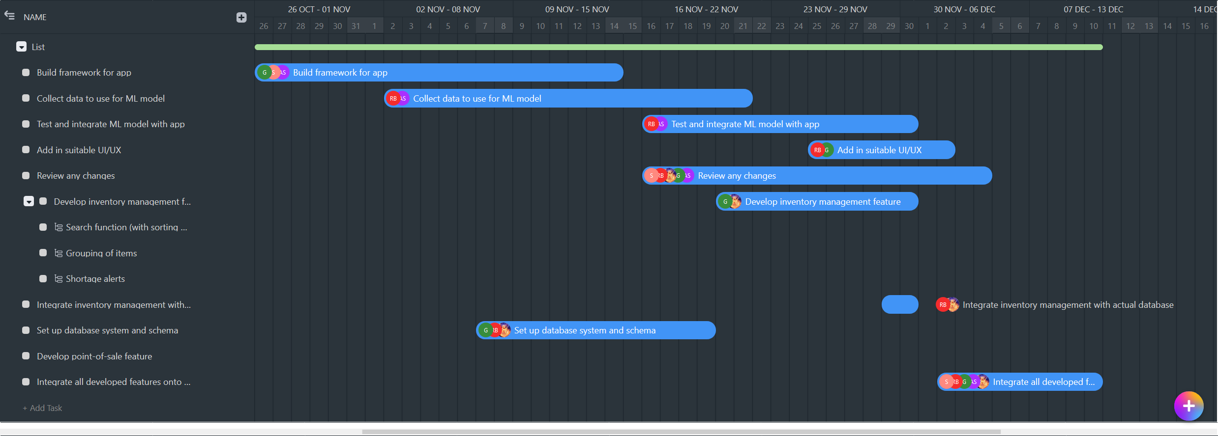
-[
TIMELINE
]-
Gantt Chart

Slide 9
THANK YOU!
sentiENTERPRIZE

