Slide 1
ConcolicDOM Concolic Generation of HTML for Testing JavaScript
James Lo
Research Proficiency Evaluation
(RPE) Report
Notes:
Tools for delivering better Web Apps
Session Migration: Imagen
Multi-User, Real Time Collaboration: BreezeShare: BreezeJs, ShareJs
Performance: Mobile-Cloud Auto Partition, combines Aiman’s, Nima’s papers
Testing: ConcolicDOM
UI Design
End Users: RAPT is showcase app
Imagen
Multi-User, Real Time Collaboration
Performance
Developers:
Testing
UI Design

Slide 2



Motivation: Why HTML for testing JS?
Web Applications are increasingly prevalent
Testing Web apps remains challenging
Lots of JS code are written to handle UI/DOM
Document Object Model, W3C standard for handling *ML documents e.g. HTML/XML
Need to generate HTML during testing to satisfy DOM operations, keep execution alive.
Executing different parts of JS code requires different yet precise structures of the DOM.
1 DOM operation not satisfied can eventually halt entire execution.
Majority of bugs in JavaScript Web apps are DOM related.
Notes:
Clip art
HTML5, Firefox OS, Tizen OS, Khan Academy

Slide 3
Motivation: Why generate HTML?
Testing browser-side JavaScript requires both Inputs & background DOM (specified in HTML)
Prior research: auto generation of inputs.
Problem: what about the DOM?
Tests can’t be run unless DOM fits precise 2D structure expected by code.
Random generation does not meet precision.
Current practice: manual generation (tedious).
Notes:
Clip art
HTML5, Firefox OS, Tizen OS, Khan Academy

Slide 4
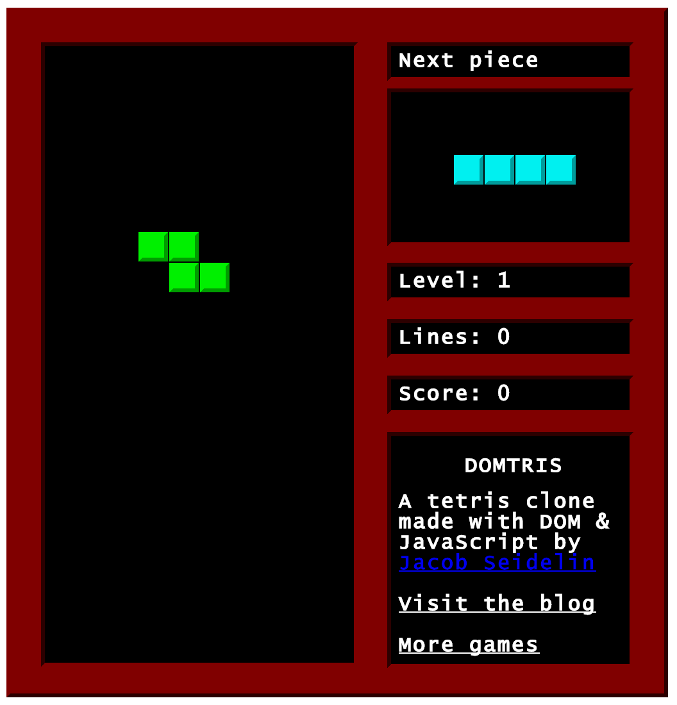
Example of Precision & Exponential Growth: DOMtris

Slide 5
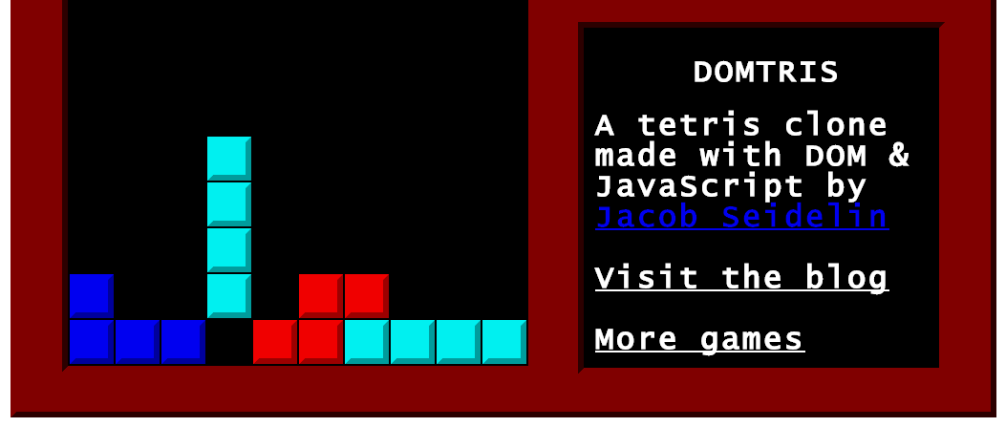
checkRows() checks filled rows Line 6-7
function checkRows() {
var field = getElementById(“field”);
var i, row;
for (i=field.children.length; i--;) {
row = getElementById(“row”+i);
if (row.children.length === 10) {
++score;
// … assert score is increased
}}}

Slide 6
Goal: cover all paths A path is a permutation of branches
function checkRows() {
var field = getElementById(“field”);
var i, row;
for (i=field.children.length; i--;) {
row = getElementById(“row”+i);
if (row.children.length === 10) {
++score;
// … assert score is increased
}}}
for loop Line 4
Stay & Break
branches
if statement Line 6
Then & Else
Also: Else If
Notes:
Question: How many paths do we have? Don’t know unless loops are bounded.

Slide 7
To cover True branch of if @ Line 6 → DOM tree must satisfy constraints
Element with ID “field” Line 2
function checkRows() {
var field = getElementById(“field”);
var i, row;
for (i=field.children.length; i--;) {
row = getElementById(“row”+i);
if (row.children.length === 10) {
++score;
// … assert score is increased
}}}
field has 1+ children Line 4
ID nomenclature “row0”, “row1”
Line 5
row has 10 children Line 6

Slide 8
To cover False branch of if → Different, Unique DOM tree
Element with ID “field” Line 2
function checkRows() {
var field = getElementById(“field”);
var i, row;
for (i=field.children.length; i--;) {
row = getElementById(“row”+i);
if (row.children.length === 10) {
++score; }
// … assert score NOT increased
}}
field has 1+ children Line 4
ID nomenclature “row0”, “row1”
Line 5
row cannot have children Line 6

Slide 9
Exponential # of precise DOM trees
Number of paths = Number of unique DOMs =
[(n number of times to stay in for loop) * 2 (Then and Else branches in if statement) ] + 1 (Break branch of for loop).
If n == 20, implies we have 20*2+1 paths.
for less than 10 lines of code
only 2 conditions: for & if
only 2 branches per condition

Slide 10



What if DOM tree is not satisfied? (e.g. field is null) → tests can’t be run
function checkRows() {
var field = getElementById(“field”);
var i, row;
for (i=field.children.length; i--;) {
row = getElementById(“row”+i);
if (row.children.length === 10) {
++score;
// … row filled, update score
}}}

Slide 11
To keep tests running…
Exponential number of precise DOM trees
Number of execution paths can grow exponentially with the number of branches
Each path may require a unique, precise tree.
Requirements of approach
Automatic: takes care of exponential growth
Systematic: meets tree precision

Slide 12
Challenges
Single DOM Clues are Partial & Incomplete.
Indirect Influence & Intermediate Variables.
JavaScript variables are Dynamically Typed.
Logic Constraints can be Interdependent.
2D Tree Structure & Implicit Clues.
1-3. Dynamic Trace & Backward Slice
4-5. DOM Solver

Slide 13
Dynamic Trace & Backward Slice
Trace considers multi-statement constraints collectively, (example coming, stay tuned).
Backward slice resolves intermediate var’s
Trace & Backward Slice have to be Dynamic
Because JavaScript is Dynamically typed

Slide 14
4-5. DOM Solver: More Complicated Example
if (d === elem.firstElementChild
|| d === b.lastElementChild) {} // …
if (d === elem.parentElement
|| d === b.parentElement) {} // …
if (b.previousElementSibling ===
c.firstElementChild) {} // …
if (elem.parentElement.parentElement ===
c.lastElementChild.previousElementSibling) {}
We already have backward slice
Slice has 4 conditions
True branches of all conditions

Slide 15
Background: Each DOM operation is a Clue to the Overall DOM tree
DOM operation:
Property access: e.g. elem.firstElementChild
Method call: e.g. document.getElementById()
on a JavaScript object associated with the DOM
d === elem.firstElementChild @ Line 1
elem
1
d

Slide 16
4. Logic constraints can be Interdependent
if (d === elem.firstElementChild
|| d === b.lastElementChild) {}
if (d === elem.parentElement
|| d === b.parentElement) {}
DOM Solver must understand the DOM API
Line 1 & Line 3 are mutually exclusive (also Line 2 & Line 4) DOM API: d cannot be both parent and a child of elem
DOM Solver must resolve Logic Constraints
To cover True branch of both if conditions at the same time DOM Solver must pick (Line 1 & Line 4) or (Line 2 & Line 3)
The 2 if conditions inter-depend on each other

Slide 17
5. 2D Structure & Implicit Clues
if (b.previousElementSibling ===
c.firstElementChild) {}
if (elem.parentElement.parentElement ===
c.lastElementChild.previousElementSibling) {}
DOM Solver must support the DOM’s 2D tree structure
To cover True branch of Lines 5-6: b is 2nd child of c; c is parent of b
To cover True branch of Lines 7-8: c is the great grandparent of elem
DOM Solver must infer Implicit Clues True branches
Line 4 → Line 1: parent of b is c, cannot be d
Line 2-3 d === b.lastElementChild === elem.parentElement
Line 2-3 b is grandparent of elem
Line 7-8 2nd last child of c is grandparent of elem → b

Slide 18
DOM Solver: Solved DOM tree
Arrows point up to the parent.
Numbers are child positions: 1 is the first child, 2 is second child -1 is the last child,
-2 is the second last child.
Line 5-6 b is 2nd child of c
d cannot be the parent of b → Line 4 → Line 1
Line 2 d === b.lastElementChild
Line 3 d === elem.parentElement
Line 2-3 b is the grandparent of elem
Line 7-8 grandparent of elem is last 2nd child of c
c has exactly 3 children, b in middle
c
1
2
-2
3
-1
b
d
elem

Slide 19
Points to take from Example
Deduction starts at lines 5-6
Jumps back & forth, not sequentially line by line from 1-8: 5-6 → 4&1 → 2-3 → 5-6 & 7-8
Deduction has to collectively consider the entire trace of DOM operations → big picture, greedy
Understanding of the DOM API is critical in resolving the multi-identify of DOM nodes
Line 2-3 d === b.lastElementChild === elem.parentElement
Line 2-3 b is grandparent of elem → b is also middle child of c

Slide 20
Example: DOM Solver & CVC
Element with ID “field” Line 2
function checkRows() {
var field = getElementById(“field”);
var i, row;
for (i=field.children.length; i--;) {
row = getElementById(“row”+i);
if (row.children.length === 10) {
++score;
// … row filled, update score
}}}
field has 1+ children Line 4
ID nomenclature “row0”, “row1”
Line 5
row has 10 children Line 6

Slide 21
Model General DOM Policies into CVC Functions & Quantifiers
ASSERT childrenLength(row0) = 10; CVC assert
childrenLength: (Node) -> INT; CVC function
To support childrenLength(), we have to further quantify
Parent-child Relationship
Ordering of children that share the same parent

Slide 22
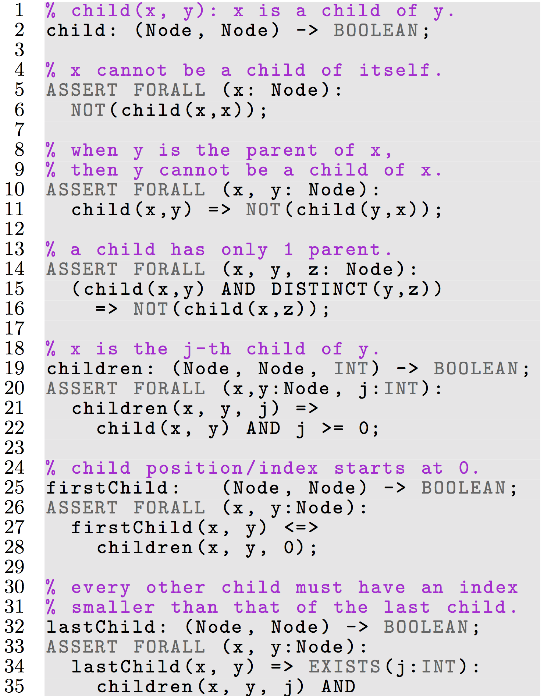
Quantifying Parent-Child Relationship

Slide 23
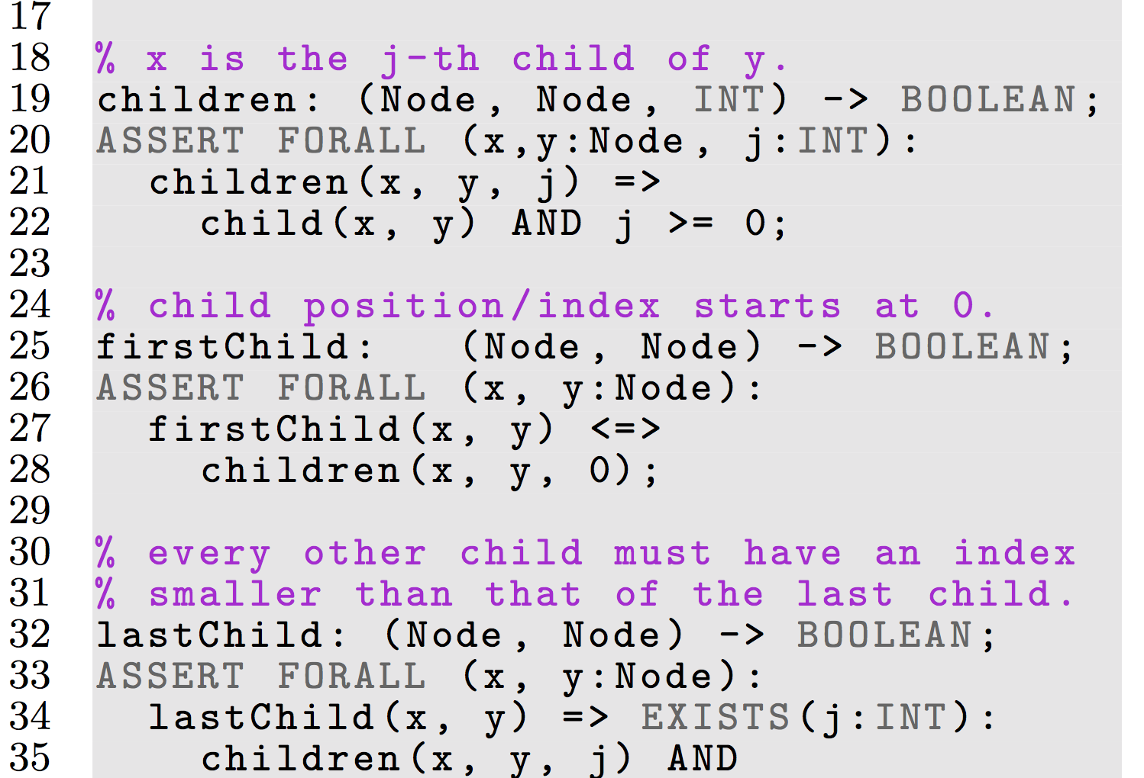
Quantifying Order of Children

Slide 24
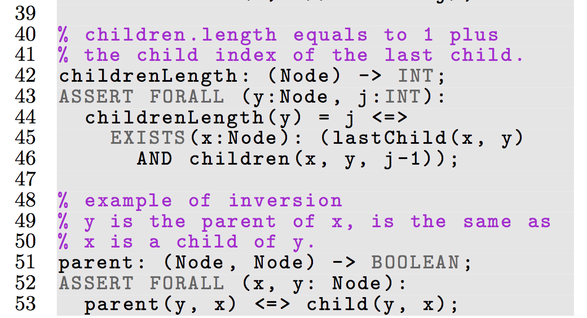
childrenLength: (Node) -> INT;

Slide 25






Approach & Implementation
Dynamic Backward Slice
Generic and Browser Independent.
Proxy to intercept download, instrument JS.
Deduce DOM constraints from backward slice.
DOM Solver
Encode DOM policies in general purpose solver
Use Quantifiers to model DOM API & 2D tree
Concolic Driver

Slide 26
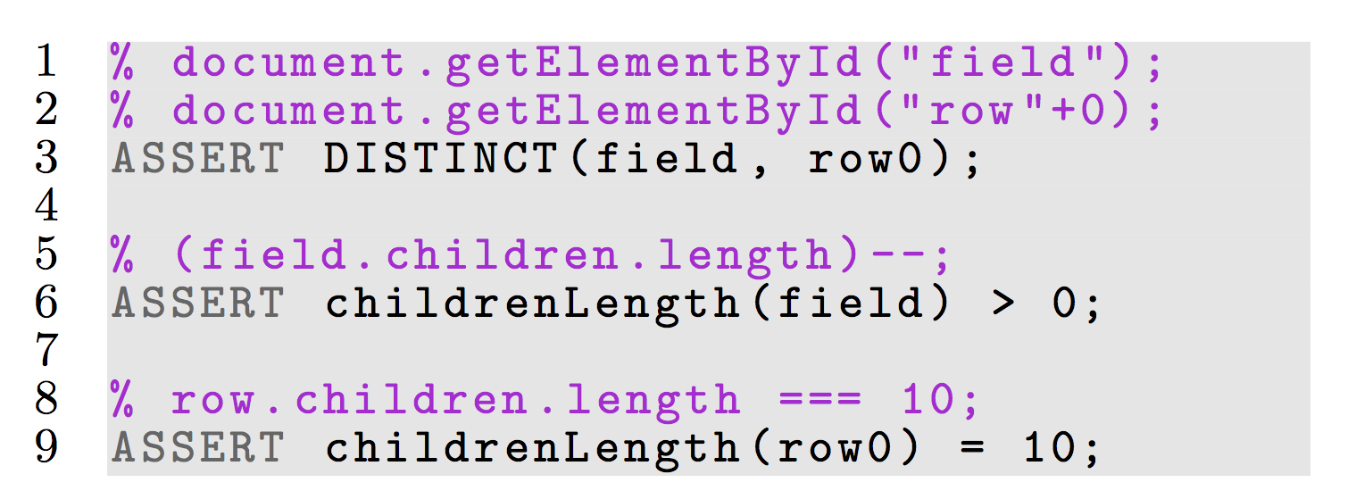
Example DOM constraints
CVC-asserts are specific to execution path e.g. True branch of if @ Line 6

Slide 27
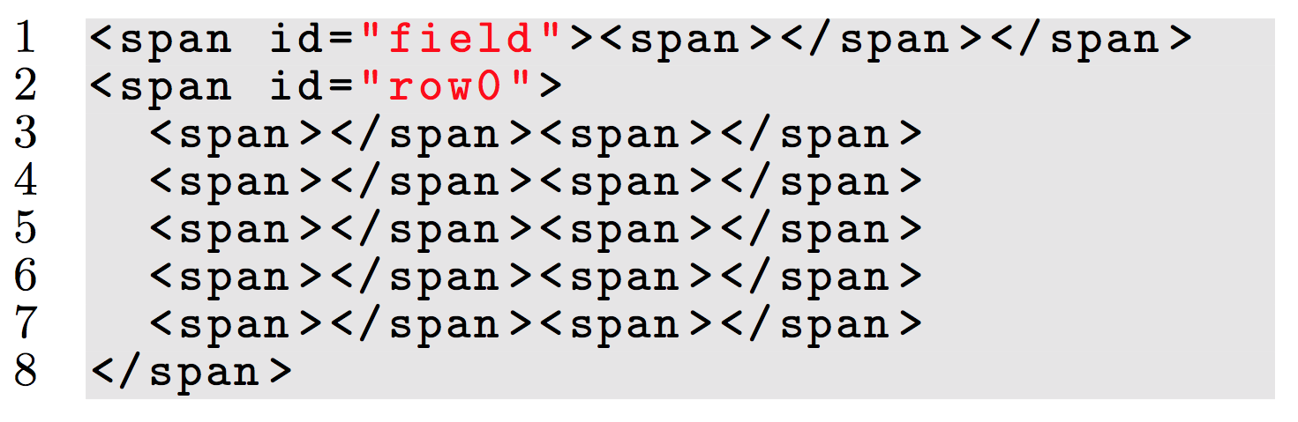
Example of HTML generated
<span> is default tag type, can be customized.
row0 is not a child of field: not in constraints.
Notes:
Row0 is not a child of field

Slide 28
Implementation Utilizing Open Technologies and Industry Standards
Dynamic Backward Slice
Proxy: WebScarab
Instrumentation: Google Closure Compiler API
Selenium WebDriver to interact with browser
DOM constraints: self-developed JS API
DOM Solver
SMT solver (CVC)
W3C DOM API to generate HTML
Notes:
Logos
WebScarab
Google Closure API
Selenium WebDriver
W3C

Slide 29
Case Study: DOMtris
function checkRows() {
var field = getElementById(“field”);
var i, row;
for (i=field.children.length; i--;) {
row = getElementById(“row”+i);
if (row.children.length === 10) {
++score;
// … assert score is increased
}}}

Slide 30
Compare Coverage
Compare Approaches
by Measuring Coverage
Without HTML
Existing HTML
ConcolicDOM
Future: jalangi
Statement Coverage
Branch Coverage
Path Coverage
Notes:
Inject bugs

Slide 31
Statement Coverage: 6 lines (2-7)
function checkRows() {
var field = getElementById(“field”);
var i, row;
for (i=field.children.length; i--;) {
row = getElementById(“row”+i);
if (row.children.length === 10) {
++score;
// … assert score is increased
}}}

Slide 32
Branch Coverage: 2 + 2 branches
function checkRows() {
var field = getElementById(“field”);
var i, row;
for (i=field.children.length; i--;) {
row = getElementById(“row”+i);
if (row.children.length === 10) {
++score;
// … assert score is increased
}}}
for loop Line 4
Stay & Break
branches
if statement Line 6
True & False

Slide 33
Path Coverage: 41 paths
field has 20 children rows in original HTML
Set # of rows for counting the # of paths: [20 (Stay branch in for loop) * 2 (Then and Else branches in if statement) ] + 1 (Break branch of for loop).

Slide 34
1. Without HTML: blank page
<body>
</body>

Slide 35
2. Existing HTML: Original Webpage
field has 20 rows.
All rows have zero children.

Slide 36
3. ConcolicDOM: generated HTML
Example:
Element with ID “field”, has 1+ children.
Nomenclature “row0”, “row1”; 10 children.
row0 is not a child of field: not in constraints.
Notes:
Row0 is not a child of field

Slide 37
Coverage Summary: DOMtris
Without HTML has low coverage
1/6 (16%) statements; 0/4 (0%) branches; 0/41 (0%) paths
1st statement of code is already a DOM operation: line 2, getElementById(“field”)
Existing HTML has high stmt/branch coverage.
5/6 (83%) statements; 3/4 (75%) branches; 1/41 (2.44%) paths
ConcolicDOM achieved 100% coverage.
6/6 statements; 4/4 branches; 41/41 paths.
Both conditions contain only DOM operations.
Only ConcolicDOM is able to cover scoring functionality & assertion ++score; (Line 7)

Slide 38
Related Work
Concolic Testing
Numerous prior work: DART, CUTE, KLEE, etc.
Dynamic language (both JS): Kudzu, Jalangi
Constraint Solvers
Xpath solver, CVC solver
Feedback Directed Testing in JavaScript
Random testing: Artemis
Mutation testing: Pythia

Slide 39
Related Work: Concolic Testing in JS
Kudzu (RegEx solver)
Single dimensional strings
Infer Regex patterns
Generate UI inputs
Detect security vulnerabilities
Jalangi (Shadow execution)
Selective record & replay
Manually define which variables are inputs
DOM Solver
2D hierarchical trees
Infer Implicit DOM clues
Background HTML
Test JavaScript code that contain DOM operations
Decorated Execution
DOM constraints from slice
Automatically infer which variables are inputs

Slide 40
Conclusion
Concolic approach to generate HTML
Auto-Test JavaScript code that contain DOM operations
Complement existing work on auto-generation of inputs.
Generic, Browser Independent.
Future Work
Solve DOM mutations, DOM attributes (strings)
Apply technique to generate XML, in other programming languages: DOM is W3C standard.
Thank you Eric & Ali.

Slide 41
Naïve DOM
Solved DOM
root
Legend
Arrows point to the parent.
Numbers are child positions: 0 is the first child -1 is the last child -2 is the second last child.
i(b) is the child position of b.
c
0
1
-2
2
-1
b
d
i(b)
i(b)+1
elem
elem
b
c
0
-1
0
1
2
-2
-1
…
elem
0
d

