Slide 1
ConcolicDOM Concolic Generation of HTML for Testing JavaScript
James Lo
Research Proficiency Evaluation
(RPE) Report
Notes:
30 minutes
Motivation
Challenges
Approach
Case Study

Slide 2



Motivation
Web Applications are increasingly prevalent
Web 2.0, HTML5, Browser war, Desktop/Mobile, Khan Academy
Testing Web apps remains challenging
Lots of JS code are written to handle UI/DOM
Document Object Model, W3C standard for handling *ML documents e.g. HTML/XML
Majority of bugs in JavaScript Web apps are DOM related
Executing different JS => Diff. DOM trees
During testing, executing different parts of JS code requires different yet specifically precise structures of the app DOM tree
1 DOM operation not satisfied can eventually halt entire execution.
Notes:
Clip art
HTML5, Firefox OS, Tizen OS, Khan Academy

Slide 3
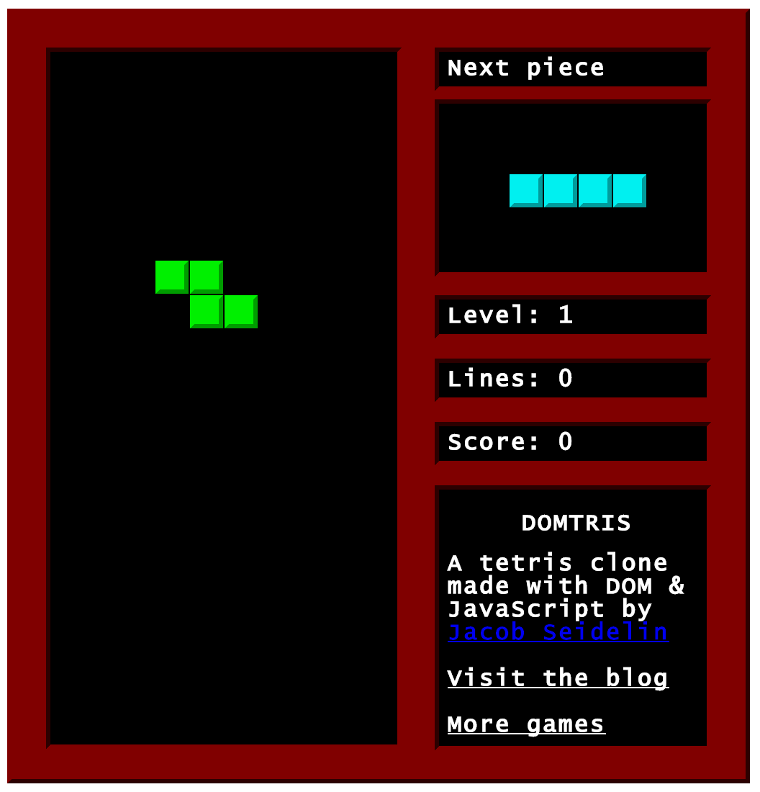
Example: DOMtris

Slide 4
Conditions (if, loops) have branches
function checkRows() {
var field = getElementById(“field”);
var i, row;
for (i=field.children.length; i--;) {
row = getElementById(“row”+i);
if (row.children.length === 10) {
++score;
// … row filled, update score
}}}
for loop Line 4
Stay & Break
branches
if statement Line 6
True & False
Also: Else If

Slide 5
To cover True branch of if @ Line 6 => DOM constraints
Element with ID “field” Line 2
function checkRows() {
var field = getElementById(“field”);
var i, row;
for (i=field.children.length; i--;) {
row = getElementById(“row”+i);
if (row.children.length === 10) {
++score;
// … row filled, update score
}}}
field has 1+ children Line 4
ID nomenclature “row0”, “row1”
Line 5
row has 10 children Line 6

Slide 6
To cover False branch of if => Different, Unique DOM tree
Element with ID “field” Line 2
function checkRows() {
var field = getElementById(“field”);
var i, row;
for (i=field.children.length; i--;) {
row = getElementById(“row”+i);
if (row.children.length === 10) {
++score;
// … row filled, update score
}}}
field has 1+ children Line 4
ID nomenclature “row0”, “row1”
Line 5
row cannot have children Line 6

Slide 7
Apply Concolic Techniques to Generate DOM trees
Automatic
# of execution paths grow exponentially with # of branching conditions
# of DOM trees grow with # of execution paths
Manual generation is too labor intensive
Systematic
Specific execution path => Precise DOM tree
Random DOM may not meet precision by chance

Slide 8
Challenges
Single Clues are Partial & Incomplete
Indirect Influence & Intermediate Variables
Dynamic Typing
Logic Constraints can be Interdependent
2D Structure & Implicit Clues
1-3. Dynamic Backward Slice
4-5. DOM Solver

Slide 9
4-5. DOM Solver: Quick Example
if (d === elem.firstElementChild
|| d === b.lastElementChild) {} // …
if (d === elem.parentElement.parentElement
|| d === b.parentElement) {} // …
if (b.previousElementSibling ===
c.firstElementChild) {} // …
if (elem.parentElement.parentElement ===
c.lastElementChild) {}

Slide 10
Each DOM operation is a clue to the Overall DOM tree
DOM operation:
Property access: e.g. elem.firstElementChild
Method call: e.g. document.getElementById()
on a JavaScript object associated with the DOM
d === elem.firstElementChild
elem
0
d

Slide 11
4. Logic constraints can be Interdependent
if (d === elem.firstElementChild
|| d === b.lastElementChild) {}
if (d === elem.parentElement
|| d === b.parentElement) {}
DOM Solver must understand the DOM API
Line 1 & Line 3 are mutually exclusive (also Line 2 & Line 4) d cannot be both parent and a child of elem
DOM Solver must resolve Logic Constraints
To cover True branch of both if conditions at the same time DOM Solver must pick (Line 1 & Line 4) or (Line 2 & Line 3)
The 2 if conditions inter-depend on each other

Slide 12
5. 2D Structure & Implicit Clues
if (b.previousElementSibling ===
c.firstElementChild) {}
if (elem.parentElement.parentElement ===
c.lastElementChild) {}
DOM Solver must support the DOM’s 2D tree structure
To cover True branch of Line 5 & Line 6: c is the parent of b
DOM Solver must infer Implicit Clues
Line 7 & Line 8: c is the great grandparent of elem
d cannot be the parent of b Line 4 => Line 1
d === b.lastElementChild Line 2
d === elem.parentElement Line 3

Slide 13
DOM Solver: Solved DOM tree
c is the parent of b Line 5 & 6
c is the great grandparent of elem Line 7 & 8
d cannot be the parent of b Line 4
d === b.lastElementChild Line 2
d === elem.parentElement Line 3
c
0
1
-2
2
-1
b
d
elem

Slide 14
Approach
Dynamic Backward Slice
Proxy to intercept download, instrument JS
Generic, Transparent and Browser Independent
Instrumented JS gives slice & DOM constraints
DOM Solver
Extend general purpose SMT solver (CVC)
Use Boolean Functions, Integer Functions and Quantifiers to model 2D tree structure of DOM

Slide 15
Example: DOM Solver & CVC
Element with ID “field” Line 2
function checkRows() {
var field = getElementById(“field”);
var i, row;
for (i=field.children.length; i--;) {
row = getElementById(“row”+i);
if (row.children.length === 10) {
++score;
// … row filled, update score
}}}
field has 1+ children Line 4
ID nomenclature “row0”, “row1”
Line 5
row has 10 children Line 6

Slide 16
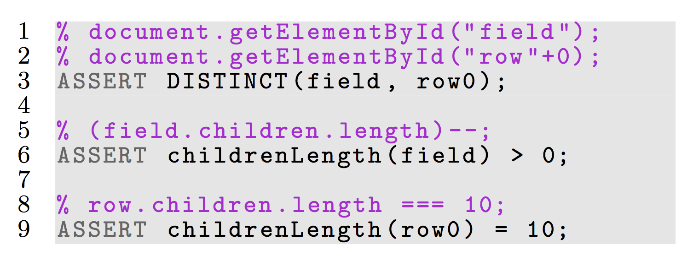
Example: DOM Solver & CVC
row.children.length === 10;

Slide 17
DOM Policies into CVC Quantifiers
ASSERT childrenLength(row0) = 10;
Parent-child relationship:
A node cannot be a child of itself
A child of a node cannot be the node’s parent at the same time: e.g. d can’t be both parent & child of elem
A child can have only 1 parent
A parent has multiple children
Ordering of Children that share the same parent
First child starts at position or index 0.
Last child has largest position or index.
childrenLength(row0) = 1 + index of last child.

Slide 18
DOM operations into SMT Boolean Functions & Integer Functions
child: (x, y) -> BOOLEAN; x is a child of y
children(x, y, j) -> BOOLEAN; x is the j-th child of y
childrenLength(x) -> INT;

Slide 19
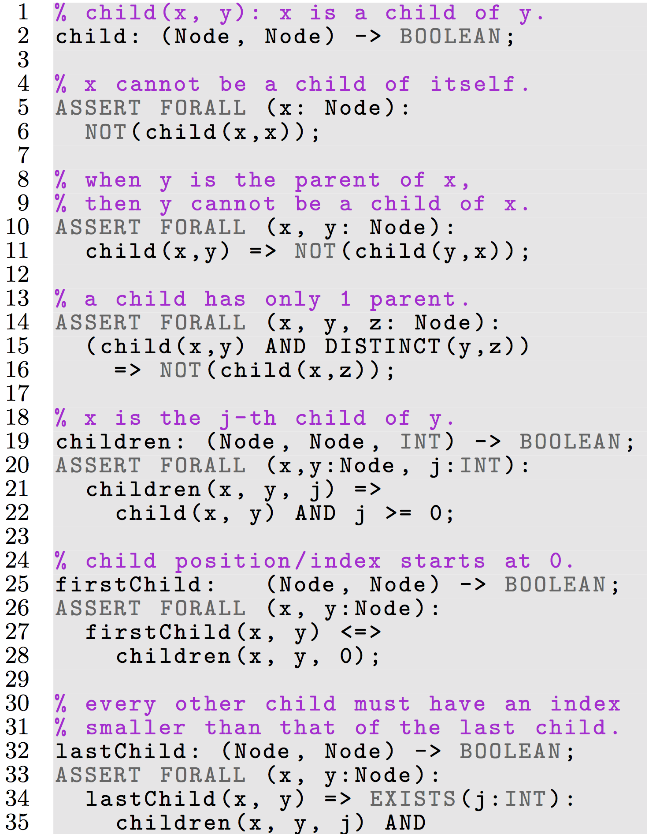
Quantifiers define relationships among Boolean / Integer Functions

Slide 20
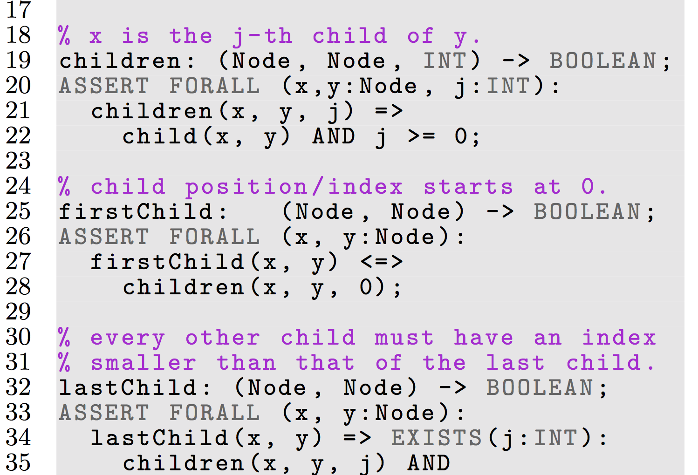
Quantifiers define relationships among Functions

Slide 21
Implementation
Dynamic Backward Slice
Proxy: WebScarab
Instrumentation: Google Closure Compiler API
Selenium WebDriver to interact with browser
DOM constraints: self-developed JS API
DOM Solver
SMT solver (CVC)
W3C DOM API to generate HTML

Slide 22
Compare Coverage
Approaches compared
Coverage measured
Without HTML
Existing HTML
ConcolicDOM
Statement Coverage
Branch Coverage
Path Coverage

Slide 23
Compare Coverage: DOMtris
function checkRows() {
var field = getElementById(“field”);
var i, row;
for (i=field.children.length; i--;) {
row = getElementById(“row”+i);
if (row.children.length === 10) {
++score;
// … row filled, update score
}}}

Slide 24
Statement Coverage: 6 lines (2-7)
function checkRows() {
var field = getElementById(“field”);
var i, row;
for (i=field.children.length; i--;) {
row = getElementById(“row”+i);
if (row.children.length === 10) {
++score;
// … row filled, update score
}}}

Slide 25
Branch Coverage: 2 + 2 branches
function checkRows() {
var field = getElementById(“field”);
var i, row;
for (i=field.children.length; i--;) {
row = getElementById(“row”+i);
if (row.children.length === 10) {
++score;
// … row filled, update score
}}}
for loop Line 4
Stay & Break
branches
if statement Line 6
True & False
Also: Else If

Slide 26
Path Coverage: 41 paths
Set field to have 20 rows as children
Counting the # of paths: [20 (stay branch in for loop) * 2 (True and False branches in if statement) ] + 1 (break branch of for loop).

Slide 27
1. Without HTML: blank page
<body>
</body>

Slide 28
2. Existing HTML: Original Webpage
field has 20 rows.
All rows have zero children.

Slide 29
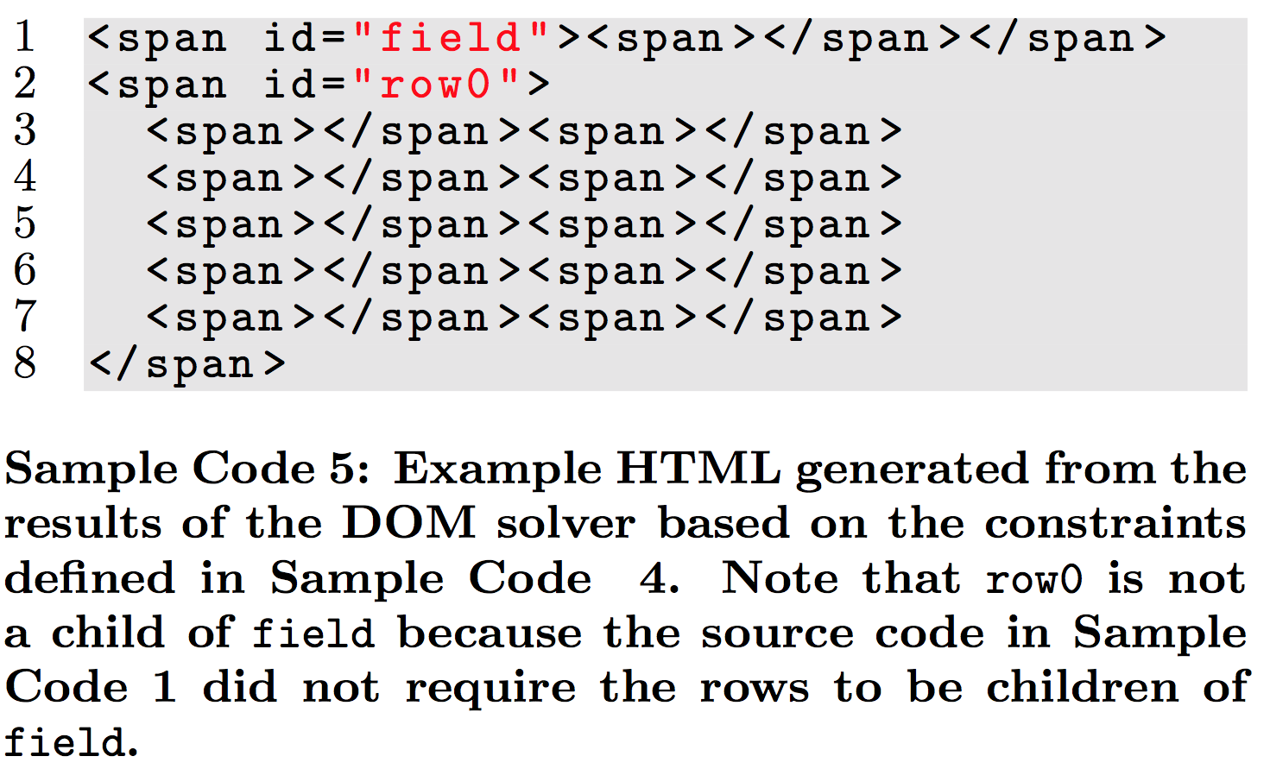
3. ConcolicDOM: generated HTML

Slide 30
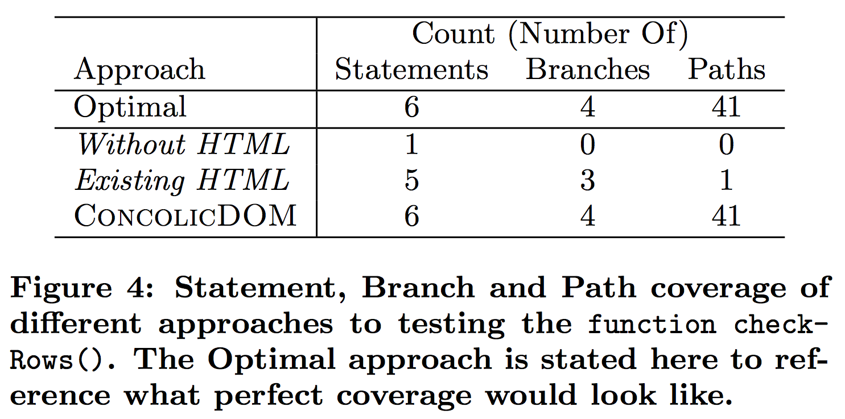
Coverage Results: DOMtris

Slide 31
Coverage Results: DOMtris
Without HTML has low coverage
First statement of code is already a DOM operation: line 2, getElementById(“field”)
Existing HTML has high statement/branch cov.
Statement coverage: 5/6 (83%)
Branch coverage: 3/4 (75%)
ConcolicDOM achieved optimal coverage
Both conditions have only a DOM operation.
Only ConcolicDOM is able to cover ++score; (Line 7)

Slide 32
Related Work
Concolic Testing in JavaScript
Kudzu, Jalangi
Constraint Solvers
Xpath solver, CVC solver
Feedback Directed Testing
Artemis, Pythia, CUTE, etc.

Slide 33
Related Work: Concolic Testing in JS
Kudzu (RegEx solver)
1D strings
Infer Regex patterns
Generate UI inputs
Detect security vulnerabilities
Jalangi (Shadow execution)
Selective record & replay
Manually define which variables are inputs
DOM Solver
2D hierarchical trees
Infer Implicit DOM clues
Generate HTML
Test JavaScript code that contain DOM operations
Decorated Execution
DOM constraints from slice
Automatically infer which variables are inputs

Slide 34
Conclusion
Concolic approach to generate HTML
Generic, Transparent, Browser Independent
Test JavaScript code that contain DOM operations
Future:
Solve mutations to tree, DOM attributes (strings)
Apply technique to generate XML, in other programming languages: DOM is W3C standard.
Thank you Eric & Ali.

Slide 35
1. Partial & Incomplete Clues
function checkRows()
4 constraints to reach and cover line 7
Element with ID “field”

Slide 36
Naïve DOM
Solved DOM
root
Legend
Arrows point to the parent.
Numbers are child positions: 0 is the first child -1 is the last child -2 is the second last child.
i(b) is the child position of b.
c
0
1
-2
2
-1
b
d
i(b)
i(b)+1
elem
elem
b
c
0
-1
0
1
2
-2
-1
…
elem
0
d

