Slide 1
ConcolicDOM Concolic Generation of HTML for Testing JavaScript
James Lo
Research Proficiency Evaluation
(RPE) Report
Notes:
Tools for delivering better Web Apps
Session Migration: Imagen
Multi-User, Real Time Collaboration: BreezeShare: BreezeJs, ShareJs
Performance: Mobile-Cloud Auto Partition, combines Aiman’s, Nima’s papers
Testing: ConcolicDOM
UI Design
End Users: RAPT is showcase app
Imagen
Multi-User, Real Time Collaboration
Performance
Developers:
Testing
UI Design

Slide 2



Motivation: Why HTML for testing JS?
Web Applications are increasingly prevalent
Testing Web apps remains challenging
Lots of JS code are written to handle UI/DOM
Document Object Model, W3C standard for handling *ML documents e.g. HTML/XML
Need to generate HTML during testing to satisfy DOM operations, keep execution alive.
Executing different parts of JS code requires different yet precise structures of the DOM.
1 DOM operation not satisfied can eventually halt entire execution.
Majority of bugs in JavaScript Web apps are DOM related.
Notes:
Clip art
HTML5, Firefox OS, Tizen OS, Khan Academy

Slide 3
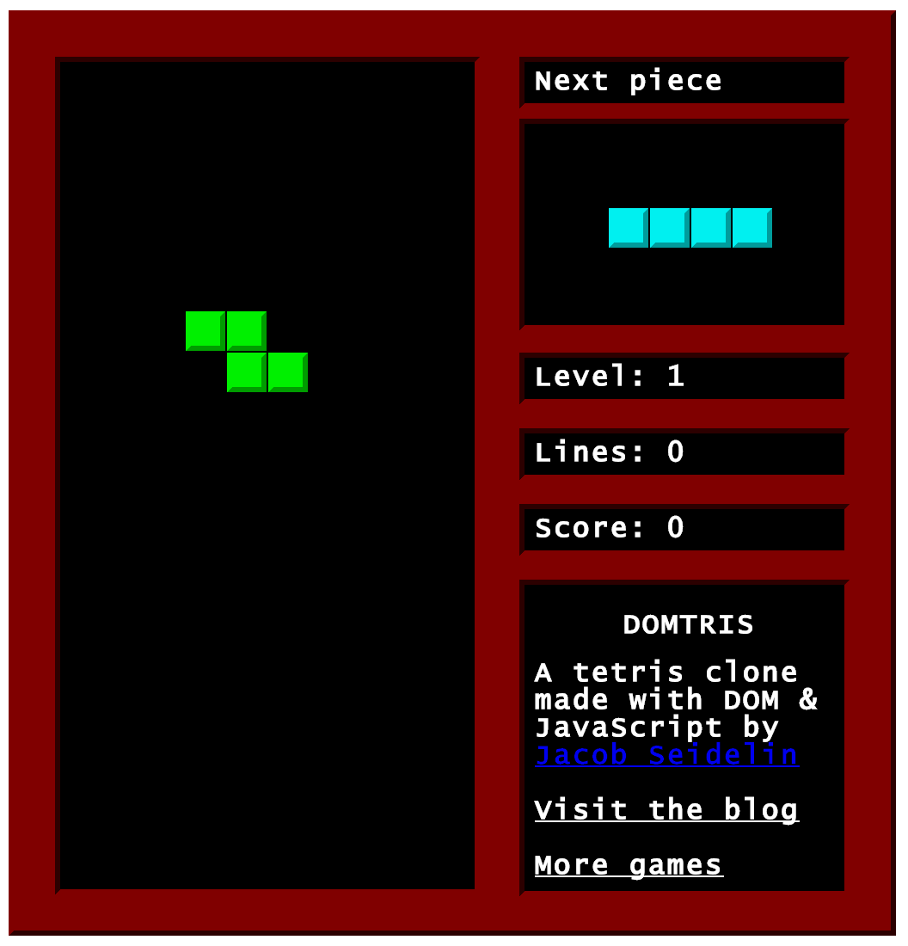
DOM Dependency Example: DOMtris

Slide 4
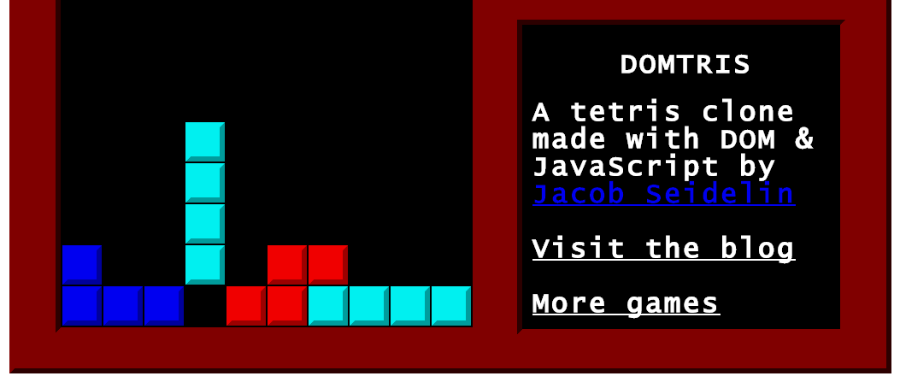
checking for filled rows: Line 6-7
function checkRows() {
var field = getElementById(“field”);
var i, row;
for (i=field.children.length; i--;) {
row = getElementById(“row”+i);
if (row.children.length === 10) {
++score;
// … row filled, update score
}}}

Slide 5
Conditions (if, loops) have branches
function checkRows() {
var field = getElementById(“field”);
var i, row;
for (i=field.children.length; i--;) {
row = getElementById(“row”+i);
if (row.children.length === 10) {
++score;
// … row filled, update score
}}}
for loop Line 4
Stay & Break
branches
if statement Line 6
True & False
Also: Else If

Slide 6
To cover True branch of if @ Line 6 → DOM tree must satisfy constraints
Element with ID “field” Line 2
function checkRows() {
var field = getElementById(“field”);
var i, row;
for (i=field.children.length; i--;) {
row = getElementById(“row”+i);
if (row.children.length === 10) {
++score;
// … row filled, update score
}}}
field has 1+ children Line 4
ID nomenclature “row0”, “row1”
Line 5
row has 10 children Line 6

Slide 7



What if DOM tree is not satisfied? (e.g. field is null) → error
function checkRows() {
var field = getElementById(“field”);
var i, row;
for (i=field.children.length; i--;) {
row = getElementById(“row”+i);
if (row.children.length === 10) {
++score;
// … row filled, update score
}}}

Slide 8
To cover False branch of if → Different, Unique DOM tree
Element with ID “field” Line 2
function checkRows() {
var field = getElementById(“field”);
var i, row;
for (i=field.children.length; i--;) {
row = getElementById(“row”+i);
if (row.children.length === 10) {
++score;
// … row filled, update score
}}}
field has 1+ children Line 4
ID nomenclature “row0”, “row1”
Line 5
row cannot have children Line 6

Slide 9
Apply Concolic Techniques to Generate DOM trees
Automatic
# of DOM trees (and # of execution paths) can grow exponentially with the # of branching conditions
Manual generation is too labor intensive.
Systematic
Specific execution path → Precise DOM tree
Random DOM may not meet precision by chance

Slide 10
Challenges
Single DOM Clues are Partial & Incomplete.
Indirect Influence & Intermediate Variables.
JavaScript variables are Dynamically Typed.
Logic Constraints can be Interdependent.
2D Tree Structure & Implicit Clues.
1-3. Dynamic Backward Slice
4-5. DOM Solver

Slide 11
4-5. DOM Solver: More Complicated Example
if (d === elem.firstElementChild
|| d === b.lastElementChild) {} // …
if (d === elem.parentElement
|| d === b.parentElement) {} // …
if (b.previousElementSibling ===
c.firstElementChild) {} // …
if (elem.parentElement.parentElement ===
c.lastElementChild.previousElementSibling) {}
We already have backward slice
Slice has 4 conditions
True branches of all conditions

Slide 12
Background: Each DOM operation is a Clue to the Overall DOM tree
DOM operation:
Property access: e.g. elem.firstElementChild
Method call: e.g. document.getElementById()
on a JavaScript object associated with the DOM
d === elem.firstElementChild @ Line 1
elem
0
d

Slide 13
4. Logic constraints can be Interdependent
if (d === elem.firstElementChild
|| d === b.lastElementChild) {}
if (d === elem.parentElement
|| d === b.parentElement) {}
DOM Solver must understand the DOM API
Line 1 & Line 3 are mutually exclusive (also Line 2 & Line 4) DOM API: d cannot be both parent and a child of elem
DOM Solver must resolve Logic Constraints
To cover True branch of both if conditions at the same time DOM Solver must pick (Line 1 & Line 4) or (Line 2 & Line 3)
The 2 if conditions inter-depend on each other

Slide 14
5. 2D Structure & Implicit Clues
if (b.previousElementSibling ===
c.firstElementChild) {}
if (elem.parentElement.parentElement ===
c.lastElementChild.previousElementSibling) {}
DOM Solver must support the DOM’s 2D tree structure
To cover True branch of Line 5 & Line 6: c is the parent of b
To cover True branch of Line 7 & Line 8: c is the great grandparent of elem
DOM Solver must infer Implicit Clues True branches
parent of b is c, not d Line 4 → Line 1
d === b.lastElementChild Line 2
d === elem.parentElement Line 3
b is grandparent of elem Line 2-3
c has exactly 3 children, b in middle Line 5-8

Slide 15
DOM Solver: Solved DOM tree
Arrows point up to the parent.
Numbers are child positions: 0 is the first child, 1 is second child -1 is the last child,
-2 is the second last child.
c is the parent of b Line 5 & 6
d cannot be the parent of b Line 4
d === b.lastElementChild Line 2
d === elem.parentElement Line 3
c has exactly 3 children Line 5-8
b is the middle child of c Line 5-8
b is grandparent of elem Line 2-3
c
0
1
-2
2
-1
b
d
elem

Slide 16
Approach
Dynamic Backward Slice
Proxy to intercept download, instrument JS.
Generic and Browser Independent.
Instrumented JS gives slice & DOM constraints.
DOM Solver
Extend general purpose SMT solver (CVC)
Use Boolean Functions, Integer Functions and Quantifiers to model 2D tree structure of DOM

Slide 17
Example: DOM Solver & CVC
Element with ID “field” Line 2
function checkRows() {
var field = getElementById(“field”);
var i, row;
for (i=field.children.length; i--;) {
row = getElementById(“row”+i);
if (row.children.length === 10) {
++score;
// … row filled, update score
}}}
field has 1+ children Line 4
ID nomenclature “row0”, “row1”
Line 5
row has 10 children Line 6

Slide 18
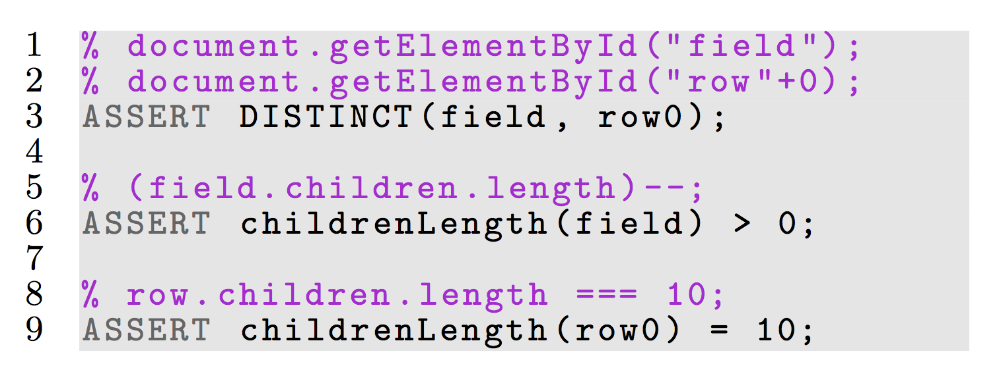
Encode DOM Constraints into CVC Asserts
Asserts are specific to execution path e.g. True branch of if @ Line 6

Slide 19
Model General DOM Policies into CVC Functions & Quantifiers
ASSERT childrenLength(row0) = 10; CVC assert
childrenLength: (Node) -> INT; CVC function
To support childrenLength(), we have to further quantify
Parent-child Relationship
Ordering of children that share the same parent

Slide 20
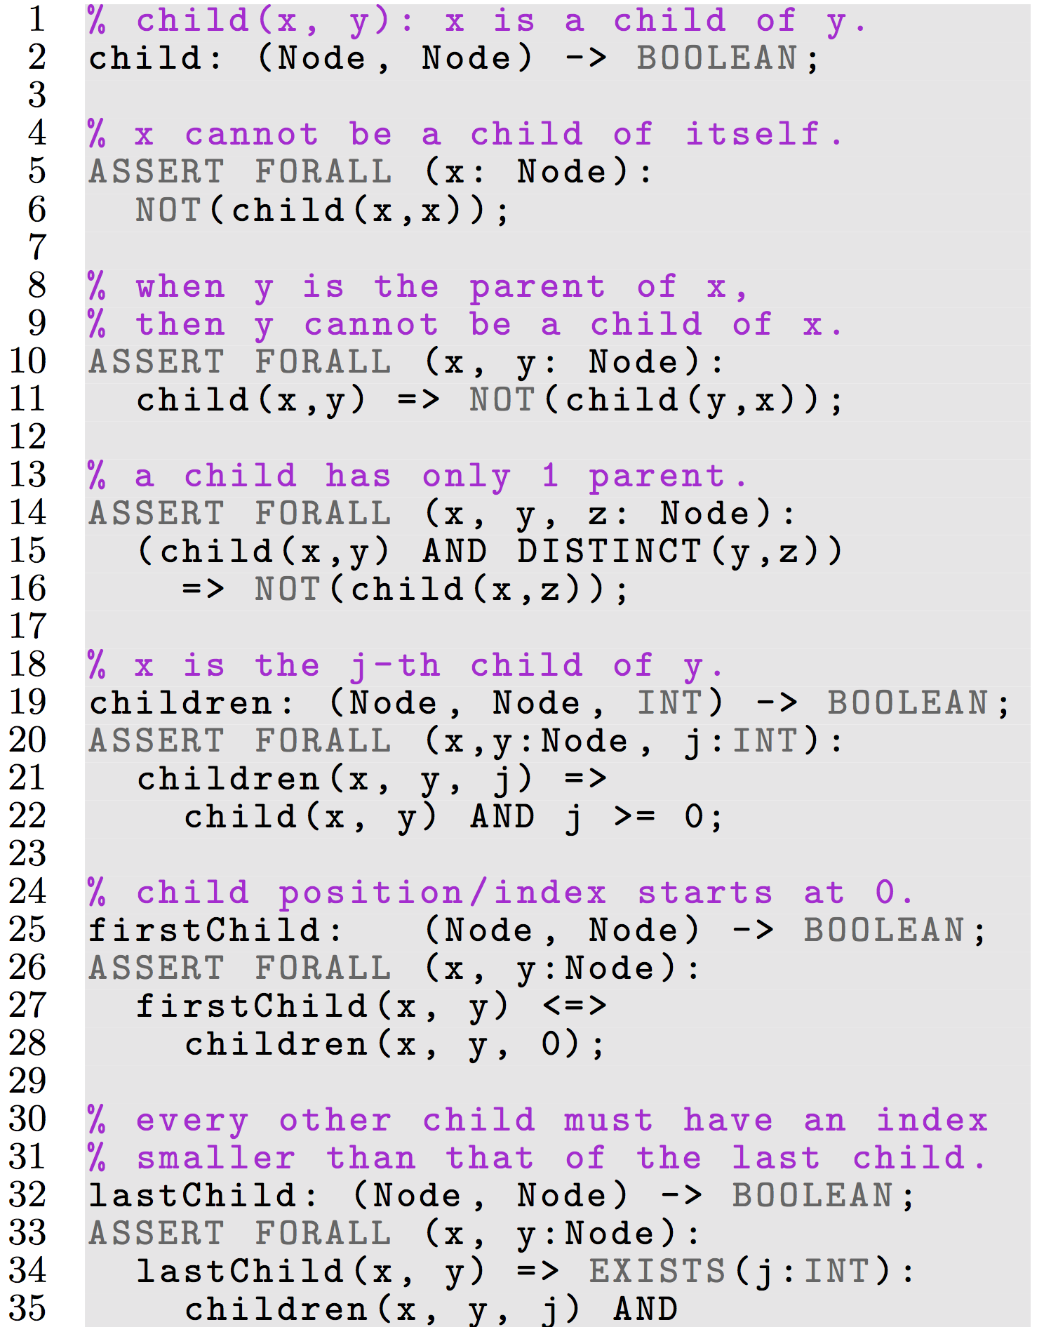
Quantifying Parent-Child Relationship

Slide 21
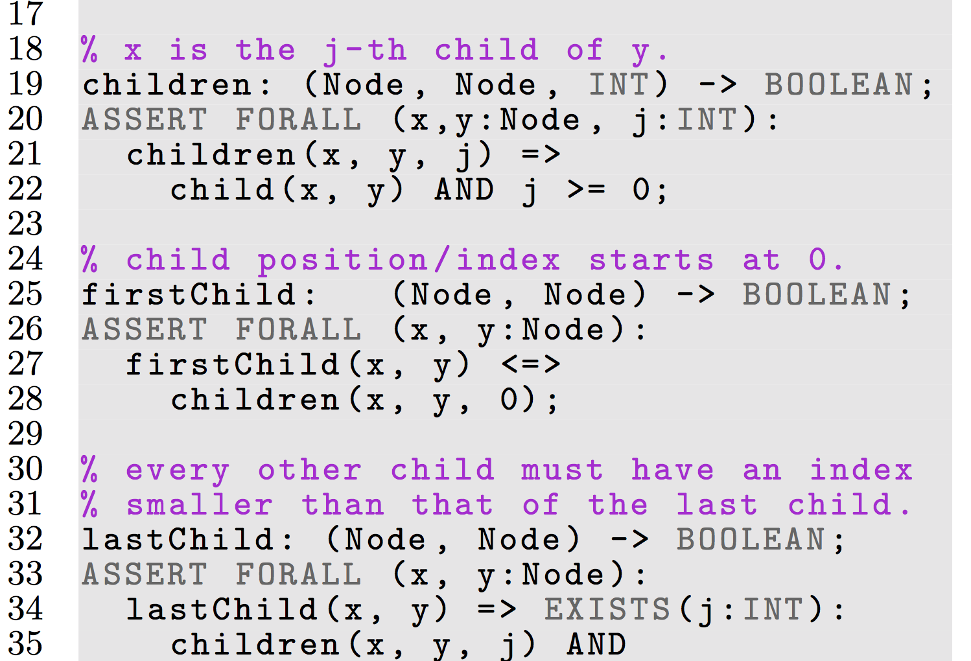
Quantifying Order of Children

Slide 22
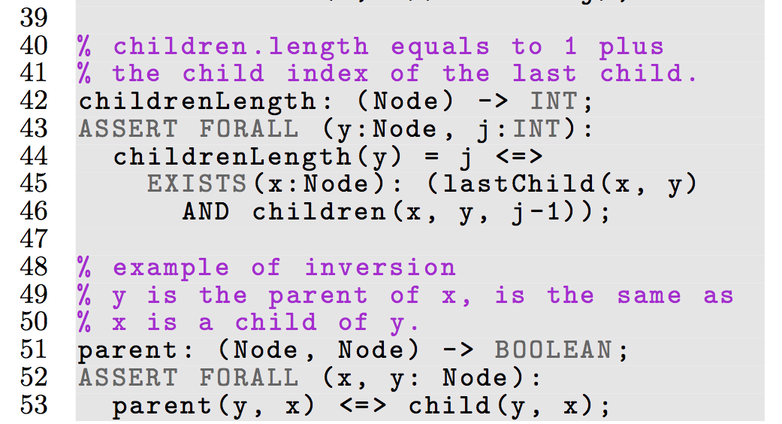
childrenLength: (Node) -> INT;

Slide 23
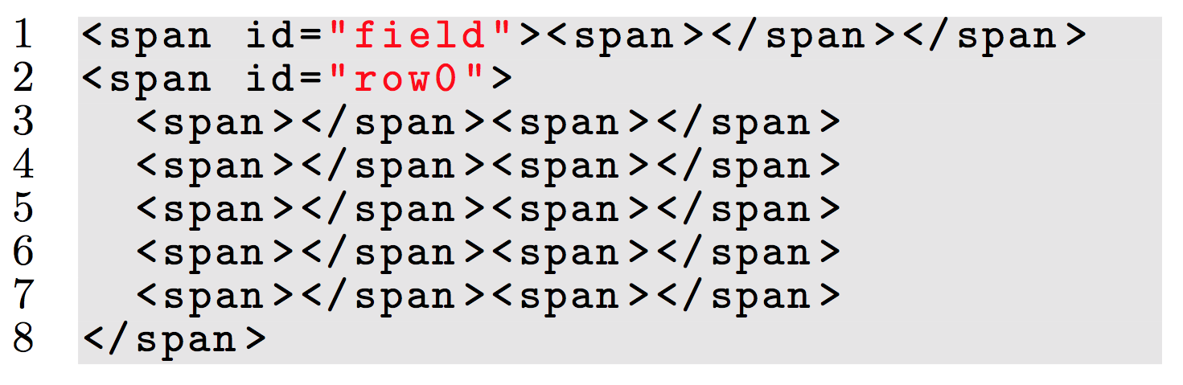
HTML Generated
row0 is not a child of field: not in constraints.
<span> is default tag type.
Notes:
Row0 is not a child of field

Slide 24




Implementation Utilizing Open Technologies and Industry Standards
Dynamic Backward Slice
Proxy: WebScarab
Instrumentation: Google Closure Compiler API
Selenium WebDriver to interact with browser
DOM constraints: self-developed JS API
DOM Solver
SMT solver (CVC)
W3C DOM API to generate HTML
Notes:
Logos
WebScarab
Google Closure API
Selenium WebDriver
W3C

Slide 25
Compare Coverage
Compare Approaches
by Measuring Coverage
Without HTML - jalangi
Existing HTML - jalangi
ConcolicDOM - jalangi
Statement Coverage
Branch Coverage
Path Coverage
Notes:
Inject bugs

Slide 26
Compare Coverage: DOMtris
function checkRows() {
var field = getElementById(“field”);
var i, row;
for (i=field.children.length; i--;) {
row = getElementById(“row”+i);
if (row.children.length === 10) {
++score;
// … row filled, update score
}}}

Slide 27
Statement Coverage: 6 lines (2-7)
function checkRows() {
var field = getElementById(“field”);
var i, row;
for (i=field.children.length; i--;) {
row = getElementById(“row”+i);
if (row.children.length === 10) {
++score;
// … row filled, update score
}}}

Slide 28
Branch Coverage: 2 + 2 branches
function checkRows() {
var field = getElementById(“field”);
var i, row;
for (i=field.children.length; i--;) {
row = getElementById(“row”+i);
if (row.children.length === 10) {
++score;
// … row filled, update score
}}}
for loop Line 4
Stay & Break
branches
if statement Line 6
True & False

Slide 29
Path Coverage: 41 paths
field has 20 children rows in original HTML
Set # of rows for counting the # of paths: [20 (Stay branch in for loop) * 2 (True and False branches in if statement) ] + 1 (Break branch of for loop).

Slide 30
1. Without HTML: blank page
<body>
</body>

Slide 31
2. Existing HTML: Original Webpage
field has 20 rows.
All rows have zero children.

Slide 32
3. ConcolicDOM: generated HTML
Element with ID “field”, has 1+ children.
Nomenclature “row0”, “row1”; 10 children.
row0 is not a child of field: not in constraints.
Notes:
Row0 is not a child of field

Slide 33
Coverage Summary: DOMtris
Without HTML has low coverage
1/6 (16%) statements; 0/4 (0%) branches; 0/41 (0%) paths
1st statement of code is already a DOM operation: line 2, getElementById(“field”)
Existing HTML has high stmt/branch coverage.
5/6 (83%) statements; 3/4 (75%) branches; 1/41 (2.44%) paths
ConcolicDOM achieved 100% coverage.
6/6 statements; 4/4 branches; 41/41 paths.
Both conditions contain only DOM operations.
Only ConcolicDOM is able to cover scoring functionality ++score; (Line 7)

Slide 34
Related Work 3 categories
Concolic Testing
Numerous prior work: DART, CUTE, KLEE, etc.
Dynamic language (both JS): Kudzu, Jalangi
Constraint Solvers
Xpath solver, CVC solver
Feedback Directed Testing in JavaScript
Random testing: Artemis
Mutation testing: Pythia

Slide 35
Related Work: Concolic Testing in JS
Kudzu (RegEx solver)
Single dimensional strings
Infer Regex patterns
Generate UI inputs
Detect security vulnerabilities
Jalangi (Shadow execution)
Selective record & replay
Manually define which variables are inputs
DOM Solver
2D hierarchical trees
Infer Implicit DOM clues
Generate HTML
Test JavaScript code that contain DOM operations
Decorated Execution
DOM constraints from slice
Automatically infer which variables are inputs

Slide 36
Conclusion
Concolic approach to generate HTML
Test JavaScript code that contain DOM operations
Generic, Browser Independent
Future Work
Solve DOM mutations, DOM attributes (strings)
Apply technique to generate XML, in other programming languages: DOM is W3C standard.
Thank you Eric & Ali.

Slide 37
Naïve DOM
Solved DOM
root
Legend
Arrows point to the parent.
Numbers are child positions: 0 is the first child -1 is the last child -2 is the second last child.
i(b) is the child position of b.
c
0
1
-2
2
-1
b
d
i(b)
i(b)+1
elem
elem
b
c
0
-1
0
1
2
-2
-1
…
elem
0
d

