Slide 1
Adaptive Descent/Ascent
James Lo

Slide 2
Problem: But…
Stochastic Gradient Descent: each iteration is quick
But… Error may still be high after convergence
Gradient Descent: gives lower convergence rate
But… each iteration is slow, has to go thru all the data

Slide 3
Hypothesis: can we switch?

Slide 4
Design Goals
Minimum engineering cost
Architecture is decoupled.

Slide 5
Challenges

Slide 6
FlexMF
Flexible / Extensible framework for Matrix Factorization
Engineering Principles

Slide 7
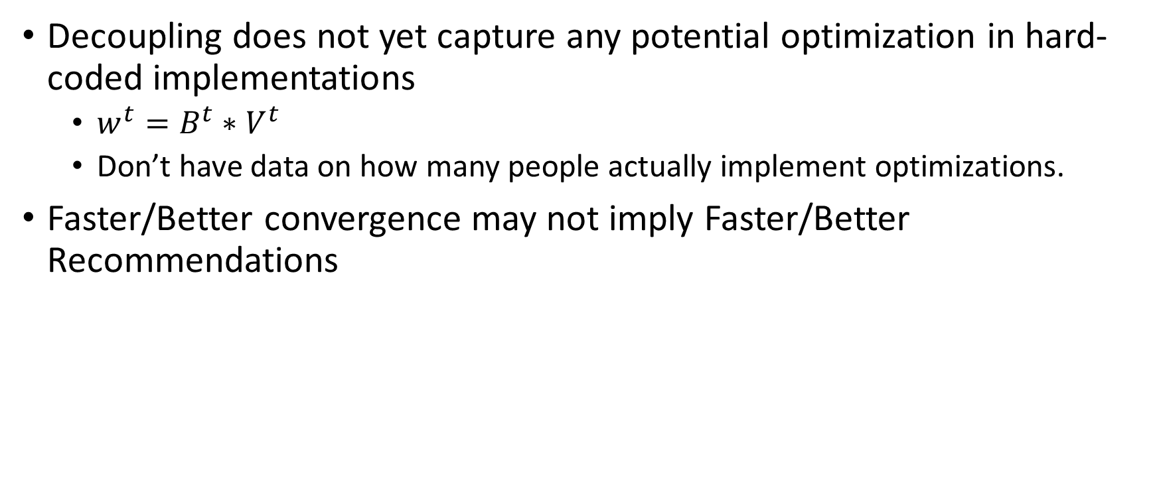
Limitations
Decoupling does not yet capture any potential optimization in hard-coded implementations
$w^{t}=B^{t}∗V^{t}$
Don’t have data on how many people actually implement optimizations.
Faster/Better convergence may not imply Faster/Better Recommendations

Slide 8
Conclusion

Slide 9
Future Work: What do we do with FlexMF?
Greedy Parallel Descent/Ascent
Problem: Individual descent/ascent can be difficult to parallelize
Idea: can run multiple individual algorithms independently in parallel
Pick the algorithm with the best convergence rate
Challenge: some algorithms are faster than others
Run faster algorithms multiple times, wait for slowest to complete
Hypothesis: Greedy Parallel would be faster than Adaptive

