Slide 1
Faster Convergence in Matrix Factorization using SAG-MF
James Lo

Slide 2
Why Matrix Factorization?
MF is the central component of
many model-based RecSys: collaborative filtering
many Unsupervised Learning methods: PCA, ICA...
Can we do MF faster?

Slide 3
Why Faster Matrix Factorization?
Don’t rec-sys run offline? Yes, But… “Speed is everything”
As a data scientist,
Getting the right formula may not be trivial.
May require multiple trials of experimentation
Formula: objective function e.g. CLiMF, MNAR, GAPfm, etc.
Fine-tuning parameters: step size, regularization… etc.
Product life-cycles are shortening
Past: multi-month phases (e.g. Waterfall)
Now: 2 week spins (e.g. Agile, “move Fast & break things”)
Datasets are getting larger
Growth of data > increase of processor speed.
Larger datasets take longer to run, even for linear algorithm

Slide 4
Why Better Matrix Factorization?
Better MF: error is lower after convergence
Error: absolute(approximation – optimum)
Lower error often leads to* → higher chance of higher accuracy → rec-sys: higher click-thru rate → higher profits $$$
*Assumption made by all rec-sys papers that utilize iterative optimization

Slide 5
Opportunity: Stochastic Average Gradient
Memory-based Stochastic Gradient Descent
Theory is sound: best of both worlds
Less # of iterations: similar to Full gradient
Fast iteration: O(1) samples similar to Stochastic
SAG’s fast convergence evaluated in supervised Logistic Regression, Support Vector Machines
Hypothesis: can SAG bring faster MF?

Slide 6


Background: Gradient Descent/ascent
$$w^{t+1}=w^{t}+α∗\left(\sum_{i=1}^{b}{∇_{point(i,t)}f(w^{t})}\right)$$
w^{t+1} = approximation at iteration t+1
α = step size
α > 0: ascent (max)
α < 0: descent (min)
$∇_{point(i,t)}f(w^{t})$ = gradient at i-th randomly selected data point at time t

Slide 7
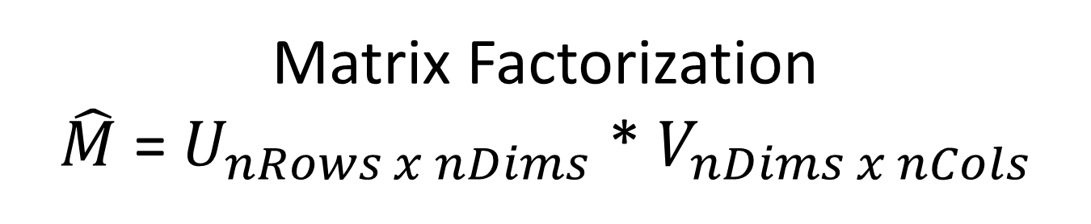


Matrix Factorization $\hat{M}$ = $U_{nRows x nDims}$ * $V_{nDims x nCols}$
$$U^{t+1}=U^{t}+α∗\left(\sum_{i=1}^{b}{\frac{df(U,V)}{dU_{point(i,t)}}}\right)$$
U^{t+1} = approximation at iteration t+1
α = step size
α > 0: ascent (max)
α < 0: descent (min)
$∇_{point(i,t)}f(U^{t})$ = gradient at i-th randomly selected data point at time t

Slide 8


Matrix Factorization $\hat{M}$ = $U_{nRows x nDims}$ * $V_{nDims x nCols}$
$$V^{t+1}=V^{t}+α∗\left(\sum_{i=1}^{b}{\frac{df(U,V)}{dV_{point(i,t)}}}\right)$$
V^{t+1} = approximation at iteration t+1
α = step size
α > 0: ascent (max)
α < 0: descent (min)
$∇_{point(i,t)}f(V^{t})$ = gradient at i-th randomly selected data point at time t

Slide 9
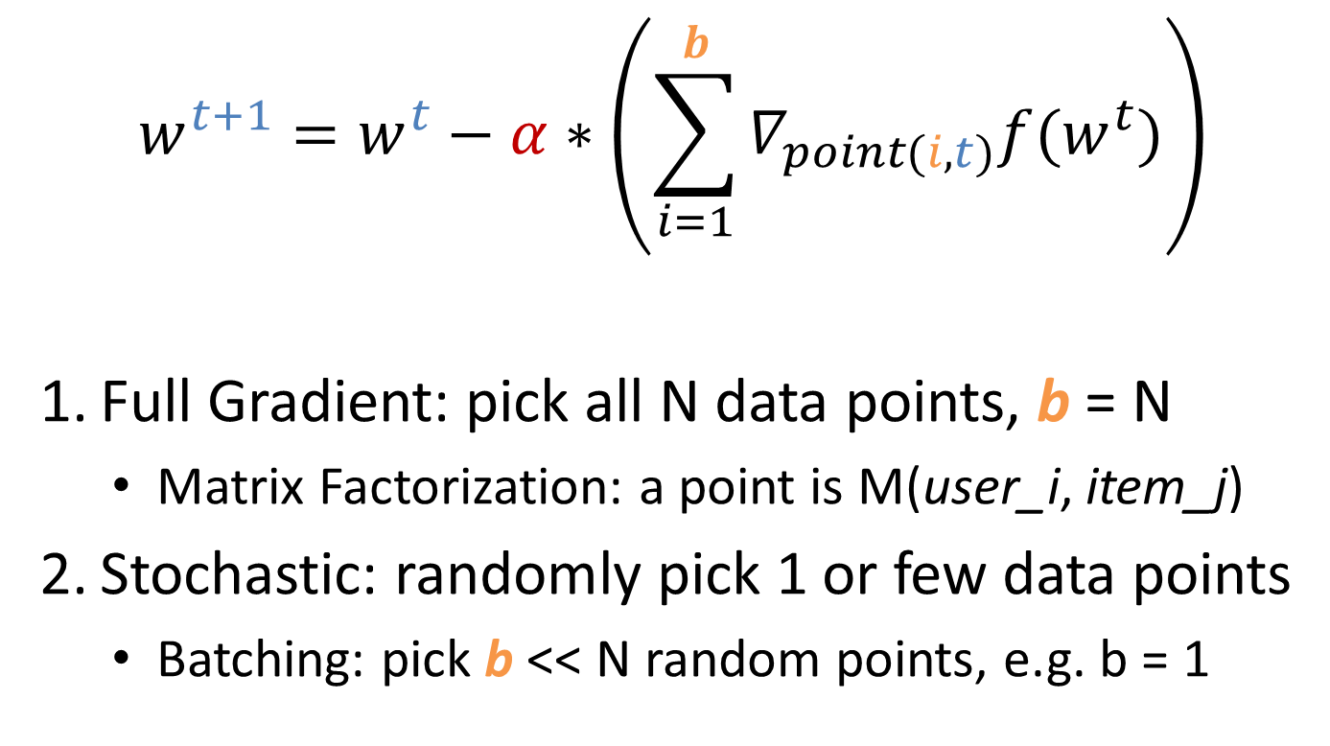
Background: Gradient Descent/ascent
$$w^{t+1}=w^{t}−α∗\left(\sum_{i=1}^{b}{∇_{point(i,t)}f(w^{t})}\right)$$
Full Gradient: pick all N data points, b = N
Matrix Factorization: a point is M(user_i, item_j)
Stochastic: randomly pick 1 or few data points
Batching: pick b << N random points, e.g. b = 1

Slide 10
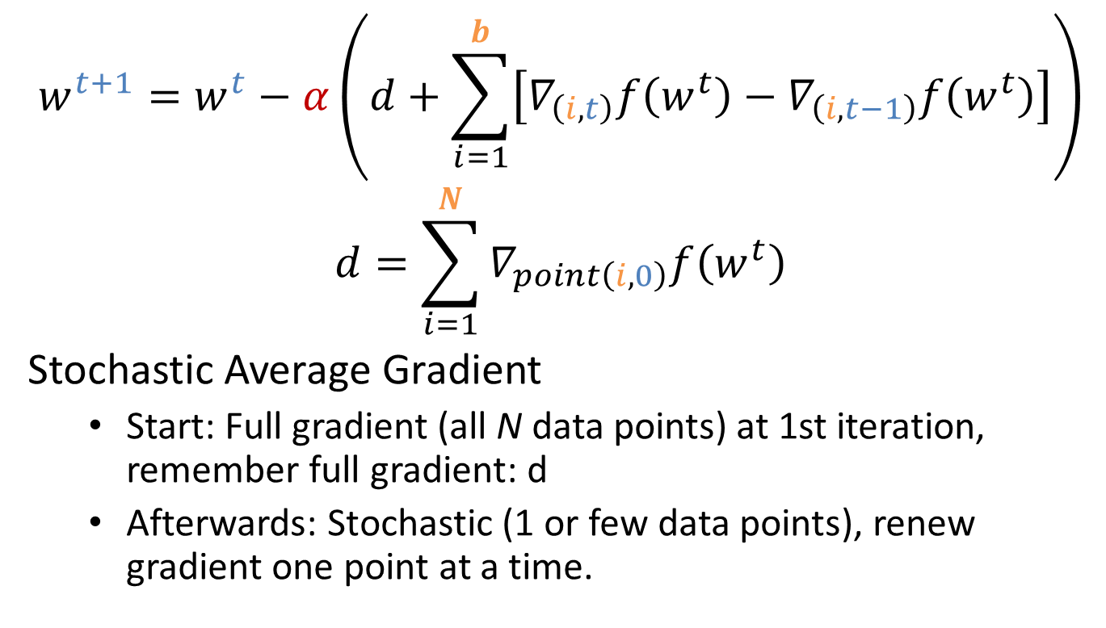
Background: SAG
$$w^{t+1}=w^{t}−α\left(d+\sum_{i=1}^{b}{\left[∇_{\left(i,t\right)}f\left(w^{t}\right)−∇_{\left(i,t−1\right)}f\left(w^{t}\right)\right]}\right)$$
$$d=\sum_{i=1}^{N}{∇_{point\left(i, 0\right)}f\left(w^{t}\right)}$$
Stochastic Average Gradient
Start: Full gradient (all N data points) at 1st iteration, remember full gradient: d
Afterwards: Stochastic (1 or few data points), renew gradient one point at a time.

Slide 11
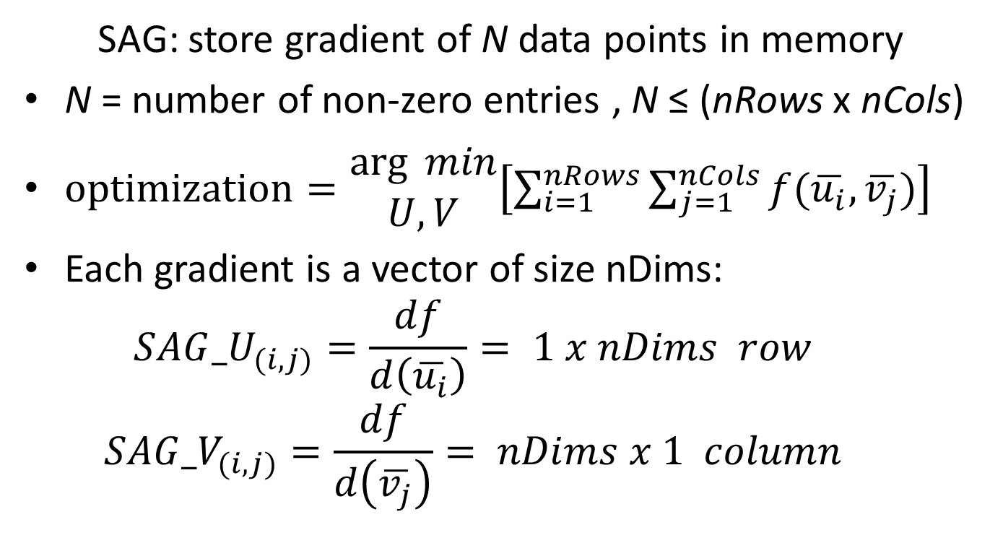
Space Complexity of SAG: θ(N*nDims)
SAG: store gradient of N data points in memory
N = number of non-zero entries , N ≤ (nRows x nCols)
$optimization=\begin{matrix}\arg{ min} \\ U,V\end{matrix}\left[\sum_{i=1}^{nRows}{\sum_{j=1}^{nCols}{f(\overline{u_{i}},\overline{v_{j}})}}\right]$
Each gradient is a vector of size nDims:
$${SAG_U}_{(i,j)}=\frac{df}{d\left(\overline{u_{i}}\right)}= 1 x nDims row$$
$${SAG_V}_{(i,j)}=\frac{df}{d\left(\overline{v_{j}}\right)}= nDims x 1 column$$

Slide 12
Why Space Complexity matters?
Does space complexity not matter anymore?
Many OS’s support 100+ GBs of RAM
Large scale SSD is cheaper
Distributed memory: Memcache
Ultra-fast fibre optic Intranet…

Slide 13
Why Space Complexity matters?
Space vs. time trade-off still applies to scale performance on analyzing Big Data
CPU/GPU: cache is still limited, page faults
RAM/memcache: it still takes time to transfer data from memory into processor
GPU: many cores share the same cache

Slide 14
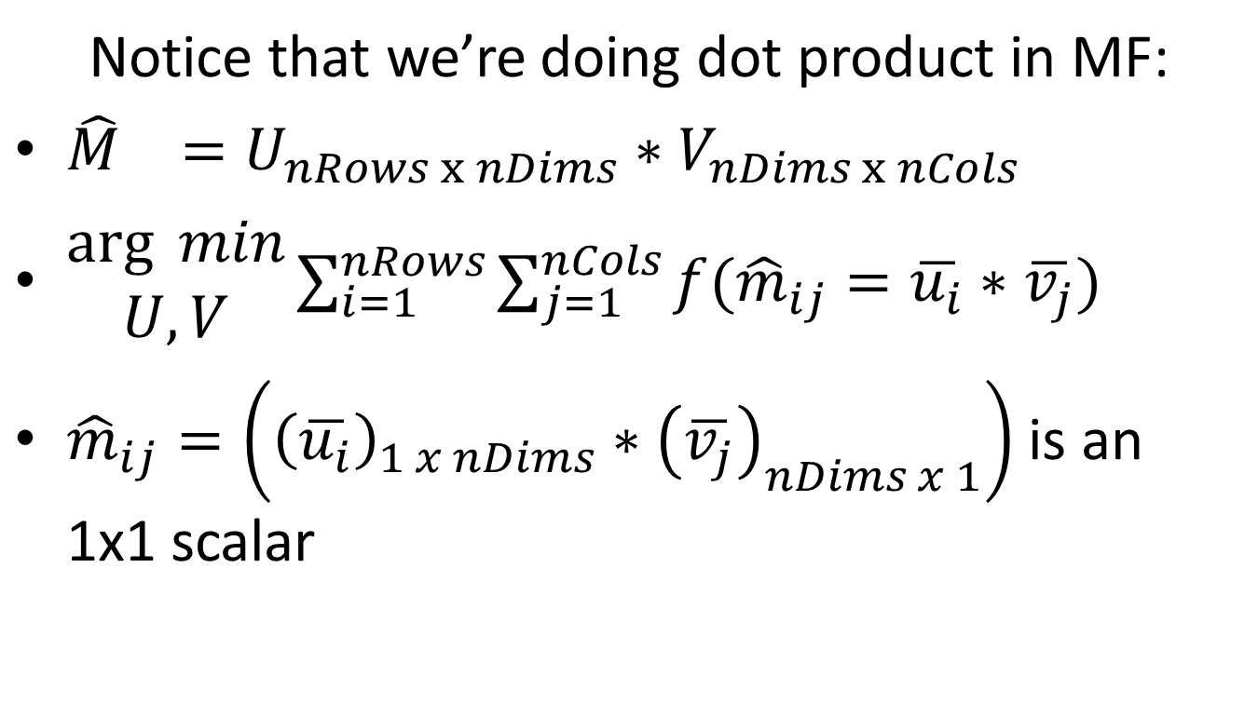
Space Complexity of SAG-MF
Notice that we’re doing dot product in MF:
${\hat{M}}_{}=U_{nRows x nDims}∗V_{nDims x nCols}$
$\begin{matrix}\arg{ min} \\ U,V\end{matrix}\sum_{i=1}^{nRows}{\sum_{j=1}^{nCols}{f({\hat{m}}_{ij}=\overline{u_{i}}∗\overline{v_{j}})}}$
${\hat{m}}_{ij}=\left({\left(\overline{u_{i}}\right)}_{1 x nDims}∗{\left(\overline{v_{j}}\right)}_{nDims x 1}\right)$ is an 1x1 scalar

Slide 15
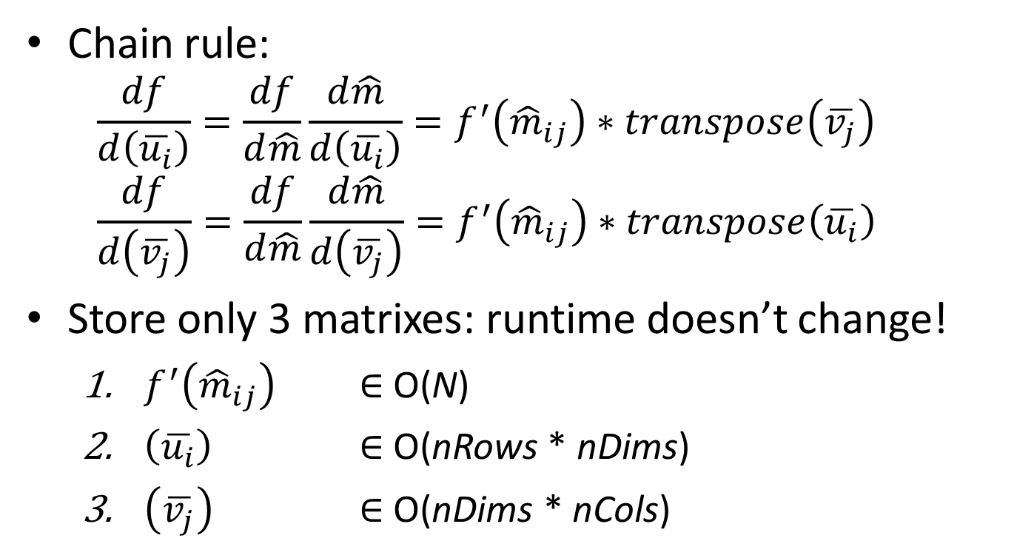
Space Complexity of SAG-MF θ(N + (nRows+nCols)*nDims)?
Chain rule:
$$\frac{df}{d\left(\overline{u_{i}}\right)}=\frac{df}{d\hat{m}}\frac{d\hat{m}}{d\left(\overline{u_{i}}\right)}=f^{′}\left({\hat{m}}_{ij}\right)∗transpose\left(\overline{v_{j}}\right)$$
$$\frac{df}{d\left(\overline{v_{j}}\right)}=\frac{df}{d\hat{m}}\frac{d\hat{m}}{d\left(\overline{v_{j}}\right)}=f^{′}\left({\hat{m}}_{ij}\right)∗transpose\left(\overline{u_{i}}\right)$$
Store only 3 matrixes: runtime doesn’t change!
$f^{′}\left({\hat{m}}_{ij}\right)$ $∈$ O(N)
$\left(\overline{u_{i}}\right)$ $∈$ O(nRows * nDims)
$\left(\overline{v_{j}}\right)$ $∈$ O(nDims * nCols)

Slide 16
Wait a minute … is that it?
Problem: U & V are different at each iteration
Optimization is to get the best possible U, V
Solution:
∀ data point, store the most recent iteration t that the data point was sampled: θ(N) space
Sample with replacement
We need only the most recent sampled Ui, Vj
∀ iteration t, store the Ui, Vj sampled at iteration t: θ(nMems * nDims) space
Total: θ(N+(nRows+nCols+nMems)*nDims)

Slide 17
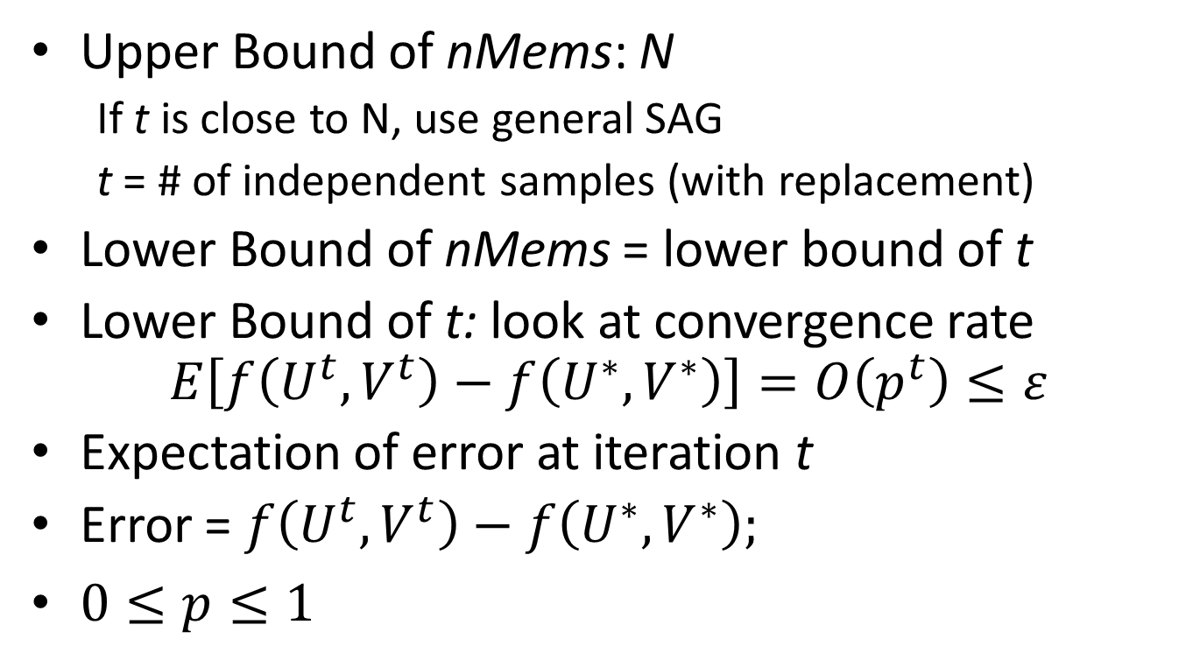
nMems = min{t, N} Can we assume nMems is much less than N?
Upper Bound of nMems: N
If t is close to N, use general SAG
t = # of independent samples (with replacement)
Lower Bound of nMems = lower bound of t
Lower Bound of t: look at convergence rate $E\left[f\left(U^{t},V^{t}\right)−f\left(U^{∗},V^{∗}\right)\right]=O\left(p^{t}\right)≤ε$
Expectation of error at iteration t
Error = $f\left(U^{t},V^{t}\right)−f\left(U^{∗},V^{∗}\right);$
$0≤p≤1$

Slide 18
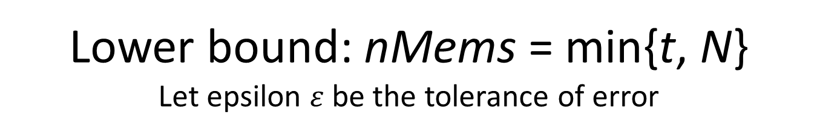
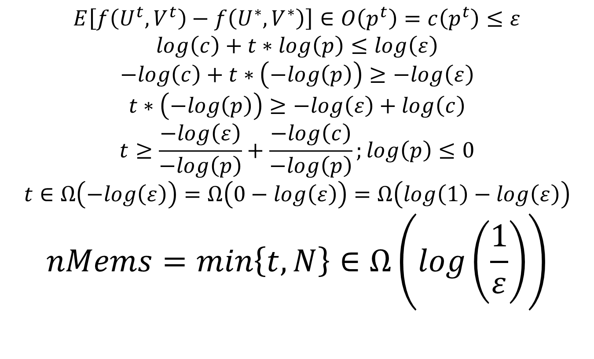
Lower bound: nMems = min{t, N} Let epsilon $ε$be the tolerance of error
$$E\left[f\left(U^{t},V^{t}\right)−f\left(U^{∗},V^{∗}\right)\right]∈O\left(p^{t}\right)=c\left(p^{t}\right)≤ε$$
$$log\left(c\right)+t∗log\left(p\right)≤log\left(ε\right)$$
$$−log\left(c\right)+t∗\left(−log\left(p\right)\right)≥−log\left(ε\right)$$
$$t∗\left(−log\left(p\right)\right)≥−log\left(ε\right)+log\left(c\right)$$
$$t≥\frac{−log\left(ε\right)}{−log\left(p\right)}+\frac{−log\left(c\right)}{−log\left(p\right)};log\left(p\right)≤0$$
$$t∈Ω\left(−log\left(ε\right)\right)=Ω\left(0−log\left(ε\right)\right)=Ω\left(log\left(1\right)−log\left(ε\right)\right)$$
$$nMems=min\left\{t,N\right\}∈Ω\left(log\left(\frac{1}{ε}\right)\right)$$

Slide 19

nMems = min{t, N}
Lower bound of nMems depends on
convergence rate: $E\left[f\left(U^{t},V^{t}\right)−f\left(U^{∗},V^{∗}\right)\right]$
error tolerance: $ε$
not N

Slide 20
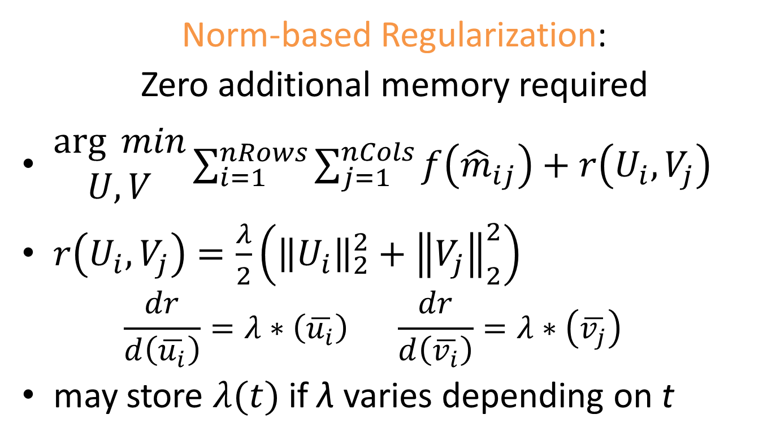
Space Complexity of SAG-MF: θ(N +(nRows +nCols +nMems)*nDims)
Norm-based Regularization:
Zero additional memory required
$\begin{matrix}\arg{ min} \\ U,V\end{matrix}\sum_{i=1}^{nRows}{\sum_{j=1}^{nCols}{f\left({\hat{m}}_{ij}\right)+r\left(U_{i},V_{j}\right)}}$
$r\left(U_{i},V_{j}\right)=\frac{λ}{2}\left({\left\|U_{i}\right\|}_{2}^{2}+{\left\|V_{j}\right\|}_{2}^{2}\right)$
$$\frac{dr}{d\left(\overline{u_{i}}\right)}=λ∗\left(\overline{u_{i}}\right) \frac{dr}{d\left(\overline{v_{i}}\right)}=λ∗\left(\overline{v_{j}}\right)$$
may store $λ(t)$ if λ varies depending on t

Slide 21
Actual Impl: SAG-MF forgetful θ((nRows +nCols)*nDims)
Only SAG_U, SAG_V at t=0 can be compressed
At 1st iteration, we are accessing all data-points
Store only U, V at t=0: U_0, V_0
Re-compute gradients(Ui_0, Vj_0) on the fly
If we converge without touching each data point more than once (t << N), store only U_0, V_0
Big-O runtime does not change

Slide 22
To enable Fine-Tuning: SAG-MF buffered What if we don’t want to re-compute everything?
Pre-compute nBufs random data points (i, j)’s that we are going to visit in the next nBufs iterations
After first iteration, store the gradients dUi, dVj of these random data points
Use nBufs to tune nMems = max{nBufs, min{t, N}}
O((nRows + nCols + nMems)*nDims)
nBufs → 0: SAG-MF forgetful
nBufs → N: SAG-MF general
Allocate buffer size nBufs = min{nAvail, E[t]} based on
E[t] = Expected # of iterations, based on ε
nAvail = Availability of memory

Slide 23
Summary
Type of Gradient | # of samples per Iteration | Space Complexity on Memory Overhead
Full | O(N) | 0
Stochastic | O(1) | 0
SAG-general |  | O(N*nDims)
SAG-MF0 (forgetful) |  | O((nRows +nCols)*nDims)

Slide 24
Implementation: Why MatLab?
Almost a standard for Rapid Prototyping
System model (code) closely matches mental model (developer).
Matrix multiplication Matlab: M = U*V;
C++ has additional mental overhead:
memory allocation, variable typing, correct function name, order of inputs…
Vectorized computation, parallel CPU/GPU

Slide 25
Evaluation: Research Questions
Compared to Full, Stochastic gradient,
Can SAG converge more quickly?
Can SAG give lower error after convergence?
Can SAG work in different objective functions?
Does SAG work with different datasets?
Is SAG-MF0 (forgetful variant) practical?
Notes:
Have to report some memory usage

Slide 26
Evaluation
RQ#3: Objective Functions
RQ#4: Datasets
Binary Data
L2: least squares
CLiMF: ordinal logistic
BPR-MF: minimize difference between any 2 predictions of same user
Binary Data: Implicit feedback
Epinions
Digg
IMDB
Live Journal
Wikipedia

Slide 27
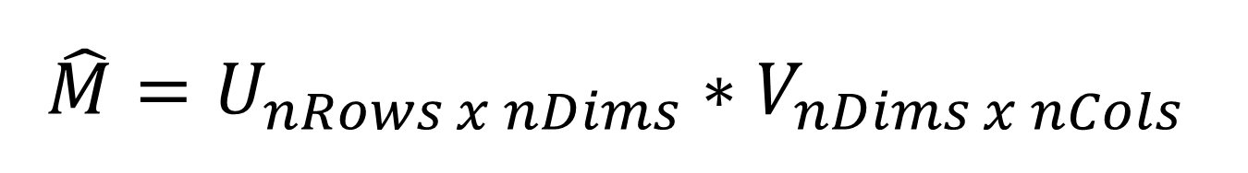
$$\hat{M}=U_{nRows x nDims}∗V_{nDims x nCols}$$
Gradient Descent
Gradient Ascent
L2, BPR
Step size = -0.0001;
LambdaU = +0.001
LambdaV = +0.001;
nDims = 5;
CLiMF
Step size = +0.0001;
LambdaU = -0.001
LambdaV = -0.001;
nDims = 5;

Slide 28
Results in Excel
Memory: SAG (original) vs. SAG-MF forgetful
# of iterations vs. time per iteration
Notes:
Scalability of SAG-MF?

Slide 29
Ongoing Work
RQ#3: Objective Functions
RQ#4: Datasets
(implemented, not evaluated)
Binary Data
WR-MF: Weighted Regularized Matrix Factorization (Hu et al.)
MNAR: Missing Not At Random
(available, not evaluated)
Binary Data
Datasets are full scale
Amazon-2008
.sk domain crawl 2005
Patent citations
Paper citations

Slide 30
Ongoing Work
Parallel SAG(-SML supervised machine learning): OpenMP, C/C++ (w. Scott Sallinen)
Does faster convergence give more accurate or high quality recommendations?
mixNmatchMF: allow data-scientists to quickly mix and match MF algorithms for quick iteration
SAG-MF+: use even less space for running MF on GPUs
Notes:
OpenMP ARM

Slide 31
Future Work: Numerical Data
RQ#3: Objective Functions
RQ#4: Datasets
(coming soon)
Numerical Data
GAPfm: Graded Avg Precision
CofiRank: SVM-like loss aka Max Margin MF
(coming soon)
Numerical Data
MovieLens
NetFlix (still have yet to parse it from .txt files)

Slide 32
Future Work: Other approaches to reduce memory
So far we’ve focused on using only algorithmic approaches to address the challenge with space complexity
Could there be other approaches?
Scientific computing: numerical optimization for sparse matrices e.g. CSPARSE API?
System: represent sparse matrices better in memory?

Slide 33
Related Work
SAG and Parallel SAG for Supervised ML
https://github.com/ScottSallinen/Gradient-Descent-Comparison
Parallel SAG: format is comparison & evaluation
SAG-MF: format is similar to SKIM
Alternating Least Squares
Orthogonal to gradient descent or ascent
Distributed or Parallel methods
Don’t deal with SAG, don’t deal with memory (no need)
Distributed Stochastic Gradient Descent Large Scale Matrix Factorization with Distributed Stochastic Gradient Descent http://www.almaden.ibm.com/cs/people/peterh/dsgdTechRep.pdf
Parallel Coordinate Descent Scalable Coordinate Descent Approaches to Parallel Matrix Factorization for Recommender Systems http://www.cs.utexas.edu/~cjhsieh/icdm-pmf.pdf

Slide 34
Contributions To the best of our knowledge, we are the first to
Adapt the Stochastic Average Gradient (SAG) method from Supervised Machine Learning into Matrix Factorization
Extend and specialize SAG into SAG-MF for Matrix Factorization (space complexity).
Extensively evaluated and compared SAG-MF across multiple objective functions and datasets
Demonstrated that SAG-MF can yield faster convergence in matrix factorization.

Slide 35
Does faster/better convergence give better recommendations?
So far we focused only on getting faster & better convergence thru SAG-MF
Intuition makes sense that faster/better convergence leads to better recommendations.
But… to what extend does faster or better convergence correlated with
higher productivity of data scientists, or
better recommendations?
Is there a sufficient, or “good-enough” bound
Approach: plug converged approx. into metrics, and compare: MRR, P@5, 1-call@5, etc.

Slide 36
SAG-MF+ What if N is big ~ nRows*nCols?

