Slide 1
State of the Art in MF 2 main types of iterative Descent/Ascent
Stochastic Gradient (SG)
Full Deterministic Gradient (FG)
Fast: O(1) samples per iteration
Bad quality: approximation flats out, gets stuck at a local sub-optimum
After many # of iterations, SG may progress to a slightly better approx… or may not
Good quality: guaranteed to yield a better approximation than stochastic after same # of iterations
Slow: O(N) samples in each iteration
What if we want both Good & Fast in MF?

Slide 2
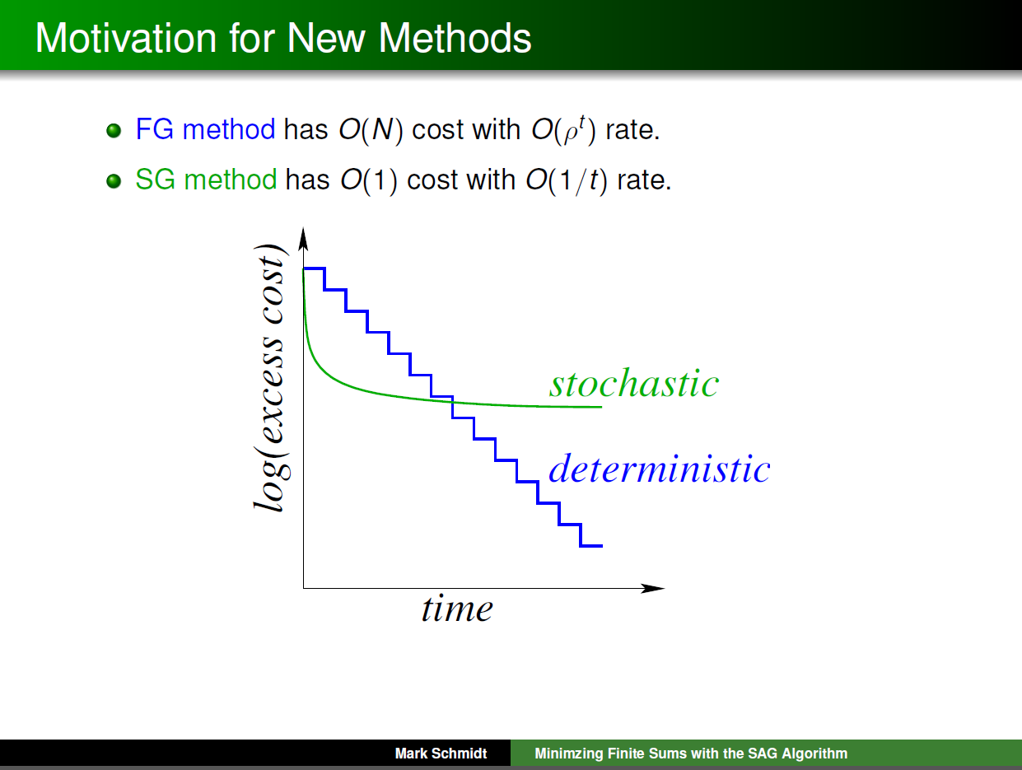

Slide 3
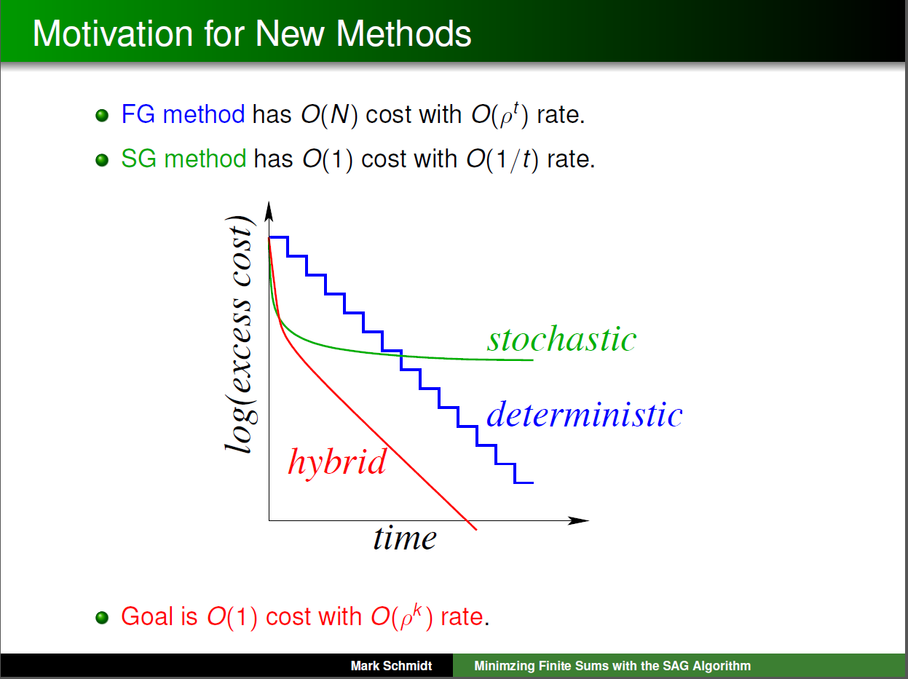
Notes:
Problem with Stochastic is that it flats out
Problem with Deterministic is that it takes O(N) samples in each iteration

Slide 4
Why Good Convergence in MF?
Optimization is min or max objective function
Better convergence: e.g. lower arg min
Better convergence can bring* → higher chance of higher accuracy → rec-sys: higher click-thru rate → higher profits $$$
*Assumption made by all rec-sys papers that utilize iterative optimization

Slide 5
Why Fast Convergence in MF?
Don’t rec-sys run offline?
Yes, But… “Speed is everything” Larry Page
As a data scientist,
Getting the right formula may not be trivial.
May require multiple trials of experimentation
Formula: objective function e.g. CLiMF, MNAR, etc.
Fine-tuning parameters: step size, regularization… etc.

Slide 6
Why Fast Convergence in MF?
Don’t rec-sys run offline?
Yes, But… “Speed is everything” Larry Page
As a data scientist,
Product life-cycles are shortening
Past: multi-month phases (e.g. Waterfall)
Now: 2 week sprints (e.g. Agile)
“Move Fast & break things” Mark Zuckerberg

Slide 7
Why Fast Convergence in MF?
Don’t rec-sys run offline?
Yes, But… “Speed is everything” Larry Page
As a data scientist,
Datasets are getting larger, more diverse
Growth of data outpaces increase of processor speed.
Larger datasets take longer to run, even for linear algorithm
Notes:
Datasets are updating

Slide 8
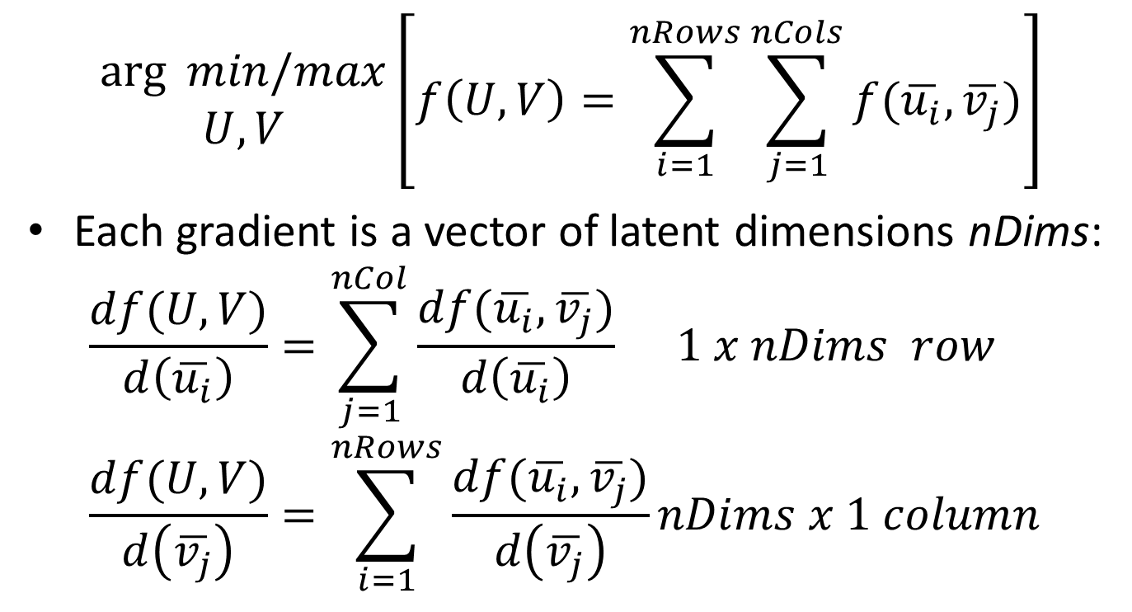
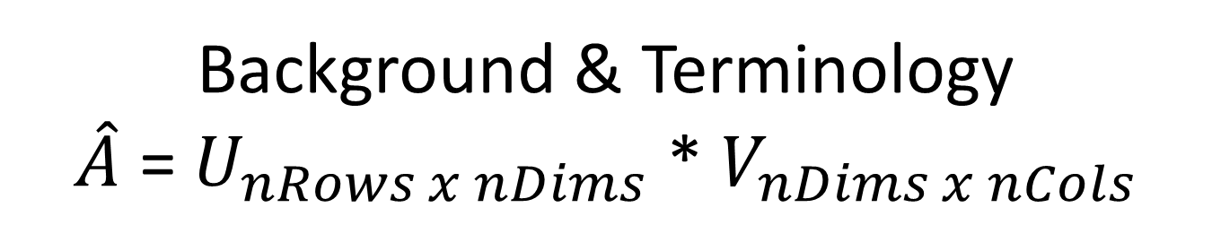
Background & Terminology $\hat{A}$ = $U_{nRows x nDims}$ * $V_{nDims x nCols}$
$$\begin{matrix}\arg{ min/max} \\ U,V\end{matrix}\left[f\left(U,V\right)=\sum_{i=1}^{nRows}{\sum_{j=1}^{nCols}{f(\overline{u_{i}},\overline{v_{j}})}}\right]$$
Each gradient is a vector of latent dimensions nDims:
$$\frac{df(U,V)}{d\left(\overline{u_{i}}\right)}=\sum_{j=1}^{nCol}{\frac{df(\overline{u_{i}},\overline{v_{j}})}{d\left(\overline{u_{i}}\right)}} 1 x nDims row$$
$$\frac{df(U,V)}{d\left(\overline{v_{j}}\right)}=\sum_{i=1}^{nRows}{\frac{df(\overline{u_{i}},\overline{v_{j}})}{d\left(\overline{v_{j}}\right)}}nDims x 1 column$$

Slide 9
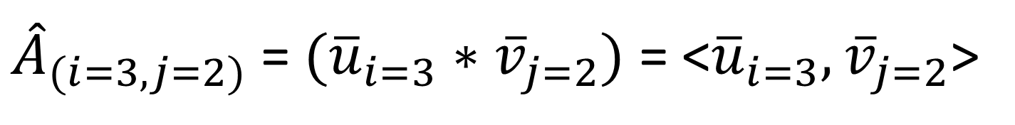
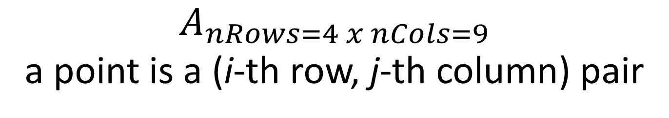
$A_{nRows=4 x nCols=9}$ a point is a (i-th row, j-th column) pair
M | 1 | 2 | 3 | 4 | 5 | 6 | 7 | 8 | 9
1
2
3 |  | (i=3, j=2) |  |  | 1 |  |  | 1
4
V | 1 | 2 | 3 | 4 | 5 | 6 | 7 | 8 | 9
1 |  | … |  |  | .. |  |  | ..
2 |  | … |  |  | .. |  |  | ..
U | 1 | 2
1
2
3 | … | …
4
${\hat{A}}_{(i=3, j=2)}$ = $({\overline{u}}_{i=3}∗{\overline{v}}_{j=2})$ = <${\overline{u}}_{i=3},{\overline{v}}_{j=2}$>

Slide 10
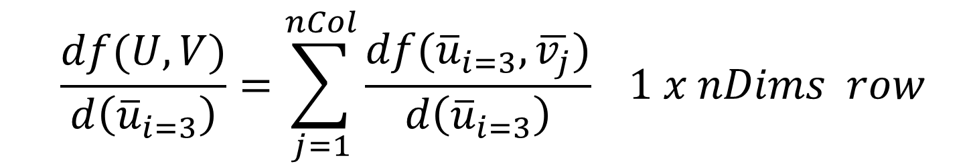
$A_{nRows=4 x nCols=9}$ a point is a (i-th row, j-th column) pair
M | 1 | 2 | 3 | 4 | 5 | 6 | 7 | 8 | 9
1
2
3 |  | (i=3, j=2) |  |  | 1 |  |  | 1
4
V | 1 | 2 | 3 | 4 | 5 | 6 | 7 | 8 | 9
1 |  | … |  |  | … |  |  | …
2 |  | … |  |  | … |  |  | …
U | 1 | 2
1
2
3 | … | …
4
$$\frac{df(U,V)}{d\left({\overline{u}}_{i=3}\right)}=\sum_{j=1}^{nCol}{\frac{df({\overline{u}}_{i=3},\overline{v_{j}})}{d\left({\overline{u}}_{i=3}\right)}} 1 x nDims row$$

Slide 11

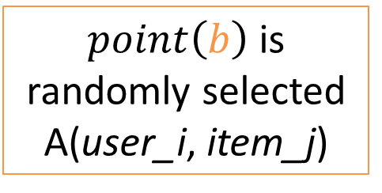
Gradient Descent/Ascent in MF
$$U^{t+1}=U^{t}+\frac{\text{α}}{B}\left(\sum_{b=1}^{B}{\frac{df({\overline{u}}_{pt\left(b\right).i}^{t},{\overline{v}}_{pt\left(b\right).j}^{t})}{d{\overline{u}}_{point\left(b\right).i}^{t}}}\right)$$
U^{t+1} = approximation at iteration t+1
α = step size
α > 0: ascent (max)
α < 0: descent (min)
$point\left(b\right)$is randomly selected A(user_i, item_j)

Slide 12


Gradient Descent/Ascent in MF
$$V^{t+1}=V^{t}+\frac{\text{α}}{B}\left(\sum_{b=1}^{B}{\frac{df({\overline{u}}_{pt\left(b\right).i}^{t},{\overline{v}}_{pt\left(b\right).j}^{t})}{d{\overline{v}}_{point\left(b\right).j}^{t}}}\right)$$
V^{t+1} = approximation at iteration t+1
α = step size
α > 0: ascent (max)
α < 0: descent (min)
$point(b)$is randomly selected A(user_i, item_j)

Slide 13
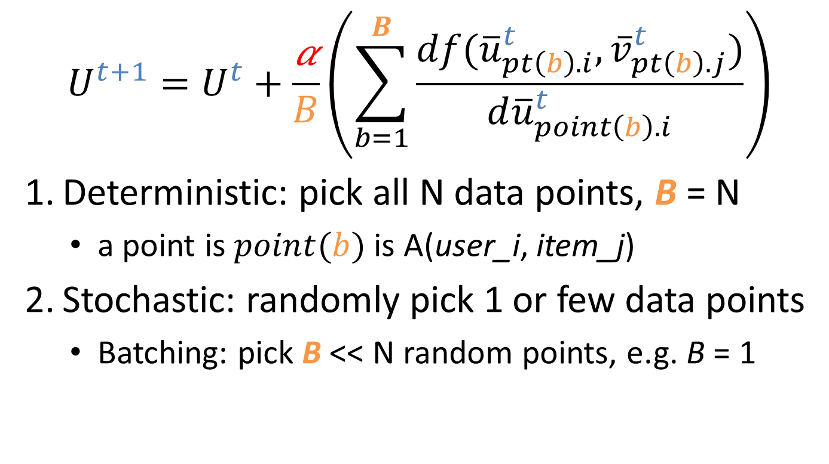
Types of Gradient Descent in MF
$$U^{t+1}=U^{t}+\frac{\text{α}}{B}\left(\sum_{b=1}^{B}{\frac{df({\overline{u}}_{pt\left(b\right).i}^{t},{\overline{v}}_{pt\left(b\right).j}^{t})}{d{\overline{u}}_{point\left(b\right).i}^{t}}}\right)$$
Deterministic: pick all N data points, B = N
a point is $point(b)$is A(user_i, item_j)
Stochastic: randomly pick 1 or few data points
Batching: pick B << N random points, e.g. B = 1

Slide 14
Insight
We are changing only 1 point at a time
In SG, we reset the whole gradient, lose gradient of all previous points
What if we keep the other points?

Slide 15
$A_{nRows=4 x nCols=9}$ a point is a (i-th row, j-th column) pair
M | 1 | 2 | 3 | 4 | 5 | 6 | 7 | 8 | 9
1
2
3 |  | (i=3, j=2) |  |  | 1 |  |  | 1
4
V | 1 | 2 | 3 | 4 | 5 | 6 | 7 | 8 | 9
1 |  | … |  |  | … |  |  | …
2 |  | … |  |  | … |  |  | …
U | 1 | 2
1
2
3 | … | …
4
$$\frac{df(U,V)}{d\left({\overline{u}}_{i=3}\right)}=\sum_{j=1}^{nCol}{\frac{df({\overline{u}}_{i=3},\overline{v_{j}})}{d\left({\overline{u}}_{i=3}\right)}} 1 x nDims row$$

Slide 16
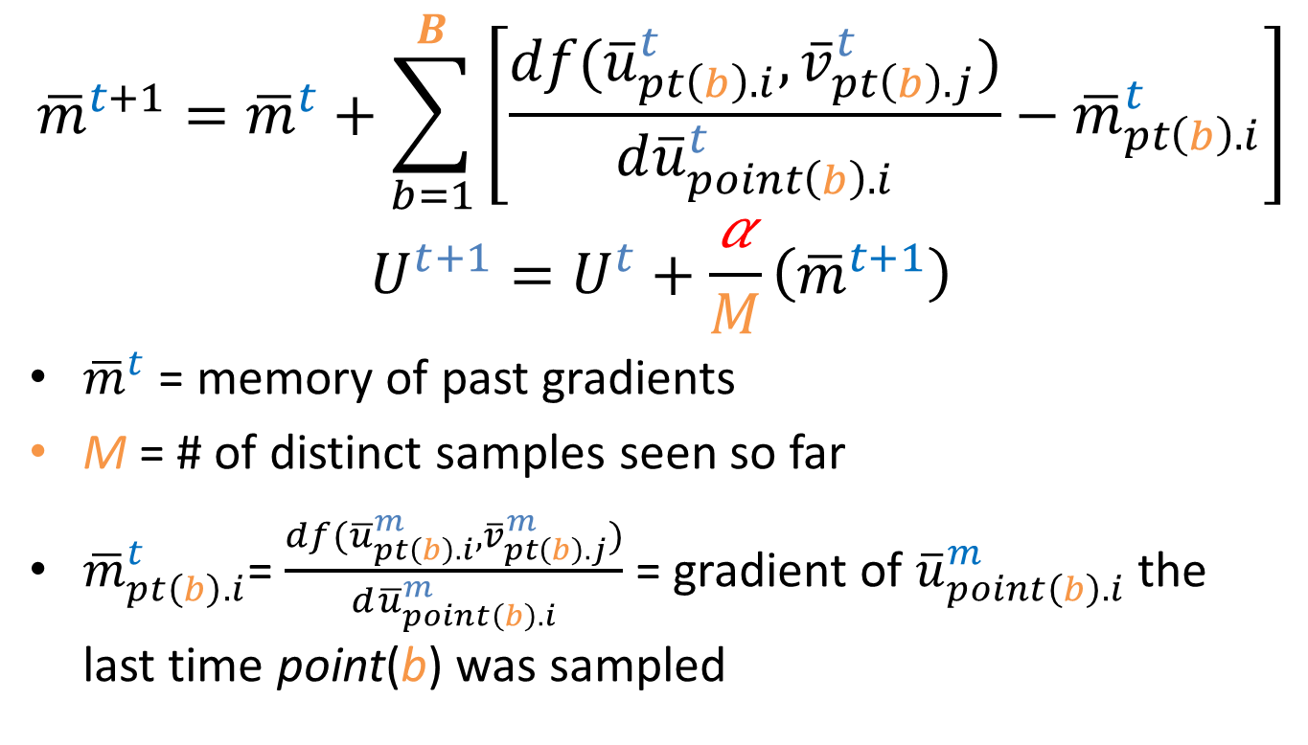
Idea: Memory Stochastic Gradient Take away the old, put in the new gradient
$${\overline{m}}^{t+1}={\overline{m}}^{t}+\sum_{b=1}^{B}{\left[\frac{df({\overline{u}}_{pt\left(b\right).i}^{t},{\overline{v}}_{pt\left(b\right).j}^{t})}{d{\overline{u}}_{point\left(b\right).i}^{t}}−{\overline{m}}_{pt\left(b\right).i}^{t}\right]}$$
$$U^{t+1}=U^{t}+\frac{\text{α}}{M}\left({\overline{m}}^{t+1}\right)$$
${\overline{m}}^{t}$ = memory of past gradients
M = # of distinct samples seen so far
${\overline{m}}_{pt\left(b\right).i}^{t}$= $\frac{df({\overline{u}}_{pt\left(b\right).i}^{m},{\overline{v}}_{pt\left(b\right).j}^{m})}{d{\overline{u}}_{point\left(b\right).i}^{m}}$ = gradient of ${\overline{u}}_{point\left(b\right).i}^{m}$ the last time point(b) was sampled

Slide 17
Extended from Stochastic Average Gradient (SAG) in Supervised Machine Learning
SAG: theory is sound: best of both worlds
Fast iteration: O(1) samples similar to Stochastic
Good convergence: better approx. than Stochastic, may equal to Deterministic after same # of iterations
SAG’s fast & good convergence is evaluated in supervised machine learning: logistic regression, SVM
We call our algorithm SAG-MF

Slide 18
SAG vs. SAG-MF
 | SAG | SAG-MF
Domain | Supervised Machine Learning | Matrix Factorization
1st itrn | Stochastic gradient (cold start) | Full gradient (warm start)
Re-computing | None required: see Challenges & Approach sections | Required: see Challenges & Approach sections
Accuracy | Similar to or slightly better than SG in Matrix Factorization | Much better than SG in Matrix Factorization

Slide 19
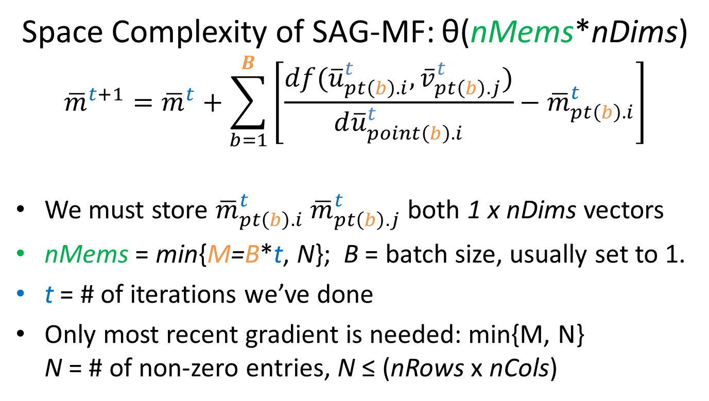
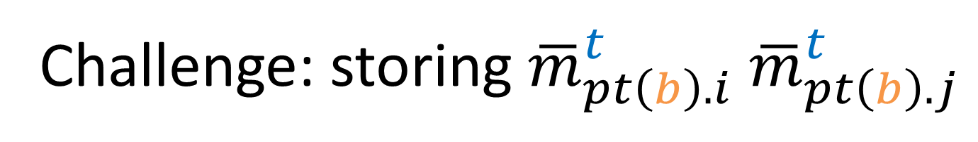
Challenge: storing ${\overline{m}}_{pt\left(b\right).i}^{t}$ ${\overline{m}}_{pt\left(b\right).j}^{t}$
Space Complexity of SAG-MF: θ(nMems*nDims)
$${\overline{m}}^{t+1}={\overline{m}}^{t}+\sum_{b=1}^{B}{\left[\frac{df({\overline{u}}_{pt\left(b\right).i}^{t},{\overline{v}}_{pt\left(b\right).j}^{t})}{d{\overline{u}}_{point\left(b\right).i}^{t}}−{\overline{m}}_{pt\left(b\right).i}^{t}\right]}$$
We must store ${\overline{m}}_{pt\left(b\right).i}^{t}$ ${\overline{m}}_{pt\left(b\right).j}^{t}$ both 1 x nDims vectors
nMems = min{M=B*t, N}; B = batch size, usually set to 1.
t = # of iterations we’ve done
Only most recent gradient is needed: min{M, N} N = # of non-zero entries, N ≤ (nRows x nCols)

Slide 20
Why Space Complexity matters?
Does space complexity not matter anymore?
Many OS’s support 100+ GBs of RAM
Large scale SSD is cheaper
Distributed memory: Memcache
Ultra-fast fibre optic Intranet…

Slide 21
Why Space Complexity matters?
Space vs. time trade-off still applies to scale performance on analyzing Big Data
CPU/GPU: cache is still limited, page faults
RAM/memcache: it still takes time to transfer data from memory into processor
GPU: many cores share the same cache

Slide 22
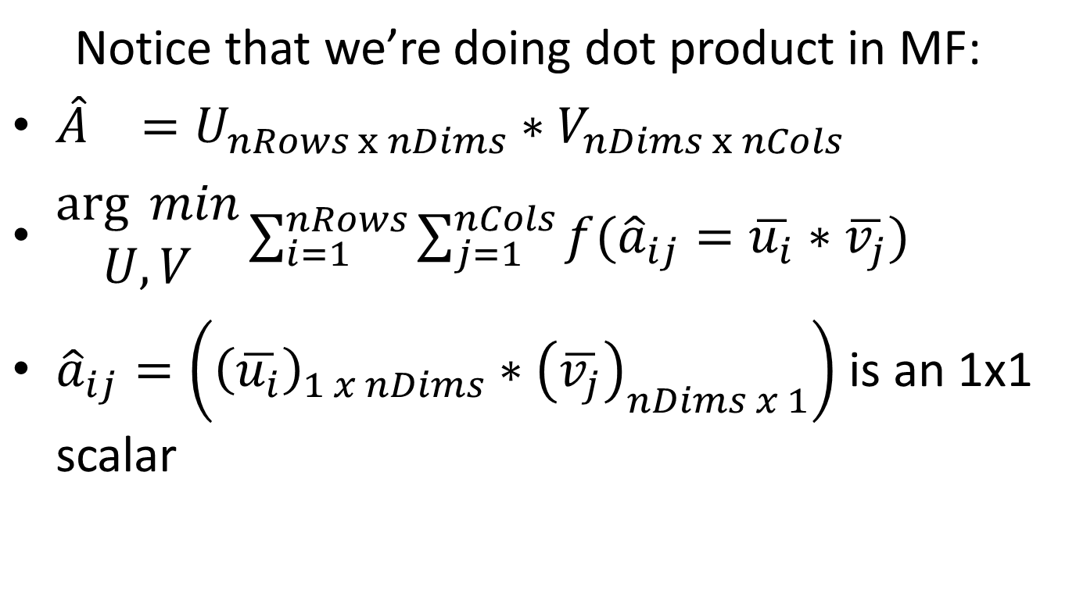
Space Complexity of SAG-MF Attempt #1: borrow a trick from SAG
Notice that we’re doing dot product in MF:
${\hat{A}}_{}=U_{nRows x nDims}∗V_{nDims x nCols}$
$\begin{matrix}\arg{ min} \\ U,V\end{matrix}\sum_{i=1}^{nRows}{\sum_{j=1}^{nCols}{f({\hat{a}}_{ij}=\overline{u_{i}}∗\overline{v_{j}})}}$
${\hat{a}}_{ij}=\left({\left(\overline{u_{i}}\right)}_{1 x nDims}∗{\left(\overline{v_{j}}\right)}_{nDims x 1}\right)$ is an 1x1 scalar

Slide 23
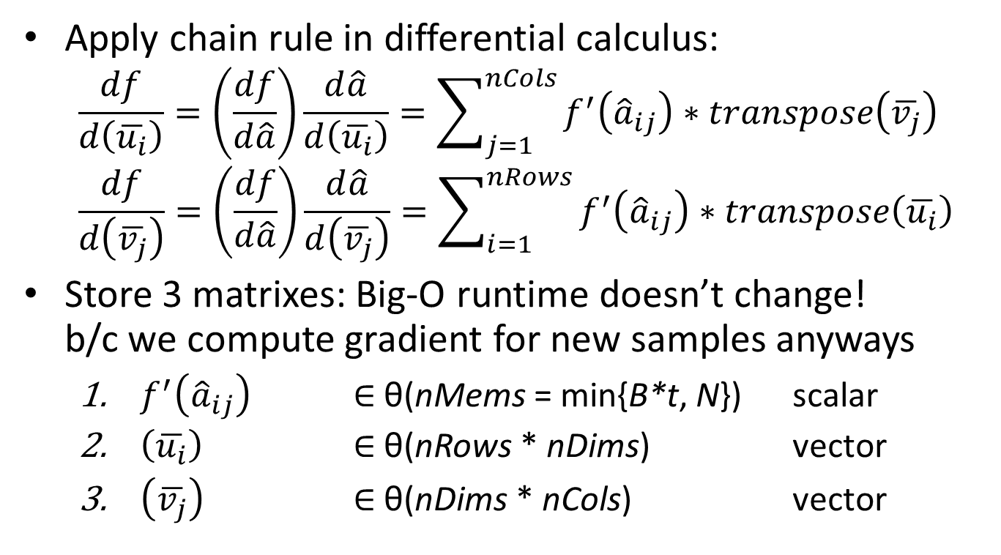
Space Complexity of SAG-MF θ(nMems + (nRows+nCols)*nDims)?
Apply chain rule in differential calculus:
$$\frac{df}{d\left(\overline{u_{i}}\right)}=\left(\frac{df}{d\hat{a}}\right)\frac{d\hat{a}}{d\left(\overline{u_{i}}\right)}=\sum_{j=1}^{nCols}{f^{′}\left({\hat{a}}_{ij}\right)∗transpose\left(\overline{v_{j}}\right)}$$
$$\frac{df}{d\left(\overline{v_{j}}\right)}=\left(\frac{df}{d\hat{a}}\right)\frac{d\hat{a}}{d\left(\overline{v_{j}}\right)}=\sum_{i=1}^{nRows}{f^{′}\left({\hat{a}}_{ij}\right)∗transpose\left(\overline{u_{i}}\right)}$$
Store 3 matrixes: Big-O runtime doesn’t change! b/c we compute gradient for new samples anyways
$f^{′}\left({\hat{a}}_{ij}\right)$ $∈$ θ(nMems = min{B*t, N}) scalar
$\left(\overline{u_{i}}\right)$ $∈$ θ(nRows * nDims) vector
$\left(\overline{v_{j}}\right)$ $∈$ θ(nDims * nCols) vector

Slide 24
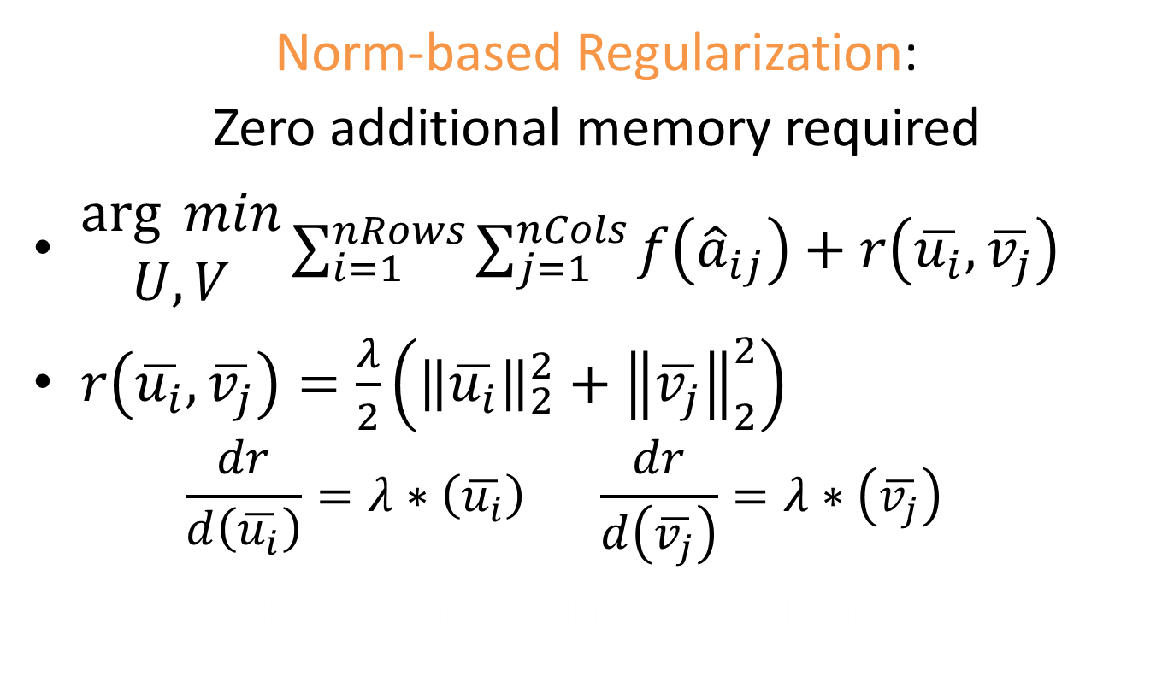
Space Complexity of SAG-MF θ(nMems + (nRows+nCols)*nDims)?
Norm-based Regularization:
Zero additional memory required
$\begin{matrix}\arg{ min} \\ U,V\end{matrix}\sum_{i=1}^{nRows}{\sum_{j=1}^{nCols}{f\left({\hat{a}}_{ij}\right)+r\left(\overline{u_{i}},\overline{v_{j}}\right)}}$
$r\left(\overline{u_{i}},\overline{v_{j}}\right)=\frac{λ}{2}\left({\left\|\overline{u_{i}}\right\|}_{2}^{2}+{\left\|\overline{v_{j}}\right\|}_{2}^{2}\right)$
$$\frac{dr}{d\left(\overline{u_{i}}\right)}=λ∗\left(\overline{u_{i}}\right) \frac{dr}{d\left(\overline{v_{j}}\right)}=λ∗\left(\overline{v_{j}}\right)$$
may store $λ(t)$ if λ varies depending on t

Slide 25
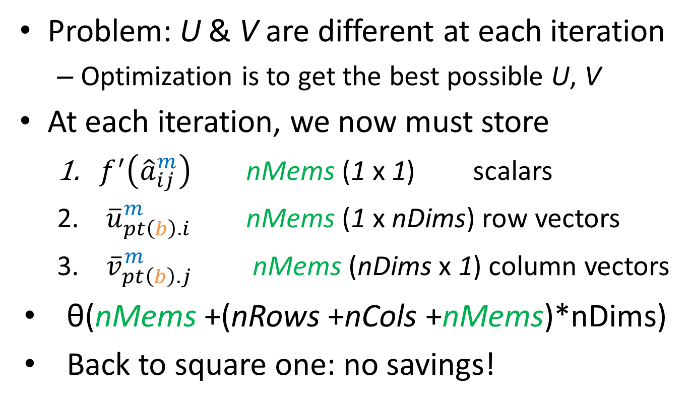
Wait a minute … is that it?
Problem: U & V are different at each iteration
Optimization is to get the best possible U, V
At each iteration, we now must store
$f^{′}\left({\hat{a}}_{ij}^{m}\right)$ nMems (1 x 1) scalars
${\overline{u}}_{pt\left(b\right).i}^{m}$ nMems (1 x nDims) row vectors
${\overline{v}}_{pt\left(b\right).j}^{m}$ nMems (nDims x 1) column vectors
θ(nMems +(nRows +nCols +nMems)*nDims)
Back to square one: no savings!

Slide 26
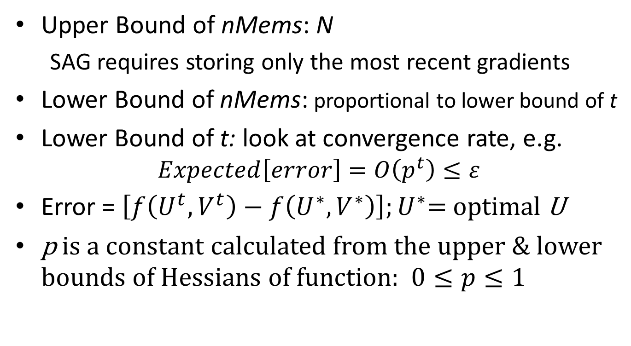
Attempt #2: nMems = min{M=B*t, N} Can we say nMems is much less than N?
Upper Bound of nMems: N
SAG requires storing only the most recent gradients
Lower Bound of nMems: proportional to lower bound of t
Lower Bound of t: look at convergence rate, e.g. $Expected\left[error\right]=O\left(p^{t}\right)≤ε$
Error = $\left[f\left(U^{t},V^{t}\right)−f\left(U^{∗},V^{∗}\right)\right];U^{∗}$= optimal U
p is a constant calculated from the upper & lower bounds of Hessians of function: $0≤p≤1$

Slide 27
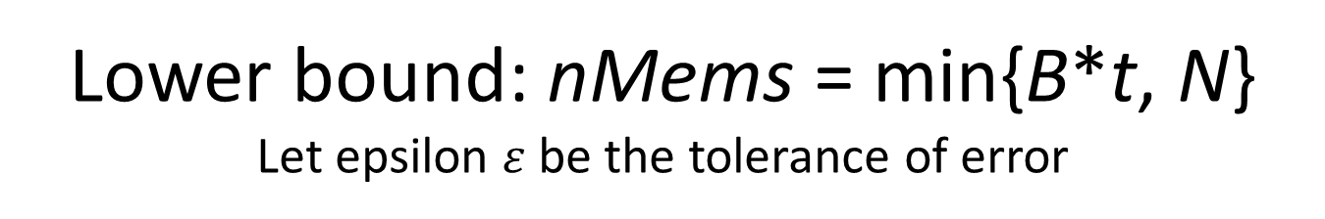
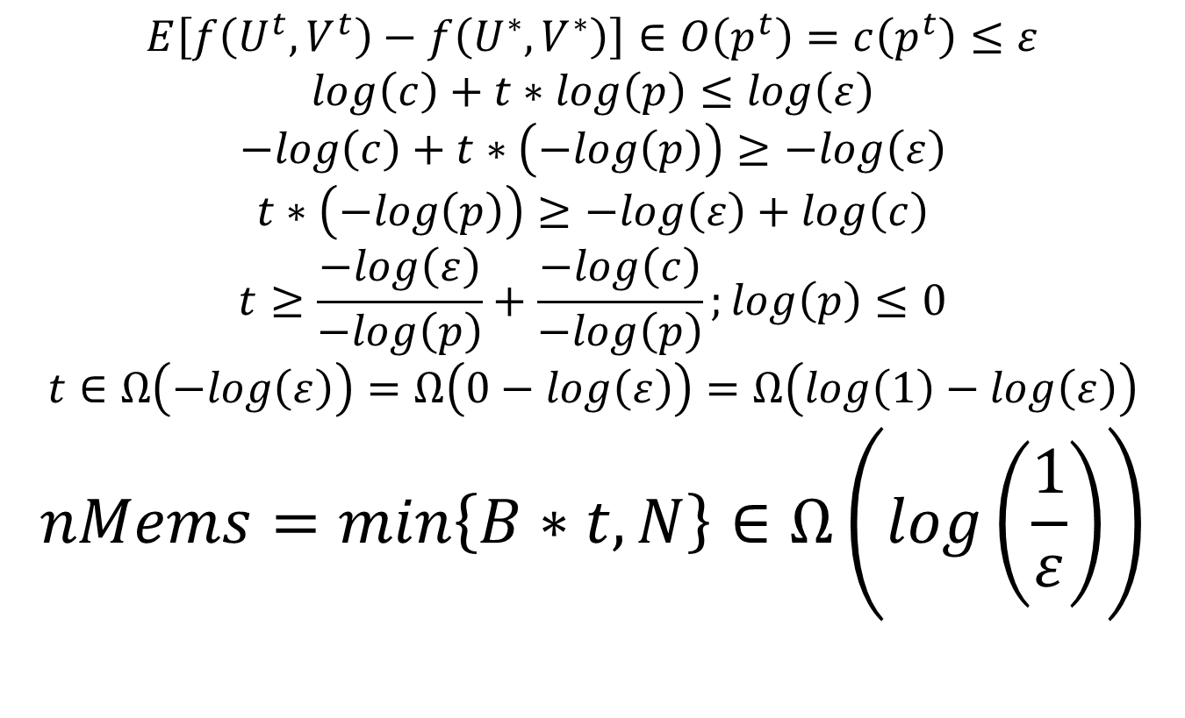
Lower bound: nMems = min{B*t, N} Let epsilon $ε$be the tolerance of error
$$E\left[f\left(U^{t},V^{t}\right)−f\left(U^{∗},V^{∗}\right)\right]∈O\left(p^{t}\right)=c\left(p^{t}\right)≤ε$$
$$log\left(c\right)+t∗log\left(p\right)≤log\left(ε\right)$$
$$−log\left(c\right)+t∗\left(−log\left(p\right)\right)≥−log\left(ε\right)$$
$$t∗\left(−log\left(p\right)\right)≥−log\left(ε\right)+log\left(c\right)$$
$$t≥\frac{−log\left(ε\right)}{−log\left(p\right)}+\frac{−log\left(c\right)}{−log\left(p\right)};log\left(p\right)≤0$$
$$t∈Ω\left(−log\left(ε\right)\right)=Ω\left(0−log\left(ε\right)\right)=Ω\left(log\left(1\right)−log\left(ε\right)\right)$$
$$nMems=min\left\{B∗t,N\right\}∈Ω\left(log\left(\frac{1}{ε}\right)\right)$$

Slide 28
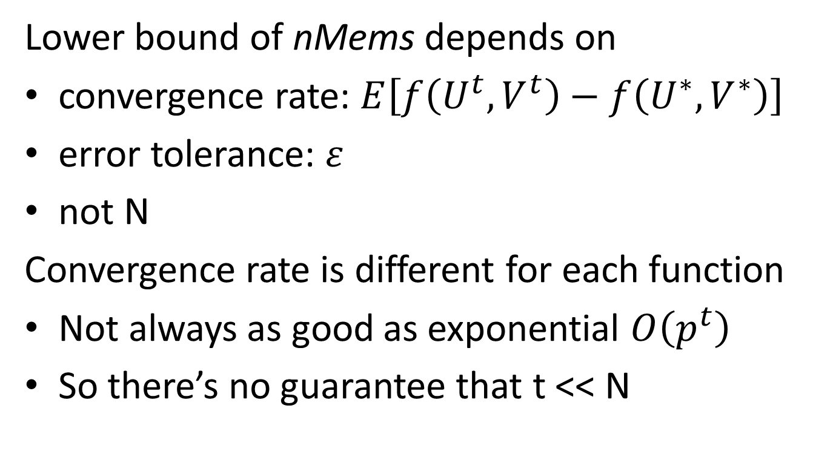
nMems = min{B*t, N}
Lower bound of nMems depends on
convergence rate: $E\left[f\left(U^{t},V^{t}\right)−f\left(U^{∗},V^{∗}\right)\right]$
error tolerance: $ε$
not N
Convergence rate is different for each function
Not always as good as exponential $O\left(p^{t}\right)$
So there’s no guarantee that t << N

Slide 29
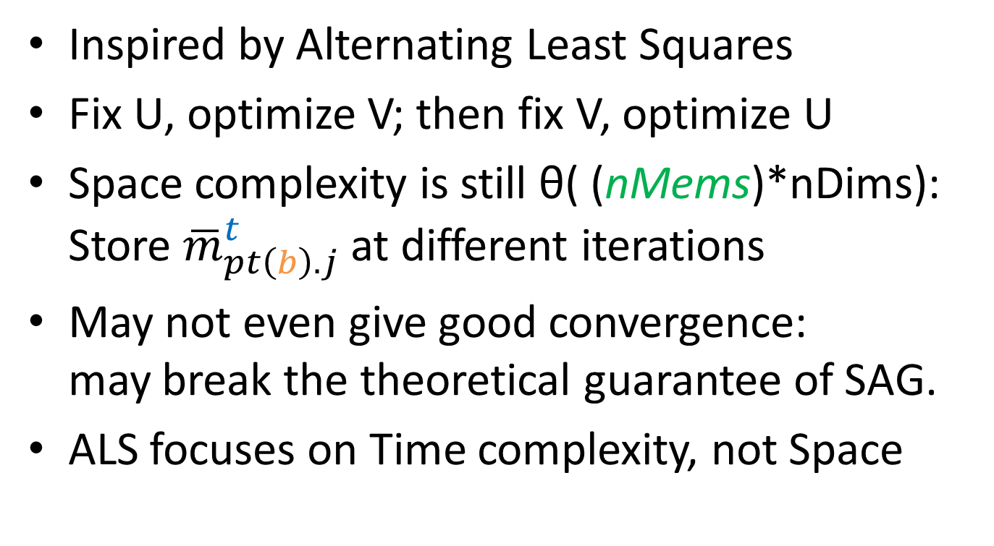
Attempt #3: Alternating SAG
Inspired by Alternating Least Squares
Fix U, optimize V; then fix V, optimize U
Space complexity is still θ( (nMems)*nDims): Store ${\overline{m}}_{pt\left(b\right).j}^{t}$ at different iterations
May not even give good convergence: may break the theoretical guarantee of SAG.
ALS focuses on Time complexity, not Space

Slide 30
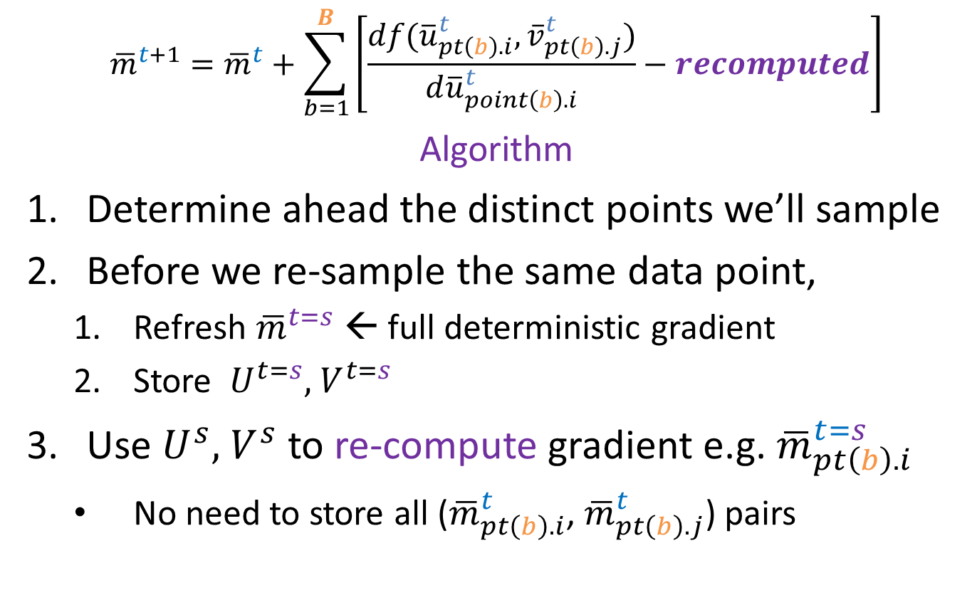
Approach: Re-compute memory θ(nMems + (nRows +nCols)*nDims)
$${\overline{m}}^{t+1}={\overline{m}}^{t}+\sum_{b=1}^{B}{\left[\frac{df({\overline{u}}_{pt\left(b\right).i}^{t},{\overline{v}}_{pt\left(b\right).j}^{t})}{d{\overline{u}}_{point\left(b\right).i}^{t}}−recomputed\right]}$$
Algorithm
Determine ahead the distinct points we’ll sample
Before we re-sample the same data point,
Refresh ${\overline{m}}^{t=s}$ ← full deterministic gradient
Store ${ U}^{t=s},{ V}^{t=s}$
Use $U^{s},{ V}^{s}$ to re-compute gradient e.g. ${\overline{m}}_{pt\left(b\right).i}^{t=s}$
No need to store all (${\overline{m}}_{pt\left(b\right).i}^{t}$, ${\overline{m}}_{pt\left(b\right).j}^{t}$) pairs

Slide 31
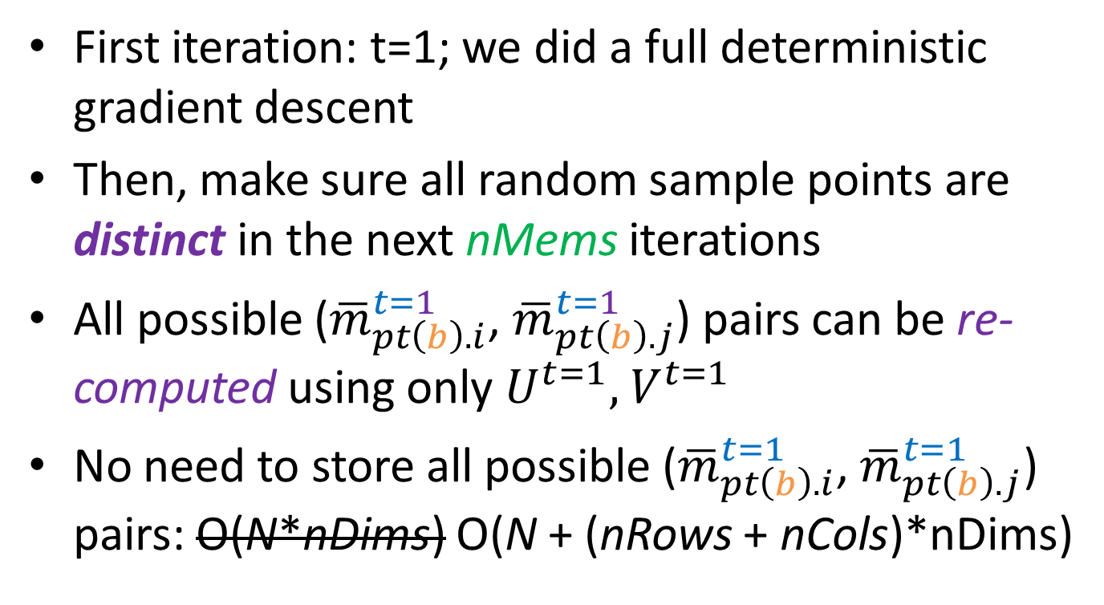
Re-computing: example
First iteration: t=1; we did a full deterministic gradient descent
Then, make sure all random sample points are distinct in the next nMems iterations
All possible (${\overline{m}}_{pt\left(b\right).i}^{t=1}$, ${\overline{m}}_{pt\left(b\right).j}^{t=1}$) pairs can be re-computed using only $U^{t=1},{ V}^{t=1}$
No need to store all possible (${\overline{m}}_{pt\left(b\right).i}^{t=1}$, ${\overline{m}}_{pt\left(b\right).j}^{t=1}$) pairs: O(N*nDims) O(N + (nRows + nCols)*nDims)

Slide 32

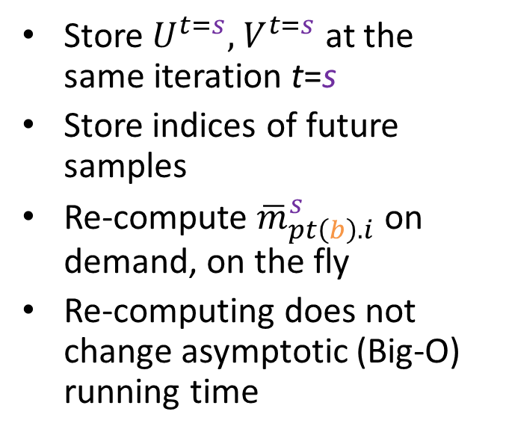
Space: Generic vs. Re-computed
SAG generic
O(N*nDims)
SAG-MF
O(N + (nRows + nCols)*nDims)
Store all (${\overline{m}}_{pt\left(b\right).i}^{t}$, ${\overline{m}}_{pt\left(b\right).j}^{t}$) pairs at different iterations
Store $U^{t=s},{ V}^{t=s}$ at the same iteration t=s
Store indices of future samples
Re-compute ${\overline{m}}_{pt\left(b\right).i}^{s}$ on demand, on the fly
Re-computing does not change asymptotic (Big-O) running time

Slide 33
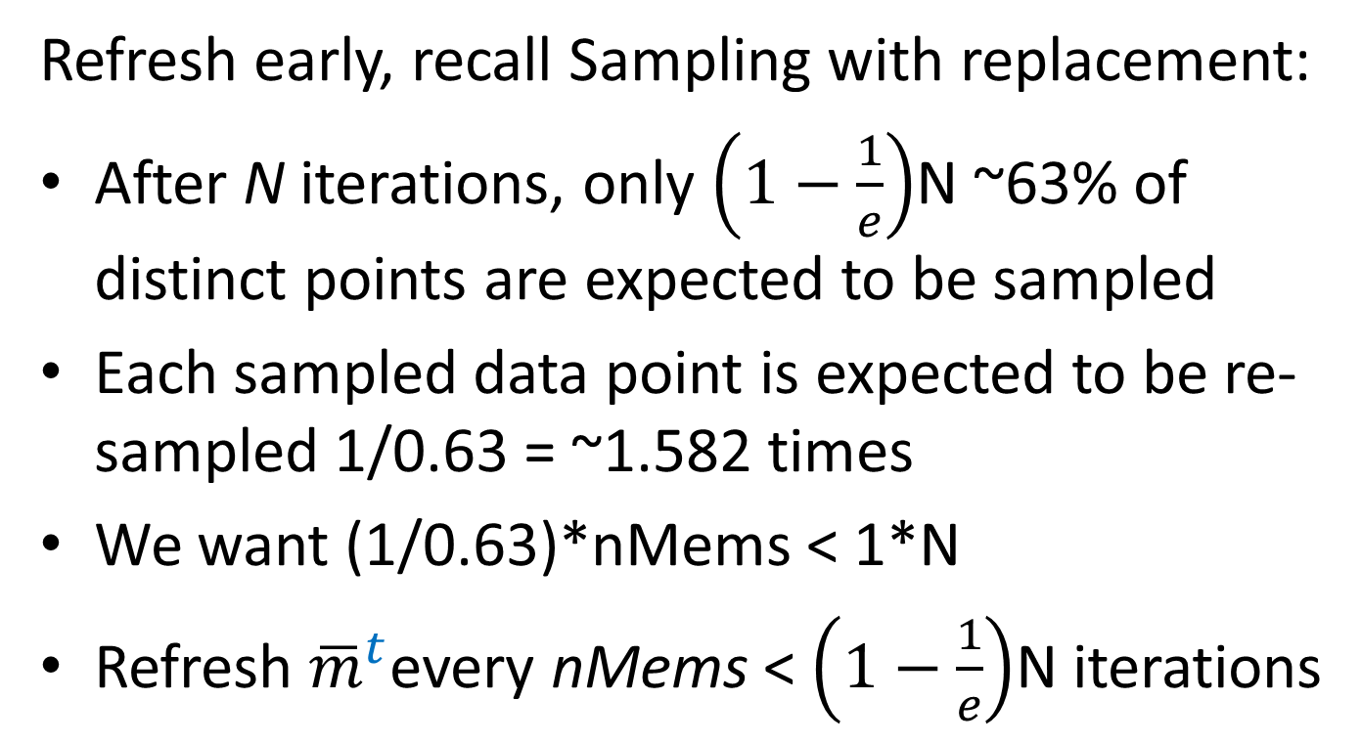
Heuristic: to not store θ(nMems) indices, θ( (nRows + nCols)*nDims )
Refresh early, recall Sampling with replacement:
After N iterations, only $\left(1−\frac{1}{e}\right)$N ~63% of distinct points are expected to be sampled
Each sampled data point is expected to be re-sampled 1/0.63 = ~1.582 times
We want (1/0.63)*nMems < 1*N
Refresh ${\overline{m}}^{t}$every nMems < $\left(1−\frac{1}{e}\right)$N iterations

Slide 34
To enable Fine-Tuning: SAG-MF buffered What if we don’t want to re-compute everything?
Pre-compute nBufs random data points (i, j)’s that we are going to visit in the next nBufs iterations
After first iteration, store the gradients dUi, dVj of these random data points
Use nBufs to tune nMems = max{nBufs, min{B*t, N}}
O((nRows + nCols + nMems)*nDims)
nBufs → 0: original SAG-MF
nBufs → N: generic SAG
Allocate buffer size nBufs = min{nAvail, E[t]} based on
E[t] = Expected # of iterations, based on ε
nAvail = Availability of memory

Slide 35
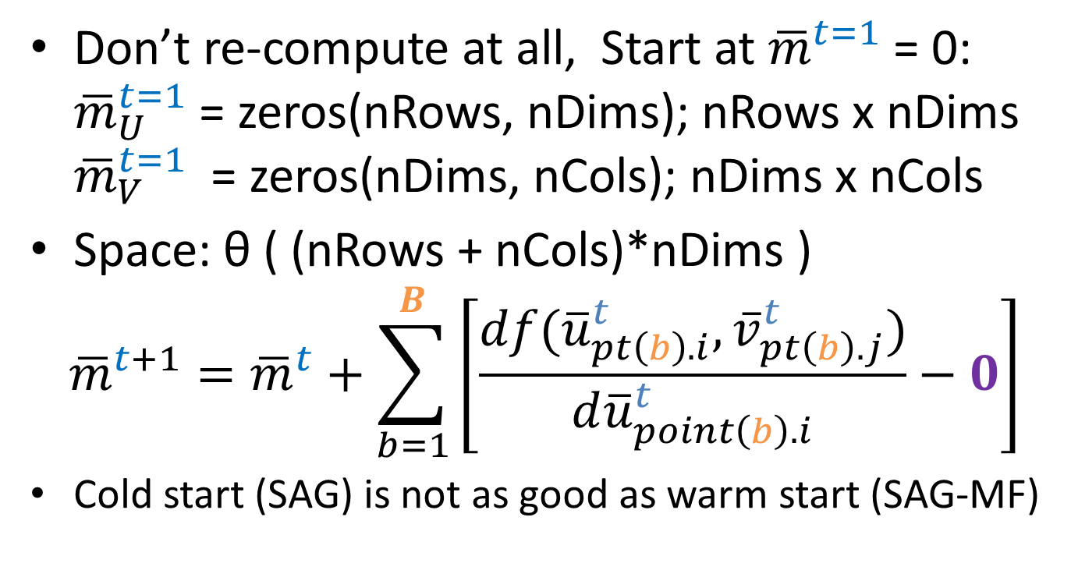
If Expected[t] << N Identical to SAG: cold start, zero re-computation
Don’t re-compute at all, Start at ${\overline{m}}^{t=1}$ = 0: ${\overline{m}}_{U}^{t=1}$ = zeros(nRows, nDims); nRows x nDims ${\overline{m}}_{V}^{t=1}$ = zeros(nDims, nCols); nDims x nCols
Space: θ ( (nRows + nCols)*nDims )
$${\overline{m}}^{t+1}={\overline{m}}^{t}+\sum_{b=1}^{B}{\left[\frac{df({\overline{u}}_{pt\left(b\right).i}^{t},{\overline{v}}_{pt\left(b\right).j}^{t})}{d{\overline{u}}_{point\left(b\right).i}^{t}}−0\right]}$$
Cold start (SAG) is not as good as warm start (SAG-MF)

Slide 36

Summary: Time & Space Complexity
$\hat{A}$ = $U_{nRows x nDims}$ * $V_{nDims x nCols}$
A ϵ O(N) U ϵ O(nRows*nDims)
V ϵ O(nDims*nCols)
Type of Gradient Descent/Ascent | # of samples per Iteration | Total Space Complexity in Memory
Deterministic | O(N) | O(N + (nRows + nCols)*nDims)
Stochastic | O(1)
A ϵ O(N)
U ϵ O(nRows*nDims)
V ϵ O(nDims*nCols)

Slide 37

Summary: Time & Space Complexity
$\hat{A}$ = $U_{nRows x nDims}$ * $V_{nDims x nCols}$
A ϵ O(N) U ϵ O(nRows*nDims)
V ϵ O(nDims*nCols)
Type of Gradient Descent/Ascent | # of samples per Iteration | Total Space Complexity in Memory
Deterministic | O(N) | O(N + (nRows + nCols)*nDims)
Stochastic | O(1)
SAG generic |  | O(N + (N + 2*(nRows+nCols))*nDims)
SAG-MF | O(2) | O(2*N + 3*(nRows + nCols)*nDims)
SAG t << N | O(1) | O(1*N + 2*(nRows + nCols)*nDims)
Index of future samples
$${\overline{m}}_{U}^{t},{\overline{m}}_{V}^{t}; U^{t=s},{ V}^{t=s}$$

Slide 38
Implementation: Why MatLab?
Almost a standard tool for rapid prototyping
Standard PL for ML at many schools UBC, Stanford
System model (code) closely matches mental model (developer).
Matrix multiplication Matlab: A = U*V;
C/C++/Java has additional mental overhead: memory allocation, variable type, correct function name, order of inputs…
Vectorized computing; parallel CPU, GPU (CUDA)
Matrix operations run in parallel by default when HW is available

Slide 39
Evaluation: Research Questions
Compared to Deterministic and Stochastic gradient,
Can SAG-MF converge quickly in Matrix Factorization?
Can SAG-MF give better approx. after convergence?
Can SAG-MF work with different objective functions?
Does SAG-MF work with different datasets?
Compared to SAG generic or Stochastic gradient,
How much slower is SAG-MF due to re-computing?
How much memory does SAG-MF ahead really save?
Is it worth it to re-compute?
Notes:
Have to report some memory usage

Slide 40
Evaluation
RQ#3: Objective Functions
RQ#4: Datasets
Binary Data
L2: sparse least squares
CLiMF: ordinal logistic
BPR-MF: minimize difference between any 2 predictions of same user
Binary Data: Implicit feedback
Epinions
Digg
IMDB
Live Journal
Wikipedia
Notes:
Justify why these objective functions are chosen.

Slide 41
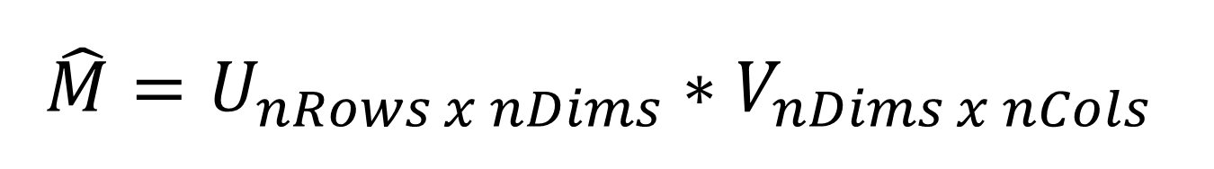
$$\hat{M}=U_{nRows x nDims}∗V_{nDims x nCols}$$
Gradient Descent
Gradient Ascent
L2, BPR
Step size = -0.0001;
LambdaU = +0.001
LambdaV = +0.001;
nDims = 5;
Deterministic: 500 iterations
Stochastic, SAG: 5000 itrns
CLiMF
Step size = +0.0001;
LambdaU = -0.001
LambdaV = -0.001;
nDims = 5;
Deterministic: 500 iterations
Stochastic, SAG: 5000 itrns

Slide 42
Results in Spreadsheet
Took subset of datasets b/c doing lots of iterations on Full Deterministic takes long
Datasets converged t << N with Stochastic
Fix seed for random number generator
Approx. vs. # of iterations vs. time/iteration
Memory: SAG generic vs. SAG-MF
Notes:
Scalability of SAG-MF?

Slide 43
Observations
Full Deterministic
Stochastic & SAG-MF
Every incremental iteration yields a better approximation than previous iteration.
Takes ~1,000-10,000X longer to run an iteration than stochastic or SAG: corresponds to number of non-zero entries
Both converged at almost the same iteration (< 5000)
SAG always yielded much better approx. than both SG@5000 and FG@500
SG@5000 yielded similar or slightly better approx. than FG@500
Both SG and SAG are faster and better than FG

Slide 44
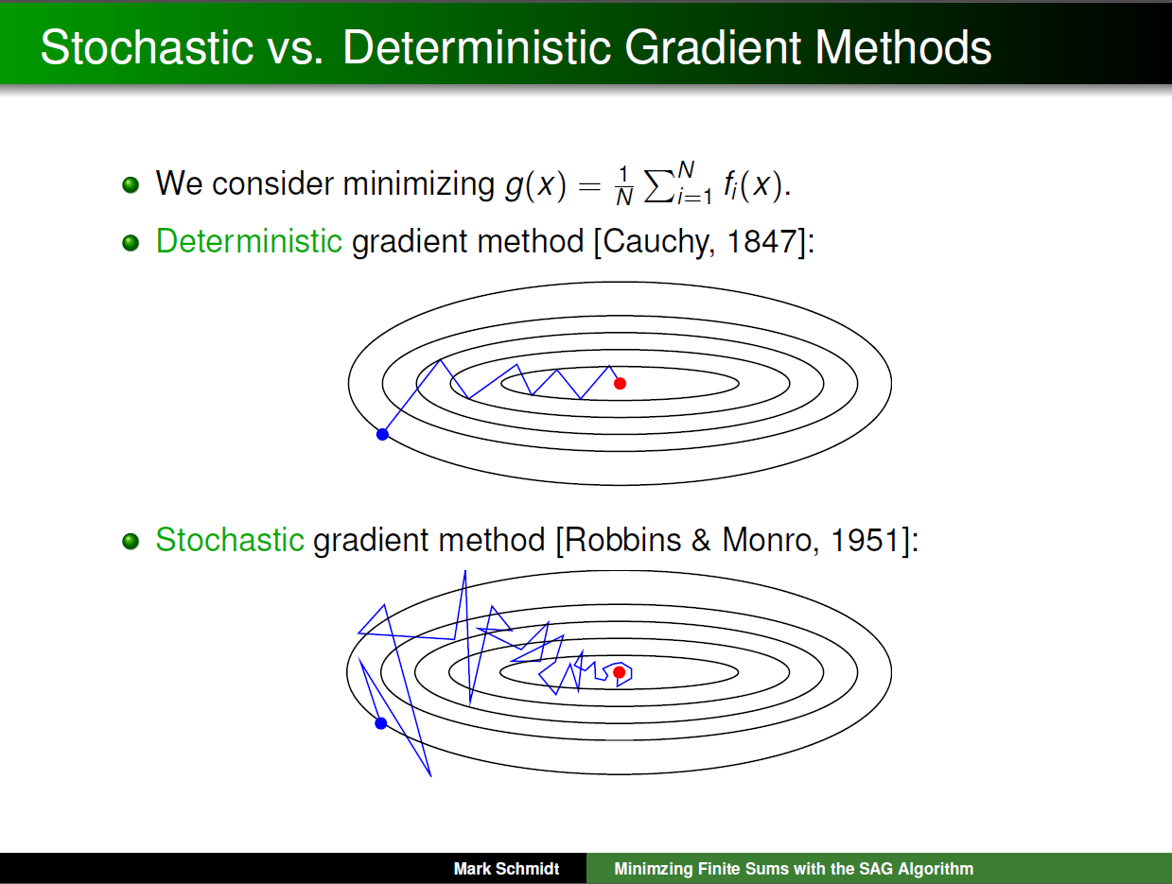
Notes:
Observed: every iteration yields a better approximation than previous iteration

Slide 45
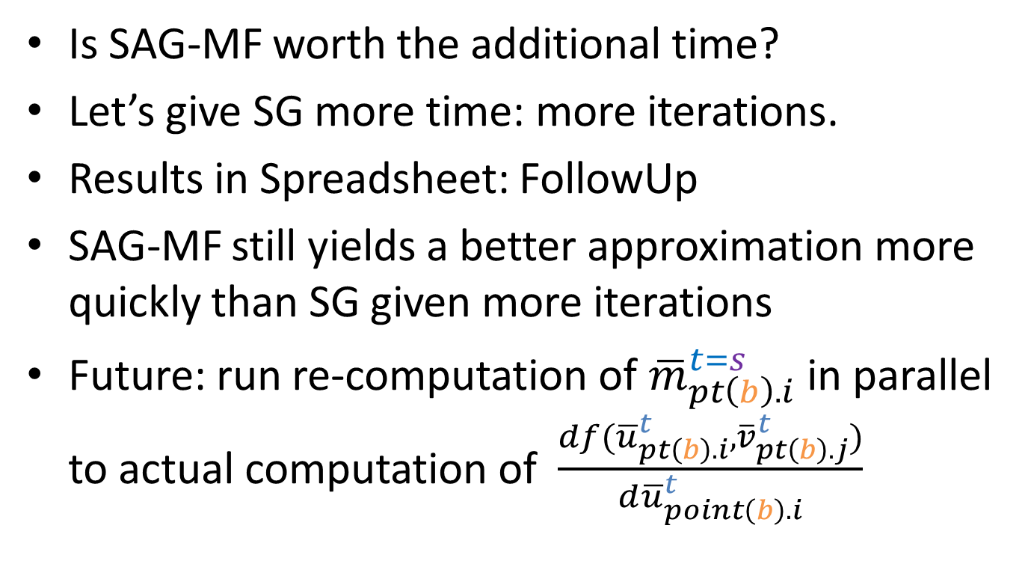
Each iteration of SAG-MF is up to 3 times slower than SG (& theoretically generic SAG)
Is SAG-MF worth the additional time?
Let’s give SG more time: more iterations.
Results in Spreadsheet: FollowUp
SAG-MF still yields a better approximation more quickly than SG given more iterations
Future: run re-computation of ${\overline{m}}_{pt\left(b\right).i}^{t=s}$ in parallel to actual computation of $\frac{df({\overline{u}}_{pt\left(b\right).i}^{t},{\overline{v}}_{pt\left(b\right).j}^{t})}{d{\overline{u}}_{point\left(b\right).i}^{t}}$

Slide 46
Discussion: Memory
In MatLab, when dynamically updating sparse matrices
memory usage depends more on dimensionality of the sparse matrix
rather than the actual # of non-zero entries
Notes:
When we are doing dynamic updates in Matlab, memory usage seems to depend more on the dimensionality of the sparse matrix rather than the actual number of non-zero entries.
SAG-MF ahead provides dimensionality reduction. It is guaranteed to store only scalars and decouples SAG’s dependence on the actual implementation of sparse matrices in underlying programming language.

Slide 47
Discussion: Memory
SAG-MF stores only scalars
Provide dimensionality reduction
Decouple SAG’s dependence on the actual implementation of sparse matrices in the underlying programming language or execution environment
Data Scientists do not need to spend time to find an efficient sparse matrix implementation and integrate it into their code just to use SAG.
SAG-MF ahead stores 1*nMems integers, no update
SAG generic stores 2*nMems*nDims floating points
Notes:
When we are doing dynamic updates in Matlab, memory usage seems to depend more on the dimensionality of the sparse matrix rather than the actual number of non-zero entries.
SAG-MF ahead provides dimensionality reduction. It is guaranteed to store only scalars and decouples SAG’s dependence on the actual implementation of sparse matrices in underlying programming language.

Slide 48
Ongoing Work
RQ#3: Objective Functions
RQ#4: Datasets
(implemented, not evaluated)
Binary Data
WR-MF: Weighted Regularized Matrix Factorization (Hu et al.)
MNAR: Missing Not At Random
(available, not evaluated)
Binary Data
Datasets at full scale, also:
Amazon-2008
.sk domain crawl 2005
Patent citations
Paper citations

Slide 49
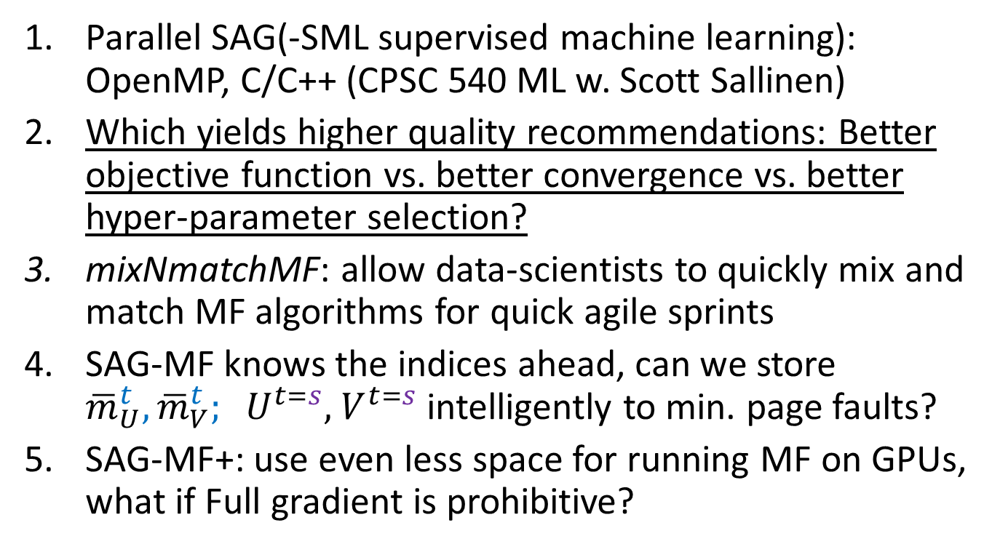
Ongoing Work
Parallel SAG(-SML supervised machine learning): OpenMP, C/C++ (CPSC 540 ML w. Scott Sallinen)
Which yields higher quality recommendations: Better objective function vs. better convergence vs. better hyper-parameter selection?
mixNmatchMF: allow data-scientists to quickly mix and match MF algorithms for quick agile sprints
SAG-MF knows the indices ahead, can we store ${\overline{m}}_{U}^{t},{\overline{m}}_{V}^{t}; U^{t=s},{ V}^{t=s}$ intelligently to min. page faults?
SAG-MF+: use even less space for running MF on GPUs, what if Full gradient is prohibitive?
Notes:
OpenMP ARM

Slide 50
Future Work: Numerical Data
RQ#3: Objective Functions
RQ#4: Datasets
Numerical Data
(coming soon)
GAPfm: Graded Avg Precision
CofiRank: SVM-like loss aka Max Margin MF
Numerical Data
(coming soon)
MovieLens
NetFlix (still have yet to parse it from .txt files)

Slide 51
Future Work: Other approaches to reduce memory
So far we’ve focused on using only algorithmic approaches to address the challenge with space complexity
Could there be other approaches?
Scientific computing: numerical optimization for sparse matrices e.g. CSPARSE API?
Systems: if we know ahead of time the indices of random samples, can be minimize page faults?

Slide 52
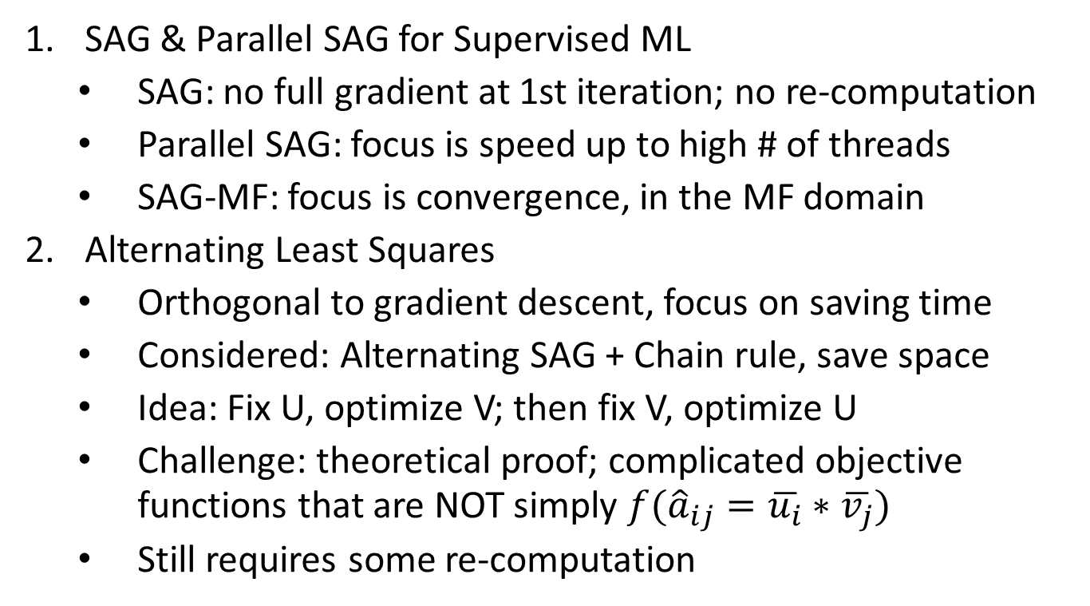
Related Work
SAG & Parallel SAG for Supervised ML
SAG: no full gradient at 1st iteration; no re-computation
Parallel SAG: focus is speed up to high # of threads
SAG-MF: focus is convergence, in the MF domain
Alternating Least Squares
Orthogonal to gradient descent, focus on saving time
Considered: Alternating SAG + Chain rule, save space
Idea: Fix U, optimize V; then fix V, optimize U
Challenge: theoretical proof; complicated objective functions that are NOT simply $f({\hat{a}}_{ij}=\overline{u_{i}}∗\overline{v_{j}})$
Still requires some re-computation
Notes:
In addition, when we calculate dU and dV together, we perform the common sub-computations only once and we reuse the results of those computations.
For example, both dU and dV of CLiMF calculate the denominator only once and store it in a variable.
However, when dU and dV are computed separately, these sub-computations also have to be done separately and cannot be reused.
The alternating concept is seen mostly in variants of least squares, in which the objective function involves calculating simply f(ui*vj).
Bootstrapping

Slide 53
Related Work
Distributed or Parallel papers in MF
Don’t deal with SAG and memory (no need)
We implemented code in a way to enable parallel for-loops in Matlab
Large Scale Matrix Factorization with Distributed Stochastic Gradient Descent http://www.almaden.ibm.com/cs/people/peterh/dsgdTechRep.pdf
Focus on large scale matrices, we focus on prototyping.
Parallel Coordinate Descent Scalable Coordinate Descent Approaches to Parallel Matrix Factorization for Recommender Systems http://www.cs.utexas.edu/~cjhsieh/icdm-pmf.pdf

Slide 54
Contributions To the best of our knowledge, we are the first to
Extend SAG, design the SAG-MF algorithm for faster, better convergence in Matrix Factorization
Extensively evaluate and compare SAG-MF across multiple objective functions and datasets
Demonstrate that SAG-MF can yield faster, better convergence… while memory usage is similar to Full Deterministic and Stochastic gradient.

Slide 55
Does faster/better convergence give better recommendations?
So far we focused only on getting faster & better convergence thru SAG-MF
Intuition makes sense that faster/better convergence leads to better recommendations.
But… to what extend does faster or better convergence correlated with
higher productivity of data scientists, or
better recommendations?
Is there a sufficient, or “good-enough” bound
Approach: plug converged approx. into metrics, and compare: MRR, P@5, 1-call@5, etc.

Slide 56
SAG-MF+ What if N is big ~ nRows*nCols?

Slide 57
Summary
SAG is memory-based Stochastic Gradient.
SAG-MF re-computes the memory to resolve the challenge with space complexity.
Even with re-computing, SAG-MF is still faster, better than both Full Deterministic (FG) and Stochastic Gradient (SG).

Slide 58
Thank you

