Slide 1
mixNmatchMF & Adaptive SAG in Matrix Factorization
James Lo
UBC CPSC 534L

Slide 2
Motivation
Gradient Descent/Ascent (Full or Stochastic) is “Gold Standard”
Gradient Descent/Ascent (GD) is a method of Iterative Optimization
After each successive iteration, GD is expected to make approximation closer to (local) optimum.
GD has many application domains
e.g. matrix factorization in RecSys
Equation has many forms, usually
“objective function” (e.g. square error) + regularization (e.g. L2)

Slide 3
Problem with Gradient Descent methods
But… it’s hard to get both speed and quality
Stochastic GD: each iteration is quick O(1*d)
But… Error may still be high after convergence
Full GD: can go towards a lower error after convergence
But… each iteration is slow O(N*d), has to go thru all N data points
Stochastic Average GD
shows some promise in logistic regression in machine learning
not yet evaluated on Matrix Factorization

Slide 4
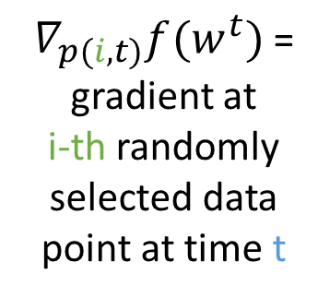

Background: Gradient Descent/ascent
$$w^{t+1}=w^{t}−α∗\left(\sum_{i=1}^{b}{∇_{p(i,t)}f(w^{t})}\right)$$
W^{t+1} = approximation at iteration t+1
α = step size
$∇_{p(i,t)}f(w^{t})$ = gradient at
i-th randomly selected data point at time t

Slide 5
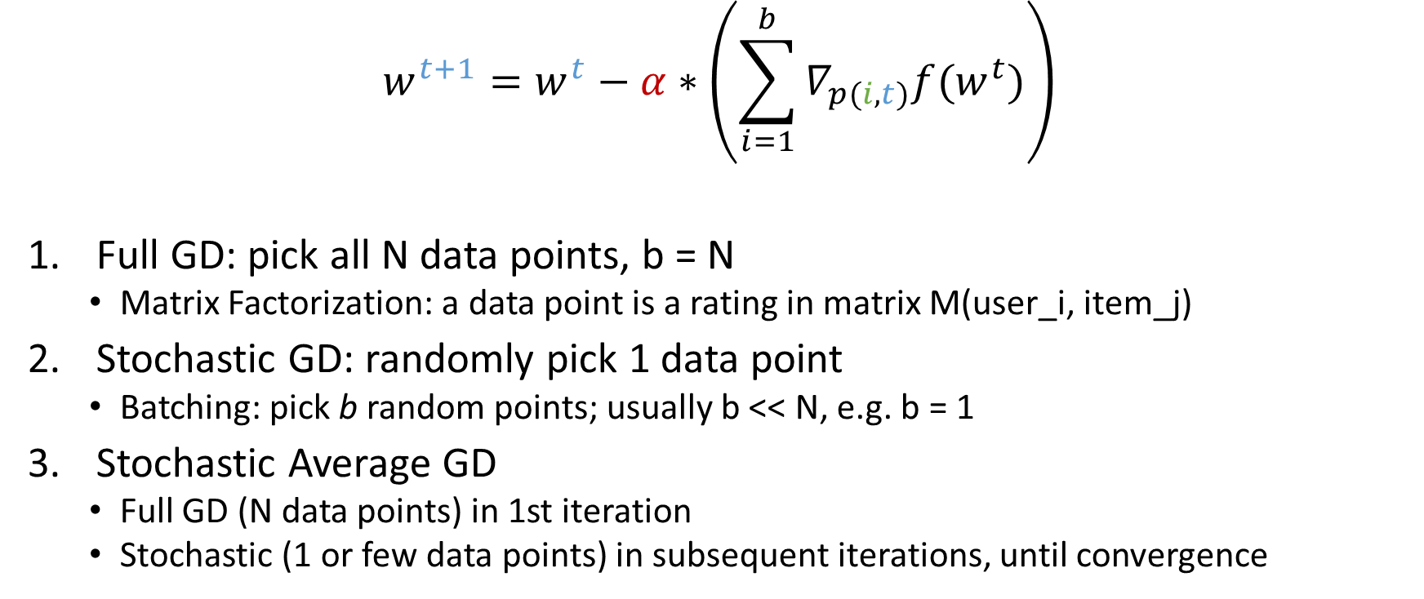
Background: Gradient Descent/ascent
$$w^{t+1}=w^{t}−α∗\left(\sum_{i=1}^{b}{∇_{p(i,t)}f(w^{t})}\right)$$
Full GD: pick all N data points, b = N
Matrix Factorization: a data point is a rating in matrix M(user_i, item_j)
Stochastic GD: randomly pick 1 data point
Batching: pick b random points; usually b << N, e.g. b = 1
Stochastic Average GD
Full GD (N data points) in 1st iteration
Stochastic (1 or few data points) in subsequent iterations, until convergence

Slide 6
Summary
GD type | Cost per Iteration | Convergence Rate | Error after convergence
Full | O(N): all N data points | Linear | Lowest
Stochastic or Batch | O(b): b random points usually b << N e.g. b=1 | Sub-Linear | > Full GD
Stochastic Average |  | Linear | In between

Slide 7
Hypothesis: can GD be adaptive?
Analogy: I’m stuck in traffic, can I change lane or route?

Slide 8
Challenges
Engineering: least effort
Can I minimize the amount of additional implementation effort needed to be adaptive?
How do I switch to another GD method when I want to?
Mathematical
Are we in local minimum?
How to get out?

Slide 9
Example: CLiMF @ GitHub https://github.com/gamboviol/climf
CLiMF: Collaborative Less is More Filtering (RecSys’12)
Optimize a Logistic function
Hard-coded to stochastic batch GD
Batch size is fixed to 1000
Step size is fixed to 0.0001
Lambda is fixed to 0.00001

Slide 10
Goals
Design
Minimum engineering cost
Architecture is decoupled.

Slide 11
flexMF
Flexible / Extensible framework for Matrix Factorization
Mix & Match: like a combo or buffet
Engineering Principles
Open for Extension, Closed for Modification
Decoupled vs. Cohesive

Slide 12
Getting out of minimum
Momentum
Reverse direction: Descent → Ascent?

Slide 13
Implementation
Why Matlab?
By default, Matlab has many matrix operators
General flexMF framework has less than 50 lines of Matlab code
Parallel toolbox: potential for parallelization (parafor, CUDA-enabled GPUs)
flexMF keeps track of (both current & previous) errors & convergence
Mix & Match (aka Plug & Play): define in options
Objective function: e.g. L2-square loss
Regularization function: e.g. L2-regularization
Update function: e.g. Full/Batch/SAG, with or w/o momentum
Adaptive function

Slide 14
Evaluation
Research Questions
Does SAG work well in MF?
How would AdaSG or AdaSAG compare to Full/Stochastic/Batch/SAG?
How easy is it to use flexMF in mixing and matching different GD algorithms?
Compare baseline (Full, Stochastic, SAG) vs. AdaSG, AdaSAG
Metrics: epsilon vs. time (# of iterations)
Epsilon is (currentError – minError)
Datasets

Slide 15
Discussion: Flexibility of flexMF
Take advantage of 1st-class functions commonly found in a dynamic programming language (PL): e.g. MatLab, also JavaScript and Python…
A 1st class Function is a function that can be stored in a variable:
passed as input: call(func);
returned as output: func = returnFunc(funcA, funcB)
In static OOP (e.g. Java, C++…): wrap function inside a class/object
Usually as static method, object is singleton or cannot be created.
public static class FuncA implements FunctionWrapper
public static call() {
// implements funcA…
}

Slide 16
Discussion: Local Minimum
Next (better) local min can be far away from currently converged min
flexMF remembers the best approximation we’ve seen
Approximated U, V that would produce the least error

Slide 17
Discussion: Convergence Rate
Depends on how many times we did Full GD, and Stochastic GD

Slide 18
Discussion: L2-regualization
Unique solution
Numerical conditioning
Picking lambdaL2
Source: Dr. Mark Schmidt

Slide 19
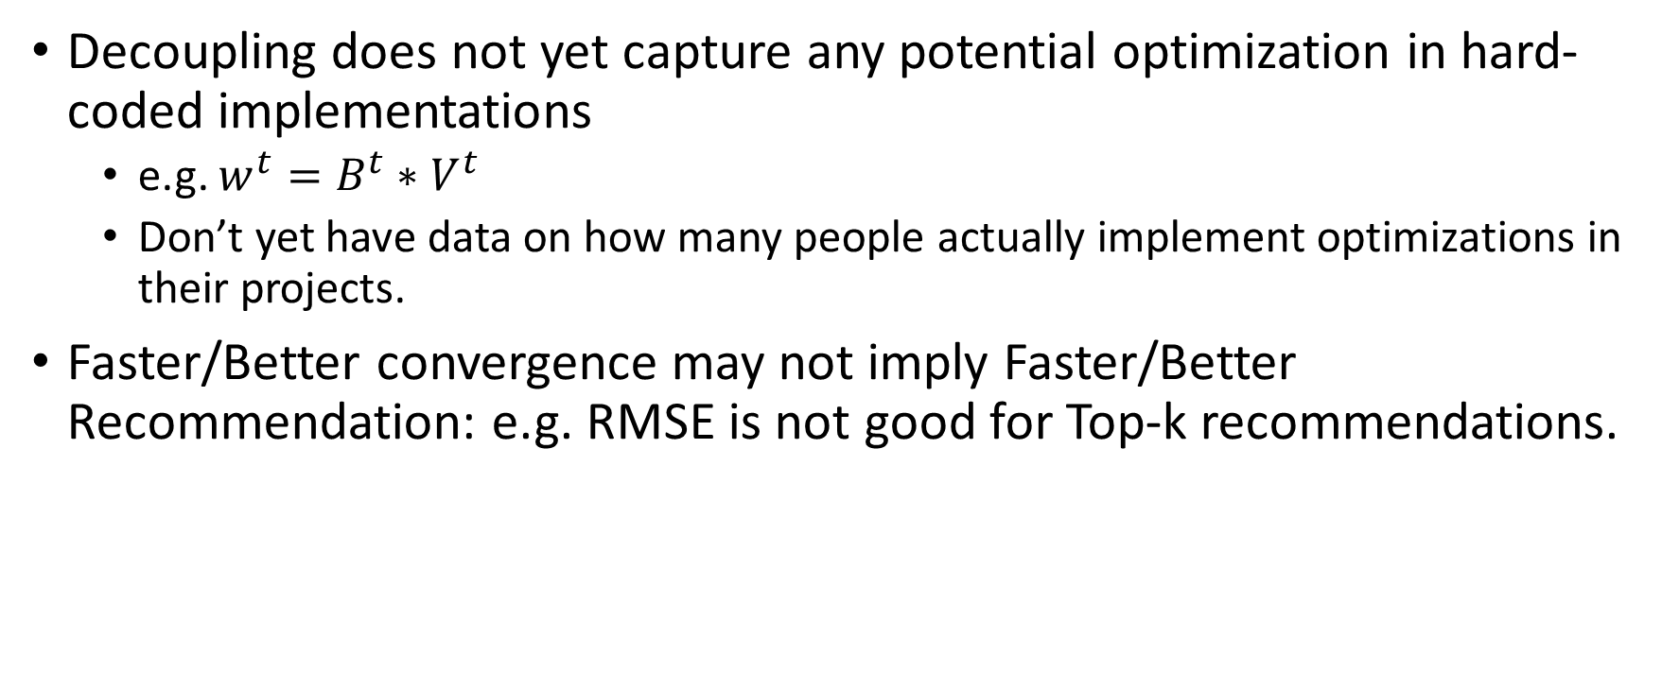
Limitations
Decoupling does not yet capture any potential optimization in hard-coded implementations
e.g. $w^{t}=B^{t}∗V^{t}$
Don’t yet have data on how many people actually implement optimizations in their projects.
Faster/Better convergence may not imply Faster/Better Recommendation: e.g. RMSE is not good for Top-k recommendations.

Slide 20
Summary
Designed and implemented flexMF, a flexible architecture for mix & match matric factorization (MF)
Proposed AdaSG and AdaSAG
Evaluated SAG in MF (using flexMF)
Compared and contrasted AdaSG & AdaSAG against baselines in the MF domain

Slide 21
Ongoing Work: Parallel SAG UBC CPSC 540
Hypothesis: can SAG be parallel?
Objective function: logistic regression in machine learning
Model-parallelism: batch GD
Data-parallelism:
CPU-parallel: implemented in OpenMP using in C/C++
GPU-parallel: implemented in CUDA
Hardware: CPU/GPU clusters
Datasets:

Slide 22
Future Work: User Study on flexMF
Task-based User Study: e.g. Do a squared-loss, L2-regularization…
Observe what users (data-scientists) do
Discover struggles that users may have
Follow up with feedback: pros & cons, likes or dislikes
Evaluate if flexMF framework really makes life easier for data-scientists
Informal & Low Cost methods for User-Study:
Is tool easy to learn (adoption)? Cognitive Walkthrough
Is tool easy to use (ongoing recurrence)? Heuristic Evaluation
Still have to polish documentation, comments, organization of files

Slide 23
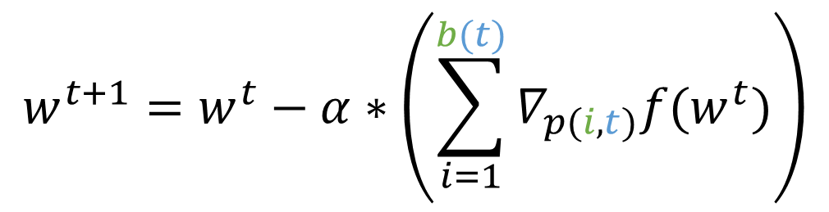
Future Work: Adaptive Batching so far adaptation has been binary: 1 or N, can we do better?
Can we change/adapt batch size in each iteration?
Is it advantageous? How to pick a good batch size in each iteration?
Can we intelligently choose which data-points to batch?
Batch size
1
b
N
$$w^{t+1}=w^{t}−α∗\left(\sum_{i=1}^{b(t)}{∇_{p(i,t)}f(w^{t})}\right)$$
Stochastic gradient descent
Batch
gradient descent
Full
gradient descent

Slide 24
Future Work: What do we do with flexMF?
Adaptive Descent/Ascent
There’re other Iterative optimization methods:
Coordinate/Proximal/Incremental: which can we integrate?
Greedy Parallel Descent/Ascent
Problem: Individual descent/ascent can be difficult to parallelize
Idea: can run multiple individual algorithms independently in parallel
Pick the algorithm with the best convergence rate
Challenge: some algorithms are faster than others
Run faster algorithms multiple times, wait for slowest to complete
Hypothesis: Greedy Parallel would be faster than Adaptive

Slide 25
Demo / Sample Code

