Slide 1
Faster & Better Convergence in Matrix Factorization using SAG-MF
James Lo

Slide 2
Why Matrix Factorization?
MF is the central component of
many model-based RecSys: collaborative filtering
many Unsupervised Learning methods: PCA, ICA...
Can we do MF faster, and better?

Slide 3
Why Faster Matrix Factorization?
Don’t rec-sys run offline? Yes, But… “Speed is everything”
As a data scientist,
Getting the right formula may not be trivial.
May require multiple trials of experimentation
Formula: objective function e.g. CLiMF, MNAR, GAPfm, etc.
Fine-tuning parameters: step size, regularization… etc.
Product life-cycles are shortening
Past: multi-month phases (e.g. Waterfall)
Now: 2 week spins (e.g. Agile, “move Fast & break things”)
Datasets are getting larger
Growth of data > increase of processor speed.
Larger datasets take longer to run, even for linear algorithm

Slide 4
Why Better Matrix Factorization?
Better MF: error is lower after convergence
Error: absolute(approximation – optimum)
Lower error often leads to* → higher chance of higher accuracy → rec-sys: higher click-thru rate → higher profits $$$
*Assumption made by all rec-sys papers that utilize iterative optimization

Slide 5
Opportunity: Stochastic Average Gradient
Memory-based Stochastic Gradient Descent
Start: full gradient descent: all N data points.
Iteration: update gradient of b random sample points; b = batch size
Theory is sound: best of both worlds
Fast Convergence: similar to Full gradient
O(1) samples per iteration: similar to Stochastic
Faster & Better convergence evaluated in supervised Logistic Regression, Support Vector Machines (SVM)
Hypothesis: can SAG bring faster/better MF?

Slide 6
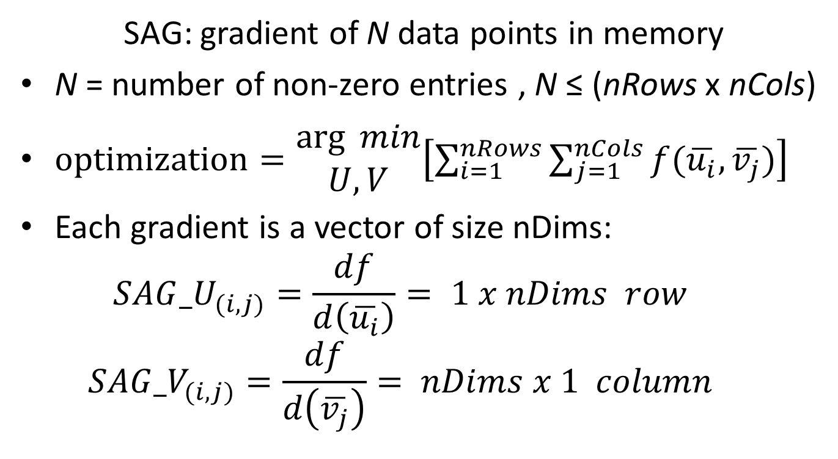
Space Complexity θ(N*nDims)
SAG: gradient of N data points in memory
N = number of non-zero entries , N ≤ (nRows x nCols)
$optimization=\begin{matrix}\arg{ min} \\ U,V\end{matrix}\left[\sum_{i=1}^{nRows}{\sum_{j=1}^{nCols}{f(\overline{u_{i}},\overline{v_{j}})}}\right]$
Each gradient is a vector of size nDims:
$${SAG_U}_{(i,j)}=\frac{df}{d\left(\overline{u_{i}}\right)}= 1 x nDims row$$
$${SAG_V}_{(i,j)}=\frac{df}{d\left(\overline{v_{j}}\right)}= nDims x 1 column$$

Slide 7
Why Space Complexity matters?
Does space complexity not matter anymore?
Many OS’s support 100+ GBs of RAM
Large scale SSD is cheaper
Distributed memory: Memcache
Ultra-fast fibre optic Intranet…

Slide 8
Why Space Complexity matters?
Space vs. time trade-off still applies to scale performance on analyzing Big Data
CPU/GPU: cache is still limited, page faults
RAM/memcache: it still takes time to transfer data from memory into processor
GPU: many cores share the same cache

Slide 9
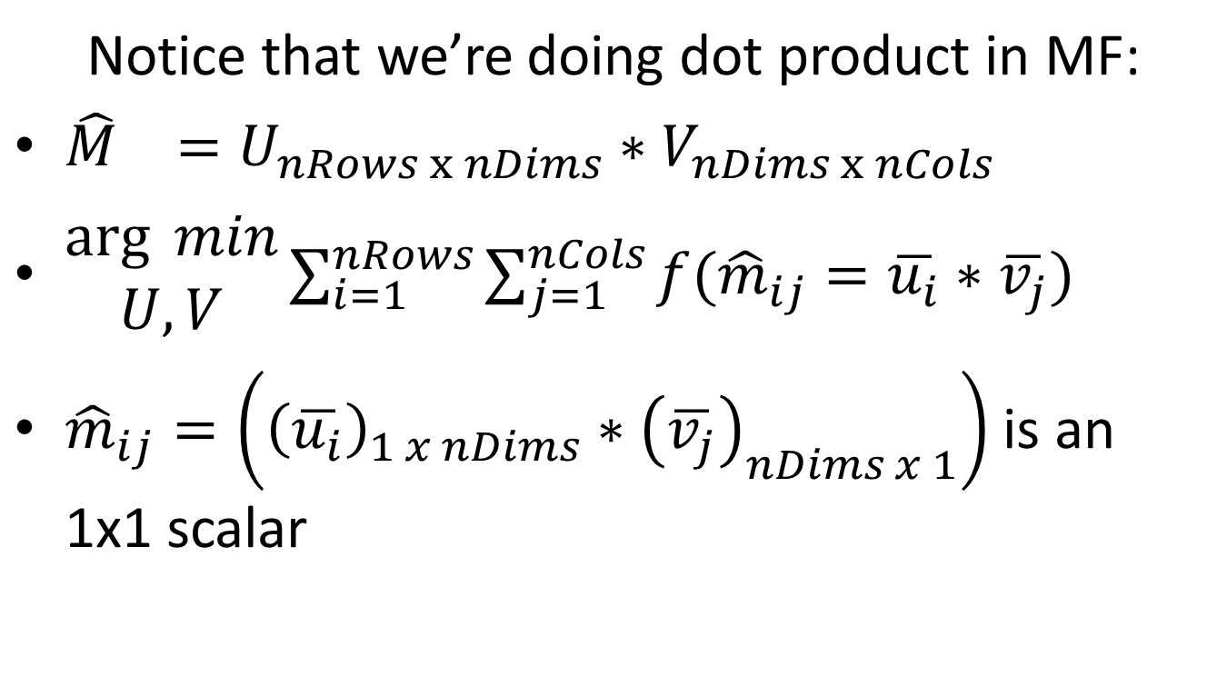
Space Complexity of SAG-MF
Notice that we’re doing dot product in MF:
${\hat{M}}_{}=U_{nRows x nDims}∗V_{nDims x nCols}$
$\begin{matrix}\arg{ min} \\ U,V\end{matrix}\sum_{i=1}^{nRows}{\sum_{j=1}^{nCols}{f({\hat{m}}_{ij}=\overline{u_{i}}∗\overline{v_{j}})}}$
${\hat{m}}_{ij}=\left({\left(\overline{u_{i}}\right)}_{1 x nDims}∗{\left(\overline{v_{j}}\right)}_{nDims x 1}\right)$ is an 1x1 scalar

Slide 10
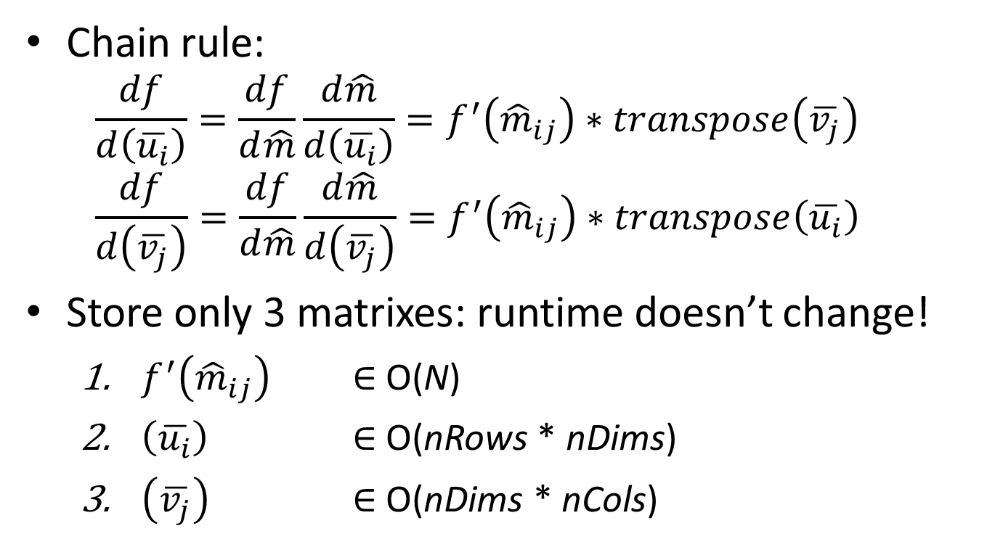
Space Complexity of SAG-MF θ(N + (nRows+nCols)*nDims)?
Chain rule:
$$\frac{df}{d\left(\overline{u_{i}}\right)}=\frac{df}{d\hat{m}}\frac{d\hat{m}}{d\left(\overline{u_{i}}\right)}=f^{′}\left({\hat{m}}_{ij}\right)∗transpose\left(\overline{v_{j}}\right)$$
$$\frac{df}{d\left(\overline{v_{j}}\right)}=\frac{df}{d\hat{m}}\frac{d\hat{m}}{d\left(\overline{v_{j}}\right)}=f^{′}\left({\hat{m}}_{ij}\right)∗transpose\left(\overline{u_{i}}\right)$$
Store only 3 matrixes: runtime doesn’t change!
$f^{′}\left({\hat{m}}_{ij}\right)$ $∈$ O(N)
$\left(\overline{u_{i}}\right)$ $∈$ O(nRows * nDims)
$\left(\overline{v_{j}}\right)$ $∈$ O(nDims * nCols)

Slide 11
Wait a minute … is that it?
Problem: U & V are different at each iteration
Optimization is to get the best possible U, V
Solution:
∀ data point, store the most recent iteration t that the data point was sampled: θ(N) space
Sample with replacement
We need only the most recent sampled Ui, Vj
∀ iteration t, store the Ui, Vj sampled at iteration t: θ(nMems * nDims) space
Total: θ(N+(nRows+nCols+nMems)*nDims)

Slide 12
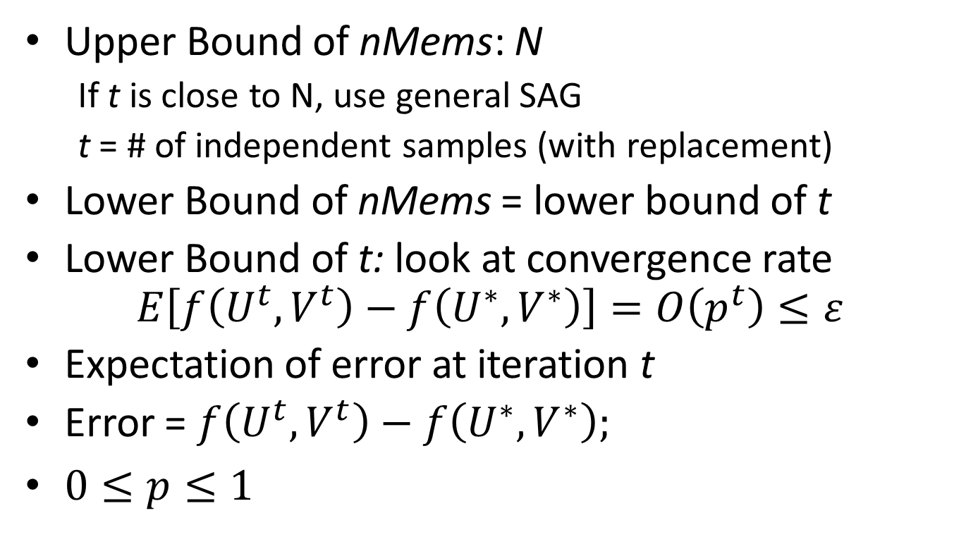
nMems = min{t, N} Can we assume nMems is much less than N?
Upper Bound of nMems: N
If t is close to N, use general SAG
t = # of independent samples (with replacement)
Lower Bound of nMems = lower bound of t
Lower Bound of t: look at convergence rate $E\left[f\left(U^{t},V^{t}\right)−f\left(U^{∗},V^{∗}\right)\right]=O\left(p^{t}\right)≤ε$
Expectation of error at iteration t
Error = $f\left(U^{t},V^{t}\right)−f\left(U^{∗},V^{∗}\right);$
$0≤p≤1$

Slide 13
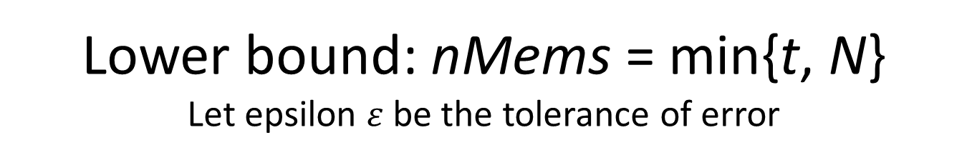
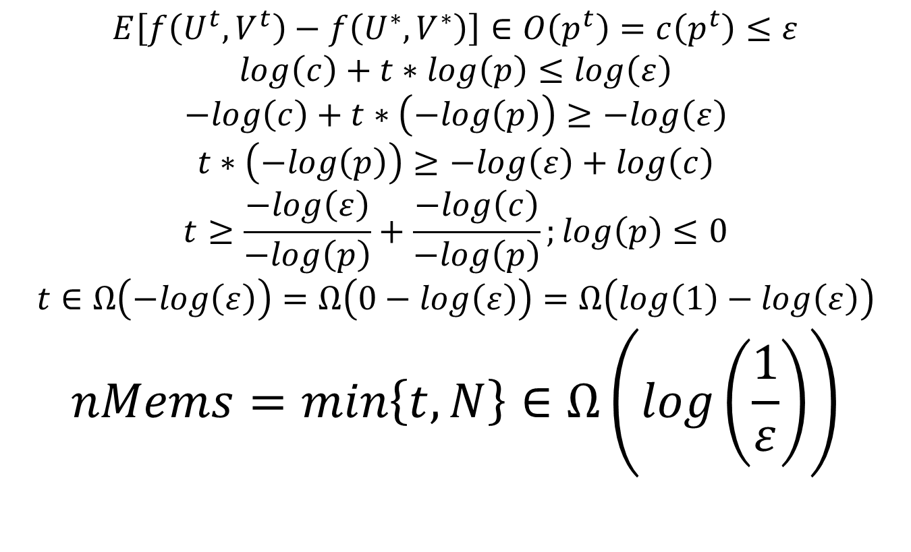
Lower bound: nMems = min{t, N} Let epsilon $ε$be the tolerance of error
$$E\left[f\left(U^{t},V^{t}\right)−f\left(U^{∗},V^{∗}\right)\right]∈O\left(p^{t}\right)=c\left(p^{t}\right)≤ε$$
$$log\left(c\right)+t∗log\left(p\right)≤log\left(ε\right)$$
$$−log\left(c\right)+t∗\left(−log\left(p\right)\right)≥−log\left(ε\right)$$
$$t∗\left(−log\left(p\right)\right)≥−log\left(ε\right)+log\left(c\right)$$
$$t≥\frac{−log\left(ε\right)}{−log\left(p\right)}+\frac{−log\left(c\right)}{−log\left(p\right)};log\left(p\right)≤0$$
$$t∈Ω\left(−log\left(ε\right)\right)=Ω\left(0−log\left(ε\right)\right)=Ω\left(log\left(1\right)−log\left(ε\right)\right)$$
$$nMems=min\left\{t,N\right\}∈Ω\left(log\left(\frac{1}{ε}\right)\right)$$

Slide 14
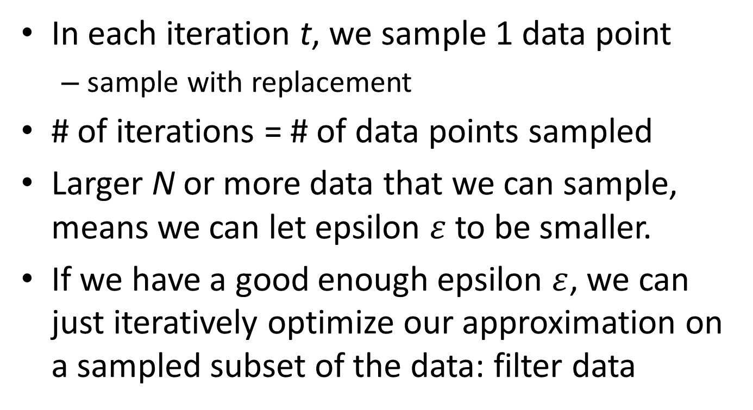
nMems = min{t, N} So lower bound doesn’t nMems depend on N?
In each iteration t, we sample 1 data point
sample with replacement
# of iterations = # of data points sampled
Larger N or more data that we can sample, means we can let epsilon $ε$to be smaller.
If we have a good enough epsilon $ε$, we can just iteratively optimize our approximation on a sampled subset of the data: filter data

Slide 15
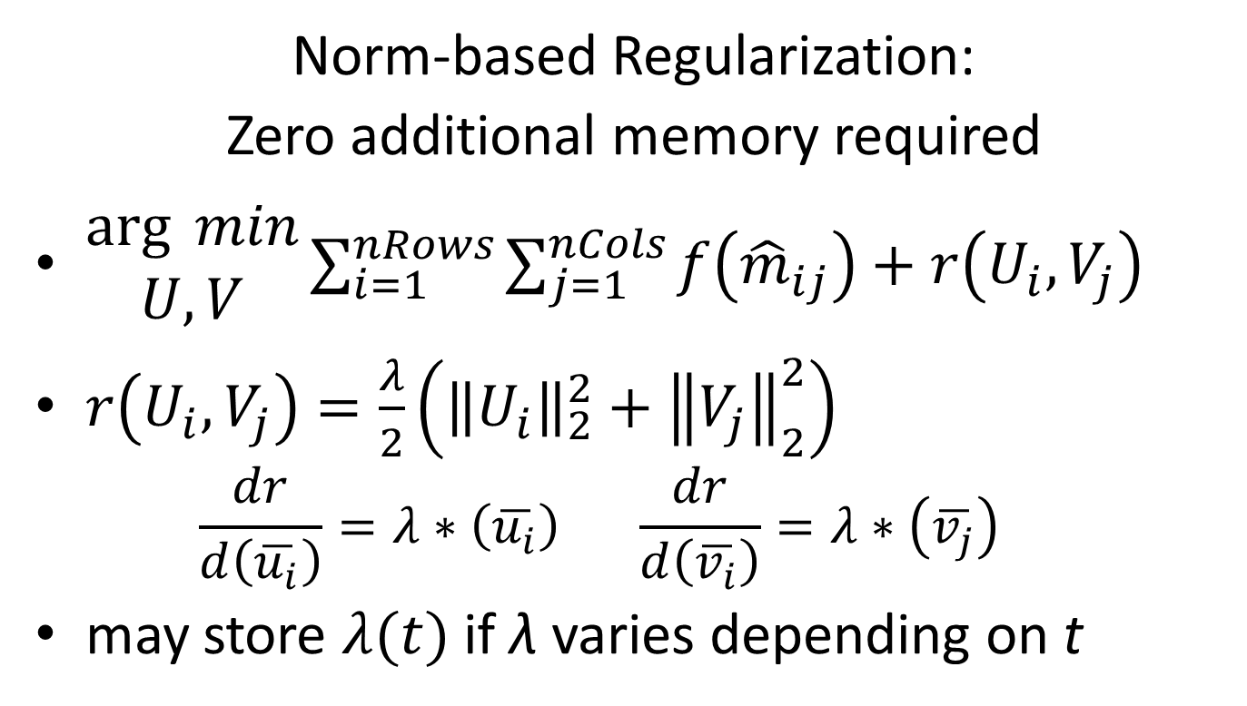
Space Complexity of SAG-MF: θ(N +(nRows +nCols +nMems)*nDims)
Norm-based Regularization:
Zero additional memory required
$\begin{matrix}\arg{ min} \\ U,V\end{matrix}\sum_{i=1}^{nRows}{\sum_{j=1}^{nCols}{f\left({\hat{m}}_{ij}\right)+r\left(U_{i},V_{j}\right)}}$
$r\left(U_{i},V_{j}\right)=\frac{λ}{2}\left({\left\|U_{i}\right\|}_{2}^{2}+{\left\|V_{j}\right\|}_{2}^{2}\right)$
$$\frac{dr}{d\left(\overline{u_{i}}\right)}=λ∗\left(\overline{u_{i}}\right) \frac{dr}{d\left(\overline{v_{i}}\right)}=λ∗\left(\overline{v_{j}}\right)$$
may store $λ(t)$ if λ varies depending on t

Slide 16
Actual Impl: SAG-MF forgetful θ((nRows +nCols +nMems)*nDims)
Only SAG_U, SAG_V at t=0 can be compressed
At 1st iteration, we are accessing all data-points
Store only U, V at t=0: U_0, V_0
Re-compute gradients(Ui_0, Vj_0) on the fly
Big-O runtime does not change
Works well when (nMems=t) << N
SAG-MF may still be better than SAG-MFforgetful when objective function is expensive (e.g. CLiMF)

Slide 17
To enable Fine-Tuning: SAG-MF buffered What if we don’t want to re-compute everything?
Pre-compute nBufs random data points (i, j)’s that we are going to visit in the next nBufs iterations
After first iteration, store the gradients dUi, dVj of these random data points
Use nBufs to tune nMems = max{nBufs, min{t, N}}
O((nRows + nCols + nMems)*nDims)
nBufs → 0: SAG-MF forgetful
nBufs → N: SAG-MF general
Allocate buffer size nBufs = min{nAvail, E[t]} based on
E[t] = Expected # of iterations, based on ε
nAvail = Availability of memory

Slide 18
Summary
Type of Gradient | # of samples per Iteration | Expected # of Iterations | Space Complexity on Memory Overhead
Full | O(N) |  | 0
Stochastic | O(1) |  | 0
SAG-general |  |  | O(N*nDims)
SAG-MF |  |  | O((nRows +nCols +nMems)*nDims)

Slide 19
Parallelization
Why MatLab:

Slide 20
Evaluation: Research Questions *SAG = SAG-general & SAG-MF
Compared to Full, Stochastic gradient,
Can *SAG converge more quickly?
Can SAG give lower error after convergence?
Can SAG work in different objective functions?
Does SAG work with different datasets
Notes:
Have to report some memory usage

Slide 21
Evaluation
RQ#3: Objective Functions
RQ#4: Datasets
Binary Data
L2: square loss SVD
CLiMF: ordinal logistic
BPR: Bayseian Personalized Ranking
Binary Data: Implicit feedback
Epinions
Digg
IMDB
Live Journal
Wikipedia

Slide 22
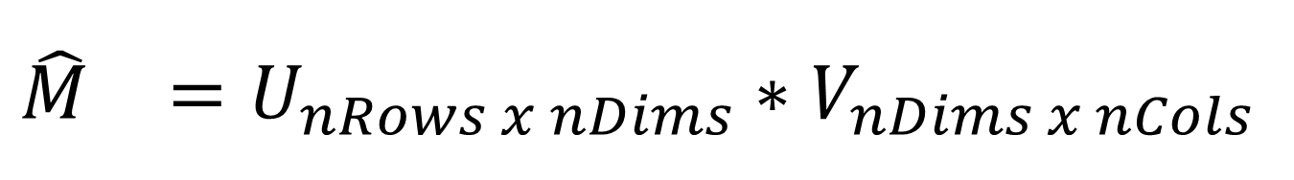
$${\hat{M}}_{}=U_{nRows x nDims}∗V_{nDims x nCols}$$
Gradient Descent
Gradient Ascent
L2, MMMF
Step size = -0.0001;
LambdaU = +0.001
LambdaV = +0.001;
nDims = 5;
CLiMF
Step size = +0.0001;
LambdaU = -0.001
LambdaV = -0.001;
nDims = 5;

Slide 23
Ongoing Work
RQ#3: Objective Functions
RQ#4: Datasets
(implemented, not evaluated)
Binary Data
WR-MF: Weighted Regularized Matrix Factorization (Hu et al.)
MNAR: Missing Not At Random
(available, not evaluated)
Binary Data
Datasets are full scale
Amazon-2008
.sk domain crawl 2005
Patent citations
Paper citations

Slide 24
Future Work: Numerical Data
RQ#3: Objective Functions
RQ#4: Datasets
(coming soon)
Numerical Data
GAPfm: Graded Avg Precision
CofiRank: SVM-like loss aka Max Margin MF
(coming soon)
Numerical Data
MovieLens
NetFlix (still have yet to parse it from .txt files)

Slide 25
Ongoing Work
Parallel SAG(-SML supervised machine learning): OpenMP, C/C++ (w. Scott Sallinen)
Does faster/better convergence really give better recommendations?
mixNmatchMF: allow data-scientists to quickly mix and match MF algorithms for quick iteration
SAG-MF+ and Parallel SAG-MF+: use even less space for running MF on GPUs
Notes:
OpenMP ARM

Slide 26
Future Work: Other approaches to reduce memory
So far we’ve focused on using only algorithmic approaches to address the challenge with space complexity
Could there be other approaches?
Scientific computing: numerical optimization for sparse matrices
System: represent sparse matrices better in memory?

Slide 27
Related Work
SAG and Parallel SAG for Supervised ML
https://github.com/ScottSallinen/Gradient-Descent-Comparison
Parallel SAG: format is comparison & evaluation
SAG-MF: format is similar to SKIM
Alternating Least Squares
Orthogonal to gradient descent or ascent
Distributed or Parallel methods
Don’t deal with SAG, don’t deal with memory (no need)
Distributed Stochastic Gradient Descent Large Scale Matrix Factorization with Distributed Stochastic Gradient Descent http://www.almaden.ibm.com/cs/people/peterh/dsgdTechRep.pdf
Parallel Coordinate Descent Scalable Coordinate Descent Approaches to Parallel Matrix Factorization for Recommender Systems http://www.cs.utexas.edu/~cjhsieh/icdm-pmf.pdf

Slide 28
Contributions To the best of our knowledge, we are the first to
Adapt the Stochastic Average Gradient (SAG) method from Supervised Machine Learning into Matrix Factorization.
Extend, specialize and parallelize SAG into a series of SAG-MF algorithms for utilizing the SAG method in Matrix Factorization
Extensively evaluated and compared SAG-MF across multiple objective functions and large datasets
Demonstrated that SAG-MF can yield faster and better convergence in matrix factorization.

Slide 29
Contributions We are the first to
Apply and adapt the SAG method from supervised machine learning into MF
Extend SAG-general into specialized SAG-MF for better space complexity in memory overhead
Parallelize both the SAG-general and SAG-MF specifically for MF tasks.
Through extensive evaluation, demonstrated that SAG-general and SAG-MF yield faster and better convergence rate across various objective functions.
Notes:
Contribution (Novelty)
Technical Merit
Overall presentation
Apply and adapt the SAG algorithm into iterative optimization for matrix factorization (MF).
Extend the general SAG algorithm into a specialized SAG algorithm (SAG-MF) for better space complexity in memory overhead.
Parallelize both the SAG-general and SAG-MF, specifically for matrix factorization tasks.
Through extensive evaluation, demonstrated that the general SAG and SAG-MF algorithms yield both faster and better convergence across various objective functions.

Slide 30
Does faster/better convergence give better recommendations?
So far we focused only on getting faster & better convergence thru SAG-MF
Intuition makes sense that faster/better convergence leads to better recommendations.
But… to what extend does faster or better convergence correlated with
higher productivity of data scientists, or
better recommendations?
Is there a sufficient, or “good-enough” bound
Approach: plug converged approx. into metrics, and compare: MRR, P@5, 1-call@5, etc.

Slide 31
SAG-MF+ What if N is big ~ nRows*nCols?

