Slide 1
Faster / Better Convergence in Matrix Factorization using SAG-MF
James Lo

Slide 2
Why Matrix Factorization?
MF is the central component of
many model-based RecSys: collaborative filtering
many Unsupervised Learning methods: PCA, ICA...
Can we do MF faster or better?

Slide 3
Why Faster Matrix Factorization?
Don’t rec-sys run offline? Yes, But… “Speed is everything”
As a data scientist,
Getting the right formula may not be trivial.
May require multiple trials of experimentation
Formula: objective function e.g. CLiMF, MNAR, GAPfm, etc.
Fine-tuning parameters: step size, regularization… etc.
Product life-cycles are shortening
Past: multi-month phases (e.g. Waterfall)
Now: 2 week spins (e.g. Agile, “move Fast & break things”)
Datasets are getting larger
Growth of data > increase of processor speed.
Larger datasets take longer to run, even for linear algorithm

Slide 4
Why Better Matrix Factorization?
Better MF: error is lower after convergence
Error: absolute(approximation – optimum)
Lower error often leads to* → higher chance of higher accuracy → rec-sys: higher click-thru rate → higher profits $$$
*Assumption made by all rec-sys papers that utilize iterative optimization

Slide 5
Opportunity: Stochastic Average Gradient
Memory-based Stochastic Gradient Descent
Theory is sound: best of both worlds
Better: low error similar to Full gradient
Faster iteration: O(1) samples similar to Stochastic
SAG’s faster & better convergence evaluated in supervised Logistic Regression, Support Vector Machines
Hypothesis: can SAG bring faster/better MF?

Slide 6
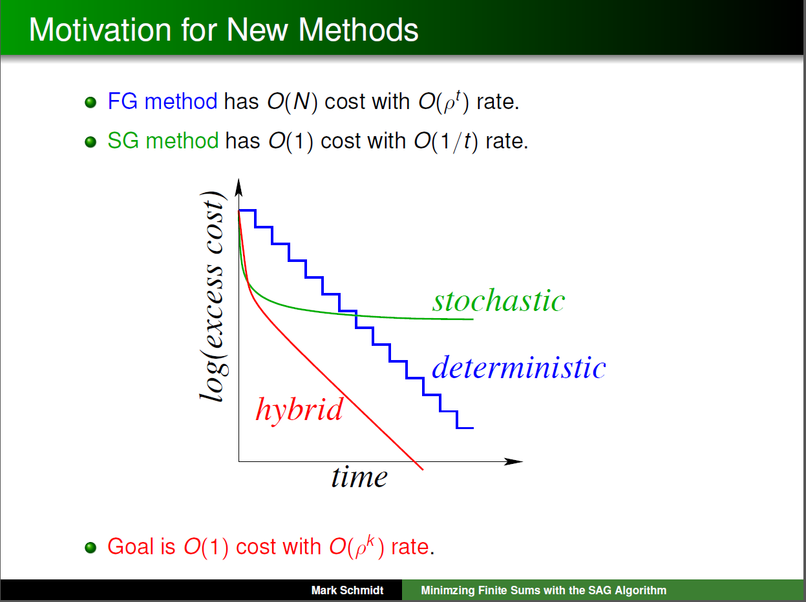

Slide 7


Background: Gradient Descent/Ascent
$$w^{t+1}=w^{t}+\frac{\text{α}}{B}\left(\sum_{i=1}^{B}{∇_{point(i,t)}f(w^{t})}\right)$$
w^{t+1} = approximation at iteration t+1
α = step size
α > 0: ascent (max)
α < 0: descent (min)
$∇_{point(i,t)}f(w^{t})$ = gradient at i-th randomly selected data point at time t

Slide 8
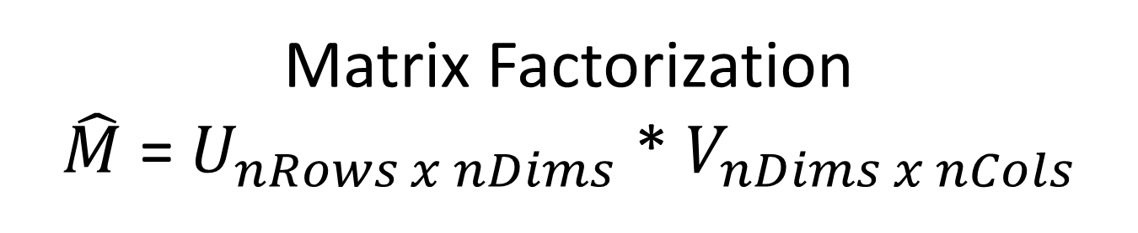


Matrix Factorization $\hat{M}$ = $U_{nRows x nDims}$ * $V_{nDims x nCols}$
$$U^{t+1}=U^{t}+\frac{\text{α}}{B}\left(\sum_{i=1}^{B}{\frac{df(U,V)}{dU_{point(i,t)}}}\right)$$
U^{t+1} = approximation at iteration t+1
α = step size
α > 0: ascent (max)
α < 0: descent (min)
$∇_{point(i,t)}f(U^{t})$ = gradient at i-th randomly selected data point at time t

Slide 9


Matrix Factorization $\hat{M}$ = $U_{nRows x nDims}$ * $V_{nDims x nCols}$
$$V^{t+1}=V^{t}+\frac{\text{α}}{B}\left(\sum_{i=1}^{B}{\frac{df(U,V)}{dV_{point(i,t)}}}\right)$$
V^{t+1} = approximation at iteration t+1
α = step size
α > 0: ascent (max)
α < 0: descent (min)
$∇_{point(i,t)}f(V^{t})$ = gradient at i-th randomly selected data point at time t

Slide 10
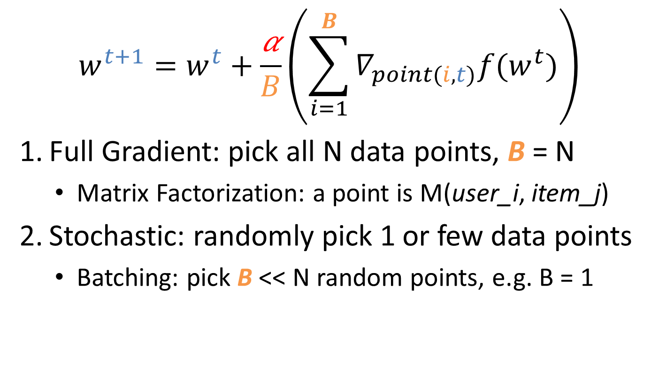
Background: Gradient Descent/Ascent
$$w^{t+1}=w^{t}+\frac{\text{α}}{B}\left(\sum_{i=1}^{B}{∇_{point(i,t)}f(w^{t})}\right)$$
Full Gradient: pick all N data points, B = N
Matrix Factorization: a point is M(user_i, item_j)
Stochastic: randomly pick 1 or few data points
Batching: pick B << N random points, e.g. B = 1

Slide 11
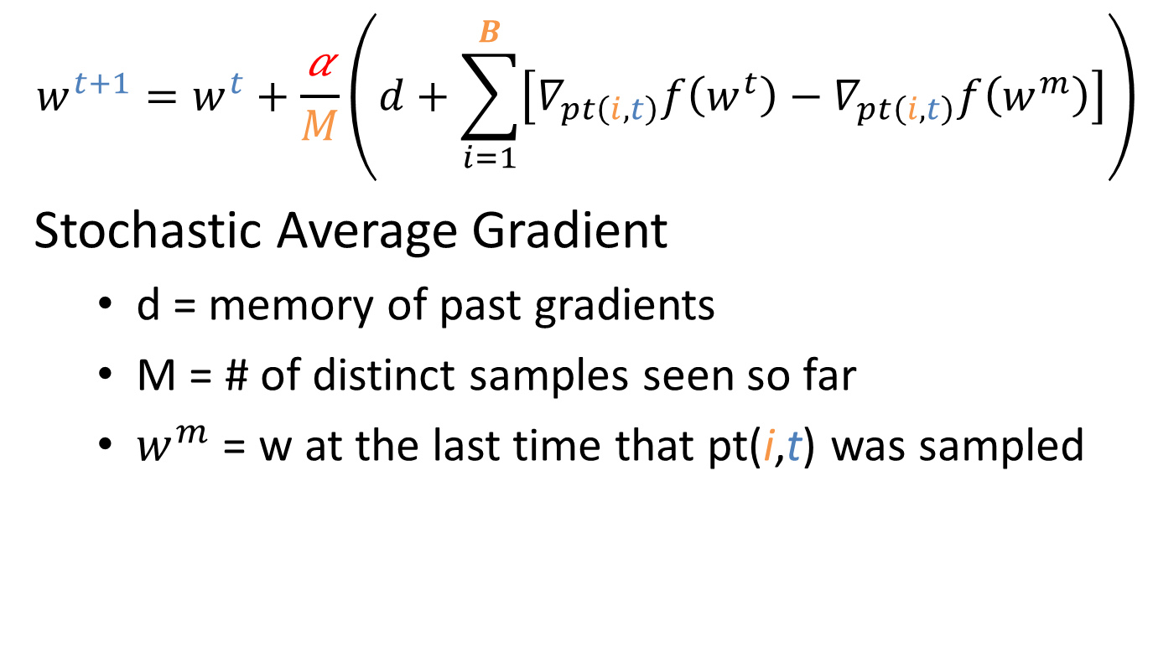
Background: SAG
$$w^{t+1}=w^{t}+\frac{\text{α}}{M}\left(d+\sum_{i=1}^{B}{\left[∇_{pt\left(i,t\right)}f\left(w^{t}\right)−∇_{pt\left(i,t\right)}f\left(w^{m}\right)\right]}\right)$$
Stochastic Average Gradient
d = memory of past gradients
M = # of distinct samples seen so far
$w^{m}$ = w at the last time that pt(i,t) was sampled

Slide 12
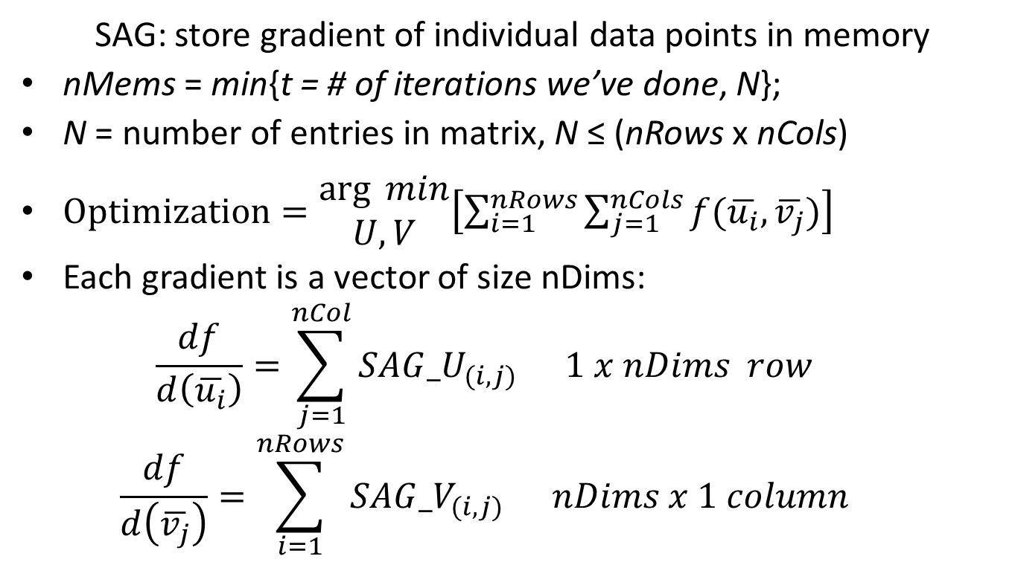
Space Complexity of SAG: θ(nMems*nDims)
SAG: store gradient of individual data points in memory
nMems = min{t = # of iterations we’ve done, N};
N = number of entries in matrix, N ≤ (nRows x nCols)
$Optimization=\begin{matrix}\arg{ min} \\ U,V\end{matrix}\left[\sum_{i=1}^{nRows}{\sum_{j=1}^{nCols}{f(\overline{u_{i}},\overline{v_{j}})}}\right]$
Each gradient is a vector of size nDims:
$$\frac{df}{d\left(\overline{u_{i}}\right)}=\sum_{j=1}^{nCol}{{SAG_U}_{(i,j)}} 1 x nDims row$$
$$\frac{df}{d\left(\overline{v_{j}}\right)}=\sum_{i=1}^{nRows}{{SAG_V}_{(i,j)}} nDims x 1 column$$

Slide 13
Why Space Complexity matters?
Does space complexity not matter anymore?
Many OS’s support 100+ GBs of RAM
Large scale SSD is cheaper
Distributed memory: Memcache
Ultra-fast fibre optic Intranet…

Slide 14
Why Space Complexity matters?
Space vs. time trade-off still applies to scale performance on analyzing Big Data
CPU/GPU: cache is still limited, page faults
RAM/memcache: it still takes time to transfer data from memory into processor
GPU: many cores share the same cache

Slide 15
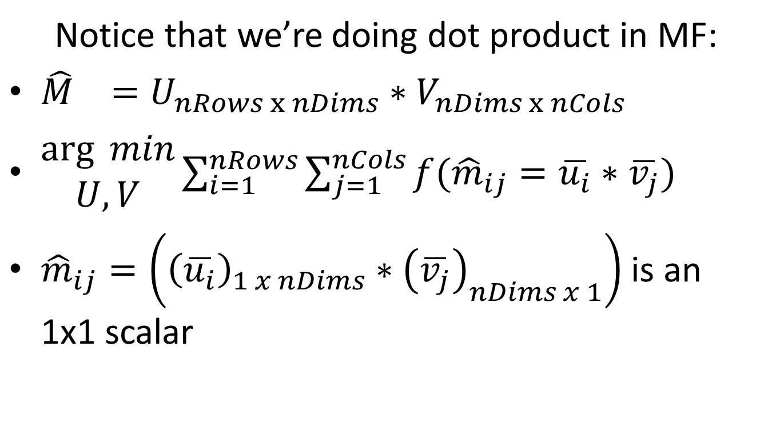
Space Complexity of SAG-MF Attempt #1
Notice that we’re doing dot product in MF:
${\hat{M}}_{}=U_{nRows x nDims}∗V_{nDims x nCols}$
$\begin{matrix}\arg{ min} \\ U,V\end{matrix}\sum_{i=1}^{nRows}{\sum_{j=1}^{nCols}{f({\hat{m}}_{ij}=\overline{u_{i}}∗\overline{v_{j}})}}$
${\hat{m}}_{ij}=\left({\left(\overline{u_{i}}\right)}_{1 x nDims}∗{\left(\overline{v_{j}}\right)}_{nDims x 1}\right)$ is an 1x1 scalar

Slide 16
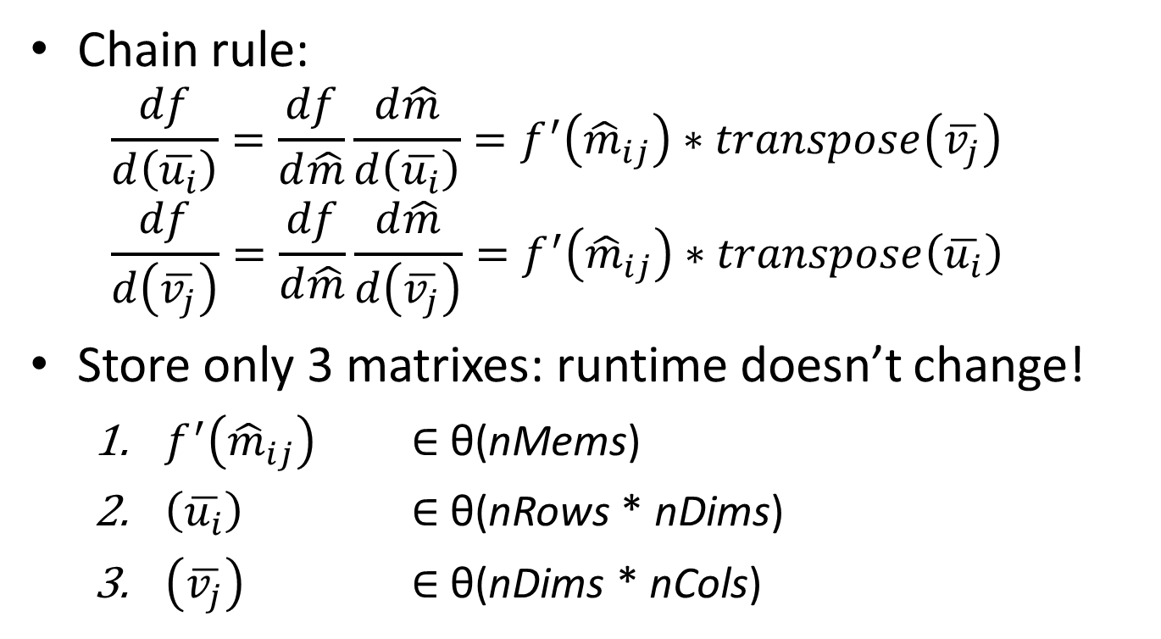
Space Complexity of SAG-MF θ(nMems + (nRows+nCols)*nDims)?
Chain rule:
$$\frac{df}{d\left(\overline{u_{i}}\right)}=\frac{df}{d\hat{m}}\frac{d\hat{m}}{d\left(\overline{u_{i}}\right)}=f^{′}\left({\hat{m}}_{ij}\right)∗transpose\left(\overline{v_{j}}\right)$$
$$\frac{df}{d\left(\overline{v_{j}}\right)}=\frac{df}{d\hat{m}}\frac{d\hat{m}}{d\left(\overline{v_{j}}\right)}=f^{′}\left({\hat{m}}_{ij}\right)∗transpose\left(\overline{u_{i}}\right)$$
Store only 3 matrixes: runtime doesn’t change!
$f^{′}\left({\hat{m}}_{ij}\right)$ $∈$ θ(nMems)
$\left(\overline{u_{i}}\right)$ $∈$ θ(nRows * nDims)
$\left(\overline{v_{j}}\right)$ $∈$ θ(nDims * nCols)

Slide 17
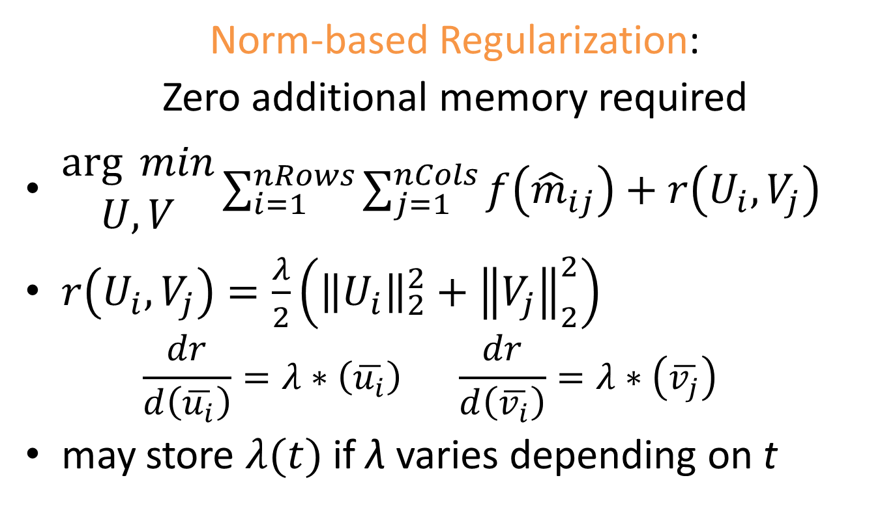
Space Complexity of SAG-MF θ(nMems + (nRows+nCols)*nDims)?
Norm-based Regularization:
Zero additional memory required
$\begin{matrix}\arg{ min} \\ U,V\end{matrix}\sum_{i=1}^{nRows}{\sum_{j=1}^{nCols}{f\left({\hat{m}}_{ij}\right)+r\left(U_{i},V_{j}\right)}}$
$r\left(U_{i},V_{j}\right)=\frac{λ}{2}\left({\left\|U_{i}\right\|}_{2}^{2}+{\left\|V_{j}\right\|}_{2}^{2}\right)$
$$\frac{dr}{d\left(\overline{u_{i}}\right)}=λ∗\left(\overline{u_{i}}\right) \frac{dr}{d\left(\overline{v_{i}}\right)}=λ∗\left(\overline{v_{j}}\right)$$
may store $λ(t)$ if λ varies depending on t

Slide 18
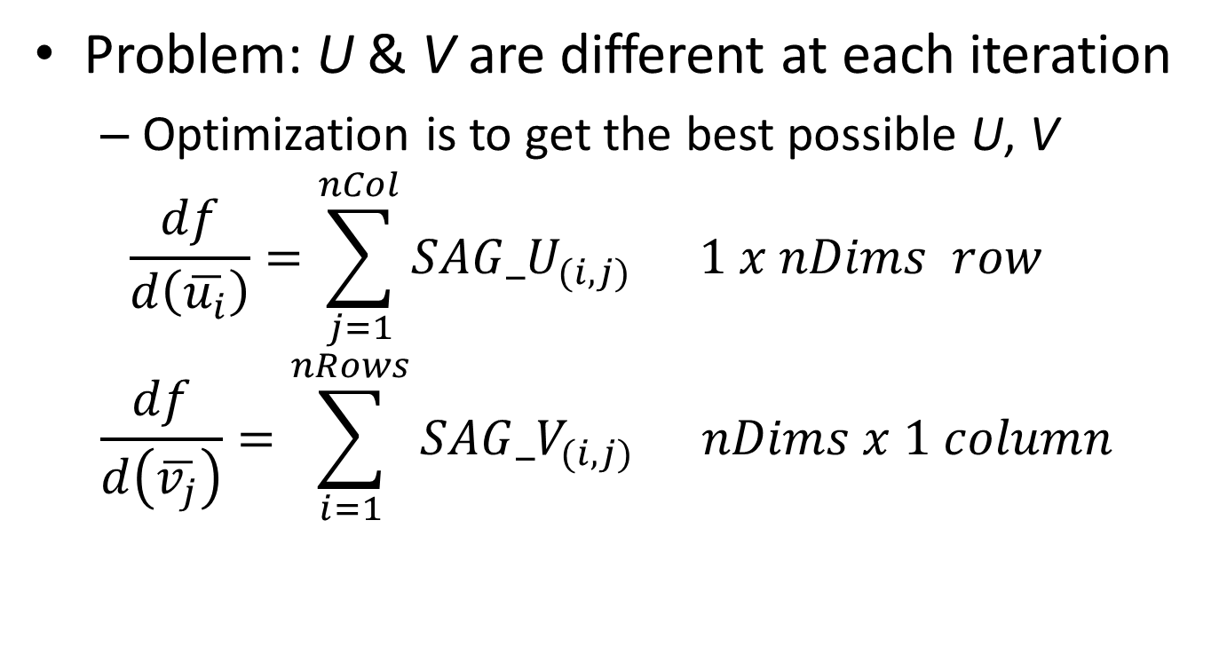
Wait a minute … is that it?
Problem: U & V are different at each iteration
Optimization is to get the best possible U, V
$$\frac{df}{d\left(\overline{u_{i}}\right)}=\sum_{j=1}^{nCol}{{SAG_U}_{(i,j)}} 1 x nDims row$$
$$\frac{df}{d\left(\overline{v_{j}}\right)}=\sum_{i=1}^{nRows}{{SAG_V}_{(i,j)}} nDims x 1 column$$

Slide 19
Wait a minute … is that it?
Problem: U & V are different at each iteration
Optimization is to get the best possible U, V
∀ data point, store the most recent iteration t that the data point was sampled: θ(N) space
Sample with replacement
We need only the most recent sampled Ui, Vj
∀ iteration t, store the Ui, Vj sampled at iteration t: θ(nMems * nDims) space
Total: θ(nMems+(nRows+nCols+nMems)*nDims)

Slide 20
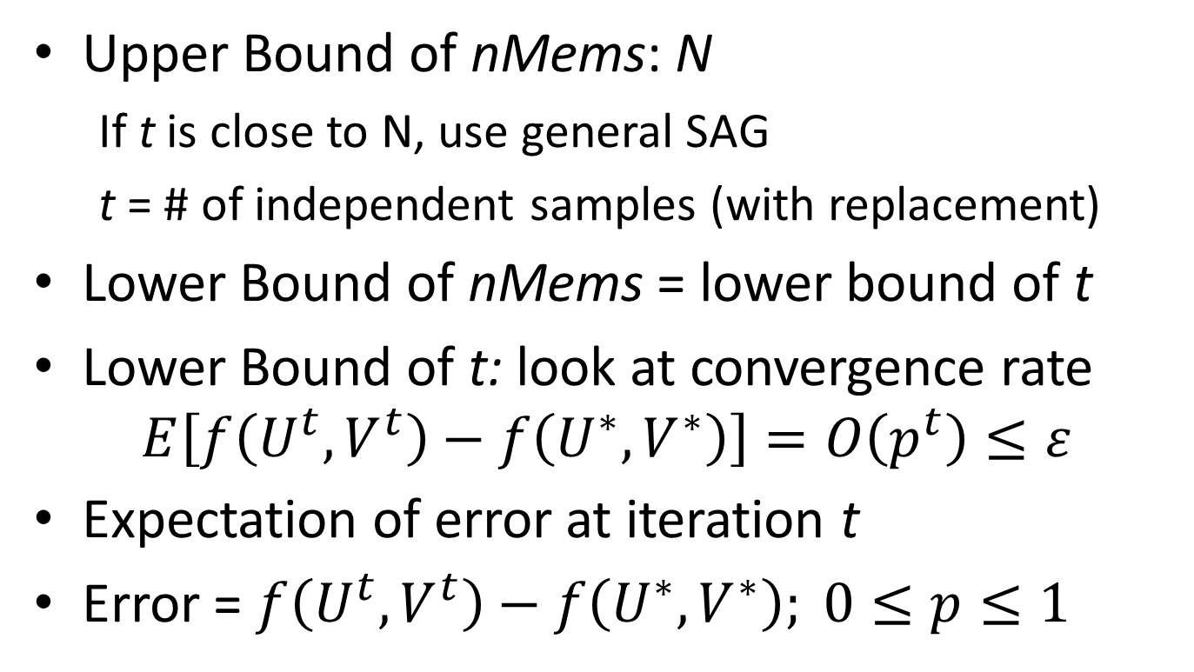
Attempt #2: nMems = min{t, N} Can we say nMems is much less than N?
Upper Bound of nMems: N
If t is close to N, use general SAG
t = # of independent samples (with replacement)
Lower Bound of nMems = lower bound of t
Lower Bound of t: look at convergence rate $E\left[f\left(U^{t},V^{t}\right)−f\left(U^{∗},V^{∗}\right)\right]=O\left(p^{t}\right)≤ε$
Expectation of error at iteration t
Error = $f\left(U^{t},V^{t}\right)−f\left(U^{∗},V^{∗}\right); 0≤p≤1$

Slide 21
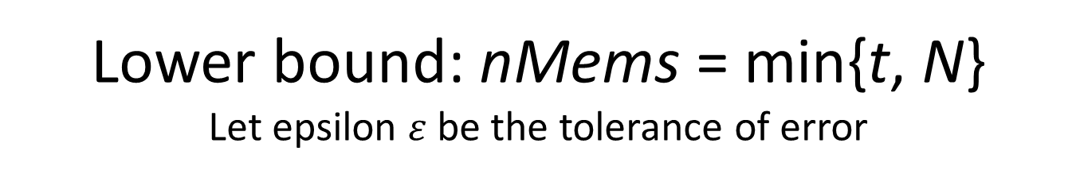
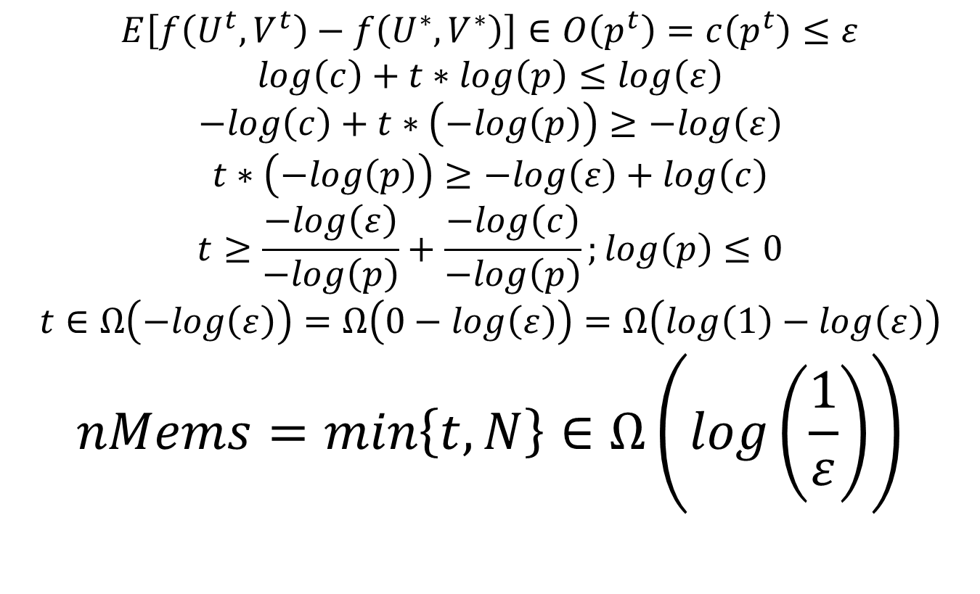
Lower bound: nMems = min{t, N} Let epsilon $ε$be the tolerance of error
$$E\left[f\left(U^{t},V^{t}\right)−f\left(U^{∗},V^{∗}\right)\right]∈O\left(p^{t}\right)=c\left(p^{t}\right)≤ε$$
$$log\left(c\right)+t∗log\left(p\right)≤log\left(ε\right)$$
$$−log\left(c\right)+t∗\left(−log\left(p\right)\right)≥−log\left(ε\right)$$
$$t∗\left(−log\left(p\right)\right)≥−log\left(ε\right)+log\left(c\right)$$
$$t≥\frac{−log\left(ε\right)}{−log\left(p\right)}+\frac{−log\left(c\right)}{−log\left(p\right)};log\left(p\right)≤0$$
$$t∈Ω\left(−log\left(ε\right)\right)=Ω\left(0−log\left(ε\right)\right)=Ω\left(log\left(1\right)−log\left(ε\right)\right)$$
$$nMems=min\left\{t,N\right\}∈Ω\left(log\left(\frac{1}{ε}\right)\right)$$

Slide 22
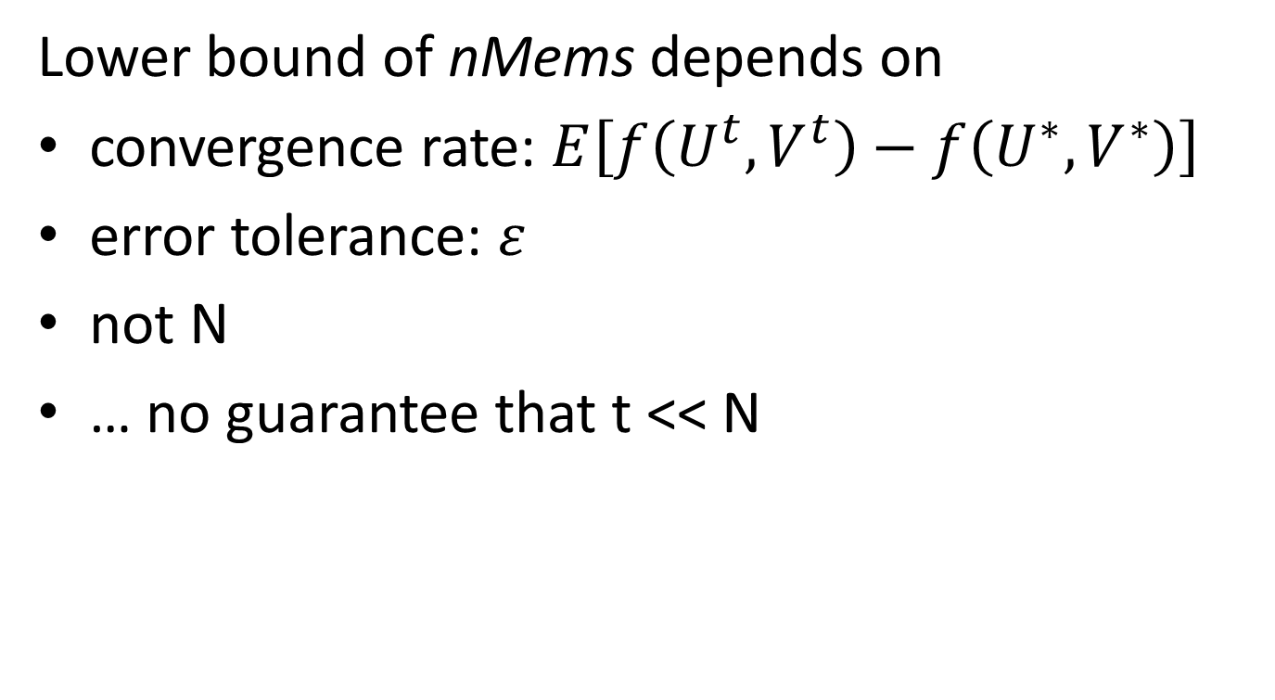
nMems = min{t, N}
Lower bound of nMems depends on
convergence rate: $E\left[f\left(U^{t},V^{t}\right)−f\left(U^{∗},V^{∗}\right)\right]$
error tolerance: $ε$
not N
… no guarantee that t << N

Slide 23
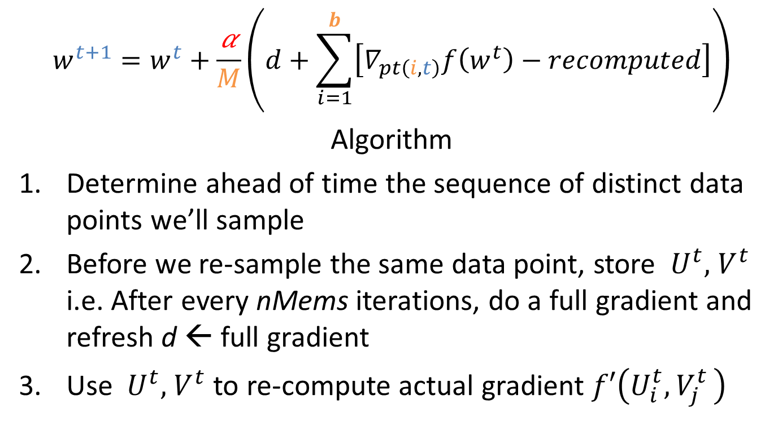
SAG-MF ahead θ(nMems + (nRows +nCols)*nDims)
$$w^{t+1}=w^{t}+\frac{\text{α}}{M}\left(d+\sum_{i=1}^{b}{\left[∇_{pt\left(i,t\right)}f\left(w^{t}\right)−recomputed\right]}\right)$$
Algorithm
Determine ahead of time the sequence of distinct data points we’ll sample
Before we re-sample the same data point, store ${ U}^{t},{ V}^{t}$ i.e. After every nMems iterations, do a full gradient and refresh d ← full gradient
Use ${ U}^{t},{ V}^{t}$ to re-compute actual gradient $f′\left(U_{i}^{t}{, V}_{j}^{t}\right)$

Slide 24
SAG-MF ahead: explained
SAG generic
O(nRows*nCols*nDims)
SAG-MF ahead
O( (nRows + nCols)*nDims )
(dUi, dVj) at different iterations
(Ut, Vt) at same iteration
Re-compute (dUi, dVj) on demand, on the fly
Re-computing does not change Big-O running time

Slide 25
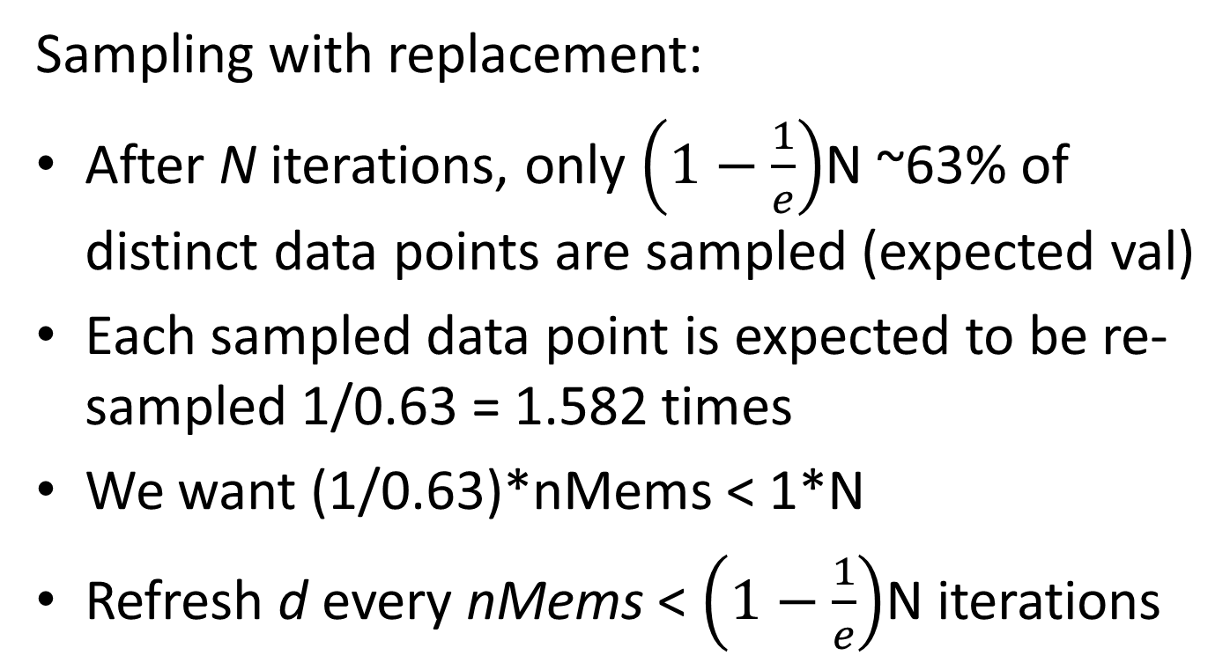
To not store θ(nMems) indices
Sampling with replacement:
After N iterations, only $\left(1−\frac{1}{e}\right)$N ~63% of distinct data points are sampled (expected val)
Each sampled data point is expected to be re-sampled 1/0.63 = 1.582 times
We want (1/0.63)*nMems < 1*N
Refresh d every nMems < $\left(1−\frac{1}{e}\right)$N iterations

Slide 26
To enable Fine-Tuning: SAG-MF buffered What if we don’t want to re-compute everything?
Pre-compute nBufs random data points (i, j)’s that we are going to visit in the next nBufs iterations
After first iteration, store the gradients dUi, dVj of these random data points
Use nBufs to tune nMems = max{nBufs, min{t, N}}
O((nRows + nCols + nMems)*nDims)
nBufs → 0: SAG-MF forgetful
nBufs → N: SAG-MF general
Allocate buffer size nBufs = min{nAvail, E[t]} based on
E[t] = Expected # of iterations, based on ε
nAvail = Availability of memory

Slide 27
Summary
Type of Gradient | # of samples per Iteration | Space Complexity on Memory Overhead
Full | O(N) | 0
Stochastic | O(1) | 0
SAG generic |  | θ(min{t,N}*nDims)
SAG-MF ahead |  | θ(nMems + (nRows +nCols)*nDims)

Slide 28
Implementation: Why MatLab?
Almost a standard for Rapid Prototyping
System model (code) closely matches mental model (developer).
Matrix multiplication Matlab: M = U*V;
C++ has additional mental overhead:
memory allocation, variable typing, correct function name, order of inputs…
Vectorized computation, parallel CPU/GPU

Slide 29
Evaluation: Research Questions
Compared to Full gradient and Stochastic gradient,
Can SAG converge more quickly?
Can SAG give lower error after convergence?
Can SAG work in different objective functions?
Does SAG work with different datasets?
Compared to SAG generic / Stochastic gradient,
How much slower is SAG-MF ahead?
How much memory does SAG-MF ahead really save?
Notes:
Have to report some memory usage

Slide 30
Evaluation
RQ#3: Objective Functions
RQ#4: Datasets
Binary Data
L2: least squares
CLiMF: ordinal logistic
BPR-MF: minimize difference between any 2 predictions of same user
Binary Data: Implicit feedback
Epinions
Digg
IMDB
Live Journal
Wikipedia

Slide 31
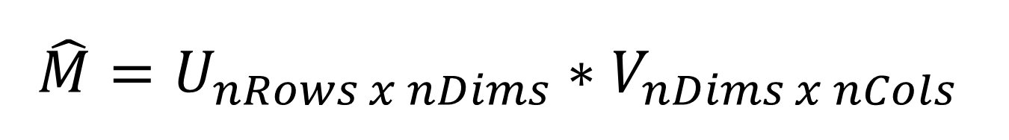
$$\hat{M}=U_{nRows x nDims}∗V_{nDims x nCols}$$
Gradient Descent
Gradient Ascent
L2, BPR
Step size = -0.0001;
LambdaU = +0.001
LambdaV = +0.001;
nDims = 5;
CLiMF
Step size = +0.0001;
LambdaU = -0.001
LambdaV = -0.001;
nDims = 5;

Slide 32
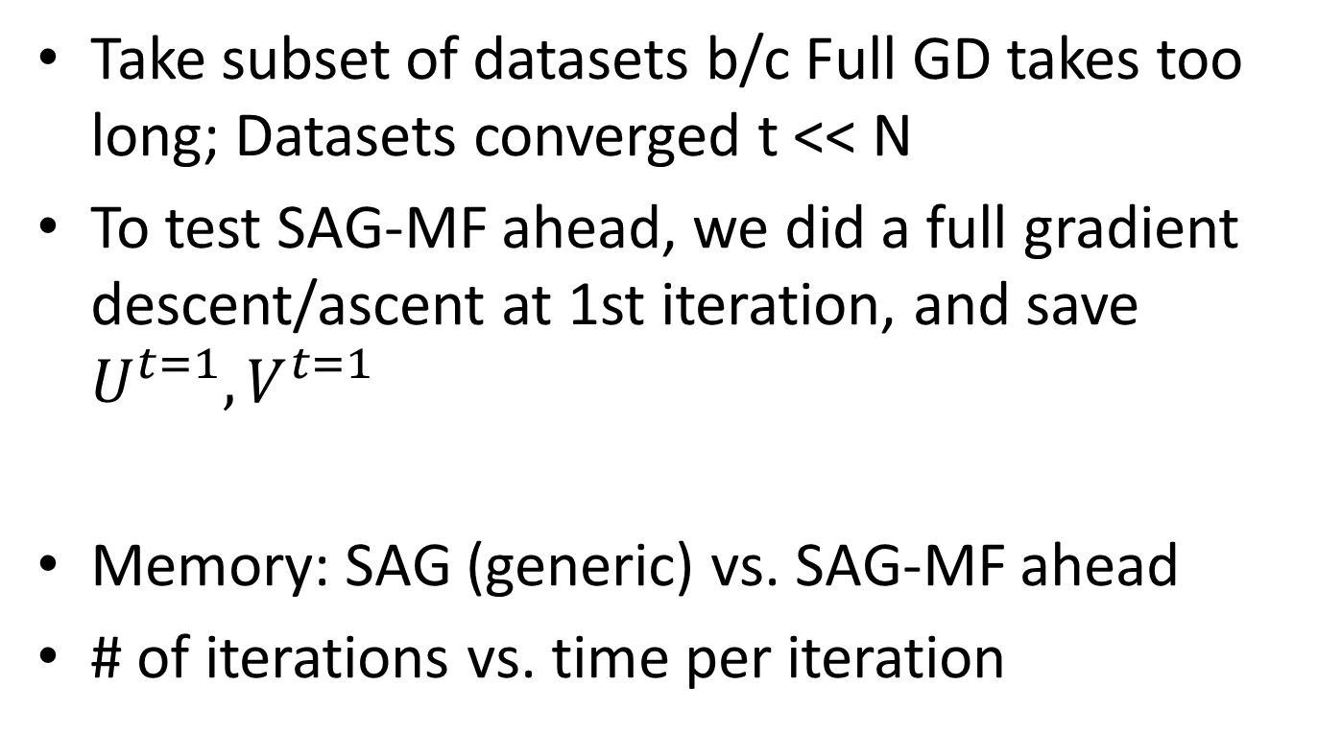
Results in Spreadsheet
Take subset of datasets b/c Full GD takes too long; Datasets converged t << N
To test SAG-MF ahead, we did a full gradient descent/ascent at 1st iteration, and save $U^{t=1}, V^{t=1}$
Memory: SAG (generic) vs. SAG-MF ahead
# of iterations vs. time per iteration
Notes:
Scalability of SAG-MF?

Slide 33
Discussion

Slide 34
Ongoing Work
RQ#3: Objective Functions
RQ#4: Datasets
(implemented, not evaluated)
Binary Data
WR-MF: Weighted Regularized Matrix Factorization (Hu et al.)
MNAR: Missing Not At Random
(available, not evaluated)
Binary Data
Datasets are full scale
Amazon-2008
.sk domain crawl 2005
Patent citations
Paper citations

Slide 35
Ongoing Work
Parallel SAG(-SML supervised machine learning): OpenMP, C/C++ (w. Scott Sallinen)
Does faster/better convergence give more accurate or high quality recommendations?
mixNmatchMF: allow data-scientists to quickly mix and match MF algorithms for quick iteration
SAG-MF+: use even less space for running MF on GPUs, what if Full gradient is prohibitive?
Notes:
OpenMP ARM

Slide 36
Future Work: Numerical Data
RQ#3: Objective Functions
RQ#4: Datasets
Numerical Data
(coming soon)
GAPfm: Graded Avg Precision
CofiRank: SVM-like loss aka Max Margin MF
Numerical Data
(coming soon)
MovieLens
NetFlix (still have yet to parse it from .txt files)

Slide 37
Future Work: Other approaches to reduce memory
So far we’ve focused on using only algorithmic approaches to address the challenge with space complexity
Could there be other approaches?
Scientific computing: numerical optimization for sparse matrices e.g. CSPARSE API?
System: represent sparse matrices better in memory?

Slide 38
Related Work
SAG and Parallel SAG for Supervised ML
https://github.com/ScottSallinen/Gradient-Descent-Comparison
Parallel SAG: format is comparison & evaluation
SAG-MF: format is similar to SKIM
Alternating Least Squares
Orthogonal to gradient descent or ascent
Distributed or Parallel methods
Don’t deal with SAG, don’t deal with memory (no need)
Distributed Stochastic Gradient Descent Large Scale Matrix Factorization with Distributed Stochastic Gradient Descent http://www.almaden.ibm.com/cs/people/peterh/dsgdTechRep.pdf
Parallel Coordinate Descent Scalable Coordinate Descent Approaches to Parallel Matrix Factorization for Recommender Systems http://www.cs.utexas.edu/~cjhsieh/icdm-pmf.pdf

Slide 39
Contributions To the best of our knowledge, we are the first to
Adapt the Stochastic Average Gradient (SAG) method from Supervised Machine Learning into Matrix Factorization
Extend and specialize SAG into SAG-MF (ahead) for Matrix Factorization: space complexity.
Extensively evaluated and compared SAG-MF across multiple objective functions and datasets
Demonstrated that SAG-MF can yield faster / better convergence in matrix factorization.

Slide 40
Does faster/better convergence give better recommendations?
So far we focused only on getting faster & better convergence thru SAG-MF
Intuition makes sense that faster/better convergence leads to better recommendations.
But… to what extend does faster or better convergence correlated with
higher productivity of data scientists, or
better recommendations?
Is there a sufficient, or “good-enough” bound
Approach: plug converged approx. into metrics, and compare: MRR, P@5, 1-call@5, etc.

Slide 41
SAG-MF+ What if N is big ~ nRows*nCols?

