Slide 1
Design Notes for 128-channel Headstage Motherboard
Doug Weber
5/16/2021

Slide 2
Concept
128-channels of HDEMG split across 4 flexPCB sub-arrays, each containing 32-channels
“Motherboard” containing:
Connectors that mate with the Intan headstage electronics
4 ZIF-style edge connectors that mate with the sub-arrays
Intan 128-ch headstage
Motherboard

Slide 3
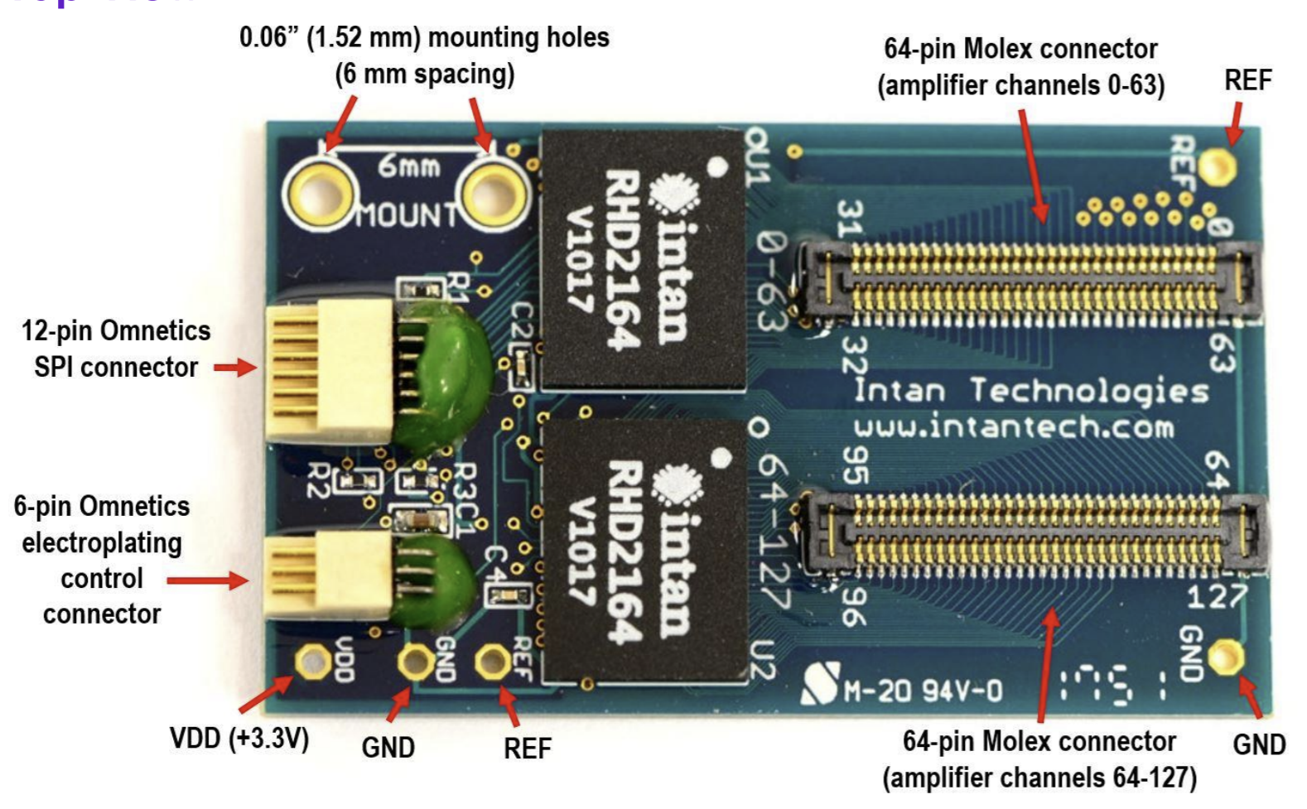
Rough layout
Intan 128 channel headstage
NOTE: This layout is completely arbitrary. Routing the traces may be difficult, and it may be better to position the edge connectors differently to make it easier to route the traces from the Intan headstage connectors to the ZIF connectors.
Channels 32-63
Channels 0-31
Intan Headstage connectors:
2x Molex SlimStack 502426-6410
(16.1 mm x 2.6 mm)
Channels 96-127
Channels 64-95
32-channel ZIF edge connectors

Slide 4
Vendors
Mouser electronics
60 x Molex SlimStack Connectors

