Slide 1
EMG cuff Project
5/15/2021
Notes:
wired connection between Myoware and arduino. Include IMU

Slide 2
Goal
Design, build, and test a wearable sensor for measuring muscle activity in the forearm.

Slide 3
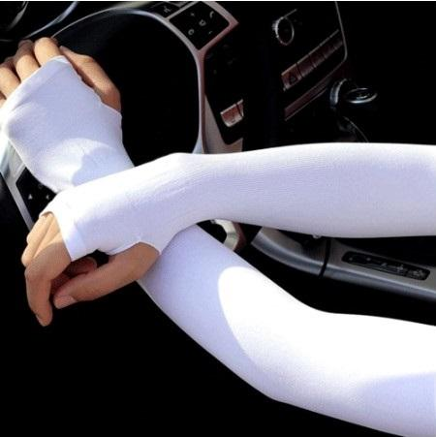
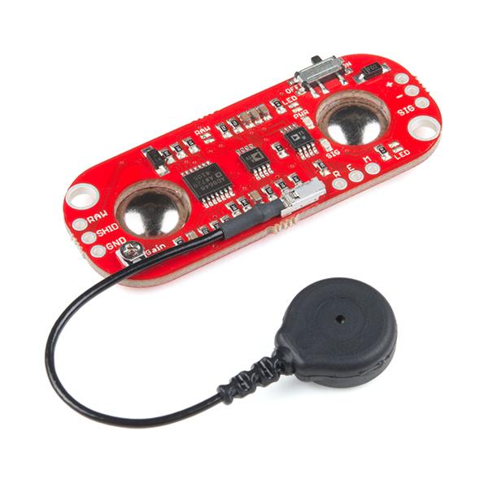
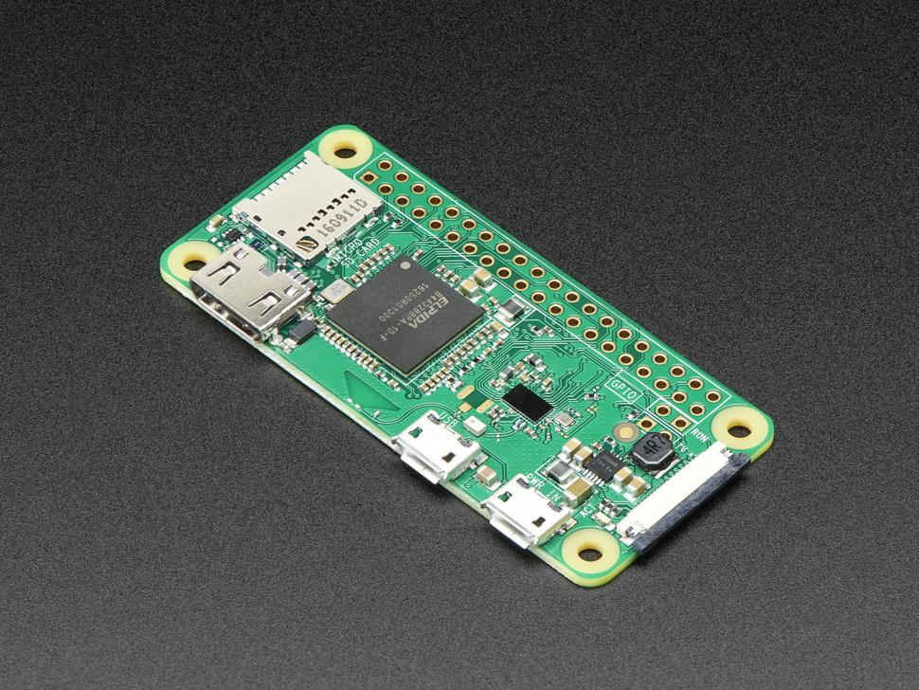
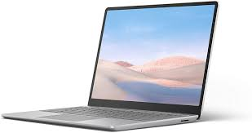
Components
Garment: Lightweight and comfortable cuff made of stretchable material that conforms to the forearm
EMG Sensors: x4 Myoware sensors for measuring EMG; attached to lining of garment
Microcontroller: Arduino or Raspberry Pi (Zero W), for collecting EMG signals from the EMG sensors
Controller Software
Host: laptop or tablet
User Interface Software

Slide 4
Recommended Software
Autodesk tools
Electrical Design: TinkerCAD
Mechanical Design: Fusion360 OR Autodesk Inventor
https://www.autodesk.com/education/edu-software/overview?sorting=featured&page=1

Slide 5
Mechanical Goals
Choose sleeve
Determine how to attach electronics
Can you ensure good contact between sensor & arm?
Consider using CAD software to visual positioning of sensors, microcontroller, and wiring

Slide 6
Electrical Goals
Wiring between sensors and microcontroller
Going from wired to wireless operations between microcontroller and host computer

Slide 7
Programming Goals
Collection of data from the EMG
Classification of EMG data to different poses

