Slide 1
Partitioning Algorithms for Induced Subgraph Problems
James Trimble

Slide 2
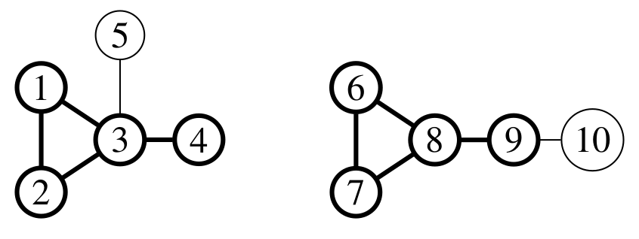
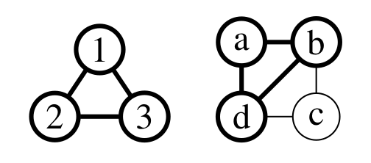
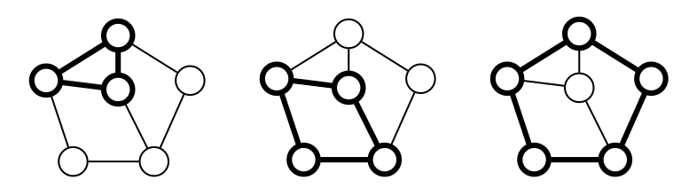
The Three Problems Considered
Maximum Common Induced Subgraph |  | + Directed, Labelled, Loops, Connected
Induced Subgraph Isomorphism |  | + Directed, Vertex Labelled
Minimal Induced Universal Graph

Slide 3
Prior Work
MCIS
  Levi (1973)
Papers that present SOTA that I’ve improved on.

Slide 4
Thesis Outline
 | Sparse | Dense
Maximum Common Induced Subgraph |  | McSplit(↓) (Chapter 3)
Induced Subgraph Isomorphism

Slide 5
Thesis Outline
 | Sparse | Dense
Maximum Common Induced Subgraph |  | McSplit(↓) (Chapter 3) McSplit-2S (Chapter 4)
Induced Subgraph Isomorphism

Slide 6
Thesis Outline
 | Sparse | Dense
Maximum Common Induced Subgraph | McSplit-sparse (Chapter 5) | McSplit(↓) (Chapter 3) McSplit-2S (Chapter 4)
Induced Subgraph Isomorphism | McSplit-SI (Chapter 5) | McSplit-SI-AM (Chapter 5)

Slide 7
Thesis Outline
 | Sparse | Dense
Maximum Common Induced Subgraph | McSplit-sparse (Chapter 5) | McSplit(↓) (Chapter 3) McSplit-2S (Chapter 4)
Induced Subgraph Isomorphism | McSplit-SI (Chapter 5) | McSplit-SI-AM (Chapter 5)
Chapter 6 uses a version of McSplit-SI-AM within exact and heuristic algorithms for Minimal Induced Universal Graph.

Slide 8
Contributions
New algorithms for MCIS and ISIP that improve on the state of the art in both speed and memory use.
Theoretical and empirical comparisons with existing algorithms.
Empirical studies of vertex-ordering heuristics.
New methods for finding small induced universal graphs, adding new terms to OEIS A097911 and adding sequence A0348638.

Slide 9
Future Directions
Better variable and value ordering heuristics for McSplit and other solvers
Restarts and nogood learning; e.g. solution-biased search (Archibald et al., 2019)
Portfolio solvers
McSplit for maximum common edge subgraph

Slide 10
Extra Slides

Slide 11
The Name “McSplit”
From “MCS” and “Split”

Slide 12
Work Not Included in Thesis
Maximum Weight Clique: new instance families and empirical study (CP 2017), a new exact algorithm (unpublished)
PACE Challenge:
  Exact Vertex Cover, 2019: 2nd Place
  Heuristic Hypertree Width, 2019: 1st Place
  Exact Treedepth, 2020: 1st Place
  Heuristic Treedepth, 2020: 4th Place

