Slide 1

QSTEP SQL Masterclass
Dr James Tripp, Senior Research Software Engineer
IDG Technology for Research
Information and Digital Group (Warwick)
25th December 2021/ Microsoft Teams

Slide 2
James Tripp
Background in Psychology (BSc, PhD), then as a Senior Academic Technologist in the Centre for Interdisciplinary Methodologies (CIM, Warwick)
Just started as a Senior Research Software Engineer at IDG Technology for Research (Research software engineers in Warwick’s Information and Digital Group)
SQL?
Large datasets
Analysis
System Administration

Slide 3
SQL?
Structure Query Language. A domain specific language – designed for a specific purpose
Relational databases
Give the database the query. The database then gets the data in an optimal way.
See:
https://en.wikipedia.org/wiki/SQL
https://www.w3schools.com/sql/sql_intro.asp

Slide 4
Our Data
Table name:
world_indicators
world_borders
country | country code | electricity | area
United Kingdom | GBR | 100 | 241930
… | … | … | …
iso3 | population | geography
GBR | 60244834 | 01060000 …
… | … | …
Row
Column

Slide 5
E.g.,
SELECT column FROM table;
SELECT country FROM world_indicators;
SELECT population FROM world_borders;

Slide 6
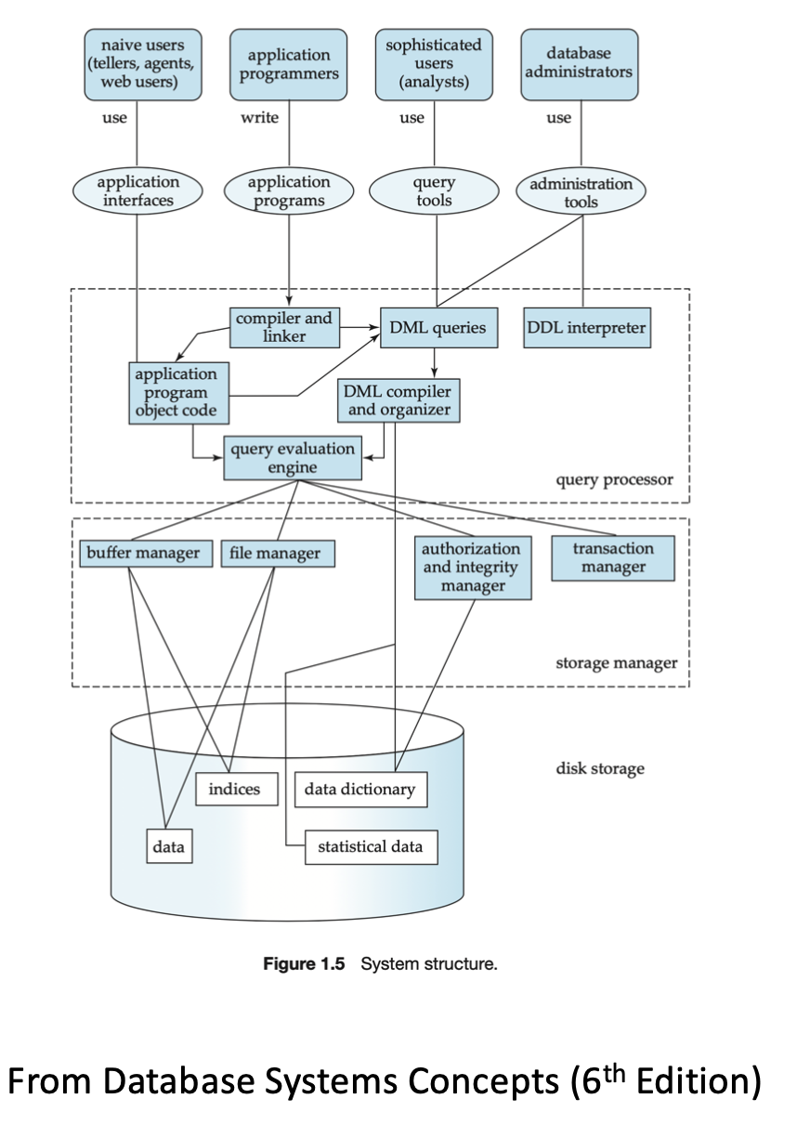
Why use a database?
Data storage
Efficient data querying via SQL
A little complicated…

Slide 7
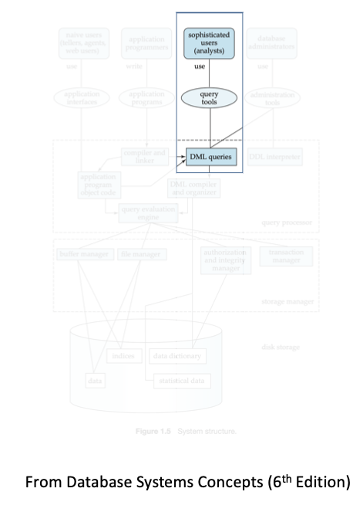
Why use a database?
Data storage
Efficient data querying via SQL
A little complicated…

Slide 8
Our brief
We are data analysts/data scientists
Question: What is the relationship between two world indicators across countries?
Our data is in a table called world_indicators in the qstep database
An additional table called world_borders contains the geospatial borders of countries. This may help with visualization work

Slide 9
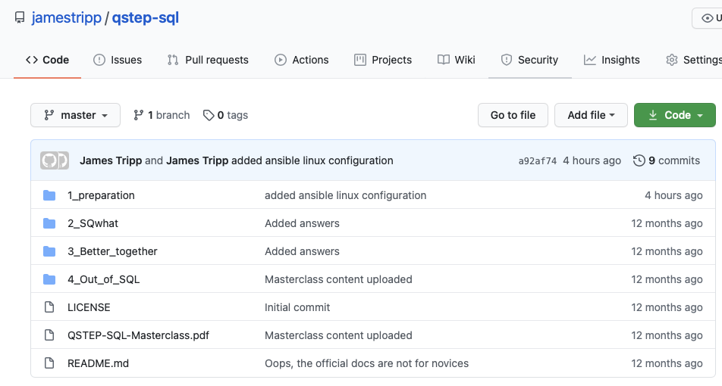
Materials
Located in Github
https://github.com/jamestripp/qstep-sql

Slide 10
Today
Introduction (this presentation)
Local installation of database and data (optional)
SQWhat?
Basic SQL introduction
Better together
Aggregate function for data and joining tables
Out of SQL
Taking data from the database
Using R for data analysis and visualisation

