Slide 1
影像處理、電腦視覺及深度學習概論 (Introduction to Image Processing, Computer Vision and Deep Learning) Homework 1
TA:
少鈞: nckubot65904@gmail.com
Office Hour: 14:00~16:00, Mon.
10:00~12:00, Fri.
At CSIE 9F Robotics Lab.

Slide 2
Notice (1/2)
Copying homework is strictly prohibited!! Penalty: Score will be zero for both persons!!
Due date => 08:00:00, 2022/10/17 (Mon.)
No delay. Penalties for late homework:
Up to 7 days late, loss of 50% of the score awarded
After 7 days, the score will be marked as 0.
You must attend the demonstration, or your score will be 0. The demonstration schedule will be announced on NCKU moodle.
You must make a GUI, or you will get some penalties.
Upload to => 140.116.154.1 -> Upload/Homework/Hw1_1 (Hw1_05)
User ID: opencvdl2022 Password: opencvdl2022
Format
Filename: Hw1_1_StudentID_Name_Version.rar
Ex: Hw1_1_F71234567_林小明_V1.rar
If you want to update your file, you should update your version to be V2, ex: Hw1_1_F71234567_林小明_V2.rar
Content: project folder*( excluding the pictures ) *note: remove your “Debug” folder to reduce file size

Slide 3
Notice (2/2)
Python (recommended)
Python 3.7 (https://www.python.org/downloads/)
opencv-contrib-python (3.4.2.17)
Matplotlib 3.1.1
UI framework: pyqt5 (5.15.1)
C++ (check MFC guide in ftp)
OpenCV 3.3.1 (https://opencv.org/release.html)
Visual Studio 2015 (download from http://www.cc.ncku.edu.tw/download/)
UI framework: MFC

Slide 4
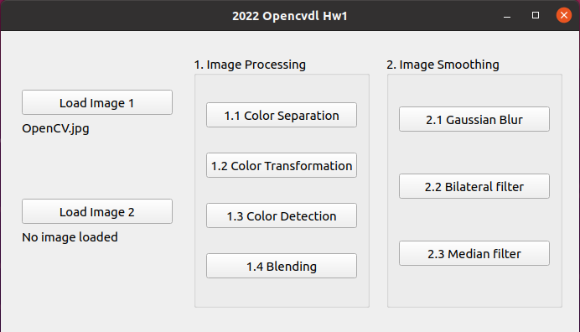
Assignment scoring (Total: 100%)
1. (20%) Image Processing
1.1 (5%) Color Separation
1.2 (5%) Color Transformation
1.3 (5%) Color Detection
1.4 (5%) Blending
2. (20%) Image Smoothing
2.1 (6%) Gaussian blur
2.2 (7%) Bilateral filter
2.3 (7%) Median filter
3. (20%)
4. (20%)
5. (20%) Training Cifar10 Classifier Using Resnet101
(出題：Sam)
(出題：Jack)
(出題：)
Don’t fix your image path
(There is another dataset for demonstration)
(出題：)
(出題：Wen)

Slide 5
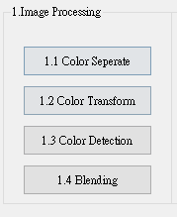
1. Image Processing (20%)
(出題：Sam)
1.1 (5%) Color Separation
1.2 (5%) Color Transformation
1.3 (5%) Color Detection
1.4 (5%) Blending

Slide 6


1.1 Color Separation (5%)
(出題：Sam)
Given: a color image, “OpenCV.jpg”
Q: 1) Extract 3 channels of the image BGR to 3 separated channels and show the result images.
Hint:
Textbook Chapter 3, p.31 ~ p.49
cv2.split(), cv2.merge()
OpenCV.jpg
B channel
G channel
R channel

Slide 7
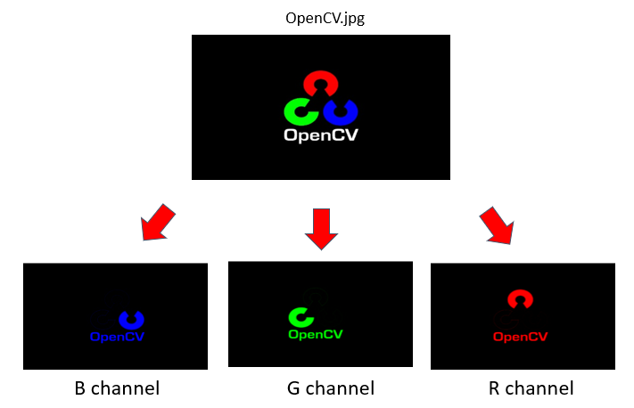

1.2 Color Transformation (5%)
(出題：Sam)
Given: 1 color image: “OpenCV. jpg”
Q: 1) Transform “OpenCV.jpg” into grayscale image I₁ by calling OpenCV function directly.
2) Merge BGR separated channel images from problem 1.2 into grayscale image I₂ by I₂ = (R+G+B)/3.
3) Show the above 2 results.
Hint:
Textbook Chapter 3, p.56 ~ p.59
cv2.cvtColor(…, cv2.COLOR_BGR2GRAY)
1) OpenCV function
2) Average weighted
I₁
I₂
Perceptually weighted formula:
I₁ = 0.07*B + 0.72*G + 0.21*R
Average weighted formula:
I₂ = (R+G+B)/3

Slide 8
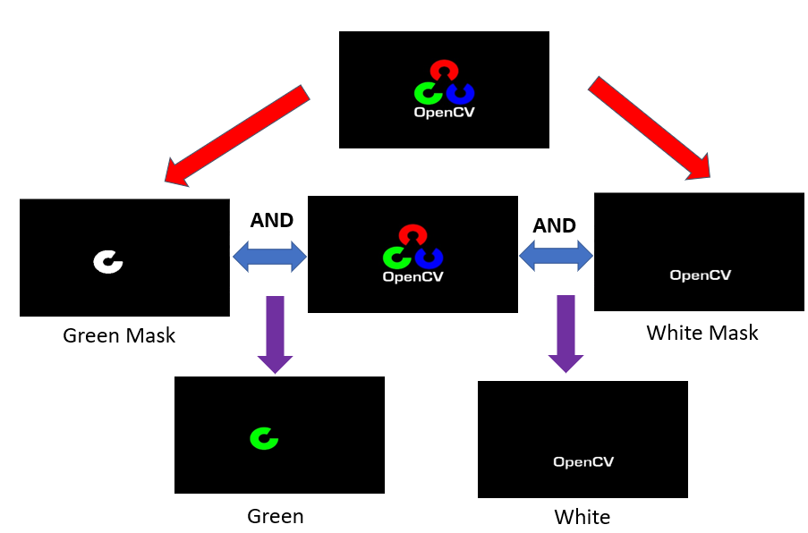
(出題：Sam)
1.3 Color Detection (5%)
Given: 1 color image: “OpenCV. jpg”
Q: 1) Transform “OpenCV.jpg” from BGR format to HSV format.
2) Generate mask by calling :
cv2.inRange(hsv_img , lower_bound , upper_bound)
3) Detect Green and White color in the image by calling :
cv2.bitwise_and(bgr_img , bgr_img , mask)
4) Show the result

Slide 9
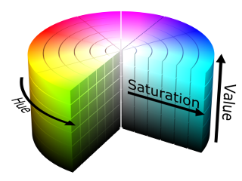
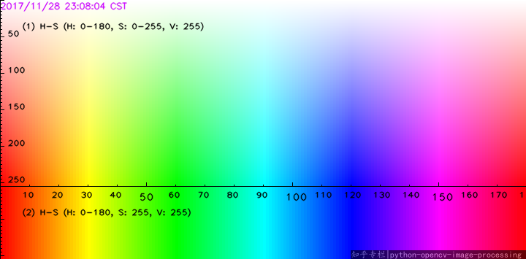
(出題：Sam)
1.3 Color Detection (5%)
Hint:
cv2.cvtColor(…, cv2.COLOR_BGR2HSV)
cv2.inRange(hsv_img , lower_bound , upper_bound)
cv2.bitwise_and(bgr_img , bgr_img , mask)
HSV values ranges between (0–180, 0–255, 0–255)
H(Hue) : x axis
S(Saturation) : y axis
V(Value) : 255
Using this range should be fine
Green Range : (40-80,50-255,20-255)
White Range : (0-180,0-20,200-255)
REF: https://medium.com/@gowtham180502/how-to-detect-colors-using-opencv-python-98aa0241e713

Slide 10
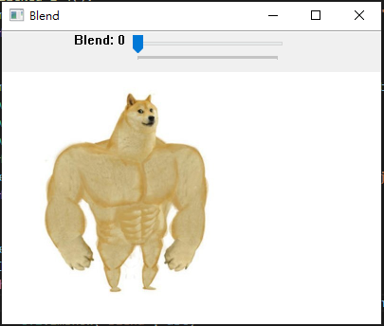
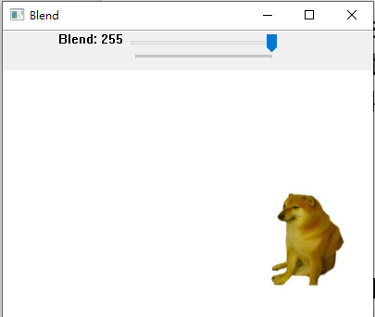
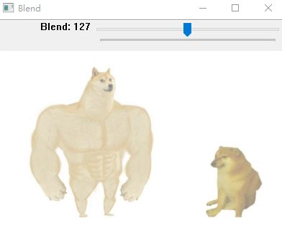
1.4 Blending (5%)
(出題：Sam)
Given: 2 images, “Dog_Strong.jpg” and “Dog_Weak.jpg”
Q: 1) Combine two images (Dog_Strong.jpg and Dog_Weak.jpg). 2) Use Trackbar to change the weights and show the result in the new window.
Hint:
Textbook Chapter 3, p. 50 ~ 52
cv2.addWeighted(), cv2.createTrackbar()
Demo:

Slide 11
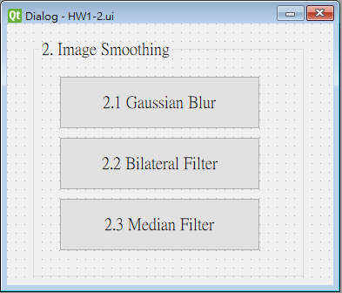
2. Image Smoothing (20%)
(出題：Jack)
2.1 (6%) Gaussian blur
2.2 (7%) Bilateral filter
2.3 (7%) Median filter

Slide 12
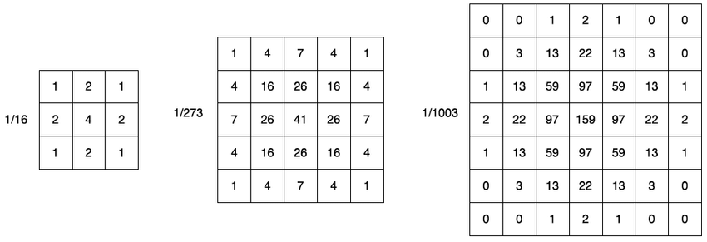
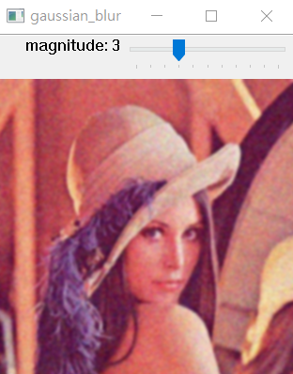
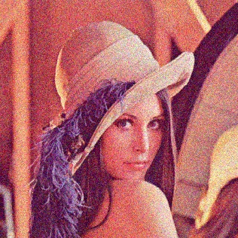
2.1 Gaussian Blur
(出題：Jack)
Given: “image1.jpg
Define: gaussian magnitude 0 ~ 10,
Condition1. magnitude = m > 0 then Apply gaussian filter k x k to “image1.jpg” (k=2m+1)
Condition2. magnitude = m = 0 then output “image1.jpg”
Q: Use Trackbar to change the magnitude and show the result in the popup window.
Hint:
Textbook Chapter 3, p. 50 ~ 52, p.109~115
cv2.GaussianBlur(), cv2.createTrackbar()
image1.jpg

Slide 13
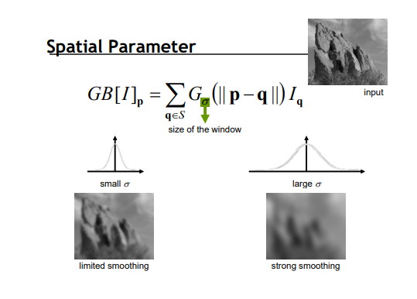
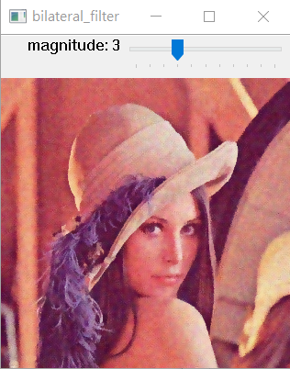
2.2 Bilateral Filter
(出題：Jack)
Given: “image1.jpg
Define: Bilateral magnitude 0 ~ 10,
Condition1. magnitude = m > 0 then Apply bilateral filter k x k to “image1.jpg” (k=2m+1)
Condition2. magnitude = m = 0 then output “image1.jpg”
Q: Use Trackbar to change the magnitude and show the result in the popup window.
Hint:
Textbook Chapter 3, p. 50 ~ 52, p.109~115
cv2.bilateralFilter(), cv2.createTrackbar()
image1.jpg

Slide 14
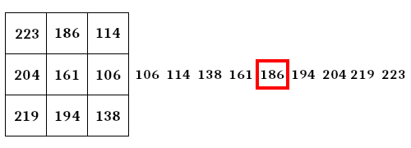
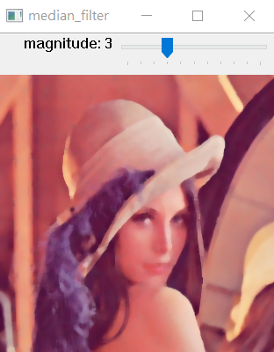
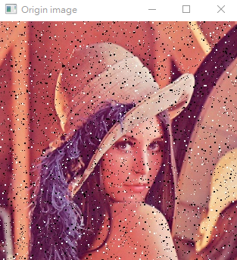
2.3 Median Filter
(出題：Jack)
Given: “image2.jpg
Define: Median magnitude 0 ~ 10,
Condition1. magnitude = m > 0 then Apply median filter k x k to “image2.jpg” (k = 2m+1)
Condition2. magnitude = m = 0 then output “image2.jpg”
Q: Use Trackbar to change the magnitude and show the result in the popup window.
Hint:
Textbook Chapter 3, p. 50 ~ 52, p.109~115
cv2.medianBlur(), cv2.createTrackbar()
Median filter example

Slide 15
5. Training Cifar10 Classifier Using Resnet101 (20%)
(出題：Wen)
5.1 Load Image and Show 9 Training Images with Different Label (2%)
5.2 Show Model Structure (2%)
5.3 Show Data Augmentation Result (2%)
5.4 Show Accuracy and Loss (2%)
5.5 Inference (12%)

Slide 16
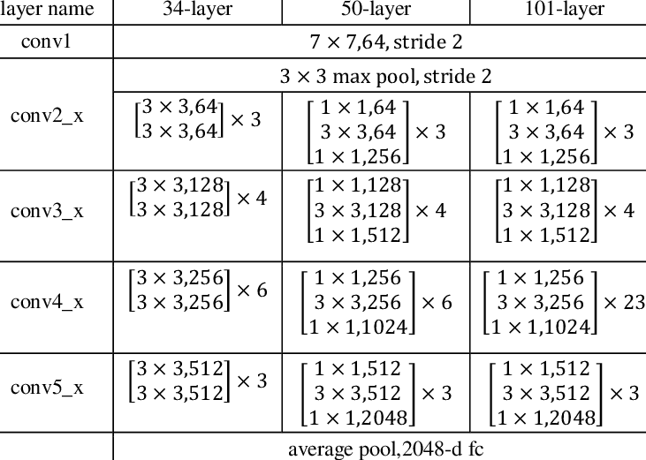
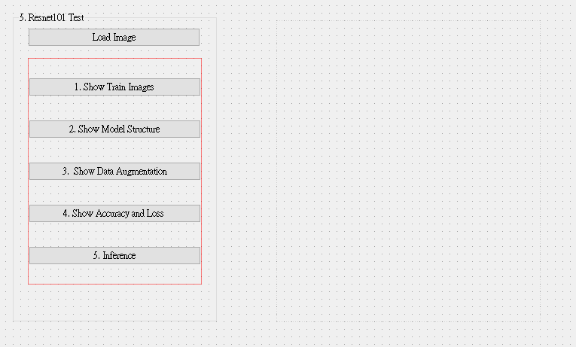
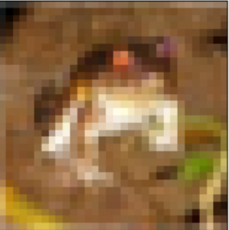
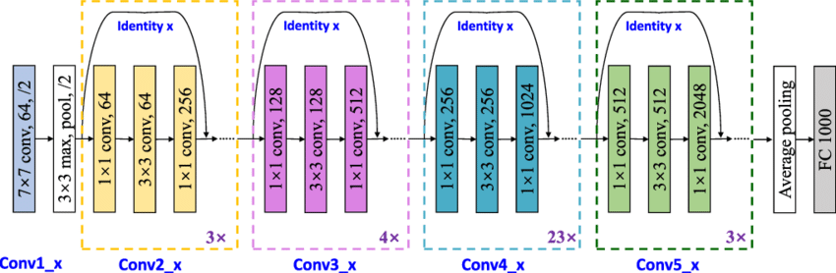
5.0 Training Cifar10 Classifier Using Resnet101
(出題：Wen)
Learn how to construct Resnet101 and train it on Cifar10.
Environment Requirement
Python
Tensorflow / PyTorch (Can choose the one)
opencv-contrib-python
Matplotlib
Reference
https://pytorch.org/vision/main/models/generated/torchvision.models.resnet101.html (Source Code)
https://www.cs.toronto.edu/~kriz/cifar.html (Cifar10 Dataset)
GUI example
Resnet101 framework

Slide 17
GUI example

Slide 18
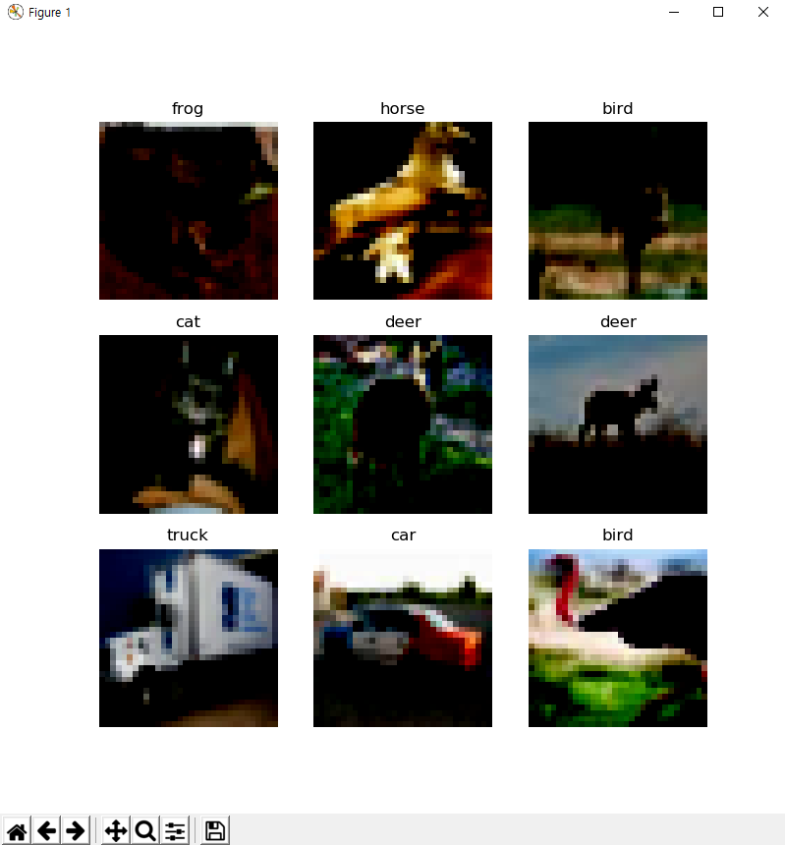
5.1 Load Cifar10 training dataset, and then show 9 Images and Labels respectively (2%)
(出題：Wen)
Class
Label
0 airplane
1 automobile
2 bird
3 cat
4 deer
5 dog
6 frog
7 horse
8 ship
9 truck
Image
10 Class of CIFAR 10 Dataset
◆ Hint
Use Matplotlib 4 function
figure()
title()
Axis()
imshow()
Can refer by tutorial at the Matplotlib library official web-site
https://matplotlib.org/stable/tutorials/index.html

Slide 19
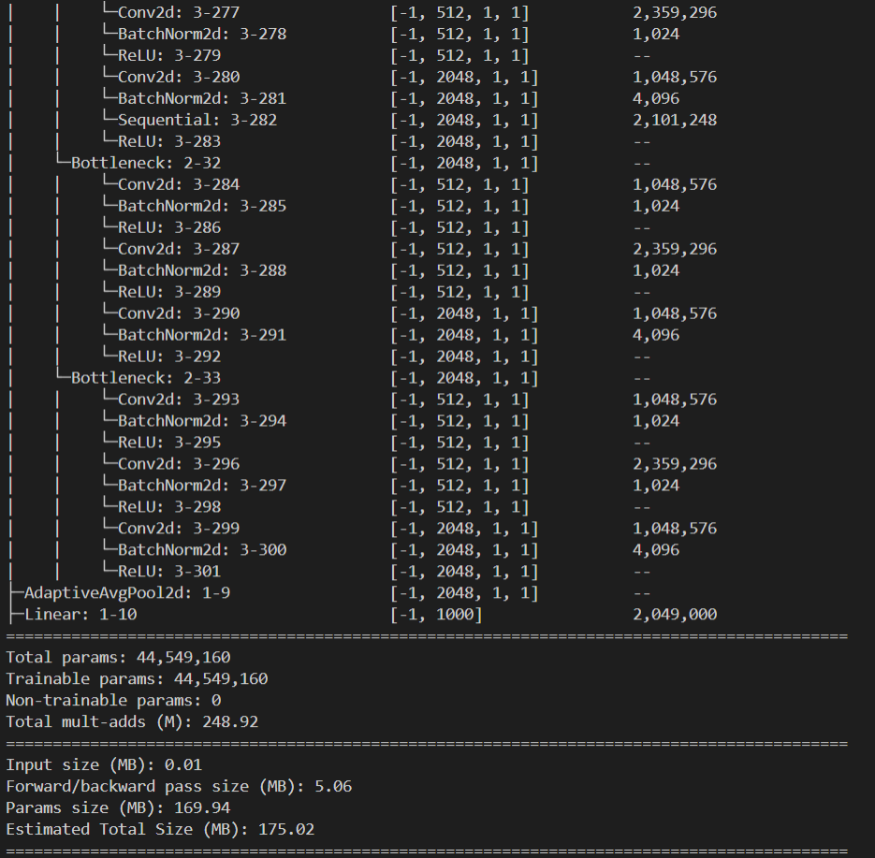
5.2 Construct and show your model structure by print out on the terminal (You can use available architecture provided by ML framework to build your model) (2%)
(出題：Wen)
◆ Hint
Pytorch API
Use the two option
Summary function
from torchsummary import summary
-> import the package
summary(Model name, (Input Channel, Input Width, Input Height))
-> run the function and print on the terminal
Print function
From torchvision import models
-> import the package
model = torchvision.models.resnet101()
-> Make the mode data
Print(Model)
Can refer this web-site
https://pypi.org/project/pytorch-model-summary/
Layers List of
Model
After processing
each layer
Change of input
data type
Number of
trainable
parameters

Slide 20
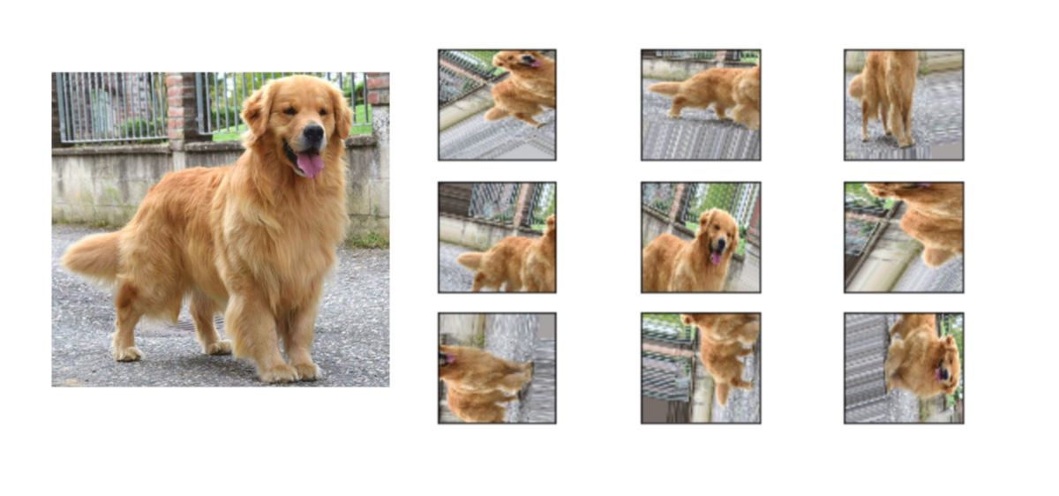
5.3 Show Data Augmentation Result (2%)
(出題：Wen)
Show three kinds of augmentation methods and show the results as example.
Transforms on PIL Image and torch.*Tensor
CenterCrop(size)
ColorJitter([brightness, contrast, ...])
FiveCrop(size)
Grayscale([num_output_channels])
Pad(padding[, fill, padding_mode])
RandomAffine(degrees[, translate, scale, ...])
RandomApply(transforms[, p])
RandomCrop(size[, padding, pad_if_needed, ...])
RandomGrayscale([p])
RandomHorizontalFlip([p])
RandomPerspective([distortion_scale, p, ...])
RandomResizedCrop(size[, scale, ratio, ...])

Slide 21
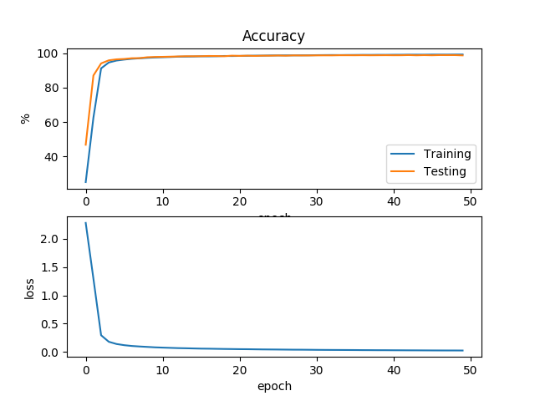
5.4 Training your model at least 30 epochs by your own computer, then save your model and take a screenshot of your training loss and accuracy. No saved images no points (2%)
(出題：Wen)
◆ Hint
There are two option.
Just use the normal method(Above image used this way)
https://www.pyimagesearch.com/2021/07/19/pytorch-training-your-first-convolutional-neural-network-cnn/
2) Use tensorboard in Tensorflow API or tensorboard in pytorch
https://pytorch.org/tutorials/intermediate/tensorboard_tutorial.html
(record accuracy/loss per epoch)

Slide 22


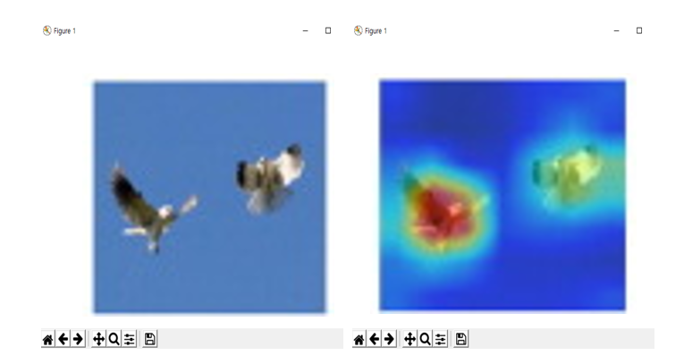
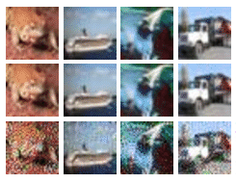
5.5 Load your model trained at 5.4, we will give you 6 images (2 pts/image), inference them and show the result image and class (12%)
(出題：Wen)
1. Choose the any data
Warning!!
You should train the model with 10 classes, but inference for 11 classes (1 label for not belong to any). Prediction label = Nothing, if confidence lower than 0.7.
Inference image will be different size, please resize the image before inference.
The image will suffer adversarial attack, please think about how to defense.
2. Run Inference
3. Show the prediction label, confidence score and the heatmap
Confidence = 0.98
Prediction Label: bird
◆ Hint
https://towardsdatascience.com/understanding-pytorch-with-an-example-a-step-by-step-tutorial-81fc5f8c4e8e#5017
https://pytorch.org/tutorials/

