Slide 1
影像處理、電腦視覺及深度學習概論 (Introduction to Image Processing, Computer Vision and Deep Learning) Homework 1
TA:
少鈞: nckubot65904@gmail.com
Office Hour: 14:00~16:00, Mon.
10:00~12:00, Fri.
At CSIE 9F Robotics Lab.

Slide 2
Notice (1/2)
Copying homework is strictly prohibited!! Penalty: Score will be zero for both persons!!
Due date => 08:00:00, 2022/10/31 (Mon.)
No delay. Penalties for late homework:
Up to 7 days late, loss of 50% of the score awarded
After 7 days, the score will be marked as 0.
You must attend the demonstration, or your score will be 0. The demonstration schedule will be announced on NCKU moodle.
You must make a GUI and follow the format, or you will get some penalties.
Upload to => 140.116.154.1 -> Upload/Homework/Hw1_2
Upload/Homework/Hw1_05
User ID: cvdl2022 Password: cvdl2022
Format
Filename: Hw1_2_StudentID_Name_Version.rar
Hw1_05_StudentID_Name_Version.rar
Ex: Hw1_2_F71234567_林小明_V1.rar
If you want to update your file, you should update your version to be V2.
Ex: Hw1_2_F71234567_林小明_V2.rar
Content: project folder*( excluding the pictures, only source code ) *note: remove your “Debug” folder to reduce file size

Slide 3
Notice (2/2)
Python
Python 3.7 (https://www.python.org/downloads/)
opencv-contrib-python (3.4.2.17)
Matplotlib 3.1.1
UI framework: pyqt5 (5.15.1)
Pytorch
Tensorflow

Slide 4
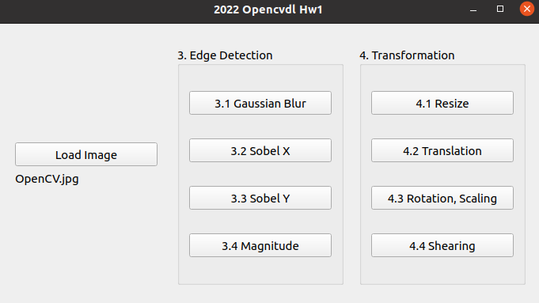
Assignment scoring (Total: 100%)
(出題：Sam)
1. (20%) Image Processing
1.1 (5%) Color Separation
1.2 (5%) Color Transformation
1.3 (5%) Color Detection
1.4 (5%) Blending
2. (20%) Image Smoothing
2.1 (6%) Gaussian blur
2.2 (7%) Bilateral filter
2.3 (7%) Median filter
3. (20%) Edge Detection
3.1 (5%) Gaussian Blur
3.2 (5%) Sobel X
3.3 (5%) Sobel Y
3.4 (5%) Magnitude
4. (20%) Transforms
4.1 (5%) Resize
4.2 (5%) Translation
4.3 (5%) Rotation, Scaling
4.4 (5%) Shearing
5. (20%) Training Cifar10 Classifier Using VGG19
5.1 (4%) Load Cifar10 and Random Show 9 Images with Label
5.2 (4%) Load Model and Show Model Structure
5.3 (4%) Show Data Augmentation Result
5.4 (4%) Show Accuracy and Loss
5.5 (4%) Inference
(出題：Jack)
(出題：Chong)
(出題：Jeffin)
(出題：Wen)

Slide 5
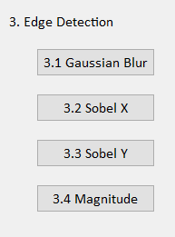
3. Edge Detection (20%)
(出題: Chong)
3.1 Gaussian Blur (5%)
3.2 Sobel X (5%)
3.3 Sobel Y (5%)
3.4 Magnitude (5%)

Slide 6
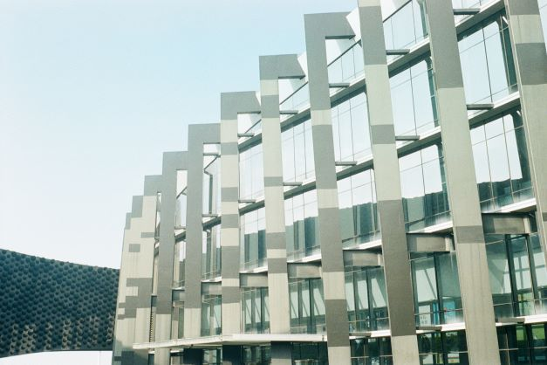
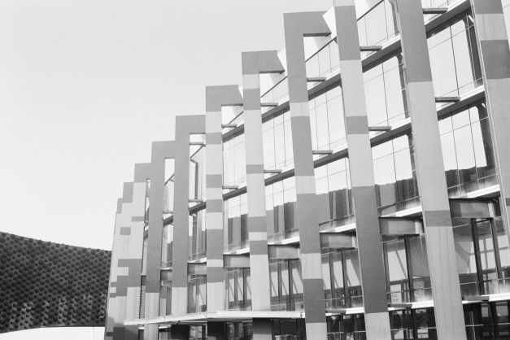

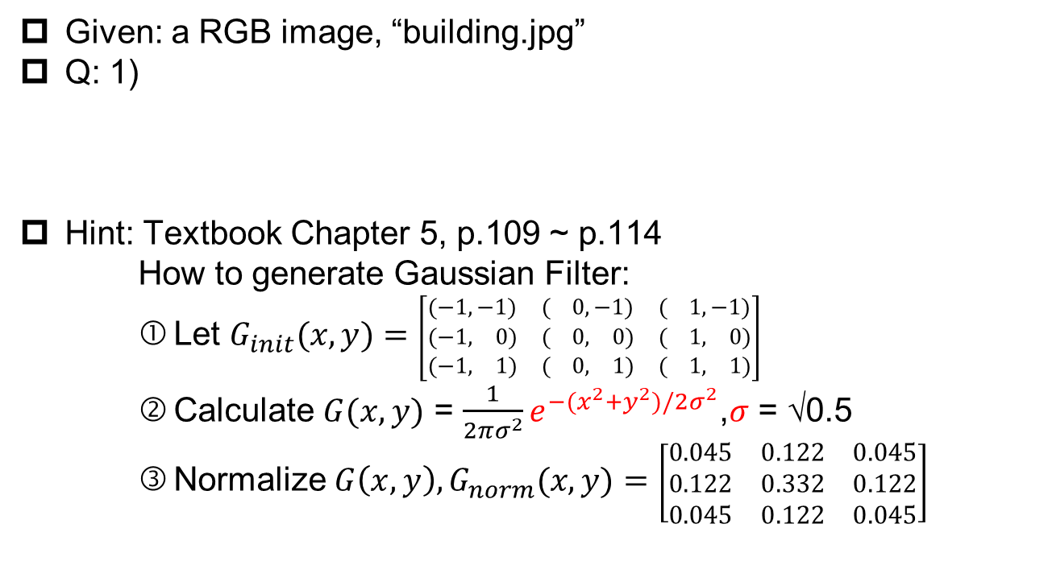
3.1 Gaussian Blur (5%)
(出題：Chong)
Given: a RGB image, “building.jpg”
Q: 1)
Hint: Textbook Chapter 5, p.109 ~ p.114
How to generate Gaussian Filter:
Let $G_{init}(x, y)=$ $\left[\begin{matrix}(−1,−1) & ( 0,−1) & ( 1,−1) \\ (−1, 0) & ( 0, 0) & ( 1, 0) \\ (−1, 1) & ( 0, 1) & ( 1, 1)\end{matrix}\right]$
Calculate $G(x, y)$ = $\frac{1}{2πσ^{2}}e^{−(x^{2}+y^{2})/2σ^{2}}$,$σ$ = √0.5
Normalize $G\left(x, y\right),G_{norm}(x, y)=$ $\left[\begin{matrix}0.045 & 0.122 & 0.045 \\ 0.122 & 0.332 & 0.122 \\ 0.045 & 0.122 & 0.045\end{matrix}\right]$
Gaussian Blur: Convert the RGB image into a grayscale image, then smooth it by your own 3x3 Gaussian smoothing filter (Can not use OpenCV Function, Sobel, GaussianBlur and conv2d). Please show the result.
building.jpg
Grayscale
Gaussian Blur

Slide 7
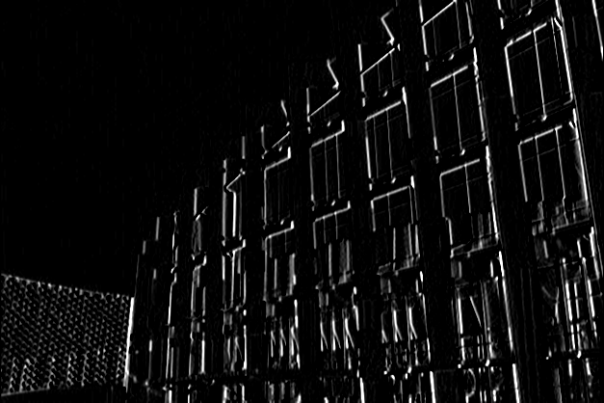
3.2 Sobel X (5%)
(出題：Chong)
Given: the result of 3.1) Gaussian Blur
Q: 2)
Hint: Textbook Chapter 6, p.148 ~ 149
Sobel X: Use Sobel edge detection to detect vertical edge by your own 3x3 Sobel X operator (Can not use OpenCV Function, Sobel, GaussianBlur and conv2d). Please show the result.
-1 | 0 | 1
-2 | 0 | 2
-1 | 0 | 1
Sobel X Filter
Gaussian Blur
Sobel X

Slide 8
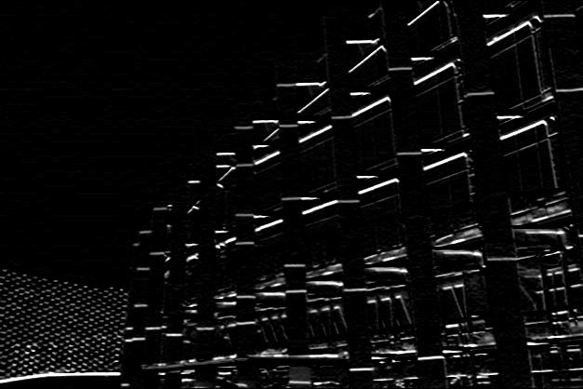
3.3 Sobel Y (5%)
(出題：Chong)
Given: the result of 3.1) Gaussian Blur
Q: 3)
Hint: Textbook Chapter 6, p.148 ~ 149
Sobel Y: Use Sobel edge detection to detect horizontal edge by your own 3x3 Sobel Y operator (Can not use OpenCV Function, Sobel, GaussianBlur and conv2d). Please show the result.
1 | 2 | 1
0 | 0 | 0
-1 | -2 | -1
Sobel Y Filter
Gaussian Blur
Sobel Y

Slide 9
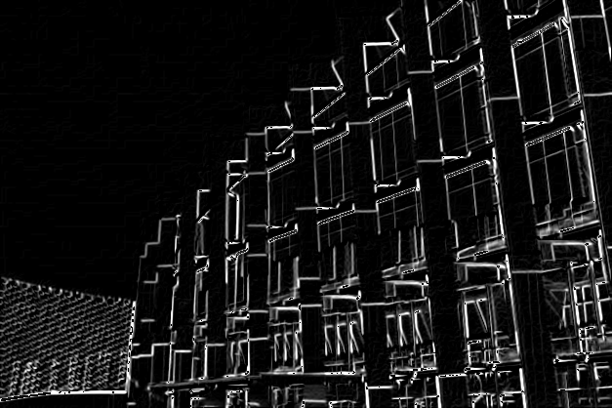
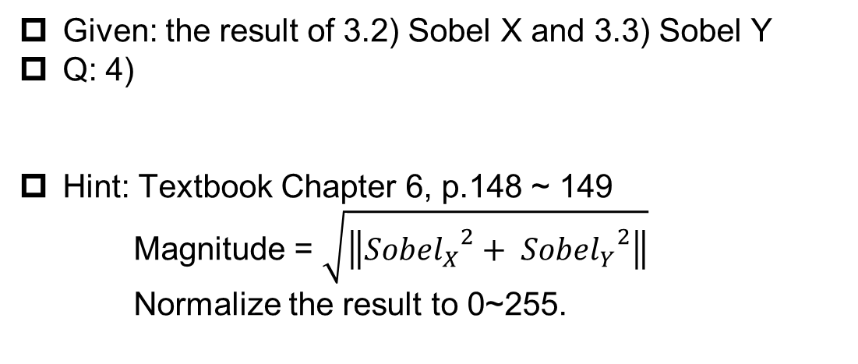
3.4 Magnitude (5%)
(出題：Chong)
Given: the result of 3.2) Sobel X and 3.3) Sobel Y
Q: 4)
Hint: Textbook Chapter 6, p.148 ~ 149
Magnitude = $\sqrt{\left\|{{Sobel}_{X}}^{2}+ {{Sobel}_{Y}}^{2}\right\|}$
Normalize the result to 0~255.
Magnitude: Use the results of 3.2) Sobel X and 3.3) Sobel Y to calculate the magnitude. Please show the result.
Sobel X
Magnitude
Sobel Y

Slide 10
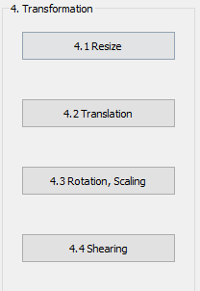
4. Transforms (20%)
(出題: Jeffin)
4.1 Resize (5%)
4.2 Translation(5%)
4.3 Rotation, Scaling (5%)
4.4 Shearing (5%)

Slide 11

4.1 Transforms: Resize, Translation, Rotation, Scaling, Shearing(20%)
Given: “Microsoft.png”, Image Size (430, 430)
Q:Please resize, translate , rotate, scale and shearing the picture (Microsoft.png)
4.1) Resize:
From (430,430) to (215,215)
and cv2.imshow with (430, 430) window (image center: (108, 108)
top left of window)
4.2) Image Translation:
Xnew = Xold + 215 pixels = 108 + 215 = 323
Ynew = Yold + 215 pixels = 108 + 215 = 323
Point C (108, 108) is center of resized image Point C’(323, 323) is new center of image (bottom right of window)
(Then overlay with result image of 4.1))
4.3) Rotation, Scaling:
Center: Center of Image
Angle = 45º (counter-clockwise)
Scale = 0.5 , window size (430,430)
4.4) Shearing:
Old location: ([[50,50],[200,50],[50,200]])
New location: ([[10,100],[100,50],[100,250]])
(Note: Please save your image after each section)
Hint: Textbook Chapter 12, (p.407 ~ 412) python: cv2.warpAffine(),
Textbook Chapter 3, (p.50 ~ 52)
cv2.addWeighted()
(出題: Jeffin)
W:430
H:430
Microsoft.png

Slide 12




4.2 Transforms: Resize, Translation, Rotation, Scaling, Shearing(20%)
EX: Given: “Microsoft.png”, image size (430, 430)
Hint: Textbook Chapter 12, (p.407 ~ 412) python: cv2.warpAffine(),
Textbook Chapter 3, (p.50 ~ 52)
cv2.addWeighted()
(出題: Jeffin)
Microsoft.png
4.1) Resized Image
4.2) Translate + Overlay
4.3) Rotate and Scale
4.4) Shearing
(0,0)
(0,0)
C ‘(108, 108)
45º
C’ (323, 323)

Slide 13
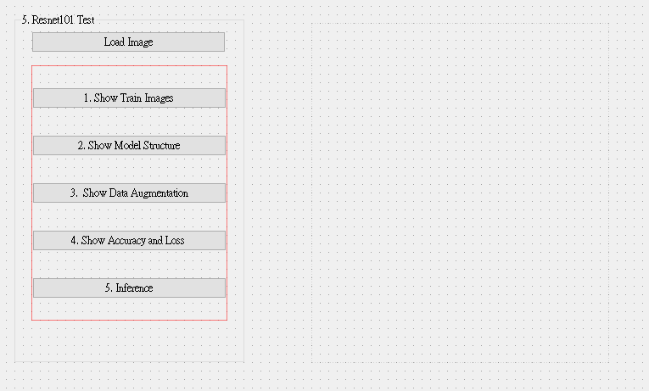
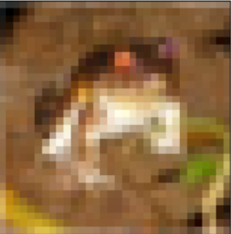
5. Training Cifar10 Classifier Using VGG19 (20%)
5.1 Load Cifar10 and Random Show 9 Images with Label(4%)
5.2 Load Model and Show Model Structure (4%)
5.3 Show Data Augmentation Result (4%)
5.4 Show Accuracy and Loss (4%)
5.5 Inference (4%)

Slide 14

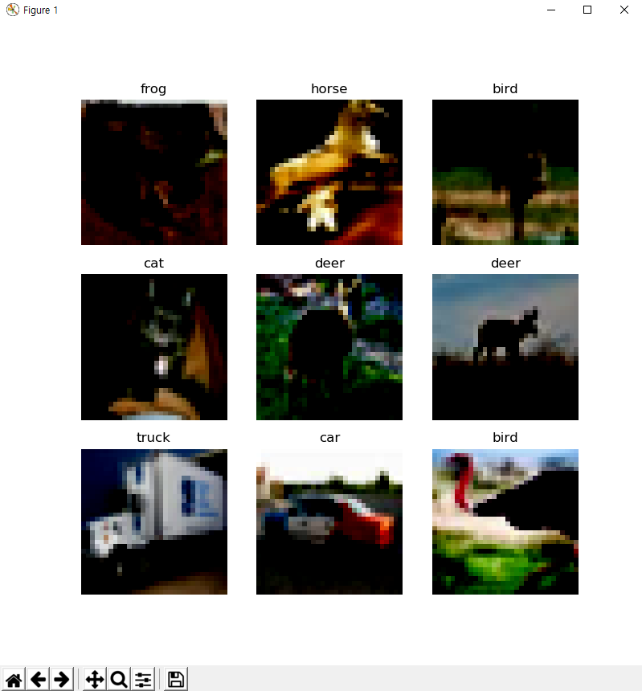
5.1 Load Cifar10 training dataset, and then Randomly show 9 Images and Labels respectively (4%)
Load Cifar10.
Tensorflow: tf.keras.datasets.cifar10.load_data()
Click Button to Random show 9 Images with Labels.
10 Class of CIFAR 10 Dataset
0 airplane
1 automobile
2 bird
3 cat
4 deer
5 dog
6 frog
7 horse
8 ship
9 truck
Class
Label
Image
◆ Hint
Use Matplotlib 4 function
figure()
title()
Axis()
imshow()
Can refer by tutorial at the Matplotlib library official web-site
https://matplotlib.org/stable/tutorials/index.html

Slide 15
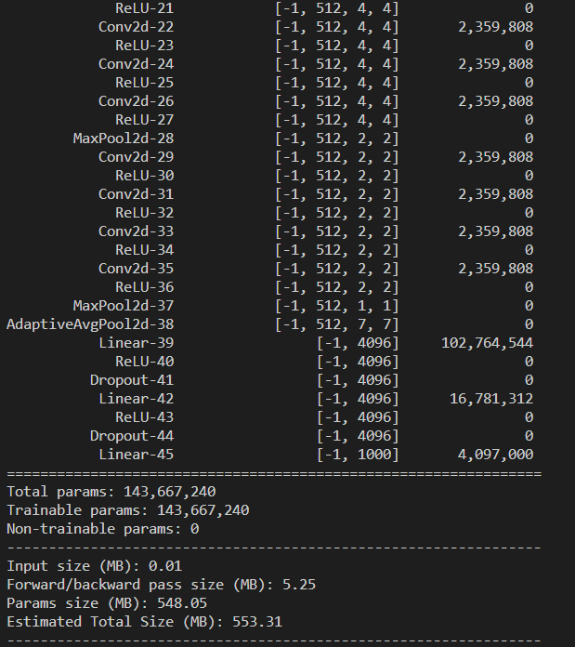
5.2 Load Model and Show Model Structure(4%)
Load Model
When Training:
Tensorflow: tf.keras.applications.VGG19()
When Demo:
1)Tensorflow: tf.keras.models.load_model(model_name)
2. Click Button to Show Model Structure on terminal.
◆ Hint(when call model)
Input shape should set to 32 x 32.
Classes should to set 10.
◆ Hint
Pytorch API
Use the two option
Summary function
from torchsummary import summary
summary(Model name, (Input Channel, Input Width, Input Height))
Print function
From torchvision import models
model = torchvision.models.vgg19()
Print(Model)
Can refer this web-site https://pypi.org/project/pytorch-model-summary/

Slide 16
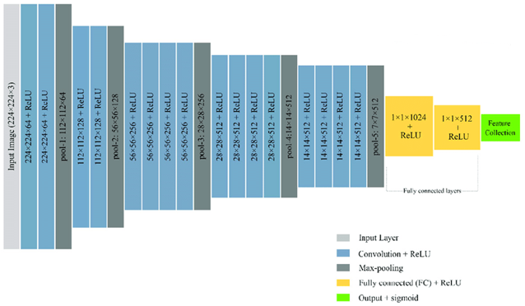
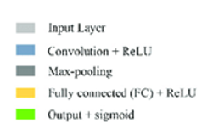
5.2 Load Model and Show Model Structure(4%)
Batch size, channel, H,W
Resize Image 32x32 to 224x224
MaxPool2d window size = 2
All convolution filter size is 3x3
Flatten Here
Layers List of
Model
After processing
each layer
Change of input
data type
Number of
trainable
parameters
The Last Layer:
Fully Connection Layer:
(1*512) to (1*10) classes
Reference
https://pytorch.org/vision/0.12/generated/torchvision.models.vgg19.html(Source Code)
https://www.cs.toronto.edu/~kriz/cifar.html (Cifar10 Dataset)
VGG19 framework

Slide 17
5.3 Show Data Augmentation Result (4%)
When conducting deep learning training, we often need massive amounts of data to ensure that there is no over-fitting during training.
Data augmentation is to modify and deform the existing pictures in the dataset to create more pictures for machine learning to make up for the lack of data.
In this section, we want you to try 3 kinds of augmentation methods.
The methods of transforms on PIL Image and torch.*Tensor
CenterCrop(size) | Crops the given image at the center.
ColorJitter([brightness, contrast, …]) | Randomly change the brightness, contrast, saturation and hue of an image.
FiveCrop(size) | Crop the given image into four corners and the central crop.
Grayscale([num_output_channels]) | Convert image to grayscale.
Pad(padding[, fill, padding_mode]) | Pad the given image on all sides with the given “pad” value.
RandomAffine(degrees[, translate, scale, …]) | Random affine transformation of the image keeping center invariant.
RandomApply(transforms[, p]) | Apply randomly a list of transformations with a given probability.
RandomCrop(size[, padding, pad_if_needed, …]) | Crop the given image at a random location.
RandomGrayscale([p]) | Randomly convert image to grayscale with a probability of p (default 0.1).
RandomHorizontalFlip([p]) | Horizontally flip the given image randomly with a given probability.
RandomPerspective([distortion_scale, p, …]) | Performs a random perspective transformation of the given image with a given probability.

Slide 18
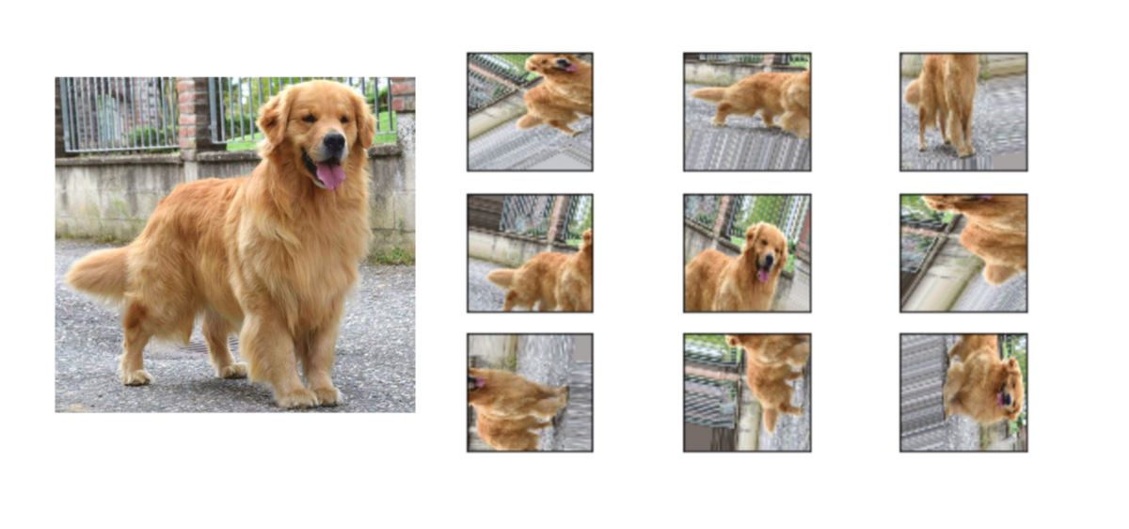

5.3 Show Data Augmentation Result (4%)
Load Image to select an image file.
2. Click Button to Show Augmentation Data. Concatenate 3 figures of the augmentation results and show it.
GUI example
Transforms on PIL Image and torch.*Tensor
Function:
RandomRotation()
RandomResizedCrop()
RandomHorizontalFlip()
Can refer by tutorial at the Matplotlib library official web-site
https://matplotlib.org/stable/tutorials/index.html

Slide 19
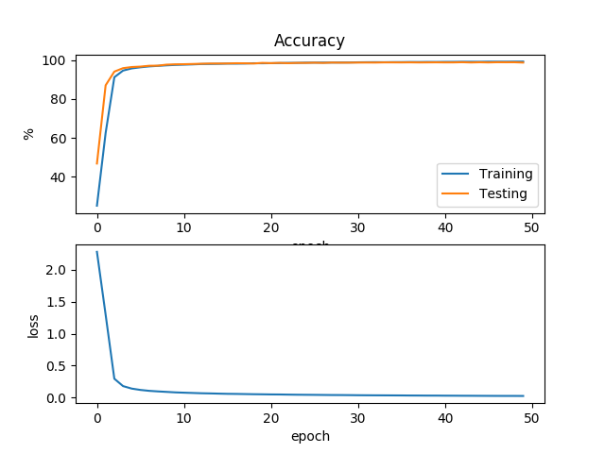
5.4 Training your model at least 30 epochs at home and record the accuracy and loss in each epoch. Show the Figure of your training loss and accuracy when demo time. (4%)
Do in your home:
tesnsorflow: model.fit()
You should set the parameter:
Epoch to 30
Loss : CrossEntropyLoss
Optimizer: Adam
Show the accuracy and loss via plt and get a screen shoot to store this image.
When Demo :
1. Click button to the image
◆ Hint
model which is called form 5.2.
model.fit() returns the accuracy and loss.
model.save() to save your model.
Notice
Please save your weighted file during training
Record each training result (accuracy, loss) and draw it as the picture on the right

Slide 20
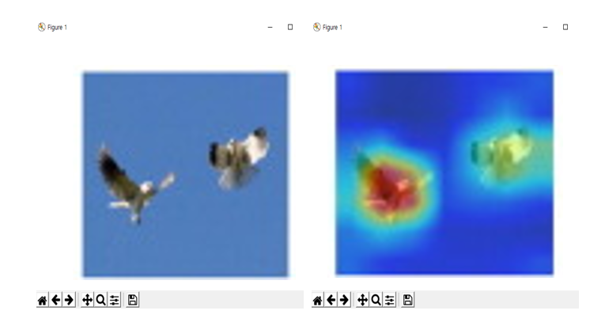


5.5 Load the image and inference them with your weighted file (.pth), and show the result image and class (4%)
1. Choose the any data
2. Run Inference
GUI example
Confidence = 0.98
Prediction Label: bird
Using the model.predict() to classification
Show the result on the UI
Show the prediction label, confidence score
GUI example
◆ Hint
https://towardsdatascience.com/understanding-pytorch-with-an-example-a-step-by-step-tutorial-81fc5f8c4e8e#5017
https://pytorch.org/tutorials/
https://yanwei-liu.medium.com/pytorch-with-grad-cam-6a92a54bfaad

