Slide 1
Flex architectural patterns
James Ward
Technical Evangelist
jaward@adobe.com
www.jamesward.com

Slide 2
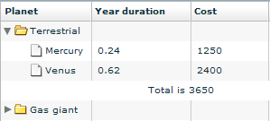

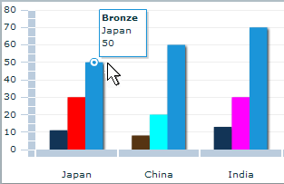
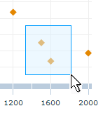
OO / Components / Encapsulation
MXML is Declarative AS3
AS3 is OO
Inheritance
Interfaces
Components can contain:
Properties
Methods
Styles
Events
Effects
Inline Classes with mx:Component

Slide 3
Project Structure
Library Projects
Reuse code across projects
Modules
Load blocks of code post-startup
RSLs
Load & cache stagnant / cross-application code at startup
Framework Cache

Slide 4
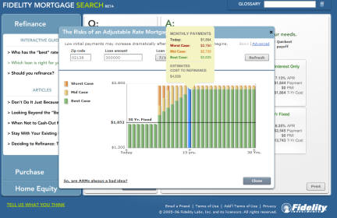
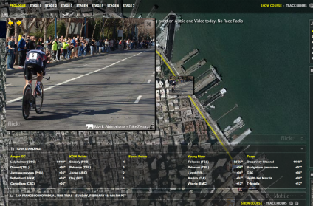
Platform Evolution – Reduced Application Size
Persistent framework caching significantly reduces size of Flex applications
Users only need to download the Adobe-signed Flex 3 platform component once
Flash Player cache stores it for use by any Flex-enabled site
Entire Flex applications can now be as small as 50KB
Site A
Site B
Custom
Code
Custom
Code
Flex 3
RSL
Flash
Player 9
Flash Player
Cache

Slide 5
Performance
Item Renderers
KEEP THEM SIMPLE!
Objects
Typed objects are optimized in the JIT
AMF!!!
Modules / Deferred Instantiation
Do things later...

Slide 6
Project Structure
Model - View - Controller
Hand rolled
Formal frameworks (Cairngorm, PureMVC, etc)
Singletons
Singletons and Modules don’t mix
Consider where Business Logic lives
AIR / Offline requires client-side business logic
Mostly stateless back-ends

Slide 7
MVC / Service Bus
Model
Component
View
Service
Controller
Component

Slide 8
Testing
Unit Testing
Flex Unit
Many others
Automated Testing
Mercury QTP
SilkTest
Others coming

Slide 9
Scalability
CDNs
Edge Cache SWFs
NIO Based Messaging
Thread per client does not scale
Working with JCP & Comet style push options like Tomcat 6
AMF!!!

Slide 10
Security
Flash Player uses the browser networking stack
JAAS
ACEGI
crossdomain.xml - BE VERY AFRAID!
  <cross-domain-policy>
  <allow-access-from domain="*"/>
  </cross-domain-policy>
Never, ever, ever put a global policy file on an intranet site
Never, ever, ever put a global policy file on a site using cookie authentication

