Slide 1
Team 09
The best team

Slide 2
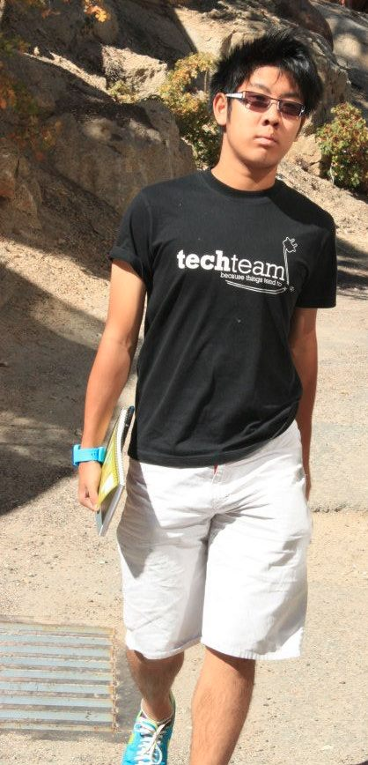
What was interesting
Team work
Sever-client
Peter’s Thai obsession
Neetu’s drawings
Shay’s personality
Harry’s childhood

Slide 3
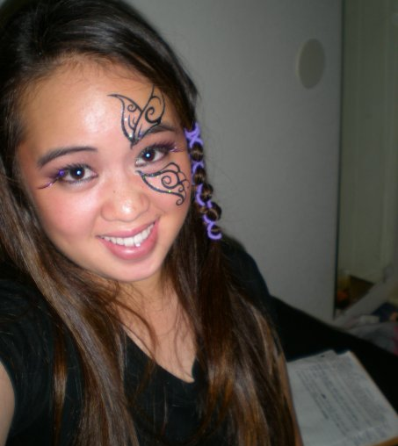
What worked?
Everything went perfectly

Slide 4
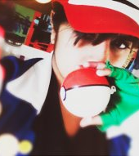
What didn’t work
Nothing

Slide 5
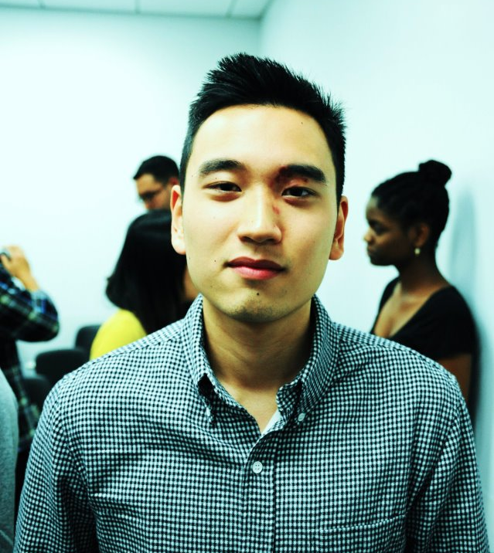
What we learned
About each other

Slide 6
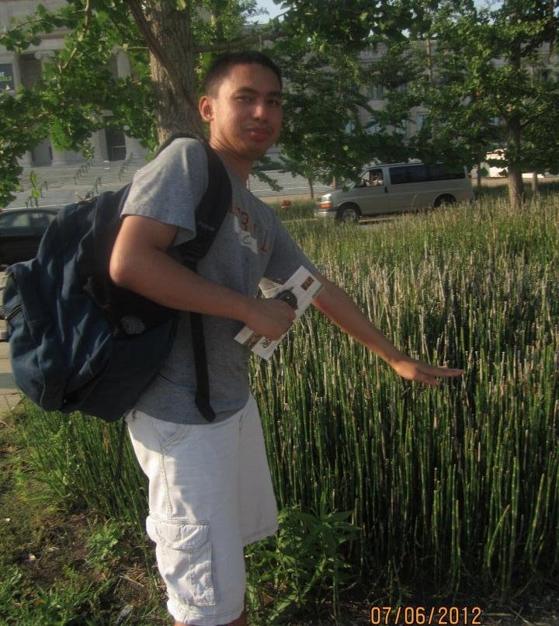
What would we do differently?
We did everything perfectly

Slide 7
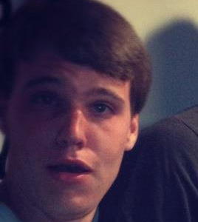
How to better the project?
Make it harder
Make the factory 3D
Create a website interface

Slide 8
Meet our

