Slide 1
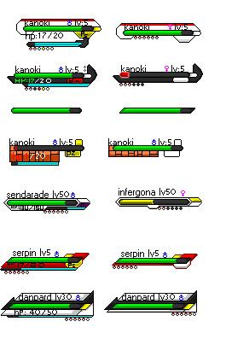
T.e.a.m.9
n
WILCZYNSKI
Lv5
\8
CROWLEY
Lv6

Slide 2
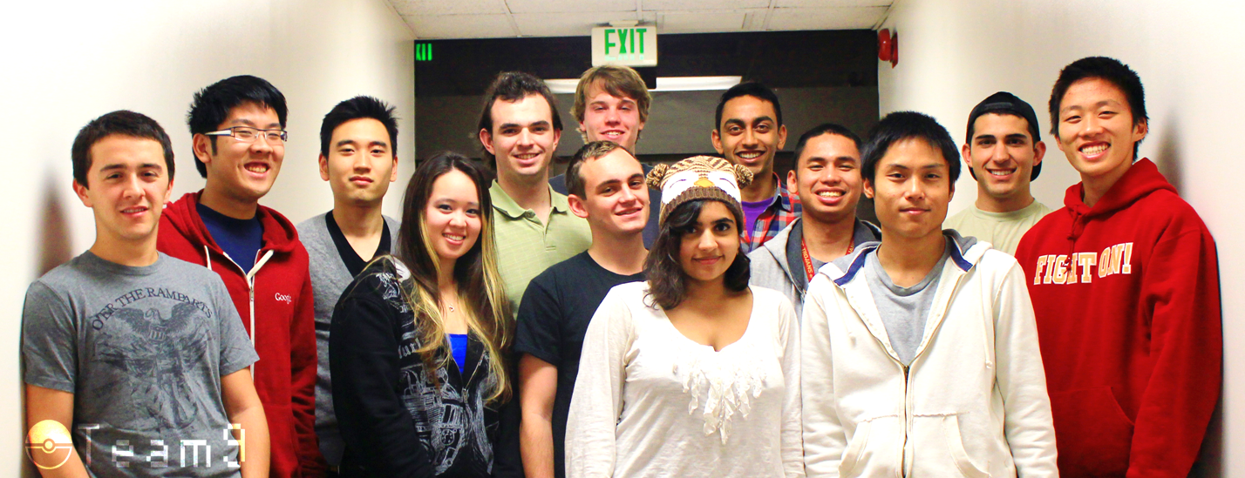
Meet the Team

Slide 3
What Was Interesting
Getting to know other group members
How much we learned from other team members
Diversity of ideas and talent
The potential of swing
Architecture
f

Slide 4
What Worked
Collaboration
True object oriented programming
Designing a great architecture from the start
Task specialization
Breaking tasks into small parts
Utilizing issue tracker
Detailed task assignments
Get Comfortable with Github
b

Slide 5
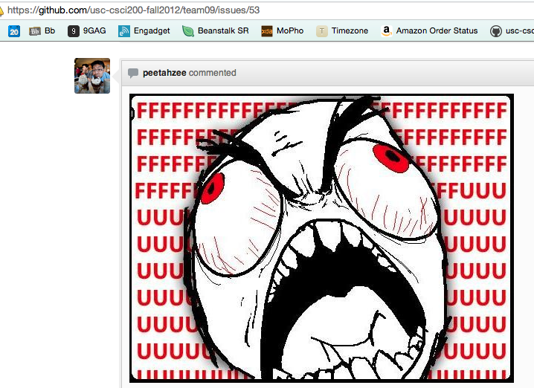

Slide 6
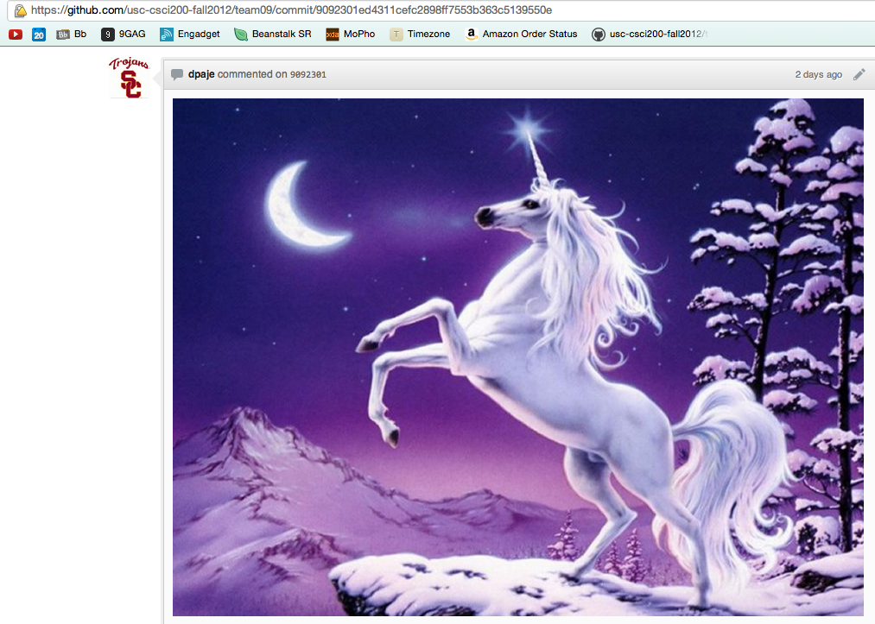

Slide 7
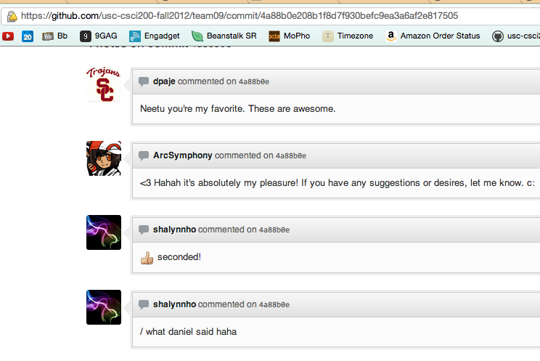

Slide 8
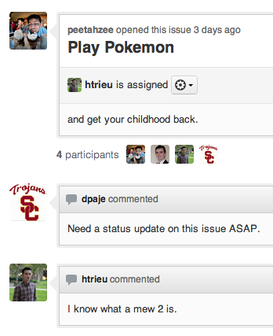

Slide 9
What Didn’t Work
Non-mandatory meetings
Expecting others to read the Wiki
Facebook communication
L=

Slide 10
What We Learned
Working efficiently with others
Effective methods of motivation
Use of Github
Importance of communication
Deeper understanding of Java
t

Slide 11
What We Would Do Differently
Individuals should be more proactive
Every team member should check assignment reqs
Take care of motivation issues early
Ask questions when assigned unclear tasks
j
Notes:
Integrate V[0]

Slide 12
Improving the Project Experience
Reward groups for taking on challenges
Integrate multiple factories to create a large factory
Make the project more relevant to today’s industry
Improve the grading system
2

