Slide 1
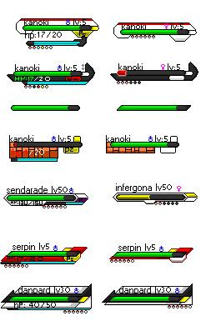
T.e.a.m.9
n
WILCZYNSKI
Lv5
\8
CROWLEY
Lv6

Slide 2
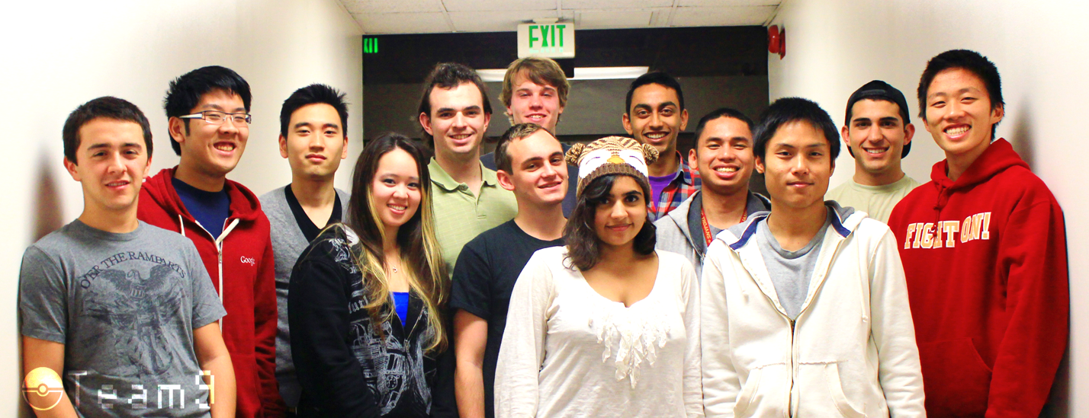
Meet the Team

Slide 3
What Was Interesting
Getting to know other group members
How much we learned from other team members
Diversity of ideas and talent
The potential of swing
Architecture
f

Slide 4
What Worked
Collaboration
Utilizing issue tracker
Detailed task assignments
True object oriented programming
Designing a great architecture from the start
Task specialization
Breaking tasks into small parts
b

Slide 5
What Didn’t Work
Non-mandatory meetings
Expecting others to read the Wiki
Facebook communication
L=

Slide 6
What We Learned
Working efficiently with others
Effective methods of motivation
Use of Github
Importance of communication
Deeper understanding of Java
t

Slide 7
What We Would Do Differently
Individuals should be more proactive
Every team member should check assignment reqs
Take care of motivation issues early
Ask questions when assigned unclear tasks
j
Notes:
Integrate V[0]

Slide 8
Improving the Project Experience
Reward groups for taking on challenges
Integrate multiple factories to create a large factory
Make the project more relevant to today’s industry
Improve the grading system
2

