Slide 1
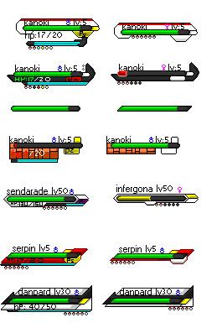
T.e.a.m.9
n
WILCZYNSKI
Lv5
\8
CROWLEY
Lv6

Slide 2
What was interesting
Potential of swing
Transparent panels
Finished product
Architecture
Implementation of other groups
f

Slide 3
What Worked
Collaboration
Great use of issue tracker
True object oriented programming
Architecture
b

Slide 4
What didn’t Work
Non-mandatory meetings
Quick fix: must attend 80% of meetings
Great Wiki
L=

Slide 5
What We Learned
Collaboration
Encouraged us to challenge ourselves
Team management/motivation
t

Slide 6
What would we do differently?
Be proactive
j
Notes:
Integrate V[0]

Slide 7
How to make the project better
Reward for challenging yourself
Make the project more relevant to the industry
2

Slide 8
Meet the team

