Slide 1
Reading checkboxes off appraisal pages
It reads what it can read for certain, hands the rest to a person, and lets the customer decide what counts as a mark.
James W. Niu · every number is read from the repo's own reports
rules, same answer always
sent for review
a person
Notes:
Thirty seconds: the assignment was to find checkboxes and say whether they are marked. The interesting part turned out not to be detection. It was deciding which boxes have a right answer and which ones genuinely do not, and who gets to decide that.

Slide 2
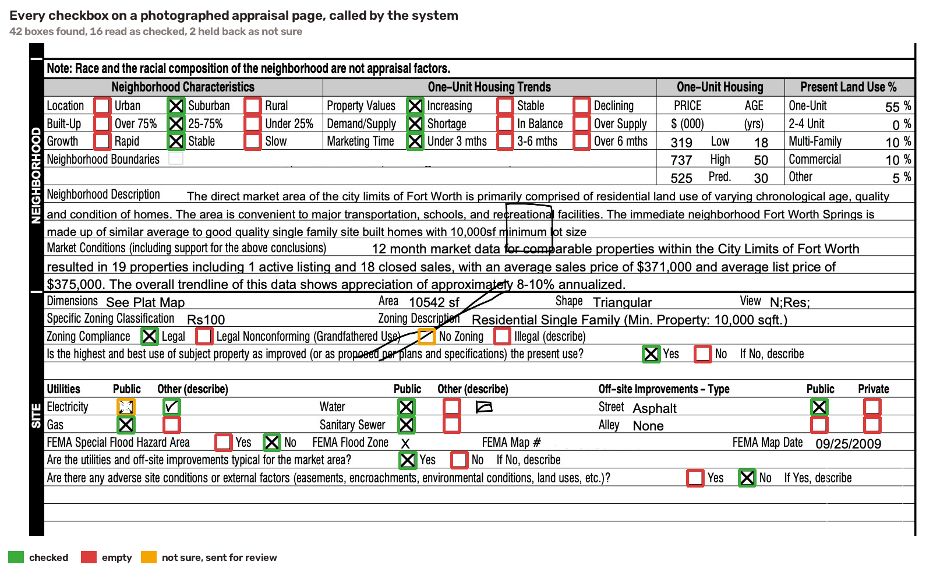
THE PROBLEM
An appraiser's answers live in the boxes
PUD or not. Utilities public or not. Market declining or not. Every one is a small square.
Notes:
This is one of the four pages the brief supplied, with every box the system found drawn on it. Green is marked, red is empty, amber is the two it refused to guess. 42 boxes, 16 read as marked. Point at the amber ones: that is the whole design in one picture.

Slide 3
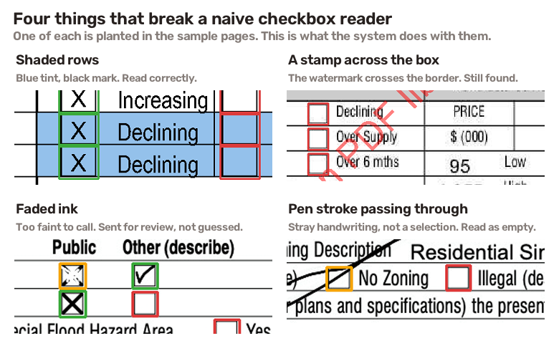
THE PROBLEM
Four things break a naive reader
One of each is planted in the sample pages.
Notes:
Shaded rows, a watermark stamped through the border, ink so faint you squint, and handwriting crossing an empty box. The last two are cases where two careful people disagree with each other. That is what shaped the design: some boxes have a right answer and some do not.

Slide 4
HOW IT WORKS
Two readers, and a queue for what they cannot settle
Clean up
the page
Reader 1
printed lines
Reader 2
blank form
Both
agree?
Read the
mark
Confident?
Checked
or empty
Exception queue
every item carries a reason
AI check on the crop
off by default
A person sets the rule
and it becomes policy
97.6% of boxes never leave the top row. 2.4% carry a reason code into the queue, measured over 61 pages. Nothing in the top row is a model.
Notes:
The top row is ordinary image processing and it is where almost everything is settled. Two readers find the boxes independently: one from the printed lines, one from the blank federal form. Where they agree the answer stands. Where they disagree the box is flagged, never dropped. The bottom row is the exception lane and it is off by default.

Slide 5
FOUR DIMENSIONS
1. Accuracy, against whose definition?
A circle instead of an X. A box struck out. A tick that overshoots. Each is defensible either way.
None of those is ours to decide. One lender wants the circle counted, another wants it sent to a person, and both are right about their own files.
So the definition lives in one settings file the customer owns. Changing what counts as a mark is editing that file. Not a ticket, not a release, not a call with us.
uv run python scripts/compare_policies.py
 | shipped | a stricter customer
a single thin stroke | counts as marked | flag, do not decide
a box scribbled out | read as empty | flag, do not overrule ink
uncertain band | 0.05 to 0.20 | 0.03 to 0.30
agreement with the key | 285 of 286 | 286 of 286
The stricter one is not simply better. It gets the faded X right by refusing to overrule ink, and the same rule would let a struck-out box report as filled. Which error you prefer is a business question.
Notes:
This is the demo I would run live. Two files, no code change, and the answer on one box moves. The point is not that one policy wins; it is that the argument now has somewhere to happen that is not our backlog.

Slide 6
FOUR DIMENSIONS
2. Cost, by using the right size of tool
Not the smallest tool. The right one.
approach | what a page costs | measured where
ordinary image processing (what runs) | 273 ms of one CPU core, no model | make telemetry, median over 61 pages
AI on boxes the core flags | one 110-token crop for 2 of 287 detections | make telemetry and make crop-tokens, the 4 brief pages
AI on those plus every model dispute | 56 of 847 boxes on the real pages | make telemetry with the model on, brief plus held-out
every page to a frontier model | the whole page, every page, priced per token | published work, docs/EVALS.md
The biggest AI models are trained to solve an enormous range of problems, and a loan file pays for none of them.
A flagged box, zoomed in the way the escalation lane sends it, is about 110 tokens of image, the median over the 287 boxes on the brief pages. A whole page is the entire image, and the answer has to list every box and its coordinates on top of that.
We do not pay for intelligence we do not use.
Notes:
The arithmetic is the whole argument. At real volume that gap stops being a rounding error, and it is the wrong trade on quality too: published work finds checkbox reading is a specific weak spot for vision models, not a strength.

Slide 7
FOUR DIMENSIONS
3. Latency, and there are two kinds
The kind the page waits for
A median of 273 ms a page, and 301 ms for 95 pages in every 100, measured in-process over 61 pages. Through the HTTP service, 120 requests of the photographed page, the smallest of the four come back at a median of 50 ms. No network call in the path at all. Nothing waits on a vendor.
It also improves on its own, which a model-first design does not. Every behaviour we understand well enough to describe becomes a rule, and a rule costs microseconds. The queue is meant to shrink.
The kind an operator waits for
Somebody has to know where the system is struggling without reading pages to find out.
That is why the reason codes are data rather than log lines, and why there is a dashboard. A flag rate is a budget line. A breakdown is something you can act on.
Notes:
Two kinds and people usually only price the first. The second one is where the operational cost actually sits, because a human reading pages to find out what went wrong is the most expensive thing in the loop.

Slide 8
FOUR DIMENSIONS
4. Governance, and how little model you use
Every model call is customer documents leaving the building.
Plain rules are not. They run on a machine you control, in your own building if the contract says so, with no vendor to ask about retention or training.
By default this sends nothing anywhere.
When the AI check is on, it sends a thumbnail of one box, never a page of somebody's finances.
Hard gates
the answer format, the blank forms, the known hard cases, the frozen answer key
Soft gates
a number with an allowed range and a verdict; one sits outside its range and one is not yet measured against it, and both say so
Humans on the loop
QA and product write the criteria in the same file the customer edits
Notes:
Both kinds of gate are visible and published. The one that is out of band is the trained classifier's flag rate, and it is written down in docs/EVALS.md rather than quietly retuned. That is the honest version of a green dashboard.

Slide 9
ALTERNATIVES
Three ways to build this
The two alternatives fail in opposite directions.
 | A. this | B. OCR plus a trained detector | C. whole page to a frontier model
accuracy here | 286 of 287 | F1 0.88 to 0.96 published | documented weak spot on checkboxes
what a page costs | 273 ms of one core, no model | $10 per 1,000 pages, Azure list price | the whole page, priced per token
latency | 273 ms median, local | a vendor round trip | seconds, and variable
same page twice | byte-identical | yes, weights are frozen | no
who defines a mark | the customer, in a file | whoever labelled the training set | the model
changing that | edit policy.json | relabel and retrain | reword the prompt and hope
gates you can inspect | hard and soft, published | none exposed | none
documents leave | never | to the vendor | to the vendor, whole pages
Notes:
B is the 2021 answer and it loses on control, not accuracy: the definition of a mark is frozen inside the weights, there is nowhere to look up why a box was read a given way, and changing it means a relabel and a retrain. C is the 2026 answer and it pays frontier prices to read something a hundred pixels wide, gives up determinism, and ships whole customer pages to a third party. If this were thousands of unseen layouts with no explainability requirement, C would be right and this would be over-engineering.

Slide 10
EVIDENCE
Results
Reprinted by make eval. Nothing typed by hand.
page | boxes | found | marks right | flagged
photographed page | 42 | 41 of 42 | 40 of 41 | 2
standard form, clean scan | 118 | 118 of 118 | 118 of 118 | 0
market addendum, shaded | 48 | 48 of 48 | 48 of 48 | 0
manufactured home, watermarked | 79 | 79 of 79 | 79 of 79 | 0
all four | 287 | 286 of 287 | 285 of 286 | 2
Two answers are not clean, and I know why for both.
The miss is a checkbox printed so faintly the labeller called it a box and the software cannot see it.
The wrong mark is the faded ink, which the system flags as unclear rather than deciding. Counted strictly, an unclear answer counts against it.
On the 52 pages damaged on purpose, the box-finding score, F1, never drops below 0.965 under any kind of damage, and shading is the floor.
Notes:
Four real pages cannot prove much on their own, which is why the synthetic corpus and the held-out appraisals exist. The held-out ones came from three offices that were never used while building anything and they flagged nothing at all.

Slide 11
EVIDENCE
Build it and run it
From the unzipped folder. No accounts, no keys, no network after the install.
uv sync --extra dev
Installs everything, tests included, into a local environment. One tool, one command.
make serve
Starts the service on localhost:8000. The same thing runs from a container: make docker-build, then make docker-run.
curl -F file=@data/samples/sample_1.jpg
localhost:8000/detect
Returns one JSON entry per checkbox, its rectangle and whether it is marked. Add /overlay after /detect and the page comes back with every box drawn on it.
make test · make eval
Runs the 26 safety gates, then reprints the accuracy table from scratch.
I ran every one of these from a fresh unzip of this zip before building the deck.
Notes:
If the room wants a live run, this is the slide to do it from: the whole loop is install, serve, one curl. The overlay endpoint is the fastest way to disagree with it, and make eval reprints the results table while people watch.

Slide 12
EVIDENCE
Where you put your own eyes on it
Four places, each a command rather than a claim.
make overlays
Every box drawn on all four pages. Green marked, red empty, amber held back. Disagreeing with a picture takes seconds.
?explain=true
One box: the ink, the confidence, the reason codes, which form matched, how far the two readers agreed, and every candidate it threw away with why.
make eval · make test
Reprints the results table from scratch and runs 26 gates.
scripts/fetch_holdout.py --score
Five completed appraisals from three offices, fetched and scored live.
Once this is running for real, the place a person looks is the exception queue. 138 boxes out of 5,872, each carrying a reason, instead of a person re-reading every page.
Notes:
The rejected-candidates field is the one I would check first, because rejection is the only place the system removes something instead of flagging it.

Slide 13
EVIDENCE
What it looks like in operation
Measured over 61 pages and 5,872 checkboxes. The full page is deliverables/dashboard.html, one file, no server.
Pages
Checkboxes
Boxes found
Sent to a person
Per page
Agrees with a person
61
5,872
286 of 287
2.4%
273 ms
0.95
52 damaged on purpose
1,868 read as marked
on the pages from the brief
138 boxes, each with a reason
no model in the path
36 of 38 rulings
Why boxes went to a person
Where the trouble concentrates
Every reason on the 138 flagged boxes, 146 in all; a box can carry more than one.
Share of boxes sent for review, by what was done to the page. The held-out real appraisals flagged 0.
stray stroke
64
shading
9.05%
a pen line crosses the box
4.17%
missing in detect
watermark
56
the form expects a box here
pen
3.12%
ink ambiguous
16
too little ink to call
scale
2.91%
extra box
9
mixed
2.72%
a box the blank form lacks
fragmented mark
1
Hardest is shading at 9.05%, easiest 1.03% for rotation. If real scans start looking like the worst case, the queue is where it shows first.
specks, not one stroke
Notes:
The panel that matters is why boxes went to a person. Of the queue, 64 a pen line crosses the box, 56 the form expects a box here, 16 too little ink to call. That is something an operator can act on without opening a document. The held-out real appraisals flagged 0. The hardest single condition is shading at 9.05%, against 1.03% for rotation. deliverables/dashboard.html in the repo is the full page, and it opens with no server.

Slide 14
EVIDENCE
Who is the apprentice?
A small model trained from scratch, raced against the rules on the brief's answer key, and left switched off.
how it ran | sent to a person | settled right | settled wrong
rules only, which is what ships | 2 of 286 | 284 | 0
the CNN alone, a test | 56 of 286 | 229 | 1
both together, a test | 19 of 286 | 267 | 0
The rules won the match, so the CNN stays switched off.
It caught nothing the rules missed. On the two hard boxes on the photographed page it settled neither, queuing the empty pen loop at p(filled) 0.845 and reading the filled faded X as empty at 0.082.
Switched on, it only adds work: 17 more boxes to people, zero errors caught.
Legibility is the invariant. The rules have it built in; the CNN can only approach it by emitting logs, a confidence and a heat map per box, replayable forever.
Verdict: rules only.
All three are nearly errorless on the 286 graded boxes, the 287 detections on the brief pages minus the tick ruled unsure. They differ in how much they hand to people, 2 against 19 against 56. Most automation at the same accuracy wins.
Notes:
The LLM that built the product wrote both contestants, the rules and this 23,381-weight model, and judged them against one referee: 52 damaged pages plus the hand-ruled answer keys. When the CNN is confident it is right 229 of 230 times, so training worked. Its problem is confidence in the right places, 56 unsure boxes where the rules are sure and correct. The 286 graded boxes are the 287 detections on the brief pages minus the one on the tick the labeler ruled unsure. Scoring a 118-box page takes it 3.9 ms on CPU (make bench-cnn). make compare reprints this table from the repo.

Slide 15
WHAT COMES NEXT
What this becomes with real volume
The reason codes are per box today. Joined to the form's official field names, the same counts say which questions on the form confuse the people filling it in.
That is a finding the customer can act on by changing the form, not by reviewing more documents. It turns an extraction service into a feedback loop on their own product.
Getting there needs the template registry to carry field names, which is item 2 on the roadmap and is not built here.
Notes:
This is the part I would want to build next. It is also the part that changes what the product is: not 'we read your checkboxes' but 'we can tell you which questions your users get stuck on'.

Slide 16
WHAT COMES NEXT
What it cannot do
Five of them, and the measurement behind each one is in docs/approach.md.
Four real pages is not a benchmark. The held-out five carry no box-by-box labels, so they were checked by eye rather than scored. Sixty-one pages in all, and 52 of them are ones I damaged myself.
The page labels were seeded by the software before correction, and that shortcut hid an invented box until a second reader disagreed about a row. That story is in the writeup.
Rejecting a candidate is the one place the system removes evidence rather than flagging it, and the rule is resolution-dependent: at half size the invented box survives.
We raced the small trained model against the rules on the brief's answer key: it sent 56 boxes to a person where the rules sent 2, and caught nothing they missed. It ships switched off.
One of the three form types has no publicly published blank, so that page runs on one reader and says so.
Notes:
I would rather be the person who lists these than the person who gets asked about them. Every one of them is written down in docs/approach.md with the measurement behind it.

