Slide 1
Feeding the Snake
Yihui Wang, Paul Takem, Zhanyao Zhang, Michael Okoro

Slide 2
The original snake game

Slide 3
The history of snake game
The concept originated in the 1976 arcade game Blockade.
After a variant was preloaded on Nokia mobile phones in 1998, there was a resurgence of interest in the snake concept as it found a larger audience.
There are over 300 Snake-like games for iOS alone.
--From Wikipedia

Slide 4
Introduction
About our project game.
General description of the game
How the game was designed and implemented.
Aims and objectives of the project game.

Slide 5
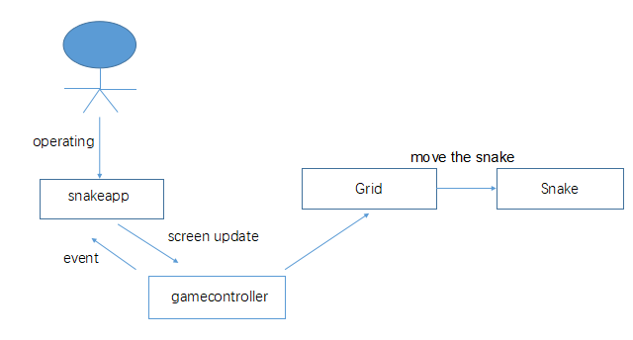
Original idea : MVC Structure

Slide 6
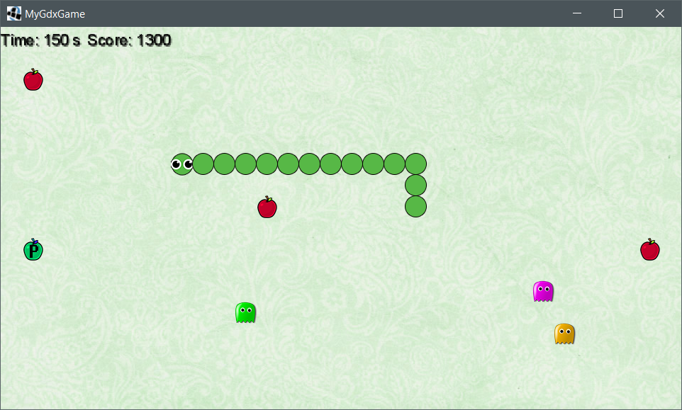

Our Snake Game

Slide 7
UML - Statechart Diagram

Slide 8
UML - Class Diagram

Slide 9
Requirements
Req.No | Req. Name: | Req. Description | EMH | AMH | Prio.
1 | Add a snake head | Create head and add picture | 7hrs | 8hrs | 1
2 | Make snake head move | Make it move in one direction | 8hrs | 10hrs | 1
3 | Make snake head controllable | Change the direction with keyboard | 6hrs | 7hrs | 1
4 | Add a body to snake head | Create body and add picture | 8hrs | 15hrs | 2
5 | Make the body parts longer | Increase the length of body | 10hrs | 12hrs | 2
6 | Add food | Create food and add picture | 6hrs | 5hrs | 3
7 | Make snake longer when eating food | Increase the length of body when eating food | 8hrs | 10hrs | 4
8 | Make food continuously | Make food appear one by one | 6hrs | 4hrs | 5
9 | Place more apples | Add more food at the same time | 4hrs | 3hrs | 6
10 | Add enemy | Create enemy and add picture | 6hrs | 8hrs | 7
11 | Restart the game when meet enemy | Remove all the body and restart the game | 6hrs | 4hrs | 8
12 | Make enemy move randomly | Make enemy move in randomly direction | 4hrs | 6hrs | 9
13 | Press space to speed up | Make snake move faster when pressing the space | 10hrs | 15hrs | 10
14 | Speed up at the cost of the length of body parts | Decrease the length of body when speeding up | 8hrs | 10hrs | 10
15 | Kill the enemy when the snake is speeding up | Remove the enemy met by the faster snake | 10hrs | 13hrs | 11
16 | add special food that have different effects | (1) speed up for a few seconds without losing body (2) won’t die in few seconds | 10hrs | 8hrs | 12
17 | Make special food disappear after a few seconds | Remove special food when it is not eaten by snake in a few seconds | 8hrs | 6hrs | 13
18 | Add sounds | Add the sounds of each action | 4hrs | 3hrs | 14
19 | Improve the interface | Make the game more good-looking | 4hrs | 2hrs | 14
20 | Score board | Count the scores | 8hrs | 10hrs | 15

Slide 10
Test Result
ReqNo | Req. Name: | Test Result
1 | Add a snake head | PASSED
2 | Make snake head move | PASSED
3 | Make snake head controllable | PASSED
4 | Add a body to snake head | PASSED
5 | Make the body parts longer | PASSED
6 | Add food | PASSED
7 | Make snake longer when eating food | PASSED
8 | Make food continuously | PASSED
9 | Place more apples | PASSED
10 | Add enemy | PASSED
11 | Restart the game when meet enemy | PASSED
12 | Make enemy move randomly | PASSED
13 | Press space to speed up | PASSED
14 | Speed up at the cost of the length of body parts | PASSED
15 | Kill the enemy when the snake is speeding up | PASSED
16 | add special food that have different effects | PASSED
17 | Make special food disappear after a few seconds | PASSED
18 | Add sounds | PASSED
19 | Improve the interface | PASSED
20 | Score Board | PASSED

Slide 11
Weekly Progress
week 1
Introduction to our project game, and it concepts with a good plan development.
week 2
Manifestation of our plant and it implementation the codes of our game.
Development of the snake head with the java code and libgdx.
week 3
Building our frame and fixing some bugs.
Adding of enemies.

Slide 12
Weekly Progress
week 4
Re-arranging of the game concept.
More requirements.
UML class diagram of our game.
week 5
Modifying the UML diagram.
Developed an attractive background for the game.
Adding of score board and sound.
Adding of special apple food.

Slide 13
Difficulties and challenges
Understanding amongst
Cultural and Linguistics differences and opinions
The coding
Time estimates
Variable
Sketching

Slide 14
Teamwork
Different cultural background
Different opinion
Mindset
Understanding
Respect

Slide 15
What we have learnt
The skills to develop game in java with libgdx
The way to draw a UML diagram
How to respect and understand each other
How to do the teamwork in project
The importance of different roles in a project

Slide 16
Priority decisions
To produced a resemblance of snake feature, e.g the head.
How to developed a libgdx game with the java intellij.
To developed the snake body parts.
Making the snake to move and eat food.
Producing food and enemies for the game.
Development of a good background interface, and sound, score board.

Slide 17
Conclusion
The game was successfully developed with the libgdx, and java intellij.
The requirements were implemented and tested positively.
The difficulties, challenges, correctness of time estimates and priority decision were all achieved without any contradiction.
We have learnt a lot about how to do project with team

Slide 18
THANK YOU

