Slide 1
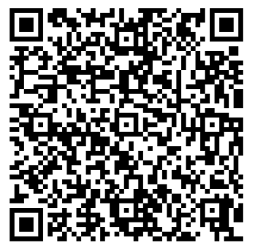
Scan this QR code to Mark Attendance:
CS2030S Lab 01
Lab Group 08H

Slide 2
$ whoami
James Yeap
Year 2 CS
Email: e0544270@u.nus.edu
took CS2030S in Y1S2

Slide 3
wbu?
Your name, year of study,
and one thing about yourself (hobbies, any sports you play, which hall you stay etc)

Slide 4
Setting Expectations
What I will do:
Run lab sessions
Provide help during lab session
Grade your work (~1 week lead time)
What I am not expected to do:
Be on call 24/7/365.25 D:
Debug your program for you :(
Be a Java / coding / CS2030S encyclopedia

Slide 5
Setting Expectations
What I will (try to) do for you:
Give you good/constructive/candid comments about your work, and progress in CS2030S
Answer your CS2030S queries outside of lab sessions
Tuesday Evenings (~7pm onwards)
Answer your non-CS2030S queries outside of lab sessions
Notes:
most have only taken CS1101S
will not give you straight-answers to your questions so that you can arrive there by yourself and familiarise yourself with the thinking-process
useful articles if i see any
tentative-availability; beyond that, I’ll probably take quite long to get back to you
how to manage workload, etc

Slide 6
Need Help?
Module Website - https://nus-cs2030s.github.io/2122-s2/
Piazza for discussion
Our Telegram Group
Module Telegram Group (unofficial) - https://telenus.nusmods.com/
Google, and then seek confirmation from me if you aren’t sure if it’s legit.
Ask me.
Notes:
oftentimes, the answers to your questions can be found there
for everyone’s benefit; and also chances are someone might have already asked the same question (in my experience)
or if you paiseh (don’t be; be the guy who dares to ask questions (even stupid ones; the first time you’ll feel damn paiseh; after that you’ll be fine) -> will come in handy next-time -> so train your muscles/get used to it now)
maybe got CS2030S group can join -> useful for admin also
google
ask me

Slide 7
Any Feedback?
Feel free to let me know if you have any feedback!
https://bit.ly/feedback_jamesyeap
Alternatively, you may use the “Anytime Feedback” tool on LumiNUS:
LumiNUS >> Survey >> click on “Anytime Feedback”
Notes:
This is my first time being a TA, and I do expect that I will make some mistakes (hopefully not too many) along the way. I would really appreciate some feedback (positive or negative) along the way to help me improve and give you guys a better experience.
Made a google form -> only I will see it.
But, if you think there’s something seriously wrong with me, you can raise the issue to Prof Boyd or Prof Ooi using the “Anytime Feedback” tool on LumiNUS.

Slide 8
Some Tips
Use vim (instead of VS Code, IntelliJ)
you’ll only have access to vim for your Practical Exam, so it pays to get used to it now!
Run your labs locally
especially when CS2030S lab servers are congested; may take some time to compile
Start early!
Don’t neglect your other mods!
if you find yourself stuck during your lab, it’s OKAY! :)
take a break, do your other stuff and come back to it tomorrow
Apply CS2030S principles!
passing all test cases !== getting full-marks
write good OOP code!
Notes:
resist the temptation to use VSCode
save some time

Slide 9
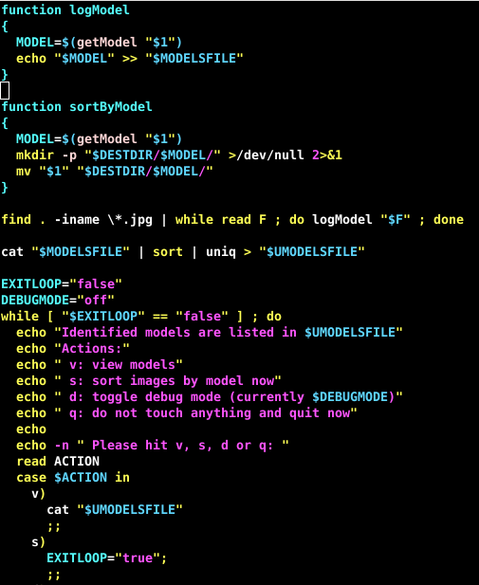
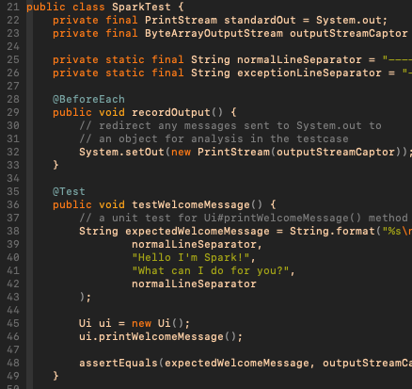
Configuring Vim

Slide 10
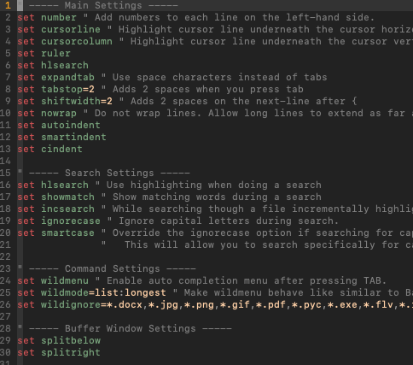
.vimrc (your vim config file)
Things you can add to your vim:
line numbering
automatic indentations
nicer colors
(and a lot of other stuff)
can use my .vimrc as a template
will be uploaded to Google Drive

Slide 11
Unix Commands
Make Directory
Change Directory
List
Clear Screen
Logout of SSH
Open in Vim
Compile
Compile ALL
Run JShell
Run CLASS
mkdir lab0
cd lab0
ls
clear
exit
vim Circle.java
javac Circle.java
javac *.java
jshell
java Circle
credits: Marcus Tan

Slide 12
OOP Recap

Slide 13
Information Hiding
class Point {
// not private
public double x;
public double y;
}
class SomeClass {
Point p1 = new Point(1,1);
Circle c1 = new Circle(p1, 5);
/* ... many lines of code later */
p1.x = 2;
// will c1 still be the same circle?
}

Slide 14
Information Hiding
class Point {
// is private
private double x;
private double y;
}
class SomeClass {
Point p1 = new Point(1,1);
Circle c1 = new Circle(p1, 5);
/* ... many lines of code later */
p1.x = 2; // compile-time error :)
}
Notes:
for this module: private final everything by default :D

Slide 15
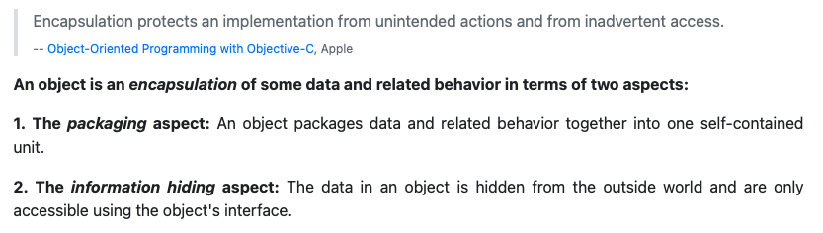
Encapsulation
from CS2103T

Slide 16
Tell, Don’t Ask
class SomeClass {
Point p1 = new Point(1,1);
Circle c1 = new Circle(p1, 2);
Point p2 = new Point(5,5);
// continued —>
/* check if p2 is inside circle c1 */
double cX = c.getX();
double cY = c.getY();
double r = c.getR();
boolean isInCircle = ((p2.x - cX) * (p2.x - cX) + (p2.y - cY) * (p2.y - cY)) <= r * r;
}
Notes:
what if we want to check if a circle contains a point?

Slide 17
Tell, Don’t Ask
class SomeClass {
Point p1 = new Point(1,1);
Circle c1 = new Circle(p1, 2);
Point p2 = new Point(5,5);
// continued —>
/* check if p2 is inside circle c1 */
boolean isInCircle = c1.contains(p2);
}
Notes:
code-reuse!

Slide 18
Inheritance
class Circle {
double x;
double y;
double r;
// constructor here…
double getArea() {
return 3.141592653589793 * r * r;
}
// continued —>
boolean contains(double x, double y) { ... };
}

Slide 19
Inheritance
class ColouredCircle {
double x;
double y;
double r;
Color color;
// constructor here…
double getArea() {
return 3.141592653589793 * r * r;
}
boolean contains(double x, double y) { ... };
}

Slide 20
Inheritance
class ColouredCircle extends Circle {
// constructor for ColouredCircle
public ColouredCircle(double x, double y, double radius, Color color) {
super(x, y, radius); // call the parent's constructor
this.color = color;
}
Notes:
much less code! better for maintainability also.
NOTE!: Inheritance tends to get overused. In practice, we seldom use inheritance.

Slide 21
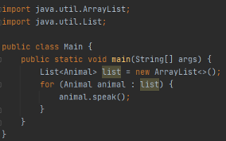



Polymorphism
credits: my TA’s TA

Slide 22
Lab 0 Recap

Slide 23
Point fields
class Point {
// fields should be private!
private double x;
private double y;
// ...
}
Notes:
Point should have two private fields, x and y. (Tie back to information hiding)

Slide 24
public methods
class Point {
// constructor should be public!
public Point(double x, double y) {
this.x = x;
this.y = y;
}
}
Notes:
The toString and constructor should be declared public

Slide 25
public methods
class Point {
// toString should also be public!
public String toString() {
return "(" + this.x + ", " + this.y + ")";
}
}
Notes:
The toString and constructor should be declared public

Slide 26
“this” - variable shadowing
class Point {
private double x;
private double y;
public Point(double x, double y) {
// use "this" to refer to the attributes x and y!
this.x = x;
this.y = y;
}
}
Notes:
variable shadowing
The this reference should be used when referring to x and y in the methods

Slide 27
Should there be a Getter-method for Point?
class Point {
private double x;
private double y;
// is this necessary?
public Point getX() {
return this.x;
}
}
NO 😗
Notes:
There should be no getter methods for Point -> why would you need x? calculating distance should be done INSIDE a Point object

Slide 28
Circle::contains (Tell, Don’t Ask)
class Circle {
public boolean contains(Point p) {
// let Point class calculate the distance!
return (p.distanceTo(this.c) < this.r);
}
}
Notes:
don’t go and get this.c.x, this.c.y, p.x, p.y, and calculate in this method. Delegate this to the Point class!

Slide 29
Circle::toString (Tell, Don’t Ask)
class Circle {
public String toString() {
// calls the toString() method of Point class!
return "{ center: " + this.c + ", radius: " + this.r + " }";
}
}
Notes:
Note that we call the Point::toString in the Circle::toString -- we are telling the center to print itself, rather than getting the x and y of the center and then print it (Tie back to Tell, Don't ASk)

Slide 30
RandomPoint (Inheritance: IS-A relationship)
class RandomPoint extends Point {
// ...
}
Notes:
RandomPoint should inherit from Point since it behaves just like a Point. Any operation that can be done on a point can be done on a RandomPoint (such as to compute the distance between two points). (Tie back to inheritance models the "is-a" relationship -- a random point is a point)

Slide 31
RandomPoint - constructor
class RandomPoint extends Point {
public RandomPoint(double minX, double maxX, double minY, double maxY) {
// super(...) must always be called FIRST in the constructor!
super(
rng.nextDouble() * (maxX - minX) + minX,
rng.nextDouble() * (maxY - minY) + minY
);
}
}
Notes:
RandomPoint should reuse the fields of Point (x and y) and call super to initialize them. super has to be the first thing the constructor does.

Slide 32
RandomPoint - random number generator
class RandomPoint extends Point {
// should be a class-field (static)
private static Random rng = new Random(1);
}
Notes:
All the random points should share the same random number generator. So the generator should be a class field.

Slide 33
RandomPoint - setting generator seed
class RandomPoint extends Point {
// should be a class-field (static)
private static Random rng = new Random(1);
public static void setSeed(int seed) {
rng = new Random(seed);
}
}
Notes:
setSeed should be a class method, since it only refers to the generator, which is a class field.

Slide 34
Can Circle::contains take in RandomPoint?
Point p = new Point(...);
RandomPoint rp = new RandomPoint(...);
Circle c = new Circle(...);
c.contains(p); // ok
c.contains(rp); // is this ok?
RandomPoint <: Point
Notes:
When we call contains, it takes in a Point but we can check if a random point is contained within a circle using the same method.

Slide 35
Reading inputs (System.in)
import java.util.Scanner;
public static void main(String[] args) {
Scanner sc = new Scanner(System.in);
// gets whatever the user has typed on the next-line!
String someInput = sc.nextLine();
}
Notes:
Explain to students what is standard input (System.in) and standard output (System.out), and point them to the ScannerJavadoc to learn more about nextInt() and other relevant methods.

Slide 36
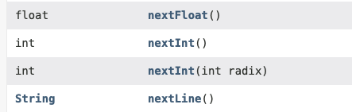
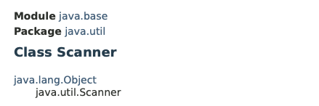
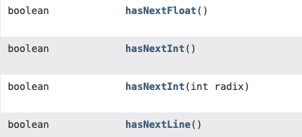
Reading inputs (System.in)

Slide 37
Printing outputs (System.out)
public static void main(String[] args) {
String s1 = “Hello I’m a line!”;
String s2 = “I’m on the same line.”;
String s3 = “I’m on a new line!”;
System.out.print(s1);
System.out.println(s2);
System.out.print(s3);
}
Hello I’m a line!I’m on the same line.
I’m on a new line!
Notes:
Explain to students what is standard input (System.in) and standard output (System.out), and point them to the ScannerJavadoc to learn more about nextInt() and other relevant methods.

Slide 38
Lab 1 Introduction

Slide 39
What is a Discrete Event Simulator? 🤨
A discrete event Simulator is a software that simulates a system (often modeled after the real world) with events and states. An Event occurs at a particular time, and each event alters the states of the system and may generate more events.

Slide 40
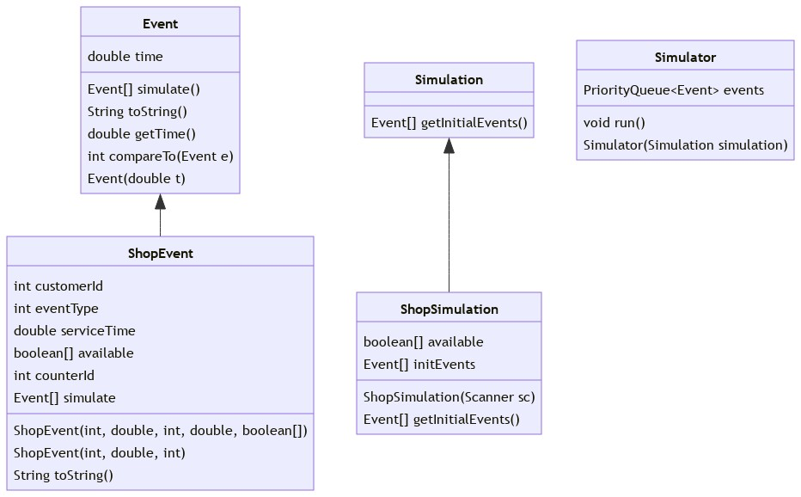
Program Structure (for now…)

Slide 41
I mean, it works… right?

Slide 42
What if
We want to add a new Event type?
say, a CounterCloseEvent
We would have to modify:
ShopEvent::toString()
ShopEvent::simulate()

Slide 43
ShopEvent 🤨
currently holds information about the shop, customer and counter
hint: can we apply Encapsulation here? (look for the nouns)
currently contains the method to find an available counter
hint: after we apply Encapsulation, can we apply Tell, Don’t Ask here?
(many more issues for you to find and fix! 😀)

Slide 44
ShopSimulation 🤨
currently holds information about the counters
hint: can we apply Encapsulation here?

