Slide 1
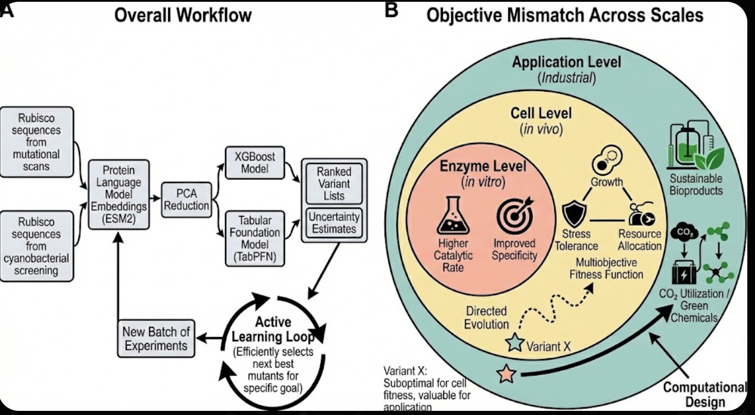
Figure 1 reference only

