Slide 1
A
Overall Workflow
B
Objective Mismatch Across Scales
Rubisco
sequences
from
mutational
scans
Application Level
(Industrial)
XGBoost
Model
Protein
Language
Model
Embeddings
(ESM2)
Ranked
Variant
Lists
Uncertainty
Estimates
PCA
Reduction
Cell Level
(in vivo)
Rubisco
sequences
from
cyanobacterial
screening
Tabular
Foundation
Model
(TabPFN)
Enzyme Level
(in vitro)
Active Learning Loop
Efficiently selects
next mutants for
specific goal
Growth
Stress tolerance
Resource allocation
New Batch of
Experiments
Higher
catalytic
rate
Improved
specificity
Sustainable
bioproducts
CO2 utilization
Directed
Evolution
Variant X
Suboptimal for cell
fitness, valuable
for application
Computational
Design

Slide 2
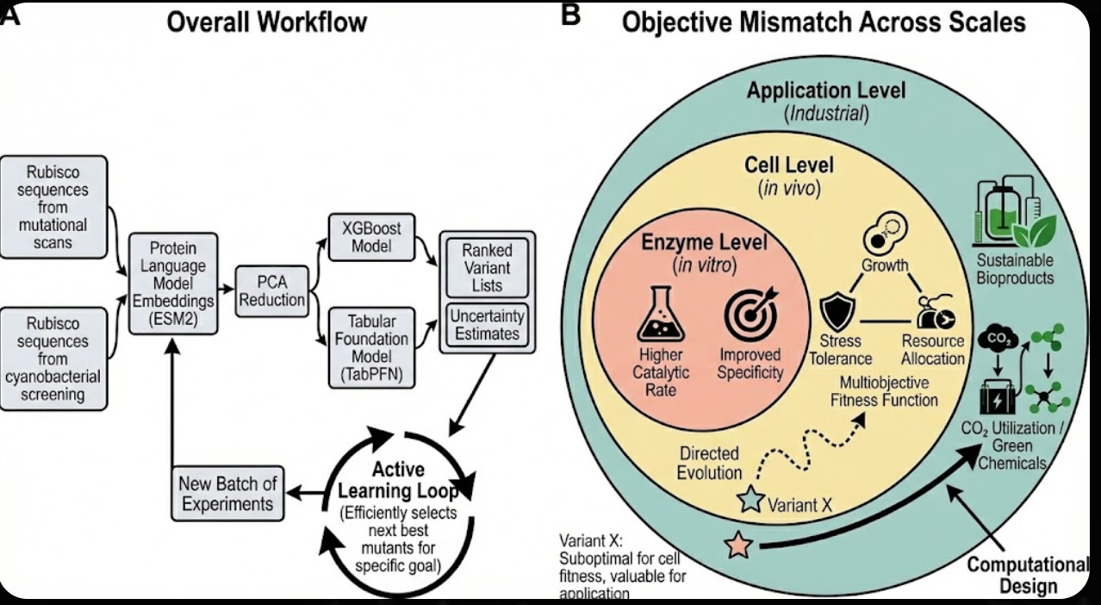
Figure 1 reference (PNG). Do not edit this slide. Use slide 1.

