Slide 1
Kestrel Monthly Brand Review
June 2026 edition · Data through May 2026
Re-issue: the samples figure is corrected in this version.

Slide 2
TRx trend
Data through May 2026

Slide 3
Key performance indicators – May 2026
KPI | May 2026 | vs PY %
TRx | 5.7K | -2.1%
NRx | 1,113 | -2.0%
NBRx | 775 | -1.8%
TRx share | 9.1% | –
IL-17 class share | 26.1% | –
Samples | 2,611 | –
Call attainment (writers only) | 95.8% | –
Data through May 2026

Slide 4
Regional performance – May 2026
Data through May 2026

Slide 5
Field activity – May 2026
Field activity | May 2026
Calls (details delivered) | 1,213
HCPs attended speaker programs | 46
Referrals (projected) | 210
New writers | 1
Data through May 2026

Slide 6
Market research
Brand tracker | Q1 2026
Brand awareness (aided) | 62%
12-month persistency | 71%
Promotion audit | May 2026
Share of voice | 18%
Data through May 2026

Slide 7
Supply – ex-factory units
Supply | May 2026
Ex-factory units | 5,966
Data through May 2026

Slide 8
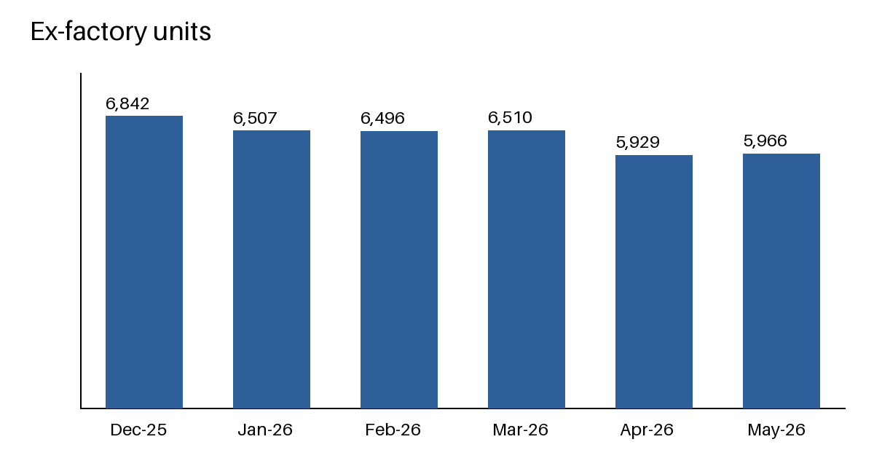
Ex-factory units trend

Slide 9
Speaker program lift – May 2026
Speaker programs drove +8% TRx lift in the East
Data through May 2026

