Slide 1
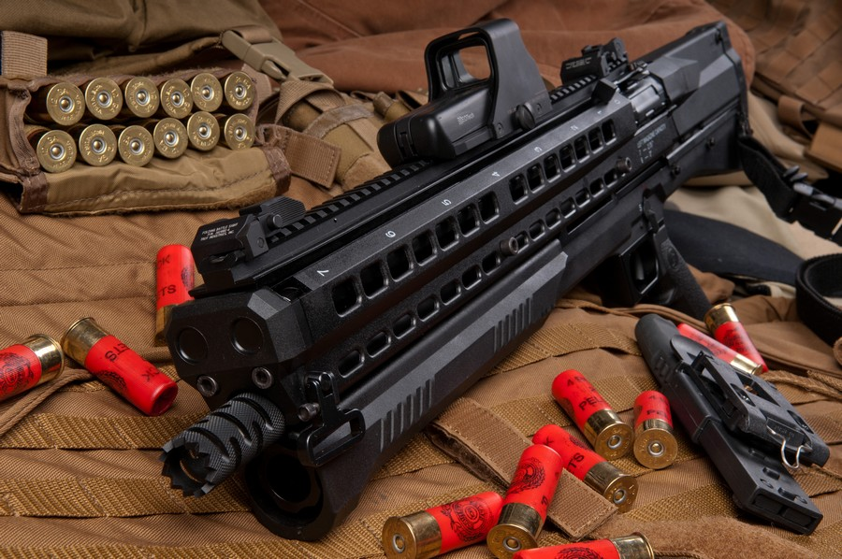
Newbee
Gun Control and Sale System

Slide 2
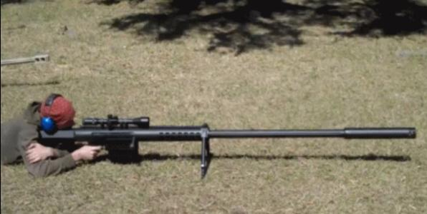
Problem Statement
Solution
Important User Case
To be Countinue

Slide 3
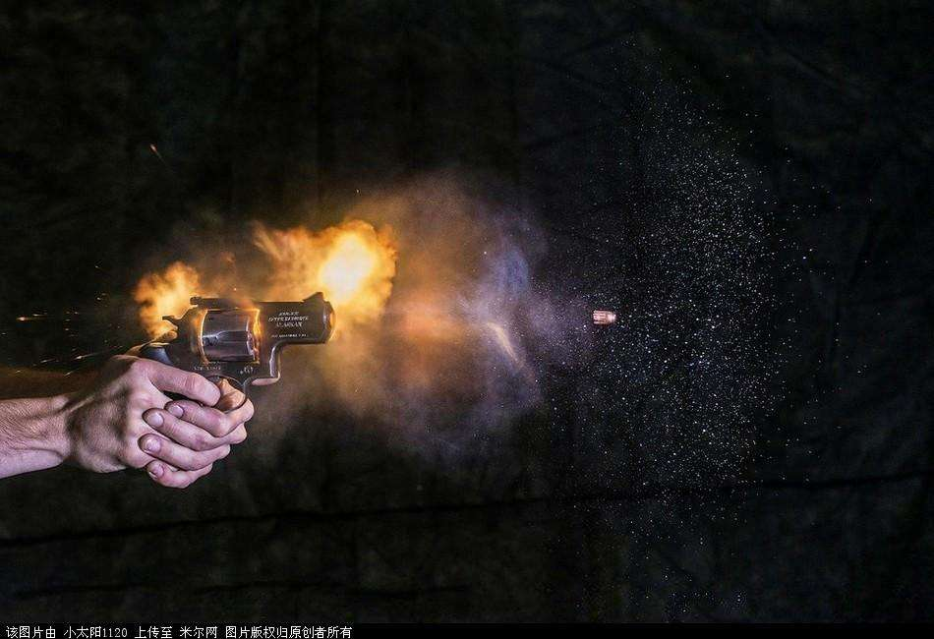
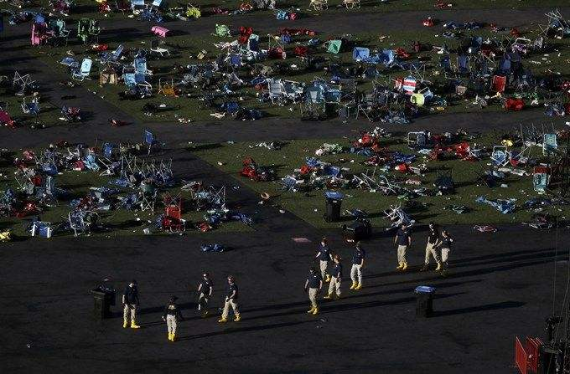
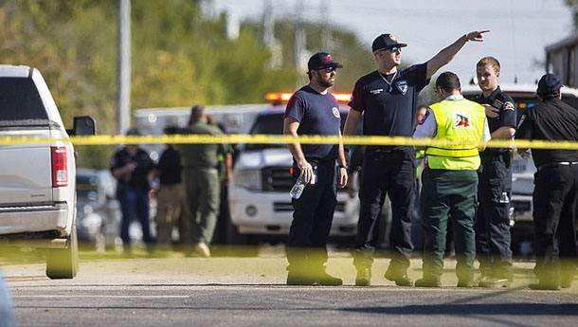
Problem
Control Part
With increasingly gunshot events, gun control and sales should be taken serious consideration. What we should do to control it?
And what if a Seller wants to make profit and sale guns to the people who don’t have a gun licenses?
Not feasible to grade a store.
Sale Part
A customer wants to buy guns, where can he find the cheapest one? Which store is the closest one?

Slide 4
Solution
Control Part
There will be a checking system to evaluate the person who wants to purchase guns, then the system will give the government a grade of the safety risk of the person, and the grade may have effects on purchasing gun’s type, quantity and price.
Seller will have their own grade which is given by tracking department, once sellers sell guns to unregistered persons, the seller will be degraded.

Slide 5
Solution
Sale Part
The project will have multiple ways for person to choose the best price, which is determined by a few influence factors. This project can also give the customer most convenience service for purchasing.

Slide 6
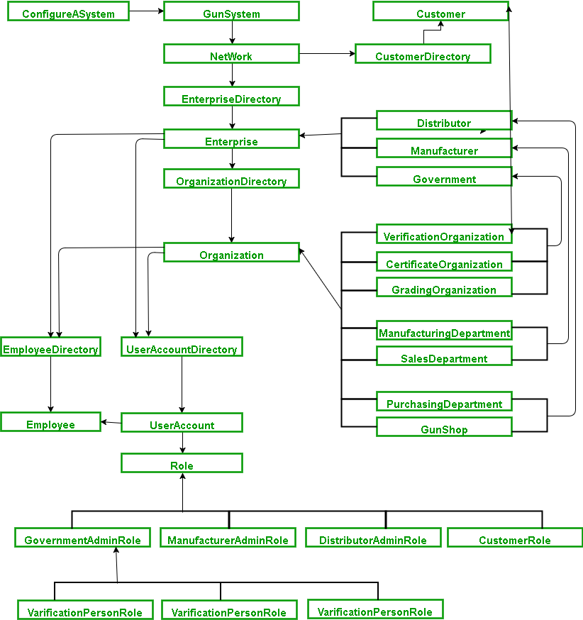
Object-Model

Slide 7


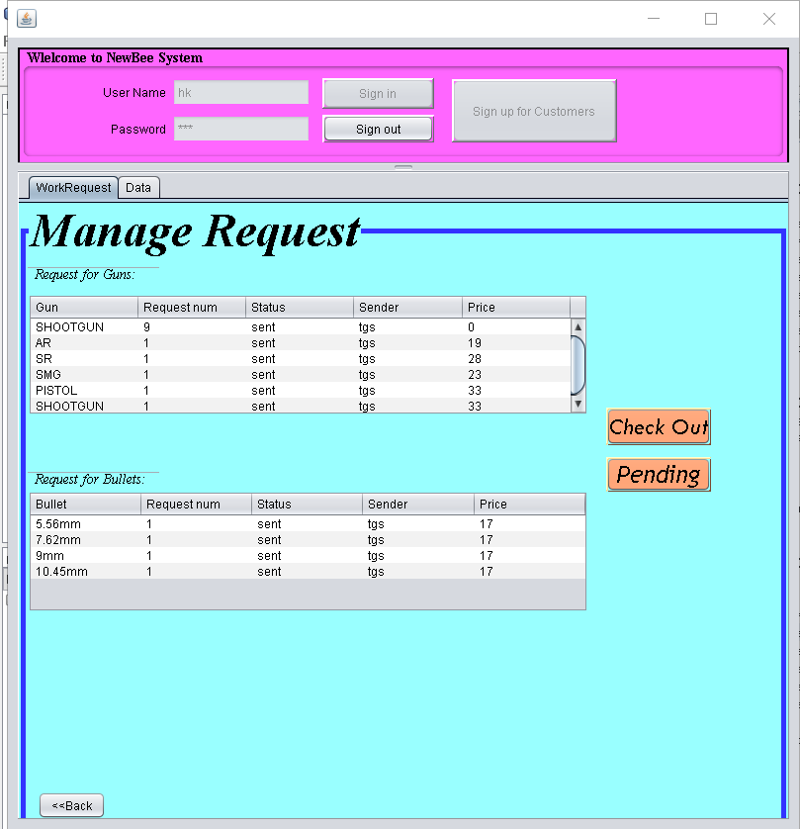


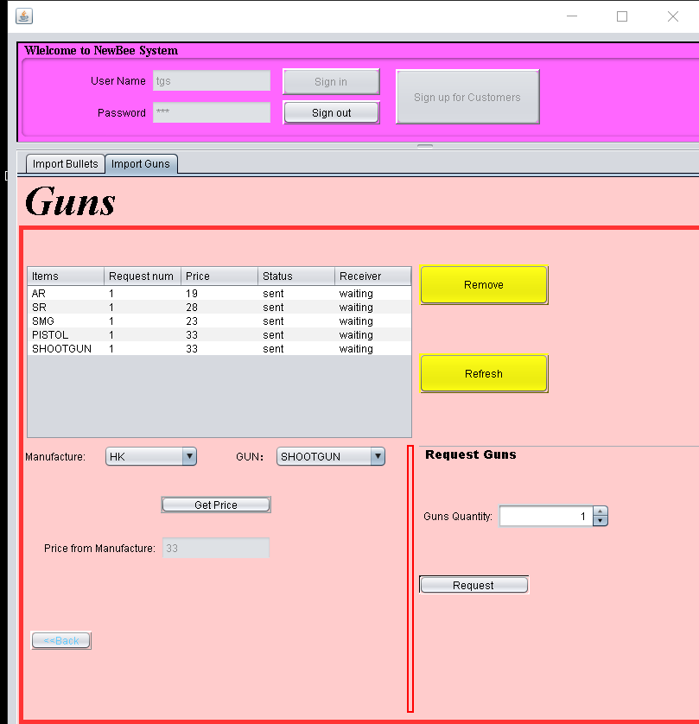

Main Function 1 Manufacture and Distributor
Manufacture imports martials to create guns
Distributor sends request to get Guns in their stock.

Slide 8
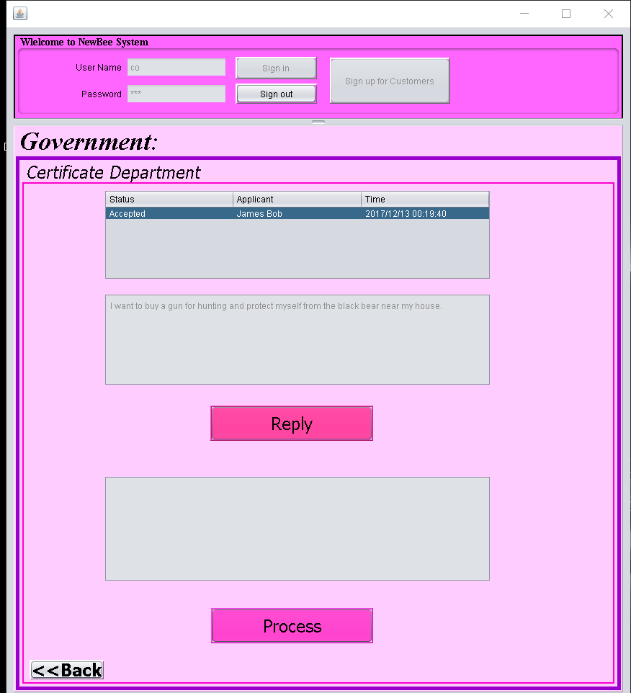
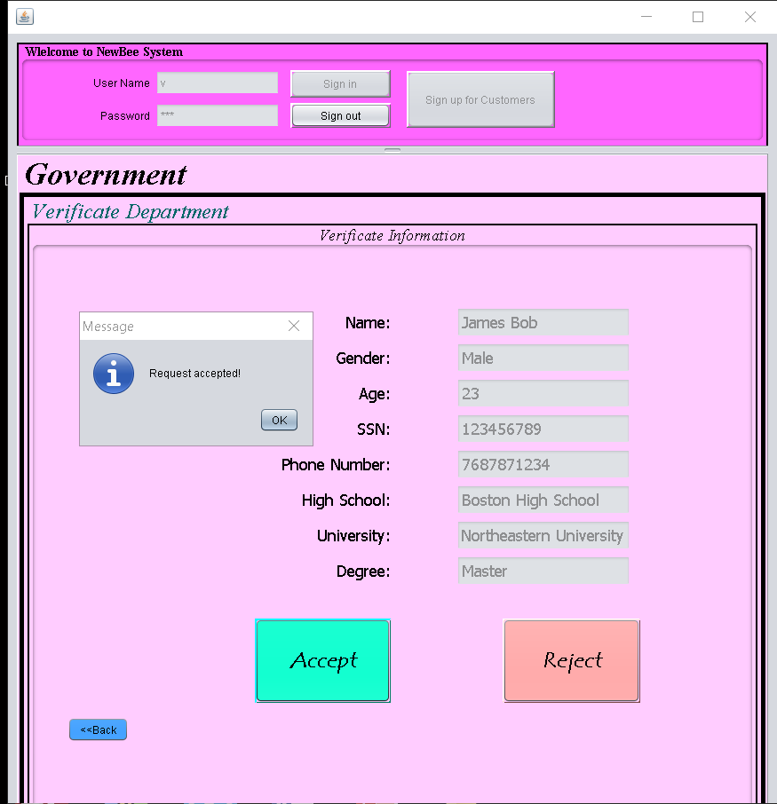
Main Function 2 Add Cutomer and Double Check
Customer need to apply both Verification and certification to buy guns, but verification first, to buy guns in legal.

Slide 9
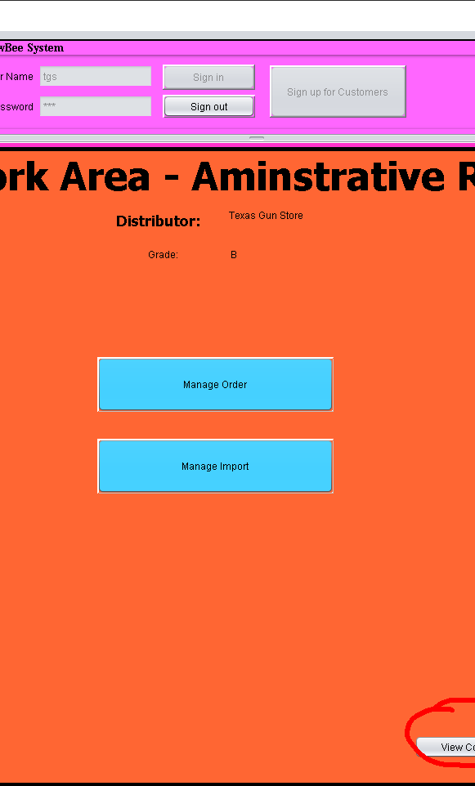
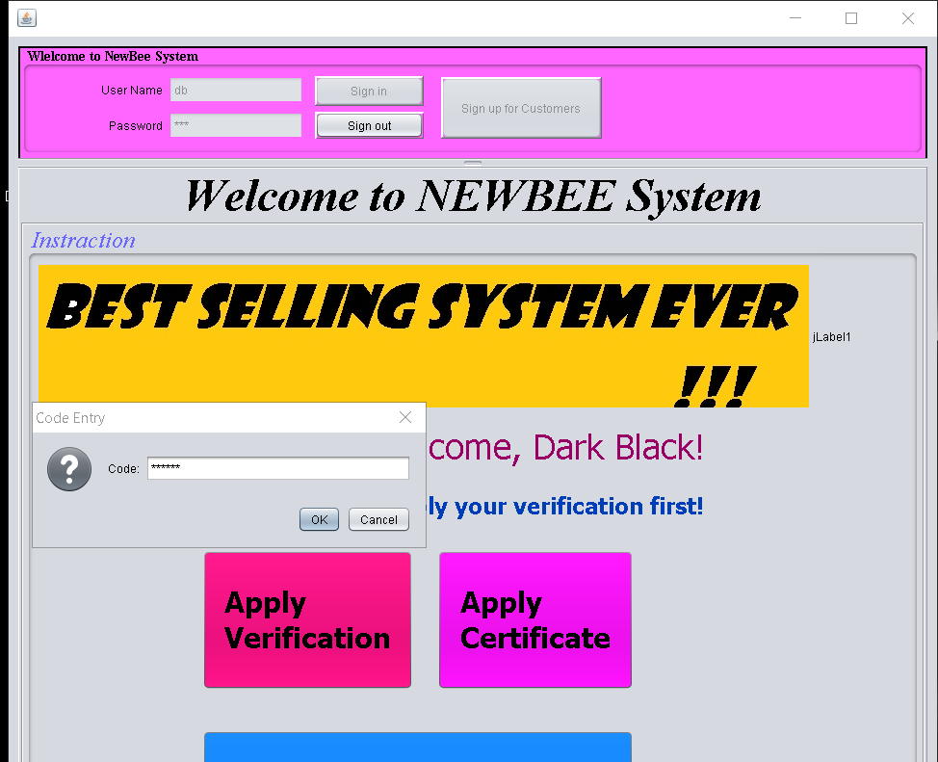
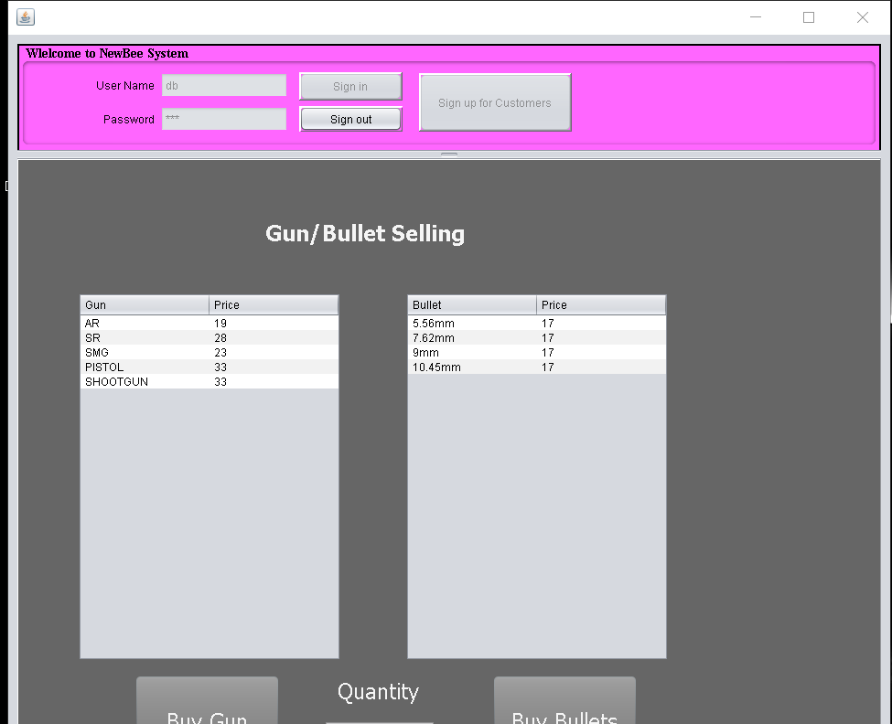
Main Function 3 Black buy
Customer can buy guns in illegal way, which need the secret code form distributor, then customer can buy guns across the area.

Slide 10
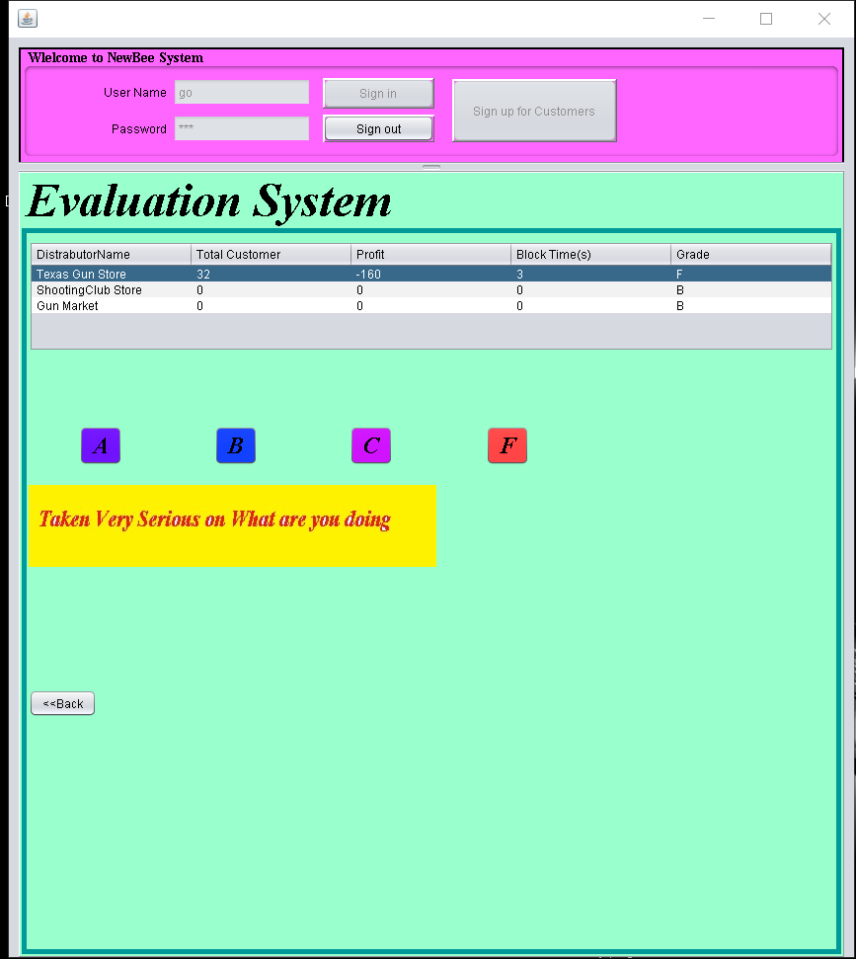
Main Function 4 grading System
If a distributor create an order illegal, the distributor will receive lower grades

Slide 11
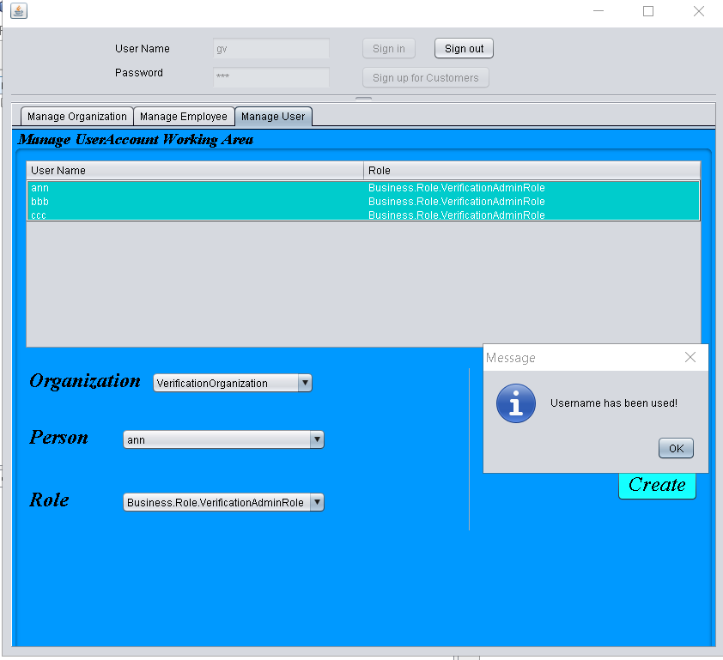
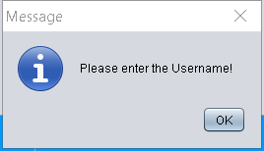
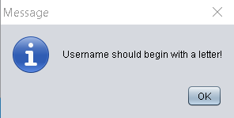
You can’t create an username start with number
You can’t leave the username empty
You can’t create an user has exsited

Slide 12
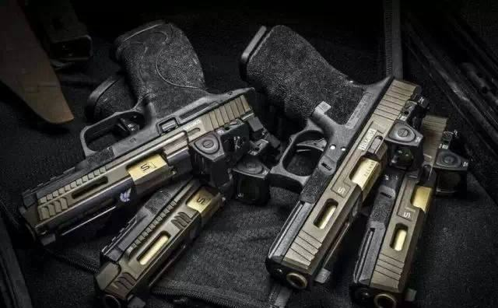
To be Continue
Sometimes gun is a gorgeous thing, it can bring you peace from a war. Gun is supposed to be there, when you are being haunted by a psychopathic killer. Also , gun can be beautiful in a picture. But if some evil show up inside a person’s mind, and there is a gun around him, he can turn to a demon.
Gun control needs to be taken a serious consideration right now, and our system can help the government and store to achieve that goal.

Slide 13
Thanks for being patient
The End

