Slide 1
HOME OFFICE LIGHTING
REDESIGN GROUP: DIGM 223-001
JAMES ZANGARI

Slide 2
Candidates
Professionals who use computers to work from home
General Questions
What types of tasks are accomplished during the day?
What does the general work area look like?
Anything that effects work productivity during the day?
Are there types of surfaces that either reflect or absorb light?
Any reflected or direct glare in the workspace?
Do you have sufficient light that avoids obscuring shadows?

Slide 3
RESULTS
Why work from home?
saving money
lowering costs
less stressful environment
quieter atmosphere
Which style of lighting is preferred?
natural light
led them to choose a room with windows

Slide 4
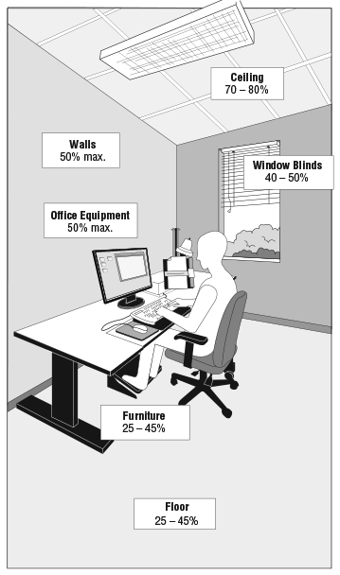
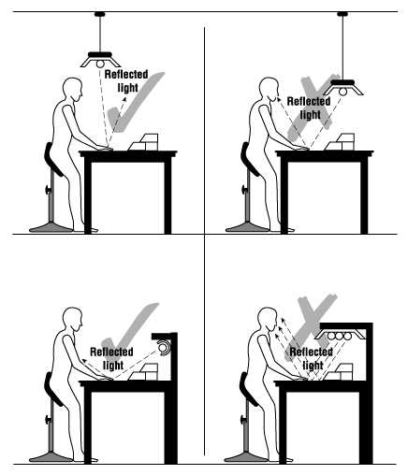
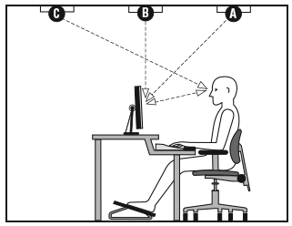
Surprising Finds
Surface Reflectance of Objects
Types of Glare
Reflected Light

Slide 5
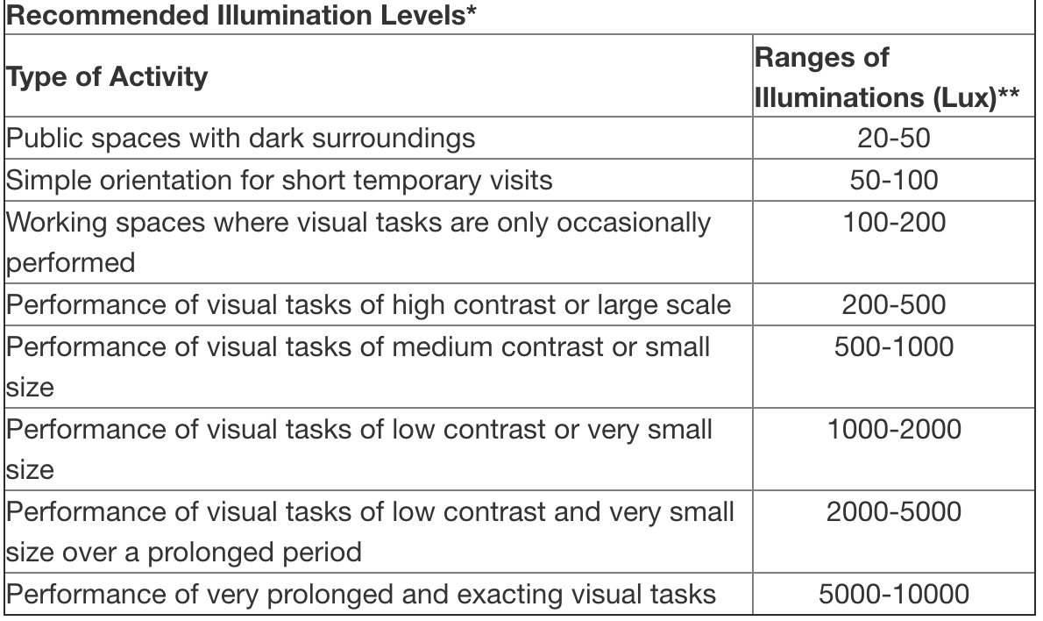
Solution
Per job description and the requirements throughout the day, create a lighting product that follows the industrial and office tasks’ recommended illumination levels

