Slide 1
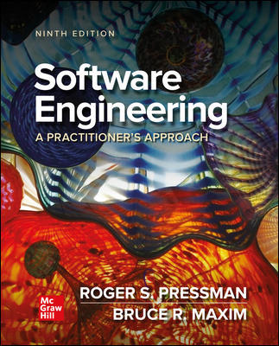
Chapter 7
Understanding Requirements
Part Two - Modeling

Slide 2
Requirements Engineering(收集-分析) 1
Inception初始 - establish a basic understanding of the problem, the people who want a solution, and the nature of the solution that is desired, important to establish effective customer and developer communication.
Elicitation启发式 - elicit requirements and business goals from all stakeholders.
Elaboration 阐述- focuses on developing a refined requirements model that identifies aspects of software function, behavior, and information.

Slide 3
Requirements Engineering 2
Negotiation—agree on the scope of a deliverable system that is realistic for developers and customers.
Specification—can be any or all of the following: written documents, graphical models, mathematical models, usage scenarios, prototypes.
Validation—Requirements engineering work products produced during requirements engineering are assessed for quality and consistency.
Requirements management – set of traceability activities to help the project team identify, control, and track requirements and their changes to requirements as the project proceeds.

Slide 4
Non-functional Requirements很重要
Non-Functional Requirement (N F R) – quality attribute, performance attribute, security attribute, or general system constraint.
A two-phase process is used to determine which N F R’s are compatible:
The first phase is to create a matrix using each N F R as a column heading and the system S E guidelines a row labels.
The second phase is for the team to prioritize each N F R using a set of decision rules to decide which to implement by classifying each N F R and guideline pair as complementary, overlapping, conflicting, or independent.

Slide 5
Establishing the Groundwork
Identify stakeholders.
“who else do you think I should talk to?”
Recognize multiple points of view.
Work toward collaboration.
The first questions.
Who is behind the request for this work?
Who will use the solution?
What will be the economic benefit of a successful solution?
Is there another source for the solution that you need?

Slide 6
Collaborative Requirements Gathering
Meetings (real or virtual) are conducted and attended by both software engineers and other stakeholders.
Rules for preparation and participation are established.
Agenda is suggested that is formal enough to cover all important points but informal enough to encourage the free flow of ideas.
A “facilitator” (customer, developer, or outsider) controls the meeting.
∙A “definition mechanism” (worksheets, flip charts, wall stickers or virtual forum) is used.
Goal is to identify the problem, propose solution elements, and negotiate different approaches.

Slide 7
Elicitation Work Products
Statement of need and feasibility可行性.
Bounded statement of scope for the system or product.
List of customers, users, and other stakeholders who participated in requirements elicitation,
Description of the system’s technical environment.
List of requirements (preferably organized by function) and the domain constraints that apply to each.
Set of usage scenarios (written in stakeholders’ own words) that provide insight into the use of the system or product under different operating conditions.

Slide 8
Use Case Definition
A collection of user scenarios that describe the thread of usage of a system
Each scenario is described from the point-of-view of an “actor” - a person or device that interacts with the software in some way
Each scenario answers the following questions:
Who is the primary actor, the secondary actor (s)?
What are the actor’s goals?
What preconditions should exist before the story begins?
What main tasks or functions are performed by the actor?
What extensions might be considered as the story is described?
What variations in the actor’s interaction are possible?
What system information will the actor acquire, produce, or change?
Will the actor have to inform the system about changes in the external environment?
What information does the actor desire from the system?
Does the actor wish to be informed about unexpected changes?

Slide 9
Analysis Model Elements
Analysis model provides a description of the required informational, functional, and behavioral domains for a computer-based system.
Scenario-based elements – functional descriptions are express in the customers own words and user stories and as interactions of actors with the system expressed using U M L use case diagrams.
Class-based elements – collections of attributes and behaviors implied by the user stories and expressed using U M L class diagrams (information domain).
Behavioral elements – may be expressed using U M L state diagrams as inputs causing state changes.

Slide 10
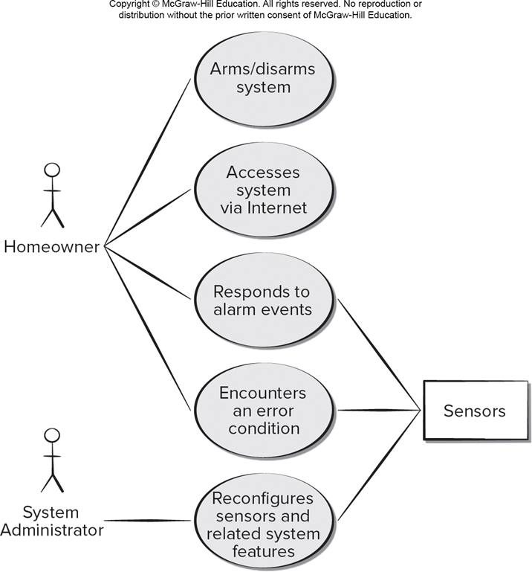
U M L Use Case Diagram(基于场景)
Access the text alternative for slide images.

Slide 11
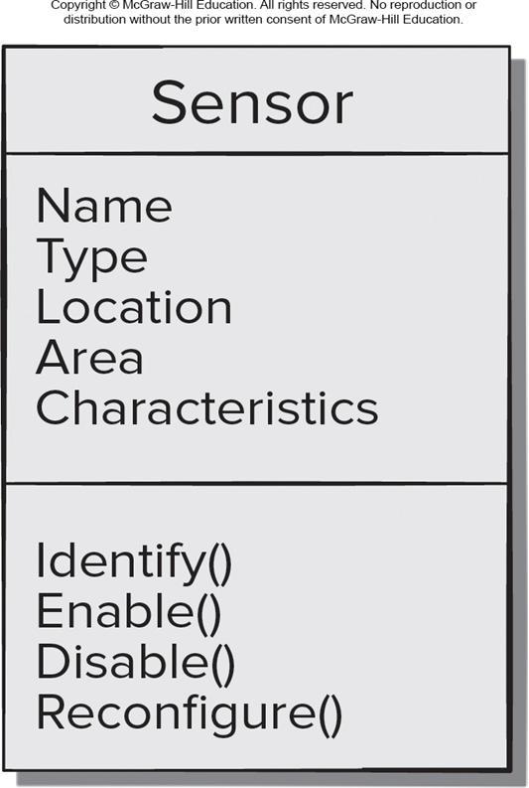
U M L Class Diagram(基于类)
Access the text alternative for slide images.

Slide 12
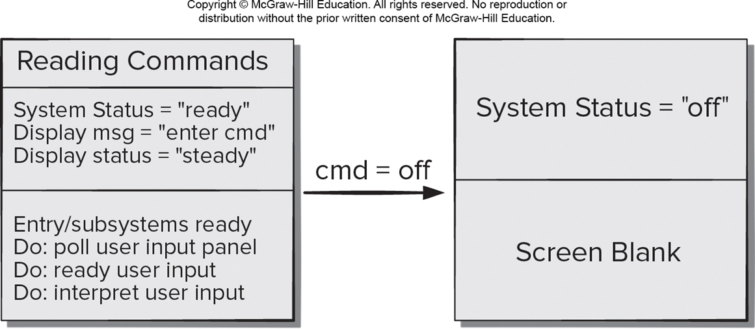
U M L State Diagram
Access the text alternative for slide images.

Slide 13
Analysis Patterns
Pattern name: A descriptor that captures the essence of the pattern.
Intent: Describes what the pattern accomplishes or represents.
Motivation: A scenario that illustrates how the pattern can be used to address the problem.
Forces and context: A description of external issues (forces) that can affect how the pattern is used and the external issues that will be resolved when the pattern is applied.
Solution: A description of how the pattern is applied to solve the problem with an emphasis on structural and behavioral issues.
Consequences: Addresses what happens when the pattern is applied and what trade-offs exist during its application.
Design: Discusses how the analysis pattern can be achieved through the use of known design patterns.
Known uses: Examples of uses within actual systems.
Related patterns: One or more analysis patterns that are related to the named pattern because (1) it is commonly used with the named pattern; (2) it is structurally similar to the named pattern; (3) it is a variation of the named pattern.

Slide 14
Negotiating Requirements
Negotiations strive for a “win-win” result, stakeholders win by getting a product satisfying most of their needs and developers win by getting achievable deadlines.
Handshaking is one-way to achieve “win-win”.
Developers propose solutions to requirements, describe their impact, and communicate their intentions to the customers.
Customer review the proposed solutions, focusing on missing features and seeking clarification of novel requirements.
Requirements are determined to be good enough if the customers accept the proposed solutions.
Handshaking tends to improve identification, analysis, and selection of variants.

Slide 15
Requirements Monitoring
Useful for incremental development includes:
Distributed debugging - uncovers errors and determines their cause.
Run-time verification - determines whether software matches its specification.
Run-time validation - assesses whether the evolving software meets user goals.
Business activity monitoring - evaluates whether a system satisfies business goals.
Evolution and codesign - provides information to stakeholders as the system evolves.

Slide 16
Validating Requirements 1
Is each requirement consistent with the overall objective for the system/product?
Have all requirements been specified at the proper level of abstraction? That is, do some requirements provide a level of technical detail that is inappropriate at this stage?
Is the requirement really necessary or does it represent an add-on feature that may not be essential to the objective of the system?
Is each requirement bounded and unambiguous?
Does each requirement have attribution? That is, is a source (generally, a specific individual) noted for each requirement?
Do any requirements conflict with other requirements?

Slide 17
Validating Requirements 2
Is each requirement achievable in the technical environment that will house the system or product?
Is each requirement testable, once implemented?
Does the requirements model properly reflect the information, function and behavior of system to be built?
Has the requirements model been “partitioned” in a way that exposes progressively more detailed information about the system?
Have requirements patterns been used to simplify the requirements model. Have all patterns been properly validated? Are all patterns consistent with customer requirements?

Slide 18
End of Main Content

Slide 19
Accessibility Content: Text Alternatives for Images

Slide 20
U M L Use Case Diagram – Text Alternative
Return to parent-slide containing images.
An illustration displays the U M L use case diagram. It displays the homeowner, and the system administrator. The home owner performs the following use cases displayed in the diagram: arms or disarms system, accesses system via internet, responds to alarm events, and encounters an error condition. The system administrator reconfigures sensor and related system features. The responds to alarm events, encounters an error condition, and reconfigures sensors and related system features are further connected to sensors.
Return to parent-slide containing images.

Slide 21
U M L Class Diagram – Text Alternative
Return to parent-slide containing images.
The class diagram is as follows: Class: Sensor. Attributes: name, type, location, area, and characteristics. Operations: identify, enable, disable, and reconfigure.
Return to parent-slide containing images.

Slide 22
U M L State Diagram – Text Alternative
Return to parent-slide containing images.
An illustration displays U M L state diagram. The class reading commands on the left side has the following attributes and operations. Operations: system status = ready; display msg = enter cmd, display status = steady. Operations: entry or subsystem ready. do: poll user input panel; do: ready user input; and do: interpret user input. When the reading is off. The system status = "off" and the screen is blank.
Return to parent-slide containing images.

