Slide 1

Chapter 9
Design Concepts
Part Two - Modeling

Slide 2
Software Design
Encompasses the set of principles, concepts, and practices that lead to the development of a high quality system or product.
Design principles establish and overriding philosophy that guides the designer as the work is performed.
Design concepts must be understood before the mechanics of design practice are applied.
Software design practices change continuously as new methods, better analysis, and broader understanding evolve.

Slide 3
Software Engineering Design
Data/Class design – transforms analysis classes into implementation classes and data structures.
Architectural design – defines relationships among the major software structural elements.
Interface design – defines how software elements, hardware elements, and end-users communicate.
Component-level design – transforms structural elements into procedural descriptions of software components.

Slide 4
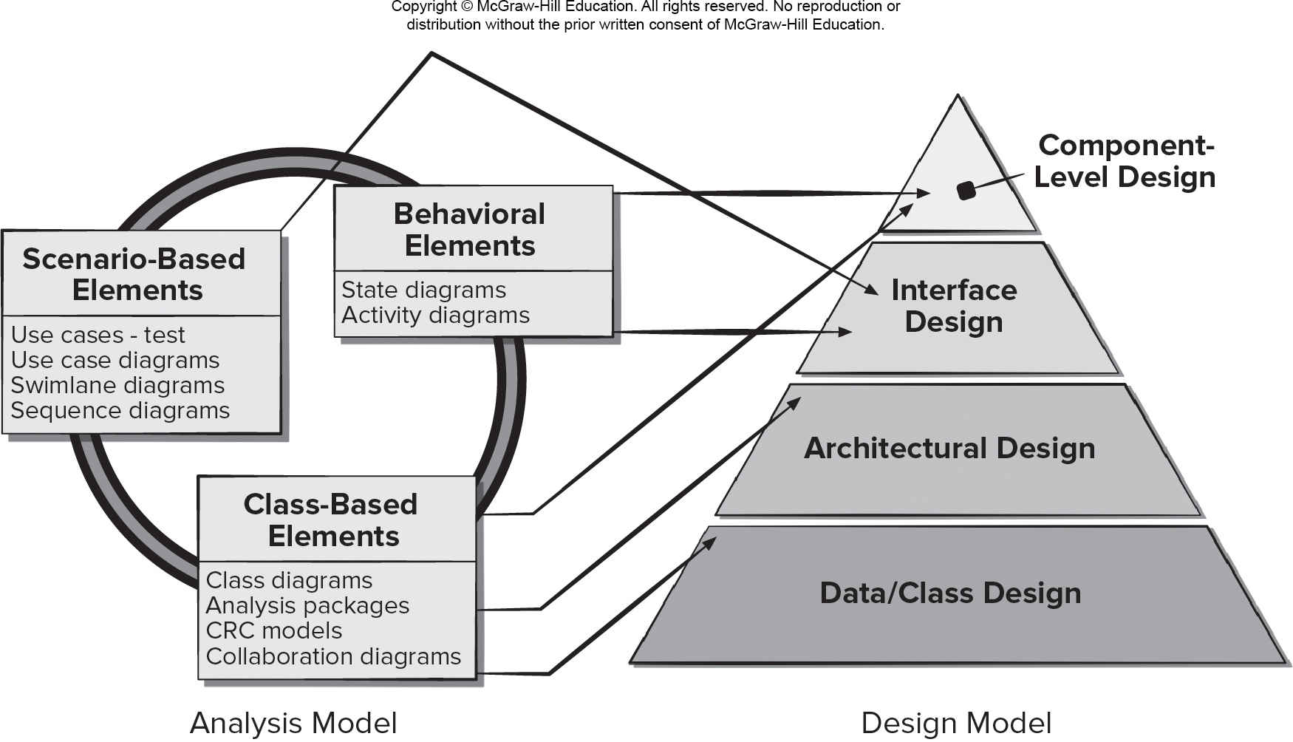
Mapping Requirements Model to Design Model
Access the text alternative for slide images.

Slide 5
Design and Quality
The design must implement all of the explicit requirements contained in the analysis model, and it must accommodate all of the implicit requirements desired by the customer.
The design should be a readable, understandable guide for those who generate code and for those who test and subsequently support the software.
The design should provide a complete picture of the software, addressing the data, functional, and behavioral domains from an implementation perspective.

Slide 6
Quality Guidelines
A design should exhibit an architecture (a) created using recognizable architectural styles or patterns, (b) composed of well designed components (c) implemented in an evolutionary fashion.
A design should be modular.
A design should contain distinct representations of data, architecture, interfaces, and components.
A design should lead to data structures that are drawn from recognizable data patterns.
A design should contain functionally independent components.
A design should lead to interfaces that reduce the complexity of connections between components and the external environment.
A design should be derived using a repeatable method that is driven by software requirements analysis.
A design should be represented using meaningful notation.

Slide 7
Common Design Characteristics
Each new software design methodology introduces unique heuristics and notions – yet they each contain:
A mechanism for the translating the requirements model into a design representation.
A notation for representing functional components and their interfaces.
Heuristics for refinement and partitioning.
Guidelines for quality assessment.

Slide 8
Design Concepts 1
Abstraction – data (named collection of data describing data object), procedural (name sequence of instructions with specific and limited function).
Architecture - overall structure or organization of software components, ways components interact, and structure of data used by components.
Design Patterns - describe a design structure that solves a well-defined design problem within a specific context.
Separation of concerns - any complex problem can be more easily handled if it is subdivided into pieces.
Modularity—compartmentalization of data and function.

Slide 9
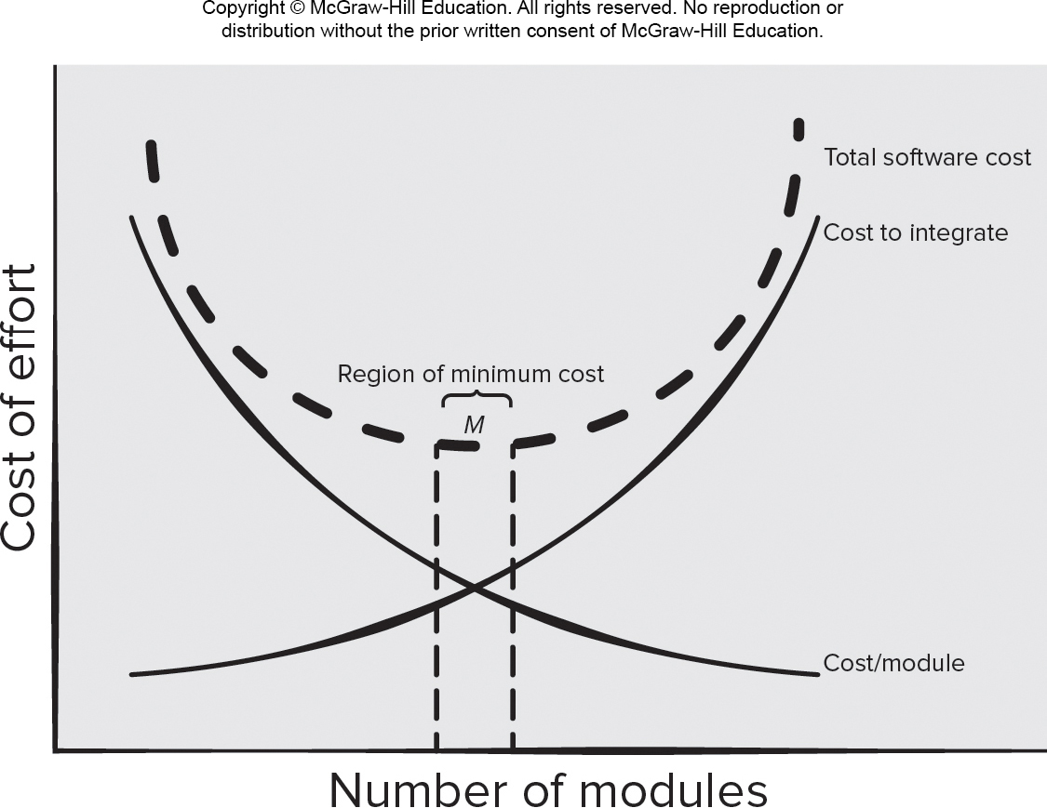
Modularity and Software Cost
Access the text alternative for slide images.

Slide 10
Design Concepts 2
Information Hiding - controlled interfaces which define and enforces access to component procedural detail and any local data structure used by the component.
Functional independence - single-minded (high cohesion) components with aversion to excessive interaction with other components (low coupling).
Stepwise Refinement – incremental elaboration of detail for all abstractions.
Refactoring—a reorganization technique that simplifies the design without changing functionality.
Design Classes—provide design detail that will enable analysis classes to be implemented.

Slide 11
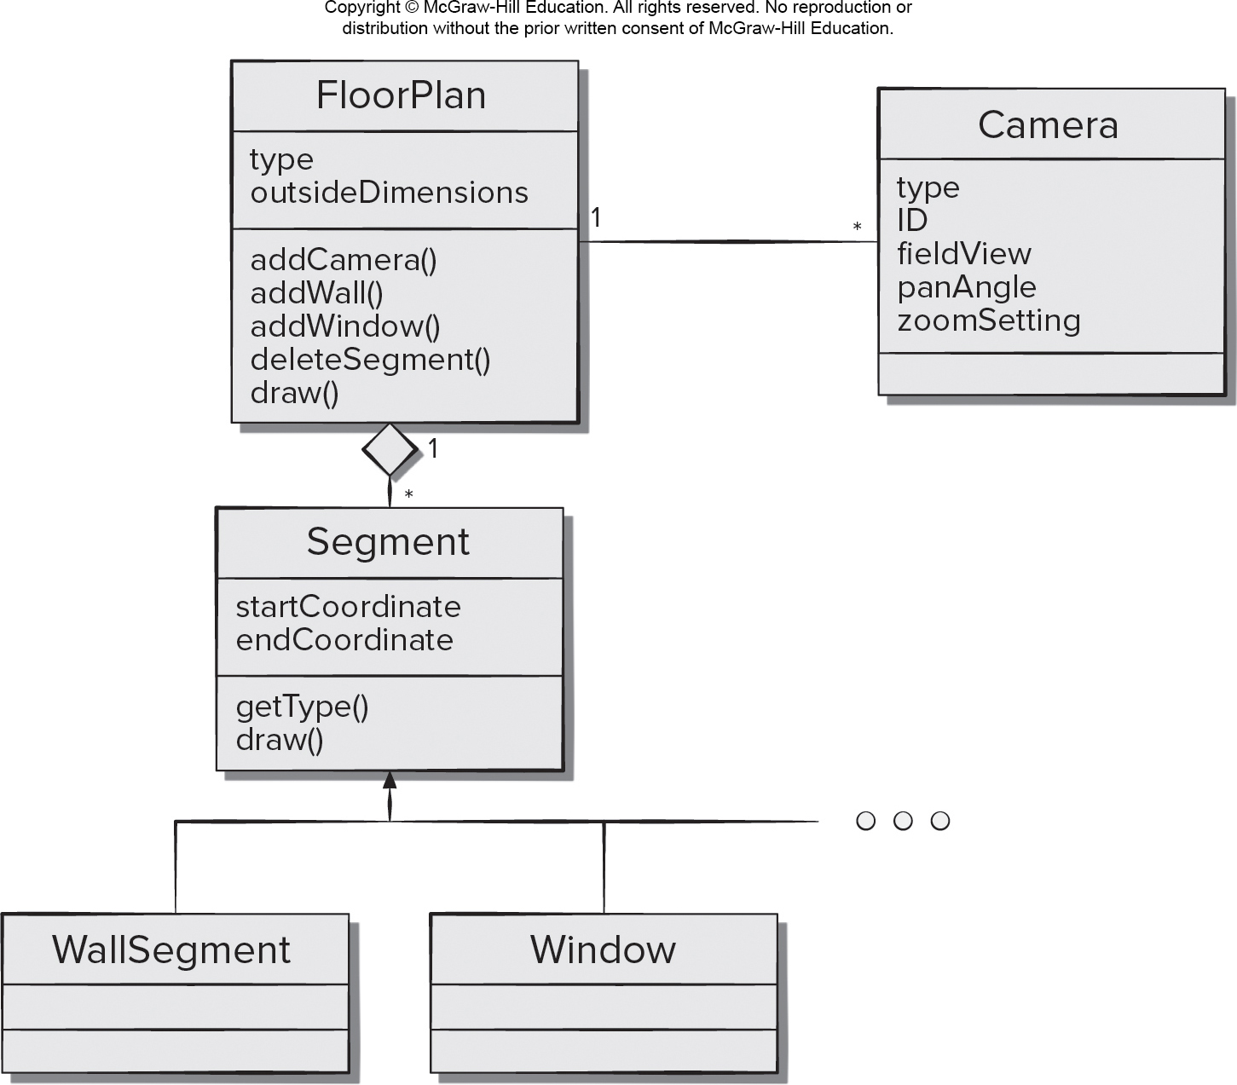
Design Class Example
Access the text alternative for slide images.

Slide 12
Design Class Characteristics
Complete - includes all necessary attributes and methods) and sufficient (contains only those methods needed to achieve class intent).
Primitiveness – each class method focuses on providing one service.
High cohesion – small, focused, single-minded classes.
Low coupling – class collaboration kept to minimum.

Slide 13
Information Hiding
Reduces the likelihood of “side effects.”
Limits the global impact of local design decisions.
Emphasizes communication through controlled interfaces.
Discourages the use of global data.
Leads to encapsulation—an attribute of high quality design.
Results in higher quality software.

Slide 14
Architecture Properties
Structural properties. This aspect of the architectural design representation defines the components of a system (for example, modules, objects, filters) and the manner in components are packaged and interact with one another.
Extra-functional properties. The architectural design description should address how the design architecture achieves requirements for performance, capacity, reliability, security, adaptability, and other characteristics.
Families of related systems. The architectural design should draw upon repeatable patterns (building blocks) often encountered in the design of similar systems.

Slide 15
Design Pattern Template
Pattern name - describes the essence of the pattern in a short but expressive name
Intent - describes the pattern and what it does
Also-known-as - lists any synonyms for the pattern
Motivation - provides an example of the problem
Applicability - notes specific design situations in which the pattern is applicable
Structure - describes the classes that are required to implement the pattern
Participants - describes the responsibilities of the classes that are required to implement the pattern
Collaborations - describes how the participants collaborate to carry out their responsibilities
Consequences - describes the “design forces” that affect the pattern and the potential trade-offs that must be considered when the pattern is implemented
Related patterns - cross-references related design patterns

Slide 16
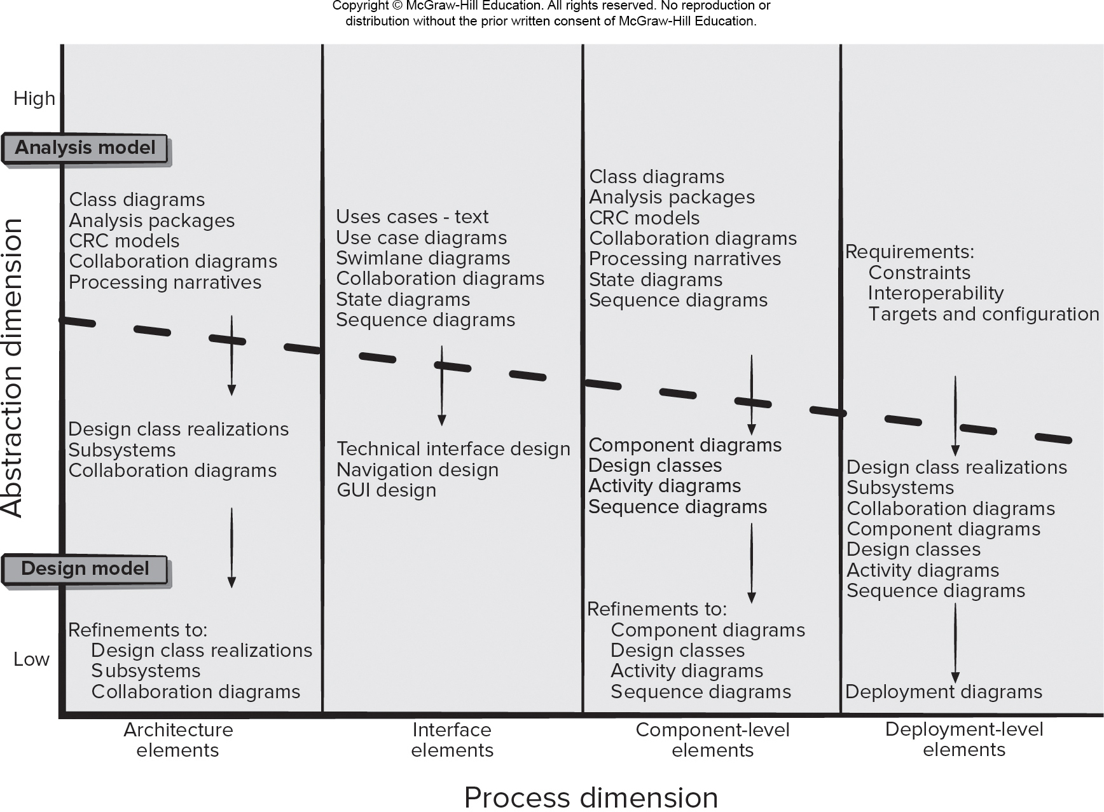
Design Model
Access the text alternative for slide images.

Slide 17
Design Modeling Principles 1
Principle #1. Design should be traceable to the requirements model.
Principle #2. Always consider the architecture of the system to be built.
Principle #3. Design of data is as important as design of processing functions.
Principle #4. Interfaces (both internal and external) must be designed with care.
Principle #5. User interface design should be tuned to the needs of the end-user and stress ease of use.

Slide 18
Design Modeling Principles 2
Principle #6. Component-level design should be functionally independent.
Principle #7. Components should be loosely coupled to each other than the environment.
Principle #8. Design representations (models) should be easily understandable.
Principle #9. The design should be developed iteratively.
Principle #10. Creation of a design model does not preclude using an agile approach.

Slide 19
Data Design Elements
Data model – data objects and database architectures.
Examines data objects independently of processing.
Focuses attention on the data domain.
Creates a model at the customer’s level of abstraction.
Indicates how data objects relate to one another.
Data object can be an external entity, a thing, an event, a place, a role, an organizational unit, or a structure.
Data objects contain a set of attributes that act as an quality, characteristic, or descriptor of the object.
Data objects may be connected to one another in many different ways.

Slide 20
Architectural Design Elements
Architectural design for software - equivalent to the floor plan for a house.
The architectural model is derived from three sources:
Information about the application domain for the software to be built.
Specific requirements model elements such as data flow analysis classes and their relationships (collaborations) for the problem at hand, and
Availability of architectural patterns and styles.

Slide 21
Interface Design Elements
Interface is a set of operations that describes the externally observable behavior of a class and provides access to its public operations.
Important elements:
User interface (UI).
External interfaces to other systems.
Internal interfaces between various design components.
UI or User Experience (UX) is a major engineering action to ensure the creation on usable software products.
Internal and external interfaces should incorporate both error checking and appropriate security features.

Slide 22
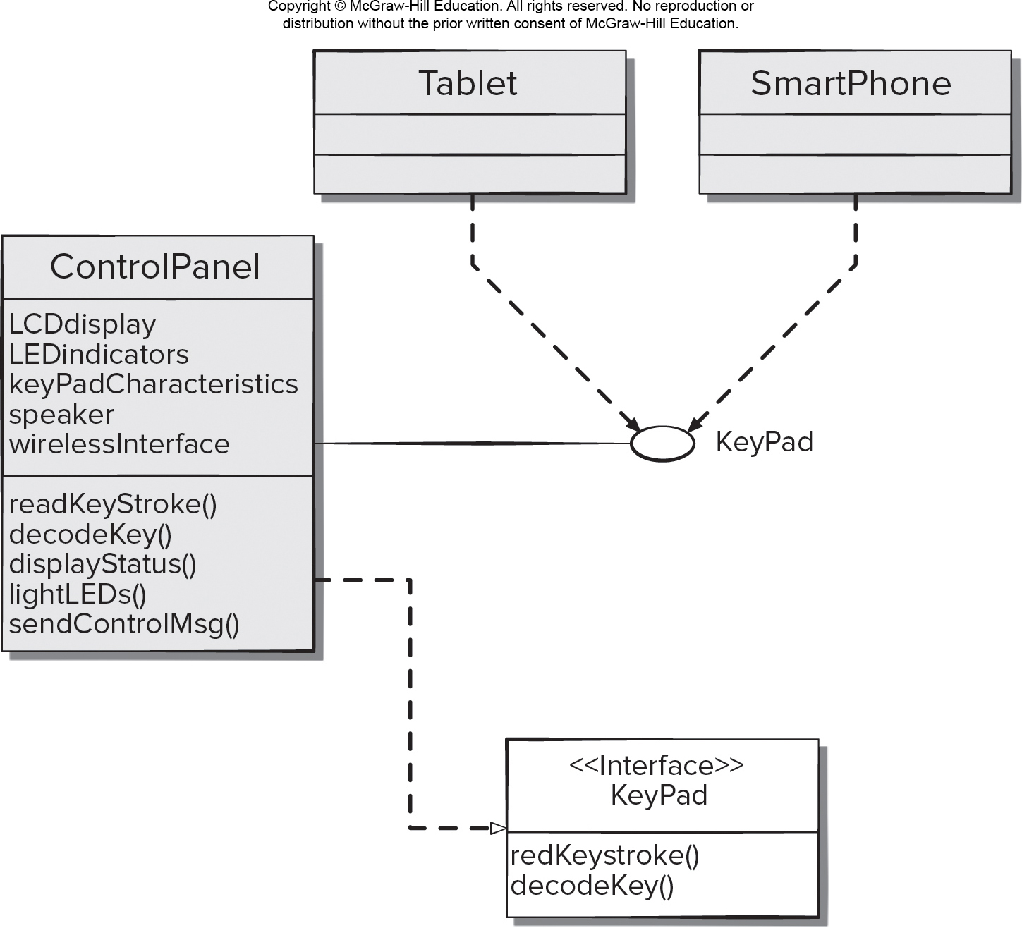
Interface Model for Control Panel
Access the text alternative for slide images.

Slide 23
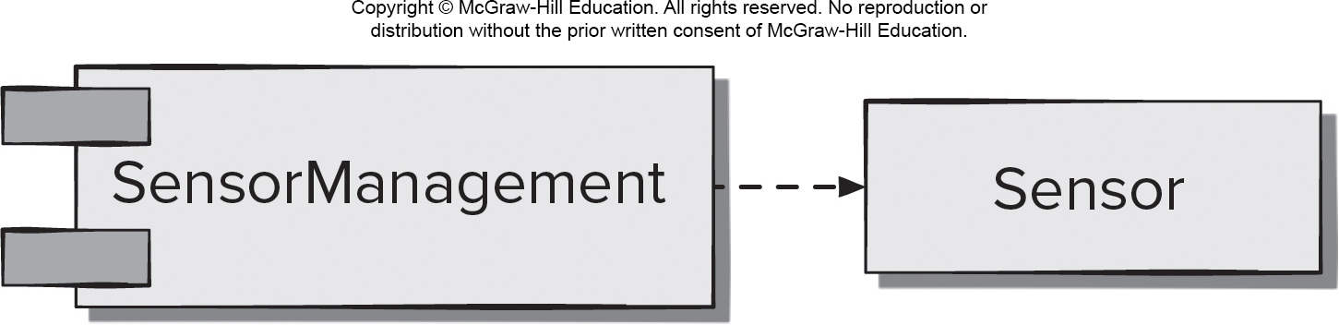
Component-Level Design Elements
Describes the internal detail of each software component.
Defines:
Data structures for all local data objects.
Algorithmic detail for all component processing functions.
Interface that allows access to all component operations.
Modeled using U M L component diagrams.

Slide 24
Deployment Design Elements
Indicates how software functionality and subsystems will be allocated within the physical computing environment.
Modeled using U M L deployment diagrams.
Descriptor form deployment diagrams - show the computing environment but does not indicate configuration details.
Instance form deployment diagrams - identify specific hardware configurations and are developed in the latter stages of design.

Slide 25
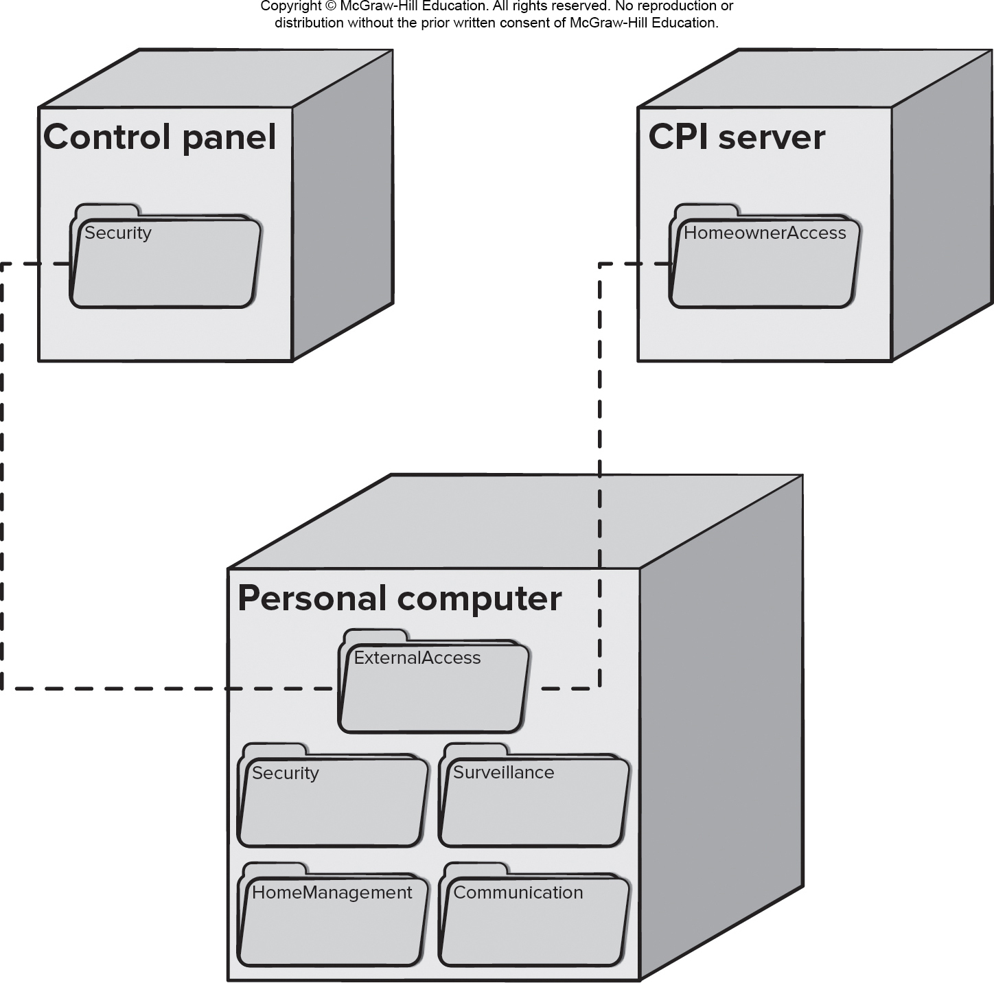
U M L Deployment Instance Diagram
Access the text alternative for slide images.

Slide 26
End of Main Content

Slide 27
Accessibility Content: Text Alternatives for Images

Slide 28
Mapping Requirements Model to Design Model – Text Alternative
Return to parent-slide containing images.
An illustration maps requirement model to design model. The requirement or analysis model is has three components, Behavioral elements, class-based elements, and scenario-based elements. The behavioral elements contain state diagrams, actively diagrams. The class-based elements contain class diagrams, analysis packages, C R C models, and collaboration diagrams. The scenario-based elements contain, use cases - test, use case diagrams, swim line diagrams, and sequence diagrams. The Design model is pyramid shaped with four levels from top to bottom as component - level design, interface design, architectural design, and data or class design. The components of the analysis model connect to different levels in the design model as follow. The behavioral elements, and class based elements are connected to the component level design. Behavioral elements and scenario based elements are connected to the interface design. The class based elements are connected to the architectural design and data or class design level.
Return to parent-slide containing images.

Slide 29
Modularity and Software Cost – Text Alternative
Return to parent-slide containing images.
A graph plots cost of effort versus number of modules. The plotted graph has three curves labeled: total software cost, cost to integrate, and cost per module. The curve for cost to ingrate rises from the origin and approaches a hypothetical vertical asymptote. The cost per module curve falls from the positive y axis approaching the positive x axis. The x axis acts as the horizontal asymptote for the curve. The curve for total software cost falls and rises between the upper intersection of the two curves: cost per module and cost to integrate. A region label M is the region of minimum cost and comprises of the region contained between two dotted vertical lines which are plotted on either sides of the two intersecting curves.
Return to parent-slide containing images.

Slide 30
Design Class Example – Text Alternative
Return to parent-slide containing images.
The diagram shows a design class example. The various class names in the diagram are as follow: wall segment, window, segment, floorplan and camera. The attributes and operation for each class are as follow. Segment, attributes are: start coordinate and end coordinate. The operations are: get type and draw. Floorplan attributes are: type and outside dimension. The operations are: add camera, add wall, add window delete segment and draw. Camera, attributes are: type, I D, field view, pan angle and zoom setting. The relationship in the class diagram is as follow: segment has an inheritance relationship with wall segment and window. Floorplan has an aggregation relationship with segment with exactly one cardinality. Floorplan has one to many association with camera.
Return to parent-slide containing images.

Slide 31
Design Model – Text Alternative
Return to parent-slide containing images.
The design model is explained in a graphical representation. The y axis plots abstraction dimension which range from low to high. The design model is plotted in the low region and analysis model is plotted in the high region. The x axis plots process dimension for architecture elements, interface elements, component level elements and deployment level elements. For architecture elements the flow from high to low is as follows. In the high range under the analysis model the components are: class diagrams, analysis packages, C R C models, collaboration diagrams and processing narratives. Between high and low for analysis model the components are: design class realization, subsystems, and collaboration diagrams. The low components under design model are: refinements to design class realizations, subsystems and collaboration diagrams. For interface elements only the components under the analysis model are used. The components ranging from high to low are: uses cases-text, use case diagrams, swimlane diagrams, processing narratives, state diagrams, and sequence diagrams. The mid-range components are: technical interface design, navigation design and G U I design. For component level elements, under the analysis model, the components ranging from high to low are: Class diagrams, analysis packages, C R C models, collaboration diagrams, processing narratives, state diagrams, and sequence diagrams. The mid-range components are: components diagrams, design classes, activity diagrams, and sequence diagrams. The low components under design model are: refinements to component diagrams, design classes, activity diagrams, and sequence diagrams. For deployment level elements, under the analysis model, the requirements ranging from high to low are: constraints, interoperability and targets and configuration. The low components under design model are: design class realizations, subsystems, collaboration diagrams, design classes, activity diagrams, and sequence diagrams. This leads to the deployment diagrams.
Return to parent-slide containing images.

Slide 32
Interface Model for Control Panel – Text Alternative
Return to parent-slide containing images.
A class diagram for an interface model for control panel. A tablet or a smartphone has dependency relationship with the keypad. The keypad has an association with the control panel. The control panel has realization relationship with the keypad interface. The control panel has the following attributes and operations. Attributes: L C D display, L E D indicators, keypad characteristics, speaker and wireless interface. Operations: read key stroke, decode key, display status, light L E Ds, send control message. The keypad interface has the following operations: read key stroke and decode key.
Return to parent-slide containing images.

Slide 33
U M L Deployment Instance Diagram – Text Alternative
Return to parent-slide containing images.
An illustration displays U M L development instance diagram. The three classes are: control panel, C P I server, and personal computer. The personal computer contains external access, security, surveillance, home management, and communication. The external access of the personal computer is connected to the security of the control panel, and home owner access of the C P I server.
Return to parent-slide containing images.

