Slide 1

Chapter 10
Architectural Design – A Recommended Approach
Part Two - Modeling

Slide 2
What is Software Architecture?
The architecture is not the operational software, it is a representation that enables a software engineer to:
Analyze the effectiveness of the design in meeting its stated requirements,
Consider architectural alternatives at a stage when making design changes is still relatively easy, and
Reduce the risks associated with the construction of the software.

Slide 3
Why is Software Architecture Important?
Software architecture provides a representation that facilitates communication among all stakeholders interested in the development of a computer-based system.
Architecture highlights early design decisions that will have a profound impact on all software engineering work that follows.
Architecture constitutes a relatively small, intellectually graspable mode of how the system is structured and how its components work together.

Slide 4
Architectural Descriptions
The I E E E Computer Society has proposed I E E E-Std-42010-2011, Systems and Software Engineering – Architecture Description.
Describes the use of architecture viewpoints, architecture frameworks, and architecture description languages as a means of codifying the conventions and common practices for architectural description.
The IEEE Standard defines an architectural description (A D) as a “a collection of products to document an architecture.”
An architecture description shall identify the system stakeholders having concerns considered fundamental to the architecture of the system-of-interest.
These concerns shall be considered when applicable and identified in the architecture description: system purpose, suitability of the architecture, feasibility of constructing and deploying the system, risks and impacts of the system, and the maintainability and evolvability of the system.

Slide 5
Architecture Decision Documentation
Determine information items needed for each decision.
Define links between each decision and appropriate requirements.
Provide mechanisms to change status when alternative decisions need to be evaluated.
Define prerequisite relationships among decisions to support traceability.
Link significant decisions to architectural views resulting from decisions.
Document and communicate all decisions as they are made.

Slide 6
Agility and Architecture
To avoid rework, user stories are used to create and evolve an architectural model (walking skeleton) before beginning any coding.
Use models which allow software architects to add user stories to the evolving storyboard and works with the product owner to prioritize the architectural stories as “sprints” (work units) are planned.
Well run agile projects include delivery of architectural documentation during each sprint.
After the sprint is completed, the architect reviews the working prototype for quality before the team presents it to the stakeholders in a formal sprint review.

Slide 7
Architectural Styles
Each style describes a system category that encompasses:
set of components (for example: a database, computational modules) that perform a function required by a system.
set of connectors that enable “communication, coordination and cooperation” among components.
constraints that define how components can be integrated to form the system.
semantic models that enable a designer to understand the overall properties of a system by analyzing the known properties of its constituent parts.

Slide 8
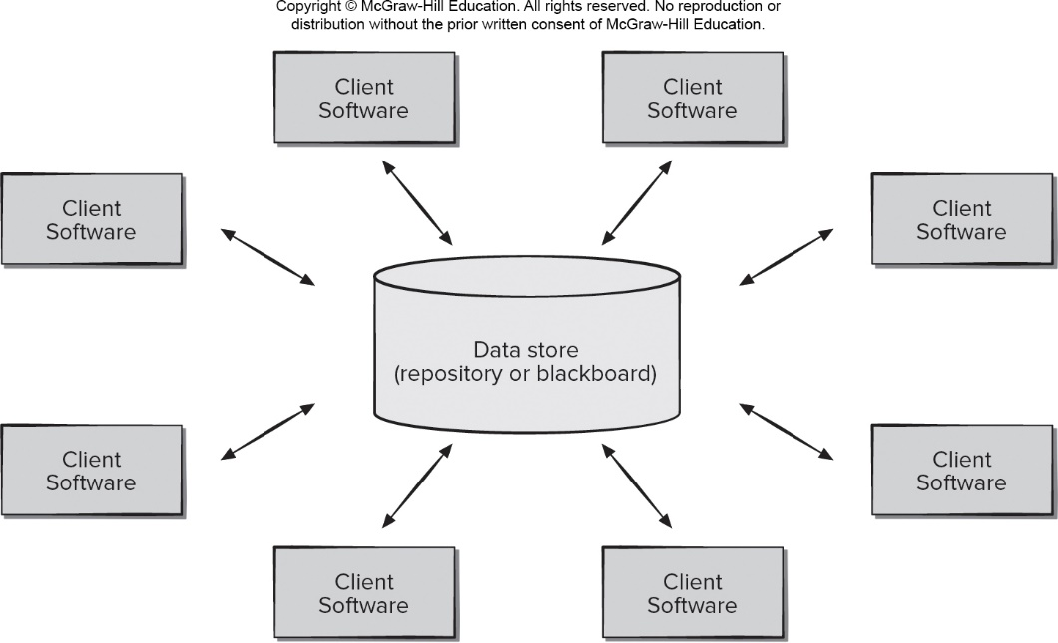
Data Centered Architecture
Access the text alternative for slide images.

Slide 9
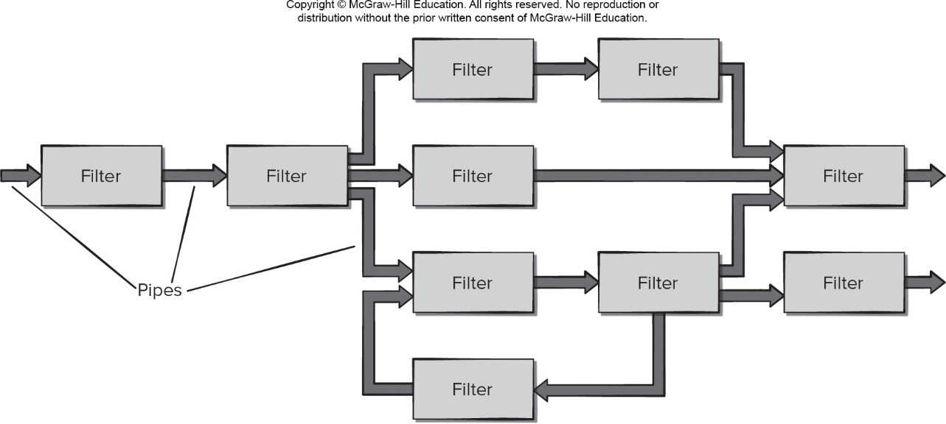
Data Flow Architecture
Access the text alternative for slide images.

Slide 10
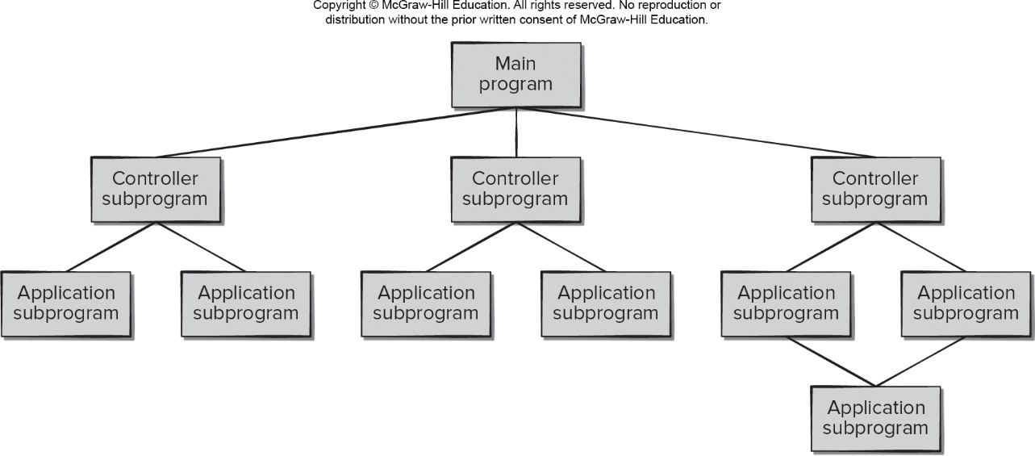
Call Return Architecture
Access the text alternative for slide images.

Slide 11
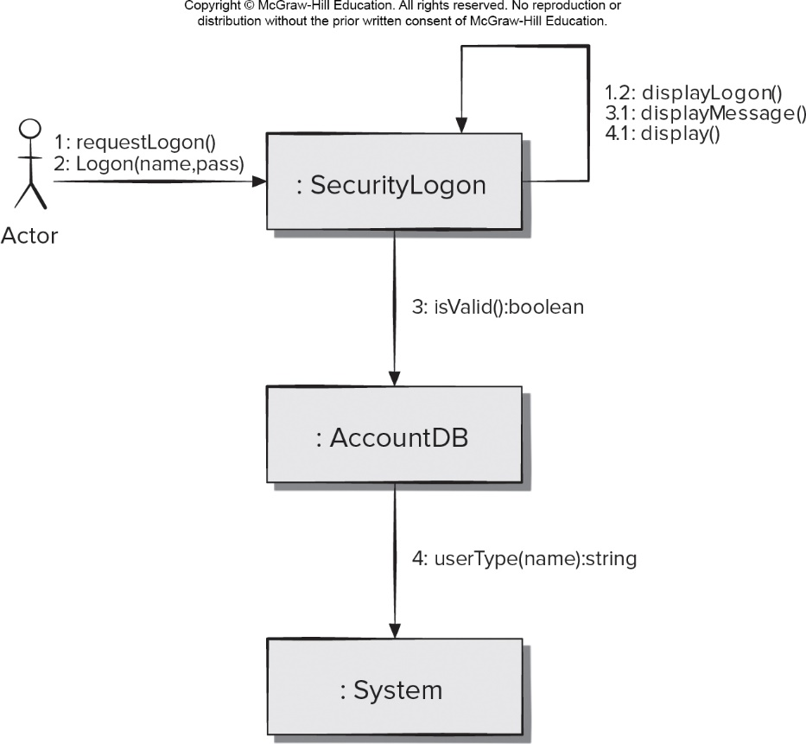
Object-Oriented Architecture
Access the text alternative for slide images.

Slide 12
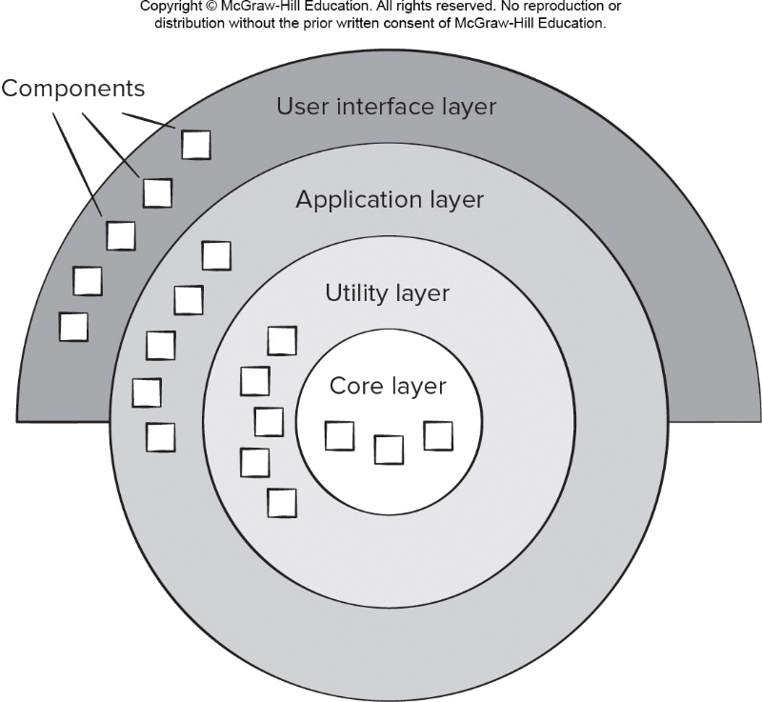
*Layered Architecture重要
Core
Utitlity
..
Access the text alternative for slide images.

Slide 13
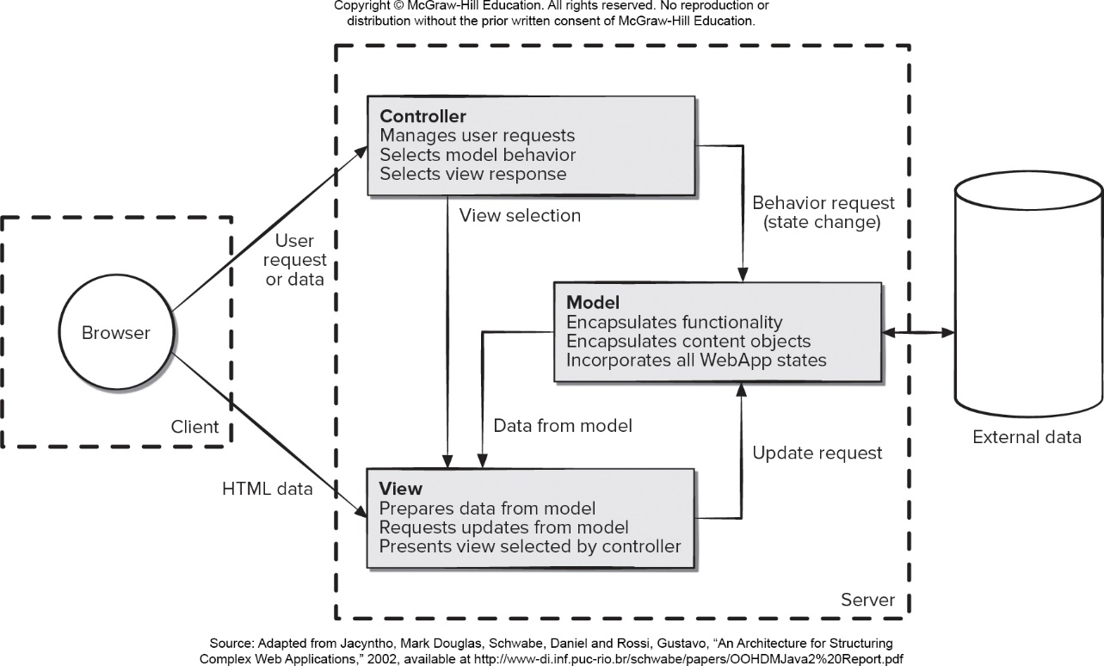
Model View Controller Architecture
Access the text alternative for slide images.

Slide 14
Architectural Organization and Refinement 1
Control.
How is control managed within the architecture?
Does a distinct control hierarchy exist, and if so, what is the role of components within this control hierarchy?
How do components transfer control within the system?
How is control shared among components?
What is the control topology (that is, the geometric form that the control takes)?
Is control synchronized, or do components operate asynchronously?

Slide 15
Architectural Organization and Refinement 2
Data.
How are data communicated between components?
Is the flow of data continuous, or are data objects passed to the system sporadically?
What is the mode of data transfer?
Do data components exist, and if so, what is their role?
How do functional components interact with data components?
Are data components passive or active?
How do data and control interact within the system?

Slide 16
Architectural Considerations
Economy – software is uncluttered and relies on abstraction to reduce unnecessary detail.
Visibility – Architectural decisions and their justifications should be obvious to software engineers who review.
Spacing – Separation of concerns in a design without introducing hidden dependencies.
Symmetry – Architectural symmetry implies that a system is consistent and balanced in its attributes.
Emergence – Emergent, self-organized behavior and control are key to creating scalable, efficient, and economic software architectures.

Slide 17
Architectural Design
The software must be placed into context.
The design should define the external entities (other systems, devices, people) that the software interacts with and the nature of the interaction.
A set of architectural archetypes should be identified.
An archetype is an abstraction (similar to a class) that represents one element of system behavior.
The designer specifies the structure of the system by defining and refining software components that implement each archetype.

Slide 18
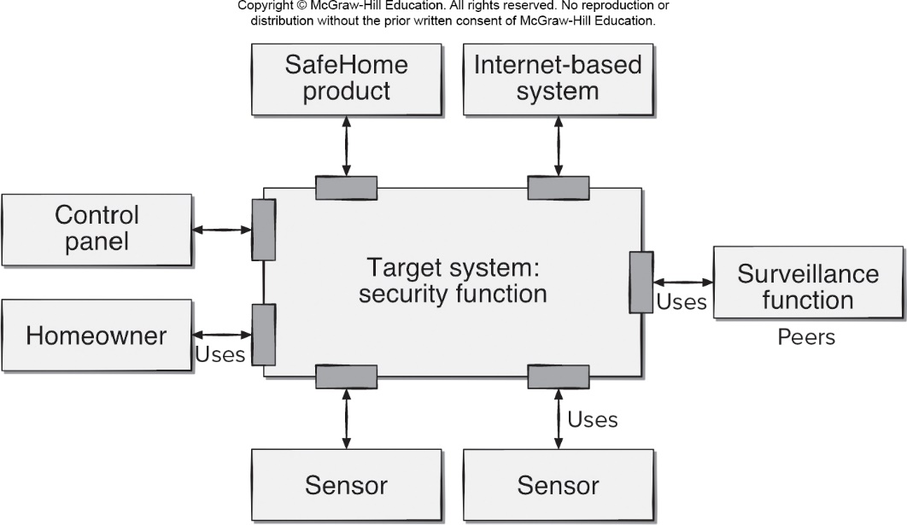
Architecture Context Diagram
Access the text alternative for slide images.

Slide 19
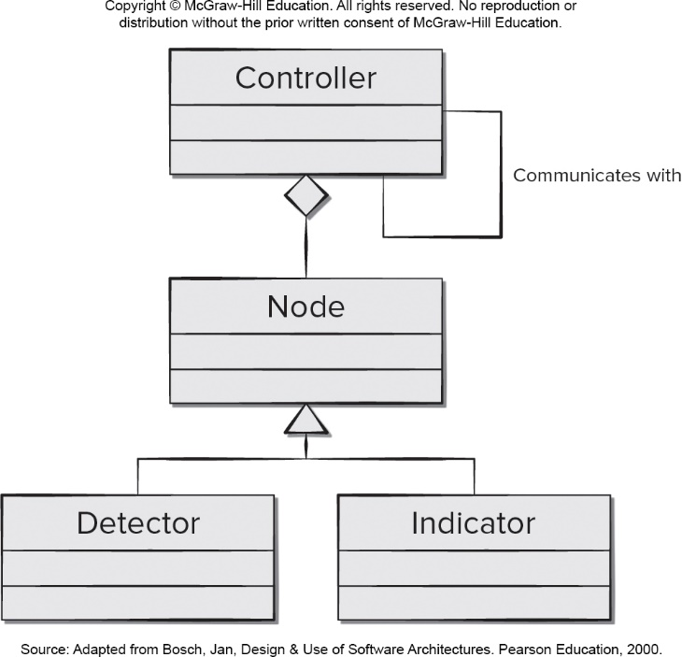
SafeHome Security Function Archetype
Access the text alternative for slide images.

Slide 20
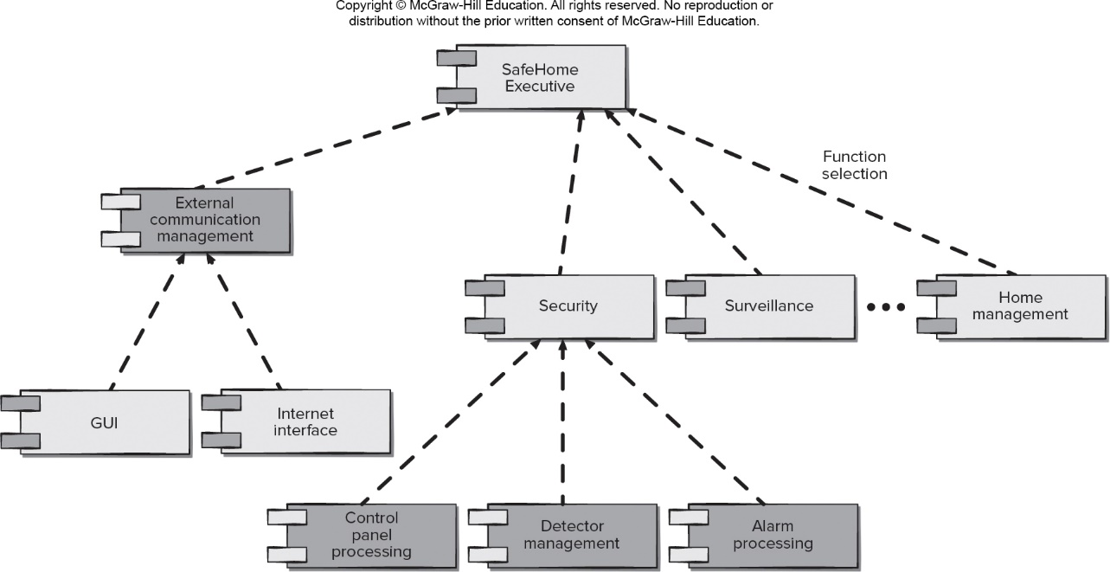
SafeHome Top-Level Component Architecture
Access the text alternative for slide images.

Slide 21
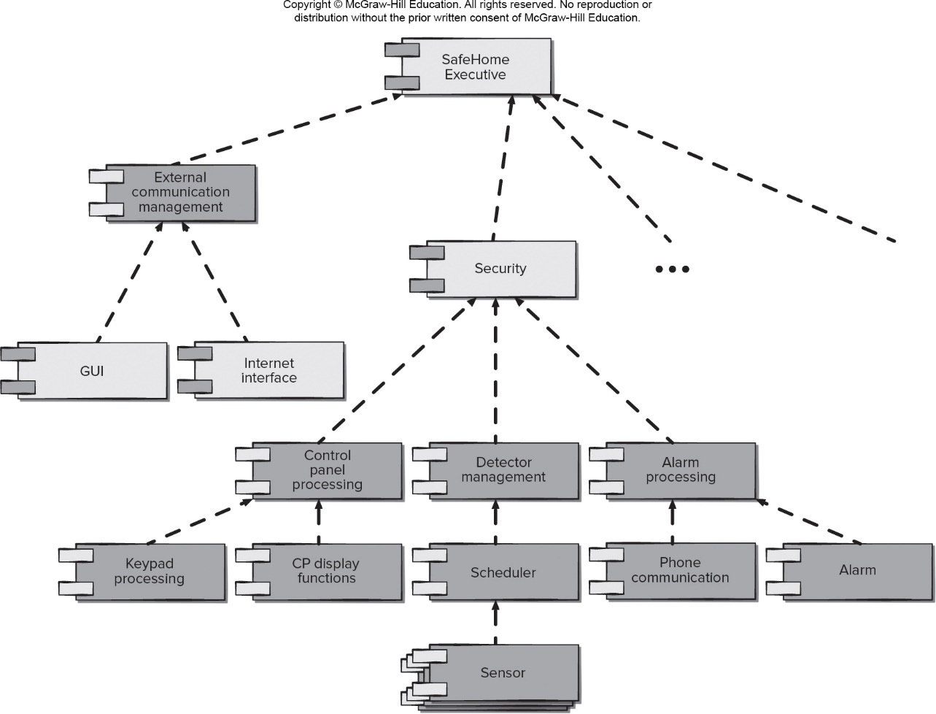
SafeHome Refined Component Architecture
Access the text alternative for slide images.

Slide 22
Architectural Tradeoff Analysis
Collect scenarios.
Elicit requirements, constraints, environment description.
Describe the architectural styles/patterns that have been chosen to address the scenarios and requirements using one of these views: module, process, data flow.
Evaluate quality attributes by considering each one in isolation.
Identify the sensitivity of quality attributes to various architectural attributes for a specific architectural style.
Critique candidate architectures (developed in step 3) using the sensitivity analysis (conducted in step 5).

Slide 23
Architectural Reviews
Assess the ability of the software architecture to meet the systems quality requirements and identify potential risks.
Have the potential to reduce project costs by detecting design problems early.
Often make use of experience-based reviews, prototype evaluation, and scenario reviews, and checklists.

Slide 24
Pattern-based Architectural Reviews
Identify and discuss the quality attributes by walking through the use cases.
Discuss a diagram of system’s architecture in relation to its requirements.
Identify the architecture patterns used and match the system’s structure to the patterns’ structure.
Use existing documentation and use cases to determine each pattern’s effect on quality attributes.
Identify all quality issues raised by architecture patterns used in the design.
Develop a short summary of issues uncovered during the meeting and make revisions to the walking skeleton.

Slide 25
End of Main Content

Slide 26
Accessibility Content: Text Alternatives for Images

Slide 27
Data Centered Architecture – Text Alternative
Return to parent-slide containing images.
An illustration displays a data centered architecture. The diagram reads data store (repository or blackboard), multiple client softwares placed around it are connected to the data store.
Return to parent-slide containing images.

Slide 28
Data Flow Architecture – Text Alternative
Return to parent-slide containing images.
The diagram shows a data flow architecture. Each rectangular component is the architecture is labeled a filter and the connecting arrows between the filters are labeled pipes. The data flow is read in the right to left direction.
Return to parent-slide containing images.

Slide 29
Call Return Architecture – Text Alternative
Return to parent-slide containing images.
A flowchart displays call return architecture. The main program is connected to three controller subprograms. Each controller subprograms are connected to two application subprograms each. These two subprograms again constitutes an application subprogram.
Return to parent-slide containing images.

Slide 30
Object-Oriented Architecture – Text Alternative
Return to parent-slide containing images.
The diagram shows an object oriented architecture. An actor connects to a security logon and requests logon and enters name password on logon. The security logon has an internal loop that relays: display, display message, and display logon. If the security logon is valid, the actor accesses the account data base. After selecting the user type the actor accessed the system.
Return to parent-slide containing images.

Slide 31
Layered Architecture – Text Alternative
Return to parent-slide containing images.
An illustration displays layered architecture. The circular diagram has four layers: core layer, utility layer, application layer, and user interface layer from inner to outer level. The outer level is in a semicircle form. Each layer has components displayed with squares which are decreasing in number from outer to inner layers.
Return to parent-slide containing images.

Slide 32
Model View Controller Architecture – Text Alternative
Return to parent-slide containing images.
The diagram shows a model view controller architecture. The architecture contains three section. The client, the server and the external data. A client accessed a browser. The browser connects to the server via two paths. the server contains controller, model and view. The browser sends a user request or data to the controller or the browser accesses H T M L data in the view. The controller manages user requests, selects model behavior and selects view response. The view prepares data from model, requests update from model and presents view selected by controller. The model, encapsulates functionality, encapsulates content objects and incorporates all web app states. The controller sends a view selection to view and sends a sends a state change behavior request to model. View receives the data from model and sends an updated request to model. Model has a two data exchange with external data.
Return to parent-slide containing images.

Slide 33
Architecture Context Diagram – Text Alternative
Return to parent-slide containing images.
The diagram shows an architecture context design. A central target system in this case a security function. The security function uses the following external entities. Homeowner, control panel, safe home product, internet based system, surveillance function, and sensors.
Return to parent-slide containing images.

Slide 34
SafeHome Security Function Archetype – Text Alternative
Return to parent-slide containing images.
The diagram shows the safehome security function archetype: The archetypal class connections from bottom to top are as follow: detector and indicator connect to the node. The node connects to the controller. The controller communicates in a loop with itself.
Return to parent-slide containing images.

Slide 35
SafeHome Top-Level Component Architecture – Text Alternative
Return to parent-slide containing images.
The safe-home top-level component architecture from bottom to top is as follows: at level 5 the control panel processing, detector management and alarm processing connect to the security on level 3. At level 4, G U I and the internet interface connect to the external communication management on level 2. At level 3, security, surveillance and home management connect to the safe home executive at level 1. At level 2, external communication management connects to the safe home executive at level 1
Return to parent-slide containing images.

Slide 36
SafeHome Refined Component Architecture – Text Alternative
Return to parent-slide containing images.
The safe-home refined component architecture from bottom to top is as follows: at level 7 the sensor connects to the scheduler on level 6. The components on level 6 are: keypad processing, C P display functions, scheduler, phone communication and alarm. Keypad processing and C P display functions connect to the control panel processing. Scheduler connects to the detector management. Phone communication and alarm connect to the alarm processing. All connections are from level 6 to level 5. At level 5 the control panel processing, detector management and alarm processing connect to the security on level 3. At level 4, G U I and the internet interface connect to the external communication management on level 2. At level 3, security, surveillance and home management connect to the safe home executive at level 1. At level 2, external communication management connects to the safe home executive at level 1
Return to parent-slide containing images.

