Slide 1
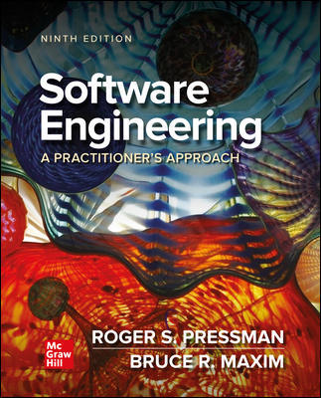
Chapter 16
Reviews – A Recommended Approach
Part Three – Quality and Security

Slide 2
Reviews
What are they?
A meeting conducted by technical people.
A technical assessment of a work product created during the software engineering process.
A software quality assurance mechanism.
A training ground.
What they are not!
A project summary or progress assessment.
A meeting intended solely to impart information.
A mechanism for political or personal reprisal!

Slide 3
Cost Impact of Software Defects
Error—a quality problem found before the software is released to end users.交付之前的问题
Defect—a quality problem found only after the software has been released to end-users.部署之后出现的问题
We make this distinction because errors and defects have very different economic, business, psychological, and human impact.
Design activities introduce 50 to 65% of all software defects.
Review activities have been shown to be 75% effective in uncovering design flaws.
The sooner you find a defect the cheaper it is to fix it.

Slide 4
Defect Amplification and Removal
Defect amplification is a term used to describe how an defect introduced early in the software engineering work flow (for example: during requirement modeling) and undetected, can and often will be amplified into multiple errors during design and more errors in construction.
Defect propagation is a term used to describe the impact an undiscovered defect has on future development activities or product behavior.
Technical debt is the term used to describe the costs incurred by failing to find and fix defects early or failing to update documentation following software changes.

Slide 5
Review Metrics 1
Preparation effort, E_{p} — the effort (in person-hours) required to review a work product prior to the actual review meeting.
Assessment effort, E_{a} — the effort (in person-hours) that is expending during the actual review.
Rework effort, E_{r} — the effort (in person-hours) that is dedicated to the correction of those errors uncovered during the review.
Work product size, W P S — a measure of the size of the work product that has been reviewed (for example: the number of U M L models, or the number of document pages, or the number of lines of code).
Minor errors found, Err_{minor} — the number of errors found that can be categorized as minor (requiring less than some pre-specified effort to correct).
Major errors found, Err_{major} — the number of errors found that can be categorized as major (requiring more than some pre-specified effort to correct).

Slide 6
Review Metrics 2
Total errors found, Errtot. Represents the sum of the errors found:
Err_{tot} = Err_{minor} + Err_{major}
Error density. Represents the errors found per unit of work product reviewed:
Error density = Err_{tot} ÷ W P S

Slide 7
Metrics Example 1
The average defect density for a requirements model is 0.68 errors per page, and a new requirement model is 40 pages long.
A rough estimate suggests that your software team will find about 27 errors during the review of the document.
If you find only 9 errors, you’ve done an extremely good job in developing the requirements model or your review approach was not thorough enough.

Slide 8
Metrics Example 2
The effort required to correct a minor model error (immediately after the review) was found to require 4 person-hours.
The effort required for a major requirement error was found to be 18 person-hours.
Examining the review data collected, you find that minor errors occur about 6 times more frequently than major errors.
Therefore, you can estimate that the average effort to find and correct a requirements error during review is about 6 person-hours.

Slide 9
Metrics Example 3
Requirements related errors uncovered during testing require an average of 45 person-hours to find and correct. Using the averages noted, we get:
Effort saved per error = E_{testing} – E_{reviews}
= 45 – 6 = 39 person-hours/error
Since 22 errors were found during the review of the requirements model, a saving of about 858 person-hours of testing effort would be achieved. And that’s just for requirements-related errors.

Slide 10
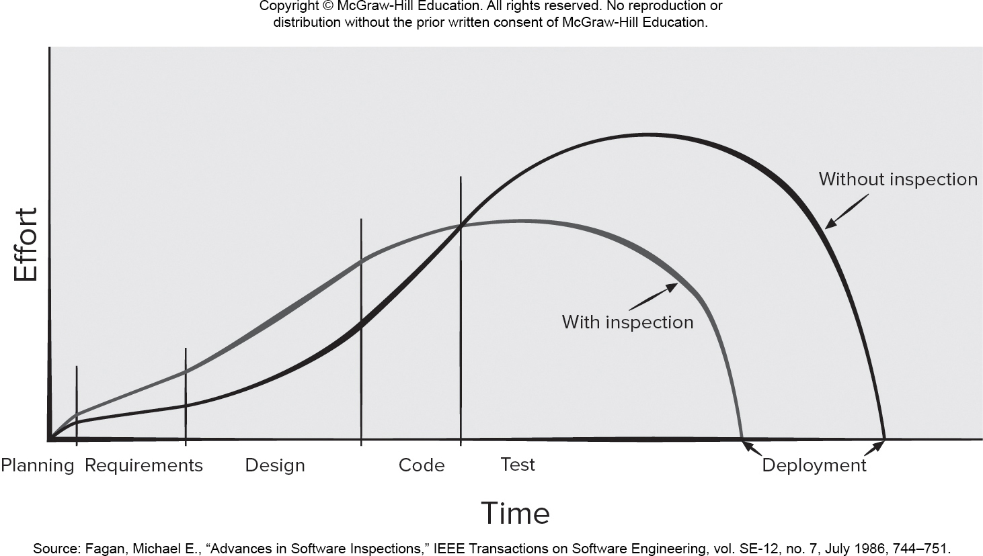
Effort Expended With and Without Reviews
Access the text alternative for slide images.

Slide 11
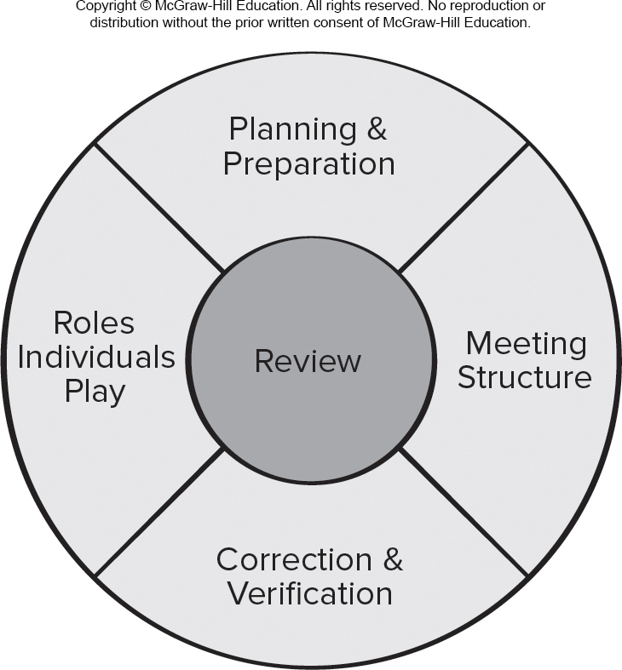
Reference Model for Technical Reviews
Access the text alternative for slide images.

Slide 12
Informal Reviews
The benefit is immediate discovery of errors and better work product quality.
Informal reviews include:
A simple desk check of a software engineering work product with a colleague.
A casual meeting (involving more than 2 people) for the purpose of reviewing a work product, or
The review-oriented aspects of pair programming which encourages continuous review as work is created.

Slide 13
Formal Technical Reviews
The objectives of an F T R (walkthrough or inspection) are:
To uncover errors in function, logic, or implementation for any representation of the software.
To verify that the software under review meets its requirements.
To ensure that the software has been represented according to predefined standards.
To achieve software that is developed in a uniform manner.
To make projects more manageable.

Slide 14
Review Meeting
Between three and five people (typically) should be involved in the review.
Advance preparation should occur but should require no more than two hours of work for each person.
The duration of the review meeting should be less than two hours.
Focus is on a work product (for example: a portion of a requirements model, a detailed component design, source code for a component).

Slide 15
Review Players
Producer—the individual who has developed the work product.
Review leader—evaluates the product for readiness, generates copies of product materials, and distributes them to two or three reviewers for advance preparation and facilitates the meeting discussion.
Reviewer(s)—expected to spend between one and two hours reviewing the product, making notes, and otherwise becoming familiar with the work.
Recorder—reviewer who records (in writing) all important issues raised during the review.

Slide 16
Review Outcome
At the end of the review, all attendees of the F T R must decide whether to:
Accept the product without further modification.
Reject the product due to severe errors (once corrected, another review must be performed).
Accept the product provisionally (minor errors have been encountered and must be corrected, but no additional review will be required).

Slide 17
Review Reporting and Record Keeping
During the F T R, the recorder records all issues raised and summarizes these in a review issues list to serve as an action list for the producer.
A formal technical review summary report is created that answers three questions:
What was reviewed?
Who reviewed it?
What were the findings and conclusions?
You should establish a follow-up procedure to ensure that items on the issues list have been properly corrected.

Slide 18
Review Guidelines
Review the product, not the producer.
Set an agenda and maintain it.
Limit debate and rebuttal.
Enunciate problem areas, but don’t try to solve every problem noted.
Take written notes.
Limit the number of participants and insist upon advance preparation.
Develop a checklist for each product that is likely to be reviewed.
Allocate resources and schedule time for F T Rs.
Conduct meaningful training for all reviewers.
Review your early reviews.

Slide 19
Postmortem Evaluations
A postmortem evaluation (P M E) is a mechanism to determine what went right and what went wrong with the software engineering process and practices applied to a specific project.
A P M E is attended by members of the software team and stakeholders who examine the entire software project, focusing on excellences (achievements and positive experiences) and challenges (problems and negative experiences).
The intent is to extract lessons learned from the challenges and excellences and to suggest improvements to process and practice moving forward.

Slide 20
Agile Reviews
During the sprint planning meeting, user stories are reviewed and ordered according to priority.
The daily Scrum meeting is an informal way to ensure that team members are all working on the same priorities and try to catch any defects that may cause the sprint to fail.
The sprint review meeting is often conducted using guidelines like the formal technical review discussed in this chapter.
The sprint retrospective meeting really a postmortem meeting in that the development team is trying to capture its lessons learned.

Slide 21
End of Main Content

Slide 22
Accessibility Content: Text Alternatives for Images

Slide 23
Effort Expended With and Without Reviews - Text alternative
Return to parent-slide containing images.
A graph plots expended effort with and without inspection. The graph is plots time on the x-axis and effort on the y-axis. The time axis has intervals for planning, requirements, design, code, test and deployment. The curve for with inspection shows and increase in effort expenses for planning, requirements, design and code. The curve begins to fall from test to deployment displaying a decrease in effort. The curve for with inspection shows and increase in effort expenses for planning, requirements, design and code. The curve begins to fall from test to deployment displaying a decrease in effort. Without inspection curve shows less effort is expensed for the planning, requirements, design and code phases, the curve is below the with inspection curve. Between test and deployment, the without inspection curve displays greater expensed effort when compared to the with inspection curve. The curve is above the with inspection curve.
Return to parent-slide containing images.

Slide 24
Reference Model for Technical Reviews - Text alternative
Return to parent-slide containing images.
A diagram displays reference model for technical reviews. The center of the diagram is labeled review and the components around the center are planning and preparation, meeting structure, correction and verification, and roles individuals play.
Return to parent-slide containing images.

