Slide 1

Chapter 20
Software Testing – Integration Level
Part Three – Quality and Security

Slide 2
Testing Fundamentals
Attributes of a good test:
A good test has a high probability of finding an error.
A good test is not redundant.
A good test should be “best of breed.”
A good test should be neither too simple nor too complex.

Slide 3
Approaches to Testing
Any engineered product can be tested in one of two ways:
Knowing the specified function that a product has been designed to perform, tests can be conducted that demonstrate each function is fully operational while at the same time searching for errors in each function.
Knowing the internal workings of a product, tests can be conducted to ensure that “all gears mesh,” that is, internal operations are performed according to specifications and all internal components have been adequately exercised.

Slide 4
White Box Testing
White-box testing, is an integration testing philosophy that uses implementation knowledge of the control structures described as part of component-level design to derive test cases.
White-box tests can be only be designed after source code exists and program logic details are known.
Logical paths through the software and collaborations between components are the focus of white-box integration testing.
Important data structures should also be tested for validity after component integration.

Slide 5
Integration Testing
Integration testing is a systematic technique for constructing the software architecture while conducting tests to uncover errors associated with interfacing.
The objective is to take unit-tested components and build a program structure that matches the design.
In the big bang approach, all components are combined at once and the entire program is tested as a whole. Chaos usually results!
In incremental integration a program is constructed and tested in small increments, making errors easier to isolate and correct. Far more cost-effective!

Slide 6
Top-Down Integration 1
Top-down integration testing is an incremental approach to construction of the software architecture.
Modules are integrated by moving downward through the control hierarchy, beginning with the main control module (main program).
Modules subordinate to the main control module are incorporated into the structure followed by their subordinates.
Depth-first integration integrates all components on a major control path of the program structure before starting another major control path.
Breadth-first integration incorporates all components directly subordinate at each level, moving across the structure horizontally before moving down to the next level of subordinates.

Slide 7
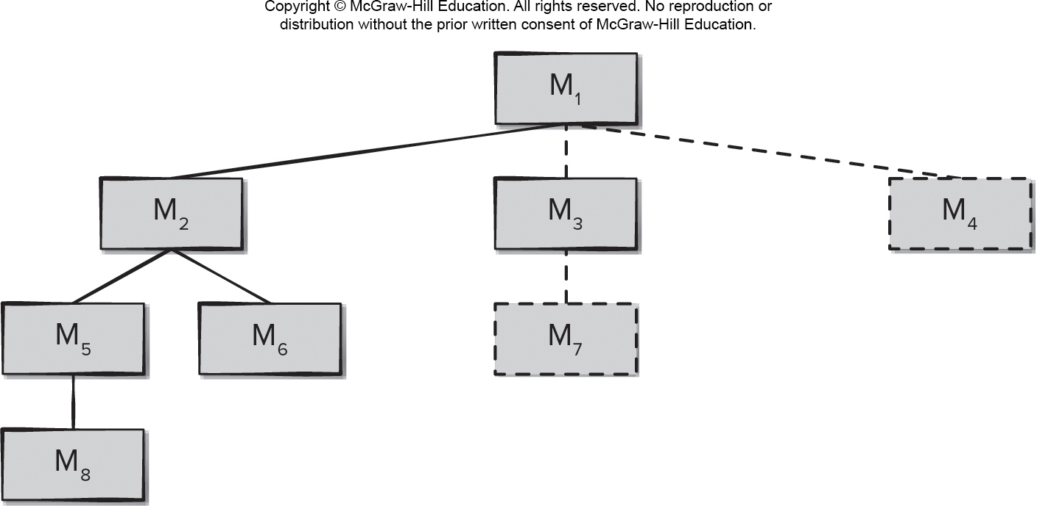
Top-Down Integration 2深度优先
Access the text alternative for slide images.

Slide 8
Top-Down Integration Testing
The main control module is used as a test driver, and stubs are substituted for all components directly subordinate to the main control module.
Depending on the integration approach selected (for example, depth or breadth first), subordinate stubs are replaced one at a time with actual components.
Tests are conducted as each component is integrated.
On completion of each set of tests, another stub is replaced with the real component.
Regression testing may be conducted to ensure that new errors have not been introduced.

Slide 9
Bottom-Up Integration Testing
Bottom-up integration testing, begins construction and testing with atomic modules components at the lowest levels in the program structure.
Low-level components are combined into clusters (builds) that perform a specific software subfunction.
A driver (a control program for testing) is written to coordinate test-case input and output.
The cluster is tested.
Drivers are removed and clusters are combined, moving upward in the program structure.

Slide 10
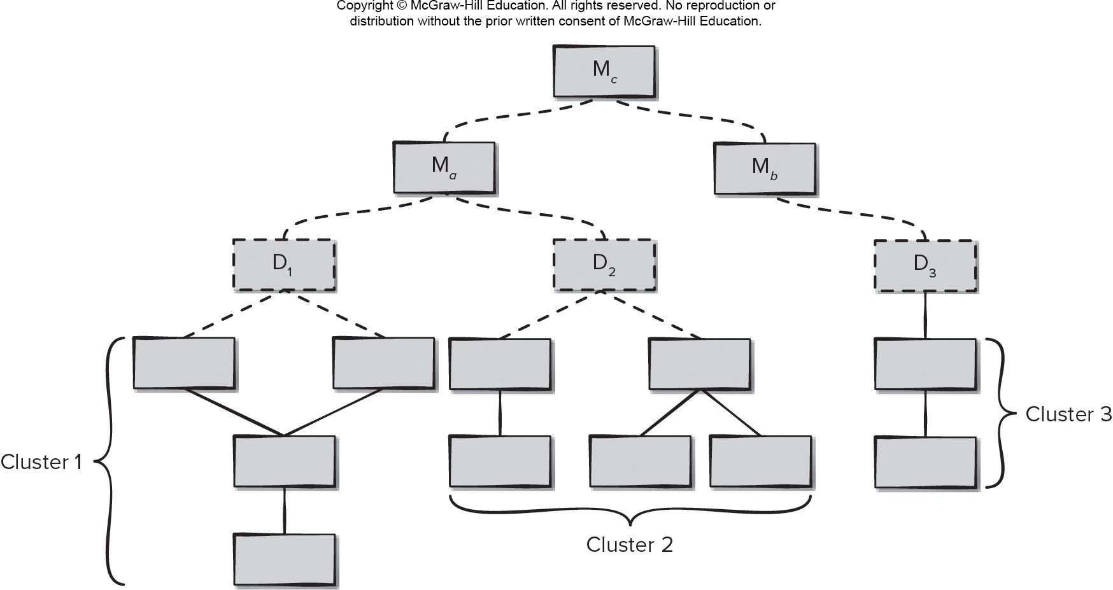
Bottom-Up Integration
Access the text alternative for slide images.

Slide 11
Continuous Integration
Continuous integration is the practice of merging components into the evolving software increment at least once a day.
This is a common practice for teams following agile development practices such as X P or DevOps. Integration testing must take place quickly and efficiently if a team is attempting to always have a working program in place as part of continuous delivery.
Smoke testing is an integration testing approach that can be used when software is developed by an agile team using short increment build times.

Slide 12
Smoke Testing Integration
Software components that have been translated into code are integrated into a build. – that includes all data files, libraries, reusable modules, and components required to implement one or more product functions.
A series of tests is designed to expose “show-stopper” errors that will keep the build from properly performing its function cause the project to fall behind schedule.
The build is integrated (either top-down or bottom-up) with other builds, and the entire product (in its current form) is smoke tested daily.

Slide 13
Smoke Testing Advantages
Integration risk is minimized, since smoke tests are run daily.
Quality of the end product is improved, functional and architectural problems are uncovered early.
Error diagnosis and correction are simplified, errors are most likely in (or caused by) the new build.
Progress is easier to assess, each day more of the final product is complete.
Smoke testing resembles regression testing by ensuring newly added components do not interfere with the behaviors of existing components.

Slide 14
Integration Testing Work Products
An overall plan for integration of the software and a description of specific tests is documented in a test specification.
Test specification incorporates a test plan and a test procedure and becomes part of the software configuration.
Testing is divided into phases and incremental builds that address specific functional and behavioral characteristics of the software.
Time and resources must be allocated to each increment build along with the test cases needed.
A history of actual test results, problems, or peculiarities is recorded in a test report and may be appended to the test specification.
It is often best to implement the test report as a shared Web document to allow all stakeholders access to the latest test results and the current state of the software increment.

Slide 15
Regression Testing
Regression testing is the re-execution of some subset of tests that have already been conducted to ensure that changes have not propagated unintended side effects.
Whenever software is corrected, some aspect of the software configuration (the program, its documentation, or the data that support it) is changed.
Regression testing helps to ensure that changes (due to testing or for other reasons) do not introduce unintended behavior or additional errors.
Regression testing may be conducted manually, by re-executing a subset of all test cases or using automated capture/playback tools.
AI tools may be able to help select the best subset of test cases to use in regression automatically based on previous experiences of the developers with the evolving software product.

Slide 16
O O Integration Testing
Thread-based testing, integrates the set of classes required to respond to one input or event for the system.
Each thread is integrated and tested individually.
Regression testing is applied to ensure no side effects occur.
Use-based testing, begins the construction of the system by testing those classes (called independent classes) that use very few server classes.
The next layer classes, (called dependent classes) use the independent classes are tested next.
This sequence of testing layers of dependent classes continues until the entire system is constructed.

Slide 17
OO Testing – Fault-Based Test Case Design
The object of fault-based testing is to design tests that have a high likelihood of uncovering plausible faults.
Because the product or system must conform to customer requirements, fault-based testing begins with the analysis model.
The strategy for fault-based testing is to hypothesize a set of plausible faults and then derive tests to prove each hypothesis.
To determine whether these faults exist, test cases are designed to exercise the design or code.

Slide 18
Fault-Based O O Integration Testing
Fault-based integration testing looks for plausible faults in operation calls or message connections:
unexpected result
wrong operation/message used
incorrect invocation
Integration testing applies to attributes andoperations – class behaviors are defined by the attributes.
Focus of integration testing is to determine whether errors exist in the calling (client) code, not the called (server) code.

Slide 19
O O Testing – Fault-Based Test Case Design
Scenario-based testing uncovers errors that occur when any actor interacts with the software.
Scenario-based testing concentrates on what the user does, not what the product does.
This means capturing the tasks (via use cases) that the user has to perform and then applying them and their variants as tests.
Scenario testing uncovers interaction errors.
Scenario-based testing tends to exercise multiple subsystems in a single test.
Test-case design becomes more complicated as integration of the object-oriented system occurs since this is when testing of collaborations between classes must begin.

Slide 20
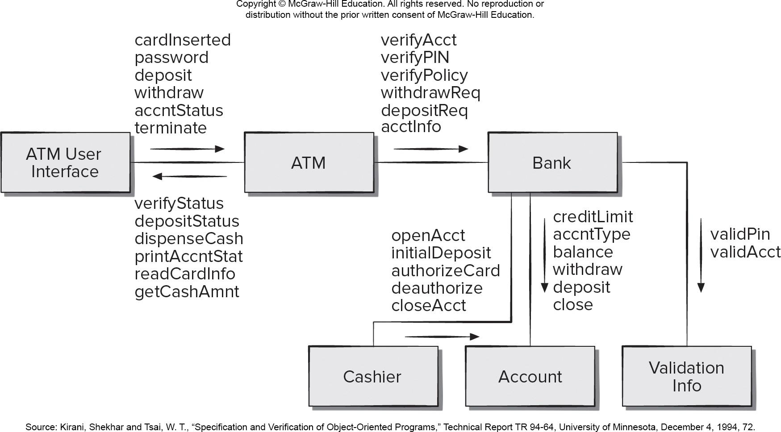
Collaboration Diagram for Banking Application
Access the text alternative for slide images.
Source: Kirani, Shekhar and Tsai, W. T., "Specification and Verification of Object-Oriented Programs," Technical Report TR 94-64, University of Minnesota, December 4, 19 94, 72.

Slide 21
O O Testing – Random Test Case Design
For each client class, use the list of class operations to generate a series of random test sequences. The operations will send messages to other server classes.
For each message that is generated, determine the collaborator class and the corresponding operation in the server object.
For each operation in the server object (that has been invoked by messages sent from the client object), determine the messages that it transmits.
For each of the messages, determine the next level of operations that are invoked and incorporate these into the test sequence.
A random test case for the Bank class might be
Test case r3 = verifyAcct·verifyPIN·depositReq

Slide 22
O O Testing – Scenario-Based Test Case Design
Scenario-based testing uncovers errors that occur when any actor interacts with the software.
Scenario-based testing concentrates on what the user does, not what the product does.
This means capturing the tasks (via use cases) that the user has to perform and then applying them and their variants as tests.
Scenario testing uncovers interaction errors.
Scenario-based testing tends to exercise multiple subsystems in a single test.
Test-case design becomes more complicated as integration of the object-oriented system occurs since this is when testing of collaborations between classes must begin.

Slide 23
Validation Testing
Validation testing tries to uncover errors, but the focus is at the requirements level - on user visible actions and user-recognizable output from the system.
Validation testing begins at the culmination of integration testing, the software is completely assembled as a package and errors have been corrected.
Each user story has user-visible attributes, and the customer’s acceptance criteria which forms the basis for the test cases used in validation-testing.
A deficiency list is created when a deviation from a specification is uncovered and their resolution is negotiated with all stakeholders.
An important element of the validation process is a configuration review (audit) that ensures the complete system was built properly.

Slide 24
Software Testing Patterns
Testing patterns are described in much the same way as design patterns.
Example:
Pattern name: ScenarioTesting
Abstract: Once unit and integration tests have been conducted, there is a need to determine whether the software will perform in a manner that satisfies users. The ScenarioTesting pattern describes a technique for exercising the software from the user’s point of view. A failure at this level indicates that the software has failed to meet a user visible requirement.

Slide 25
End of Main Content

Slide 26
Accessibility Content: Text Alternatives for Images

Slide 27
Top-Down Integration 2 – Text alternative
Return to parent-slide containing images
The diagram shows a top down integration testing process. The primary module is labeled M1. Module 1 links to module 2, 3 and 4. Module 2 links to module 5 and 6. Module 3 links to module 7. Module 5 links to module 8.
Return to parent-slide containing images

Slide 28
Bottom-Up Integration – Text alternative
Return to parent-slide containing images
The diagram shows a bottom up integration testing process. The diagram a flowchart with multiple modules and three clusters. The first cluster is a collection of four modules which links up to a module labeled D1. The second cluster is a collection of five modules which links up to a module labeled D2. The third cluster is a collection of two modules which links up to a module labeled D3. Modules D1 and D2 link up to a module labeled M a. Module D3 links up to a module labeled M b. Modules M a and M b link up to a module labeled M o.
Return to parent-slide containing images

Slide 29
Collaboration Diagram for Banking Application – Text alternative
Return to parent-slide containing images
A flowchart displays collaboration diagram for banking application. The A T M user interface insert the card, and put password and initiate the deposit or withdraw or account status or terminate. The A T M verify account, PIN, policy and analyse and forward the withdraw request or deposit request and the account information to the bank. The bank validate the pin and account by validation information. The bank check account for credit limit, account type, balance, and withdraw or deposit or close request. The cashier open account, check initial deposit, authorize card or deauthorize it or close the account. Finally the A T M verify status, deposit status, dispense cash, print account status, read card information, and get cash amount.
Return to parent-slide containing images

