Slide 1

Chapter 3
Agility and Process
Part 1 - The Software Process

Slide 2
- What is Agility?
Effective (rapid and adaptive) response to change.
Effective communication among all stakeholders.
Drawing the customer onto the team.
Organizing a team so that it is in control of the work performed.
Rapid, incremental delivery of software.

Slide 3
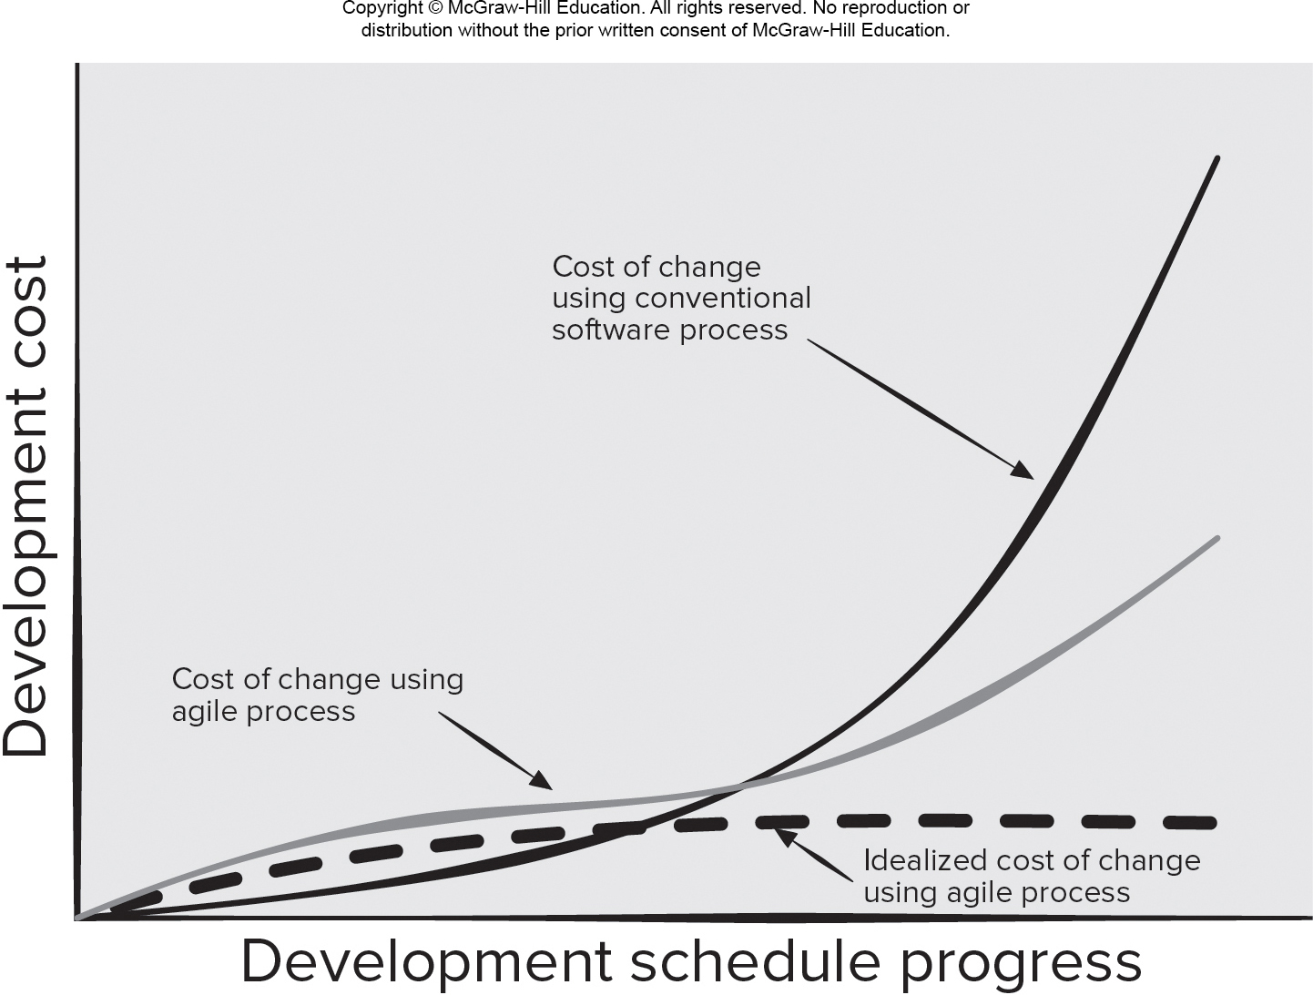
Agility and Cost of Change
Access the text alternative for slide images.

Slide 4
- What is an Agile Process?
Driven by customer descriptions of what is required (scenarios).
Customer feedback is frequent and acted on.
Recognizes that plans are short-lived.
Develops software iteratively with a heavy emphasis on construction activities.
Delivers multiple ‘software increments’ as executable prototypes.
Adapts as project or technical changes occur.

Slide 5
- Agility Principles 1
Customer satisfaction is achieved by providing value through software that is delivered to the customer as rapidly as possible.
Developers recognize that requirements will change and welcome changes.
Deliver software increments frequently (weeks not months) to stakeholders to ensure feedback on their deliveries is meaningful.
Agile team populated by motivated individuals using face-to-face communication to convey information.
Team process encourages technical excellence, good design, simplicity, and avoids unnecessary work.

Slide 6
Agility Principles 2
Working software that meets customer needs is the primary goal.
Pace and direction of the team’s work must be “sustainable,” enabling them to work effectively for long periods of time.
An agile team is a “self-organizing team”—one that can be trusted develop well-structured architectures that lead to solid designs and customer satisfaction.
Part of the team culture is to consider its work introspectively with the intent of improving how to become more effective for its primary goal (customer satisfaction).

Slide 7
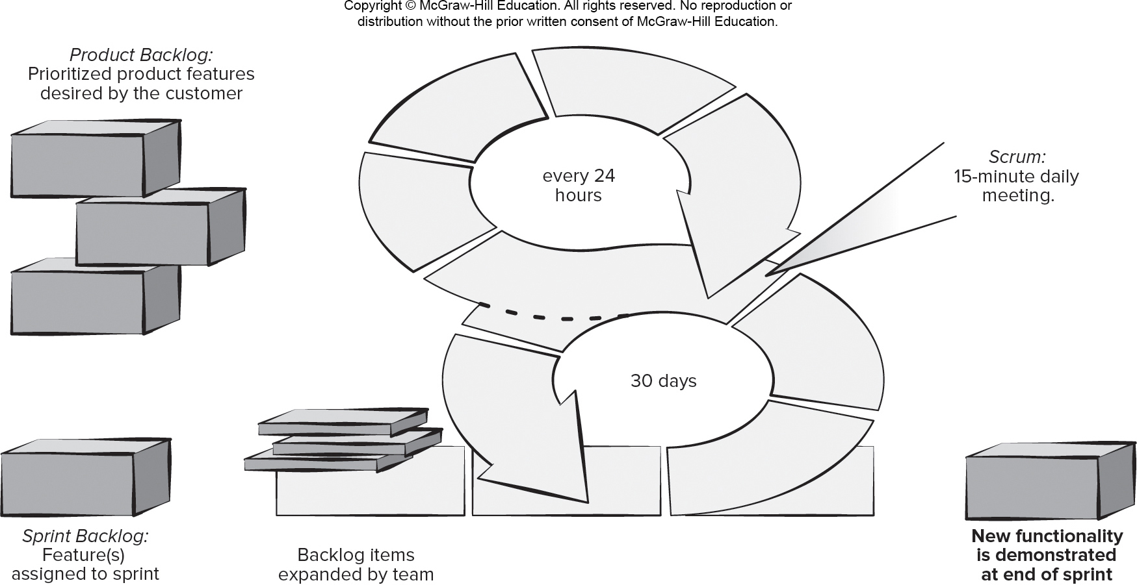
- Scrum Framework 敏捷开发的具体做法
Access the text alternative for slide images.

Slide 8
- Scrum Details
Backlog Refinement Meeting Developers work with stakeholders to create product backlog.
Sprint Planning Meeting Backlog partitioned into “sprints” derived from backlog and next sprint defined.
Daily Scrum Meeting Team members synchronize their activities and plan work day (15 minutes max).
Sprint Review Prototype “demos” are delivered to the stakeholders for approval or rejection.
Sprint Retrospective After sprint is complete, team considers what went well and what needs improvement.
Pros
Product owner sets priorities.
Team owns decision making.
Documentation is lightweight.
Supports frequent updating.
Cons
Difficult to control the cost of changes.
May not be suitable for large teams.
Requires expert team members.

Slide 9
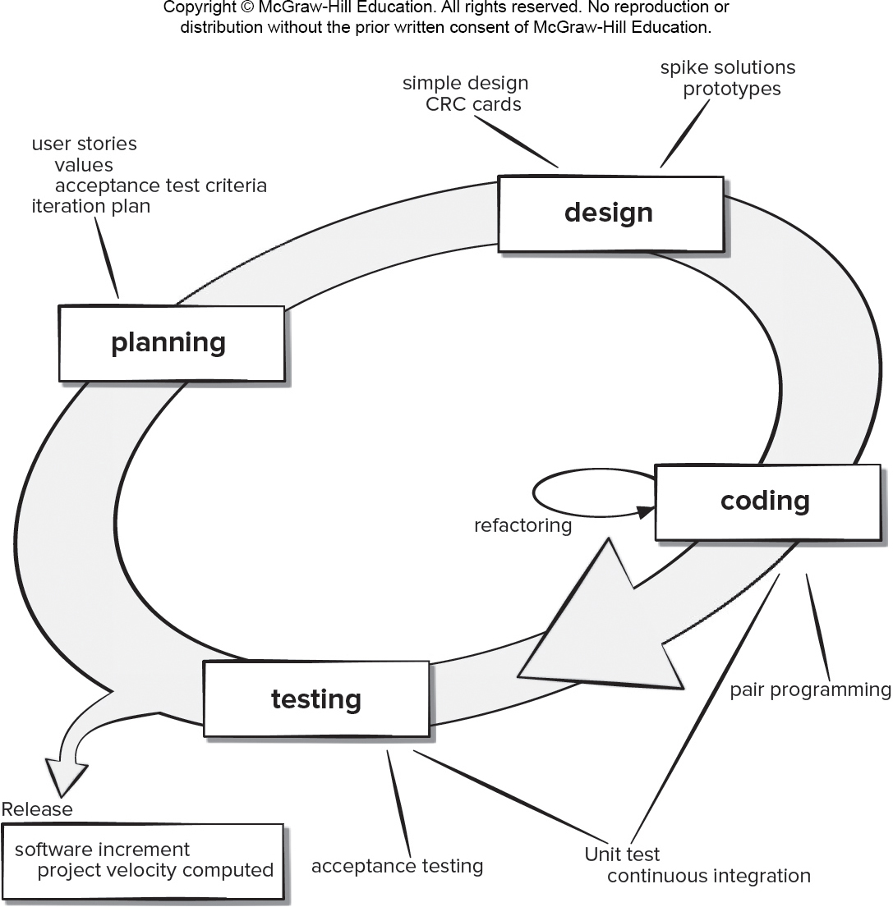
Extreme Programming (XP) Framework 极度编程
Access the text alternative for slide images.

Slide 10
XP Details
XP Planning – Begins with user stories, team estimates cost, stories grouped into increments, commitment made on delivery date, computer project velocity.
XP Design – Follows KIS (Keep It Simple) principle, encourages use of CRC (Class-Responsibility-Collaborator) cards, design prototypes, and refactoring.
XP Coding – construct unit tests before coding, uses pair.
XP Testing – unit tests executed daily, acceptance tests define by customer.
Pros
Emphasizes customer involvement.
Establishes rational plans and schedules.
High developer commitment to the project.
Reduced likelihood of product rejection.
Cons
Temptation to “ship” a prototype.
Requires frequent meetings about increasing costs.
Allows for excessive changes.
Depends on highly skilled team members.

Slide 11
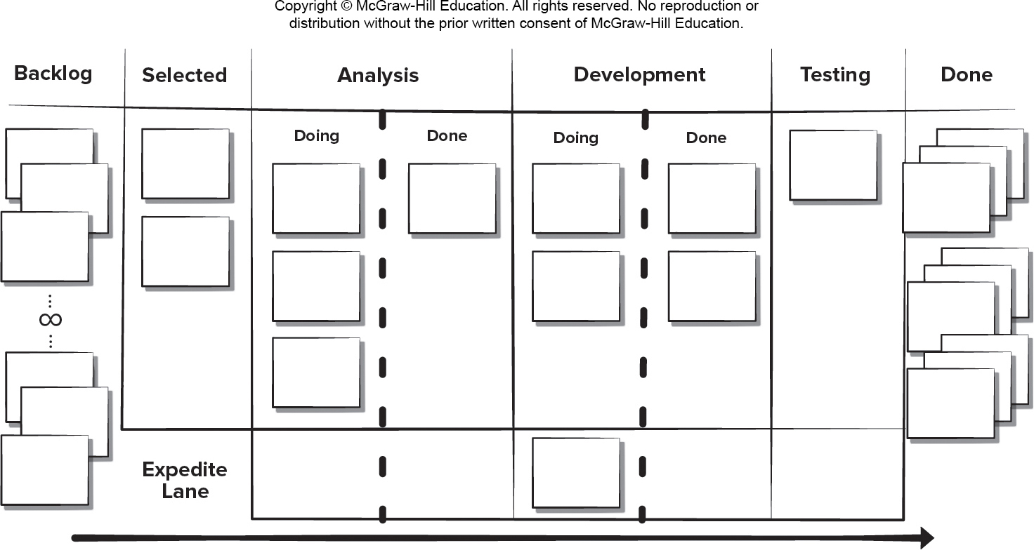
Kanban Framework
Access the text alternative for slide images.

Slide 12
Kanban Details
Visualizing workflow using a Kanban board.
Limiting the amount of work in progress at any given time.
Managing workflow to reduce waste by understanding the current value flow.
Making process policies explicit and the criteria used to define “done”.
Focusing on continuous improvement by creating feedback loops where changes are introduced.
Make process changes collaboratively and involve all stakeholders as needed.
Pros
Lower budget and time requirements.
Allows early product delivery.
Process policies written down.
Continuous process improvement.
Cons
Team collaboration skills determine success.
Poor business analysis can doom the project.
Flexibility can cause developers to lose focus.
Developer reluctance to use measurement.

Slide 13
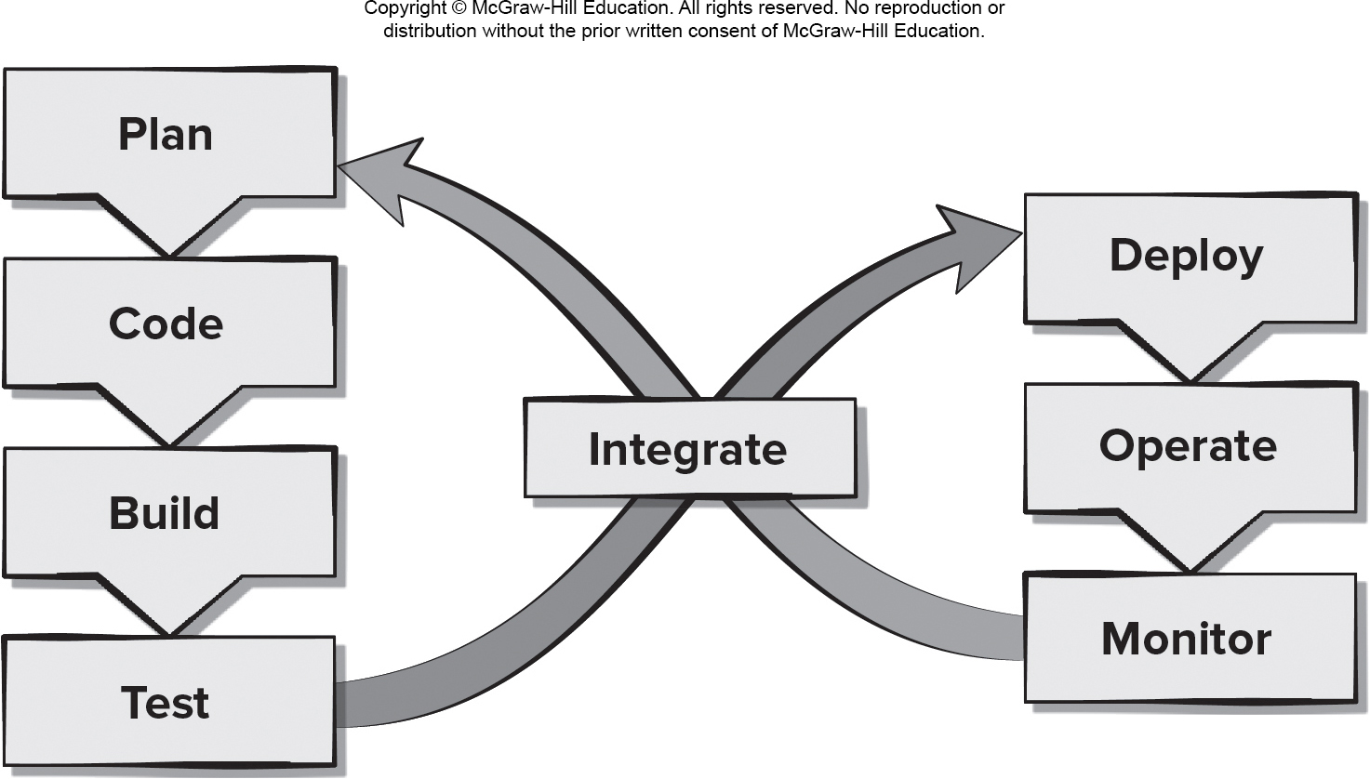
DevOps
Access the text alternative for slide images.

Slide 14
DevOps Details
Continuous development. Software delivered in multiple sprints.
Continuous testing. Automated testing tools used prior to integration.
Continuous integration. Code pieces with new functionality added to existing code running code.
Continuous deployment. Integrated code is deployed to the production environment.
Continuous monitoring. Team operations staff members proactively monitor software performance in the production environment.
Pros
Reduced time to code deployment.
Team has developers and operations staff.
Team has end-to-end project ownership.
Proactive monitoring of deployed product.
Cons
Pressure to work on both old and new code.
Heavy reliance on automated tools to be effective.
Deployment may affect the production environment.
Requires an expert development team.

Slide 15
Homework
Form teams of 4 students each team and name your teams
Select a real problem your team wants to resolve with software
Start discussing the problem within your team
Provide the name of your team, team members and the selected problem to Teaching Assistants
Complete step 1 – 4 and submit your form to TA by 9/13 Wednesday

Slide 16
End of Main Content

Slide 17
Accessibility Content: Text Alternatives for Images

Slide 18
Agility and Cost of Change – Text Alternative
Return to parent-slide containing images.
An illustration displays agility and cost of change graph. The graph plots development schedule progress on the x axis, and development cost on the y axis. It displays three graphs representing, the cost of change using agile process, cost of change using conventional software process, and idealized cost of change using agile process. The cost of change using agile process graph shows a slow and steady increase. The graph of idealized cost of change using agile process displays a slow beginning and a constant rate after that. The graph of cost of change using conventional software process shows a slow beginning and then displays a peak towards the end.
Return to parent-slide containing images.

Slide 19
Scrum Framework – Text Alternative
Return to parent-slide containing images.
An illustration displays scrum framework. The products backlog contains prioritized product features desired by the customer. The sprint backlog contains the features assigned to sprint. The backlog items are expanded by team over 30 days. Every 24 hours scrum constitutes of a 15 minute daily meeting. Finally new functionality is demonstrated at end of sprint.
Return to parent-slide containing images.

Slide 20
Extreme Programming (XP) Framework – Text Alternative
Return to parent-slide containing images.
An illustration displays extreme programming framework cycle. The components in the cycle left to right are planning, design, coding, and testing. The planning include user stories, values, acceptance test criteria, and iteration plan. The design include simple design and C R C card; spike solutions and prototypes. Coding reads refactoring and pair programming. The testing and coding share unit test, and continuous integration. The testing reads acceptance testing. The testing releases software increment and project velocity computed.
Return to parent-slide containing images.

Slide 21
Kanban Framework – Text Alternative
Return to parent-slide containing images.
A Kanban framework consists of 6 verticals which, from left to right, are: backlog, selected, analysis, development, testing, and done. The process moves from left to right. Between backlog and selected one can introduce an expedite lane.
Return to parent-slide containing images.

Slide 22
DevOps – Text Alternative
Return to parent-slide containing images.
A flowchart displays Dev Ops. The flowchart displays plan, code, build, and test on the left side from top to bottom and deploy, operate, and monitor from top to bottom on the right side. Test integrates with deploy, and monitor integrates with plan.
Return to parent-slide containing images.

