Slide 1

Chapter 6
Principles that Guide Practice
Part Two - Modeling

Slide 2
Principles that Guide Process 1
Principle #1. Be agile. Regards of your process model, let the basic tenets of agile development govern your approach.
Principle #2. Focus on quality at every step. The exit condition for every process activity, action, and task should focus on the quality of the work product produced.
Principle #3. Be ready to adapt. Dogma has no place in software development. Adapt your approach to constraints imposed by the problem, the people, and the project itself.
Principle #4. Build an effective team. Software engineering process and practice are important, but the bottom line is people. Build a self-organizing team.

Slide 3
Principles that Guide Process 2
Principle #5. Establish mechanisms for communication and coordination. Projects fail because information falls into the cracks and/or stakeholders fail to coordinate their efforts.
Principle #6. Manage change. Approach may formal or informal. You need mechanisms to manage how changes are requested, assessed, approved and implemented.
Principle #7. Assess risk. Lots of things can go wrong as software is being developed, establish contingency plans.
Principle #8. Create work products that provide value for others. Create only those work products that provide value for other process activities, actions or tasks.

Slide 4
Principles that Guide Practice 1
Principle #1. Divide and conquer. Analysis and design should always emphasize separation of concerns (SoC).
Principle #2. Understand the use of abstraction. Abstraction is a simplification of a complex system element used to communication meaning simply.
Principle #3. Strive for consistency. A familiar context makes software easier to use.
Principle #4. Focus on the transfer of information. Pay special attention to the analysis, design, construction, and testing of interfaces.

Slide 5
Principles that Guide Practice 2
Principle #5. Build software that exhibits effective modularity. Provides a mechanism for realizing the philosophy of Separation of concerns .
Principle #6. Look for patterns. The goal of patterns is to create a body of literature to help developers resolve recurring problems encountered in software development.
Principle #7. Use multiple viewpoints. Represent the problem and solution from different perspectives.
Principle #8. Some consumes your work products. Remember that someone will maintain the software.

Slide 6
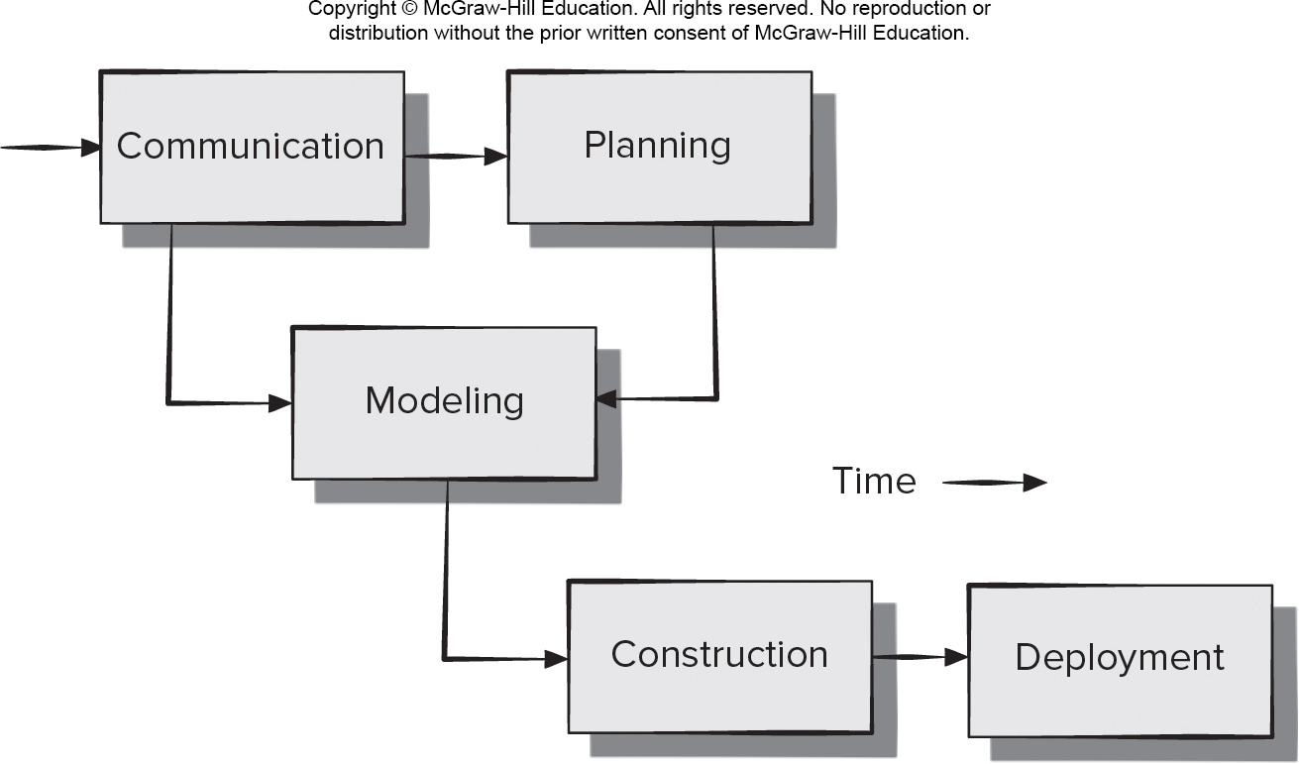
Simplified Process Framework
Access the text alternative for slide images.

Slide 7
Communications Principles 1
Principle #1. Listen. Try to focus on the speaker’s words, not formulating your response to those words.
Principle # 2. Prepare before you communicate. Understand a problem before meeting with others.
Principle # 3. Someone should facilitate the activity. Every communication meeting should have a leader to keep the conversation moving in a productive direction.
Principle #4. Face-to-face communication is best. Visual representations of information can be helpful.
Principle # 5. Take notes and document decisions. Someone should serve as a “recorder” and write down all important points and decisions.

Slide 8
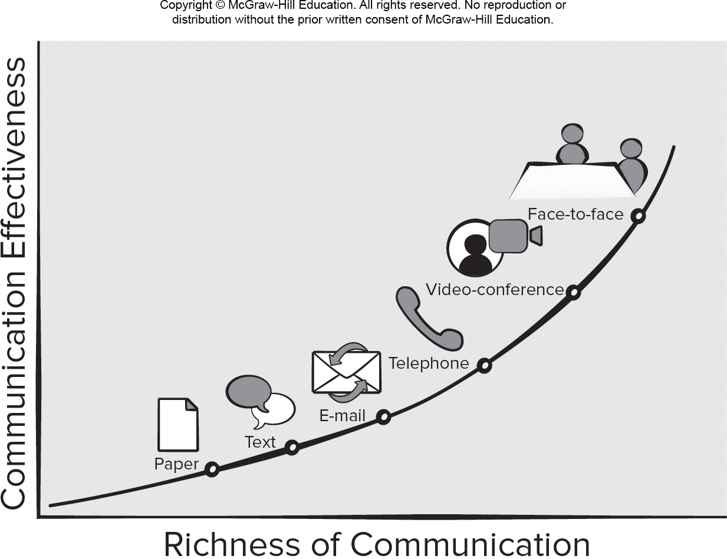
Communications Mode Effectiveness
Access the text alternative for slide images.

Slide 9
Communications Principles 2
Principle # 6. Strive for collaboration. Consensus occurs when collective team knowledge is combined.
Principle # 7. Stay focused, modularize your discussion. The more people involved in communication the more likely discussion will bounce between topics.
Principle # 8. If something is unclear, draw a picture.
Principle # 9. (a) Once you agree to something, move on; (b) If you can’t agree to something, move on; (c) If a feature or function is unclear and cannot be clarified at the moment, move on.
Principle # 10. Negotiation is not a contest or a game. It works best when both parties win.

Slide 10
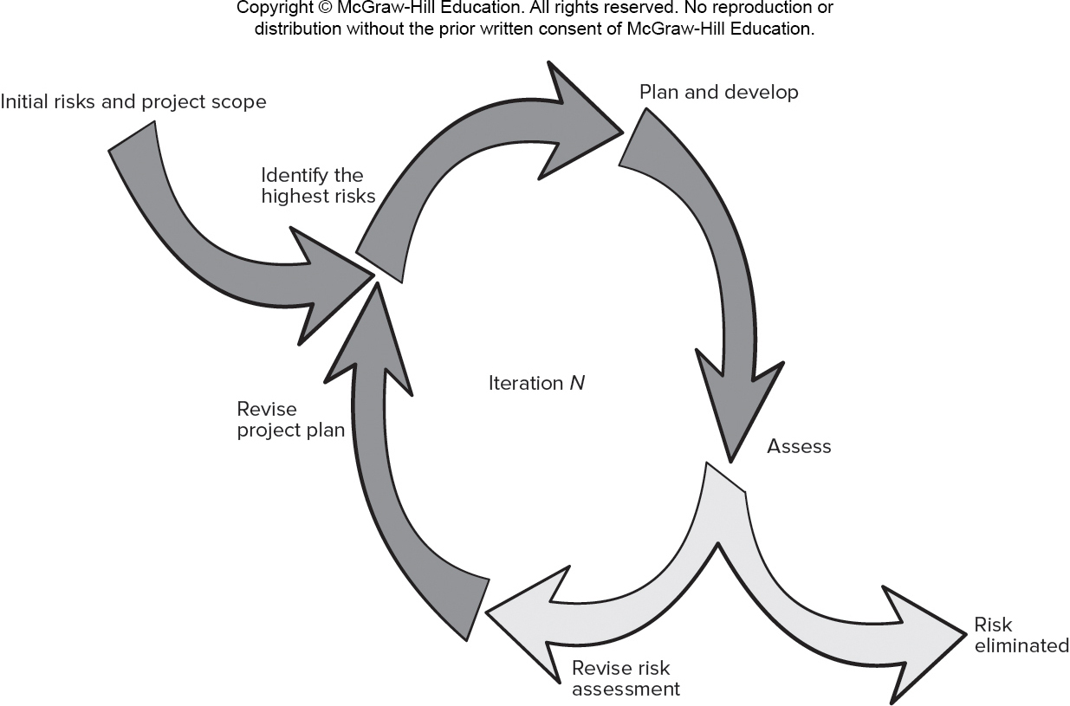
Iterative Planning Process
Access the text alternative for slide images.

Slide 11
Planning Principles 1
Principle #1. Understand the scope of the project. Scope provides the software team with a destination as the roadmap is created.
Principle #2. Involve the customer in the planning activity. They define priorities and project constraints.
Principle #3. Recognize that planning is iterative. A project plan is likely to change as work begins.
Principle #4. Estimate based on what you know. Estimation provides an indication of effort, cost, and task duration, based on team’s current understanding of work.
Principle #5. Consider risk as you define the plan. Contingency planning is needed for identified high impact and high probability risks.

Slide 12
Planning Principles 2
Principle #7. Adjust granularity as you define the plan. Granularity refers to the level of detail that is introduced as a project plan is developed.
Principle #8. Define how you intend to ensure quality. Your plan should identify how the software team intends to ensure quality.
Principle #9. Describe how you intend to accommodate change. Even the best planning can be obviated by uncontrolled change.
Principle #10. Track the plan frequently and make adjustments as required. Software projects fall behind schedule one day at a time.

Slide 13
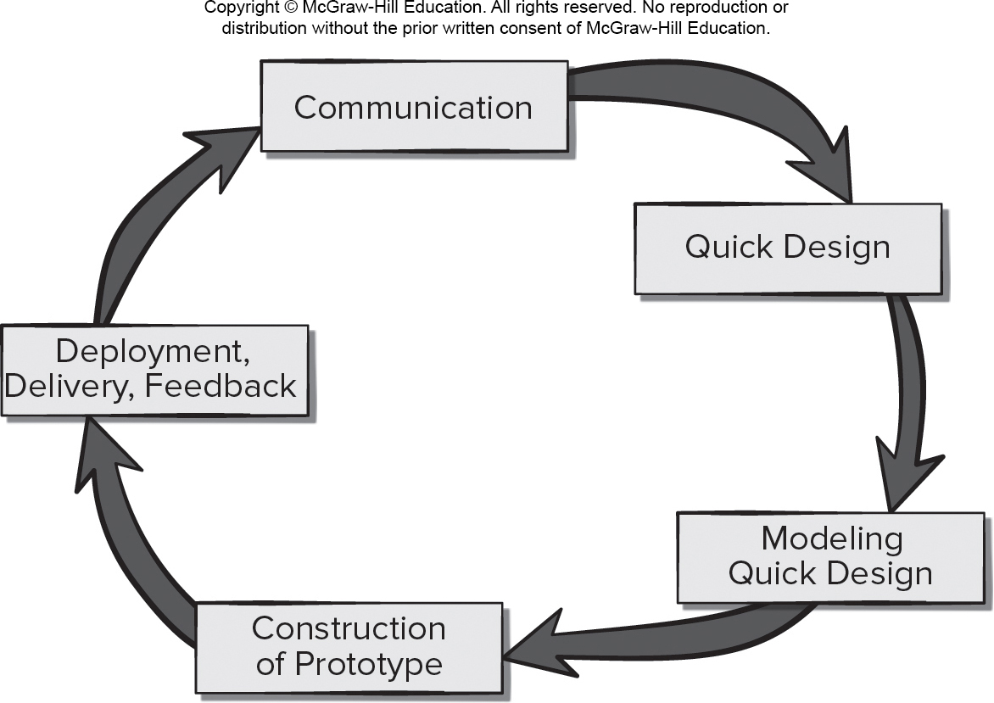
Software Modeling 敏捷的过程
Access the text alternative for slide images.

Slide 14
Agile Modeling Principles 1
Principle #1. The primary goal of the software team is to build software not create models.
Principle #2. Travel light – don’t create more models than you need.
Principle #3. Strive to produce the simplest model that will describe the problem or the software.
Principle #4. Build models in a way that makes them amenable to change.
Principle #5. Be able to state an explicit purpose for each model that is created.

Slide 15
Agile Modeling Principles 2
Principle #6. Adapt the models you create to the system at hand.
Principle #7. Try to build useful models, forget abut building perfect models.
Principle #8. Don’t become dogmatic about model syntax. Successful communication is key.
Principle #9. If your instincts tell you a paper model isn’t working you may have a reason to be concerned.
Principle #10. Get feedback as soon as you can.

Slide 16
Construction Principles - Coding 1
Preparation Principles: Before you write one line of code, be sure you:
Principle 1. Understand the problem to be solved.
Principle 2. Understand basic design principles and concepts.
Principle 3. Pick a programming language that meets the needs of the software to be built.
Principle 4. Select a programming environment that provides tools that will make your work easier.
Principle 5. Create a set of unit tests that will be applied once the component you code is completed.

Slide 17
Construction Principles - Coding 2
Coding Principles: As you begin writing code, be sure you:
Principle 6. Constrain your algorithms by following structured programming practice.
Principle 7. Consider the use of pair programming.
Principle 8. Select data structures that will meet the needs of the design.
Principle 9. Understand the software architecture and create interfaces that are consistent with it.

Slide 18
Construction Principles - Coding 3
Validation Principles: After you’ve completed your first coding pass, be sure you:
Principle 10. Conduct a code walkthrough when appropriate.
Principle 11. Perform unit tests and correct errors you’ve uncovered.
Principle 12. Refactor the code to improve its quality.

Slide 19
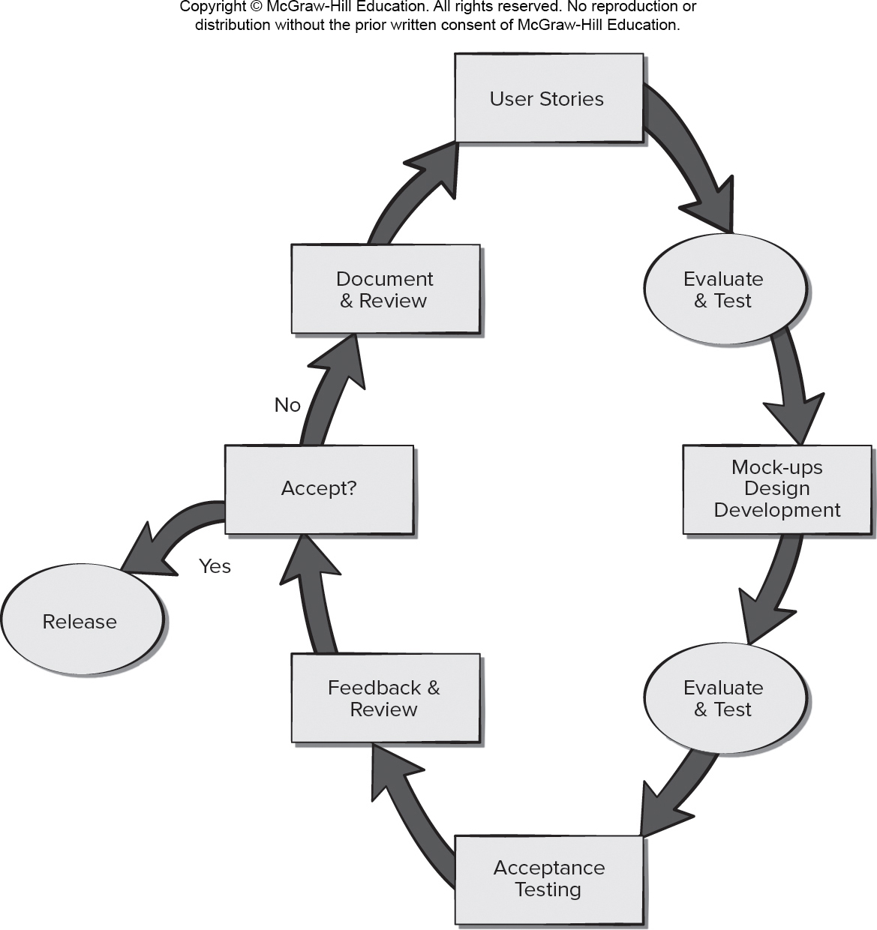
Agile Testing
Access the text alternative for slide images.

Slide 20
Testing Principles 1
Principle #1. All tests should be traceable to customer requirements.
Principle #2. Tests should be planned long before testing begins.
Testing is a process of executing a program with intent of finding an error,
A good test case is one that has a high probability of finding an as-yet-undiscovered error.
A successful test is one that uncovers an as-yet-undiscovered error.
Principle #3. The Pareto principle applies to software testing.

Slide 21
Testing Principles 2
Principle #4. Testing should begin “in the small” and progress toward testing “in the large.”
Principle #5. Exhaustive testing is not possible.
Principle #6. Testing effort for each system module commensurate to expected fault density.
Principle #7. Static testing can yield high results.
Principle #8. Track defects and look for patterns in defects uncovered by testing.
Principle #9. Include test cases that demonstrate software is behaving correctly.

Slide 22
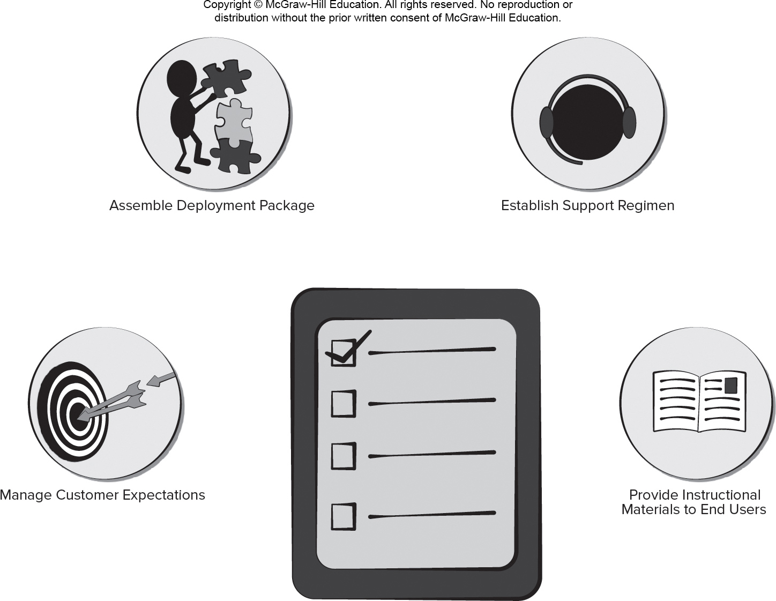
Software Deployment Actions
Access the text alternative for slide images.

Slide 23
Deployment Principles 1
Principle #1. Customer expectations for the software must be managed.
Principle #2. A complete delivery package should be assembled and tested.
Principle #3. A support regime must be established before the software is delivered.
Principle #4. Appropriate instructional materials must be provided to end-users.
Principle #5. Buggy software should be fixed first, delivered later.

Slide 24
End of Main Content

Slide 25
Accessibility Content: Text Alternatives for Images

Slide 26
Simplified Process Framework – Text Alternative
Return to parent-slide containing images.
An illustration displays the simplified process framework. The process starts with communication, which leads to planning and modeling. Planning leads to modeling. Modeling further leads to construction and deployment.
Return to parent-slide containing images.

Slide 27
Communications Mode Effectiveness – Text Alternative
Return to parent-slide containing images.
A graph displays communications mode effectiveness. The graph plots richness of communication on the x axis, and communication effectiveness on the y axis. The graph plots a positive curve with points representing modes of communication. The modes of communication plotted in the curve in increasing effectiveness are as follow: paper, text, email, telephone, video-conference, and face to face.
Return to parent-slide containing images.

Slide 28
Iterative Planning Process – Text Alternative
Return to parent-slide containing images.
An illustration displays the iterative planning process. The planning process starts with the initial risks and project scope analysis, then the process takes a circular mode which is displayed as iteration N. It starts by identifying the highest risks, and then moves to the plan and develop stage. This passes to the assessment stage which can lead to revise the risk assessment or to risk eliminated. After revise risk assessment, it passes to the revise project plan which leads back to the beginning of the cycle.
Return to parent-slide containing images.

Slide 29
Software Modeling – Text Alternative
Return to parent-slide containing images.
An illustration displays a circular flow diagram. The components in the diagram are communication, quick design, modeling quick design, construction of prototype, and deployment, delivery and feedback.
Return to parent-slide containing images.

Slide 30
Agile Testing – Text Alternative
Return to parent-slide containing images.
An illustration displays agile testing flow diagram. The flowchart is circular. The user stories are evaluated and tested. Then the mockups design development are evaluated and tested. After the acceptance of the testing, feedbacks and reviews are made. If these feedbacks and reviews are accepted the it is released, if its not accepted then it is documented and reviewed again and the process repeats from user stories.
Return to parent-slide containing images.

Slide 31
Software Deployment Actions – Text Alternative
Return to parent-slide containing images.
An illustration displays software deployment actions. Four actions are displayed around a checklist. The actions are manage customer expectation, assemble development package, establish support regimen, and provide instructional materials to end users.
Return to parent-slide containing images.

