Slide 1
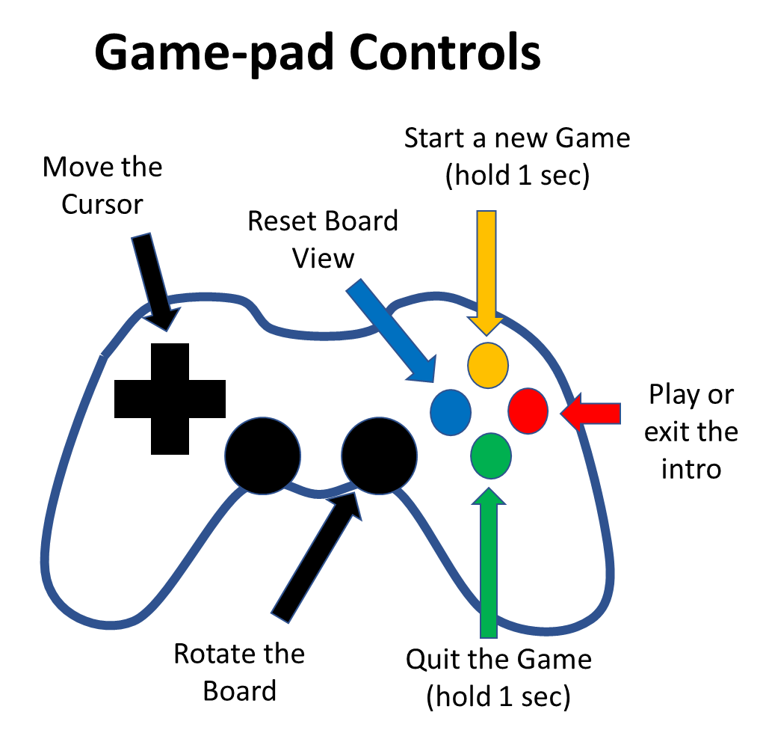
Cuatro
Written by Alfredo Martín
Github: https://github.com/jamflcjamflc/cuatro
Music by hagfilms: https://freesound.org/people/hagfilms/sounds/338823/
If no game-pads are plugged, Cuatro will play against itself
If one game-pad is plugged, you will play against Cuatro
If two game-pads are plugged, you can play against a friend
Press the Play button to start

Slide 2
Game-pad Controls
Start a new Game (hold 1 sec)
Move the Cursor
Reset Board View
Play or exit the intro
Rotate the Board
Quit the Game (hold 1 sec)

Slide 3
Game-pad Controls
Drive the car
Select track and start qualification
Scroll tracks

Slide 4
TopRace
Written by Alfredo Martín:
https://github.com/jamflcjamflc/TopRace
Music by Sirkoto51: https://freesound.org/people/Sirkoto51/sounds/414214/
Background Sound by Omar Alvarado: https://freesound.org/6/251152/

Slide 5
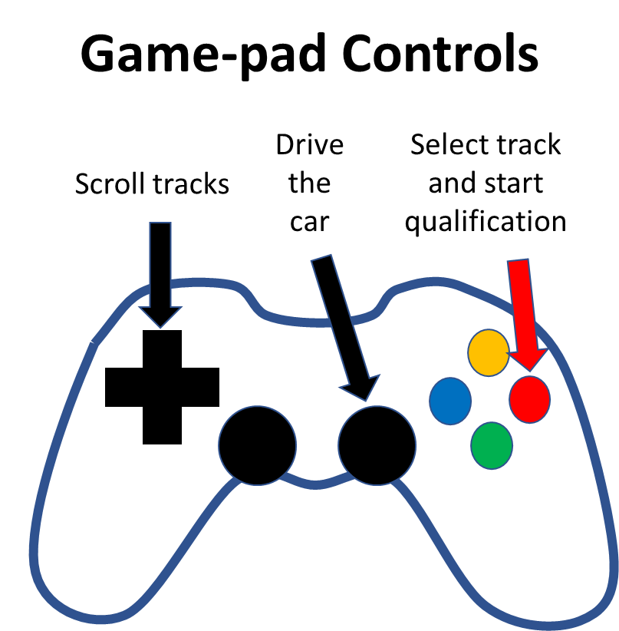
Track
TopRace

Slide 6
TopRace
Exit the game
Start a new race

