Slide 1
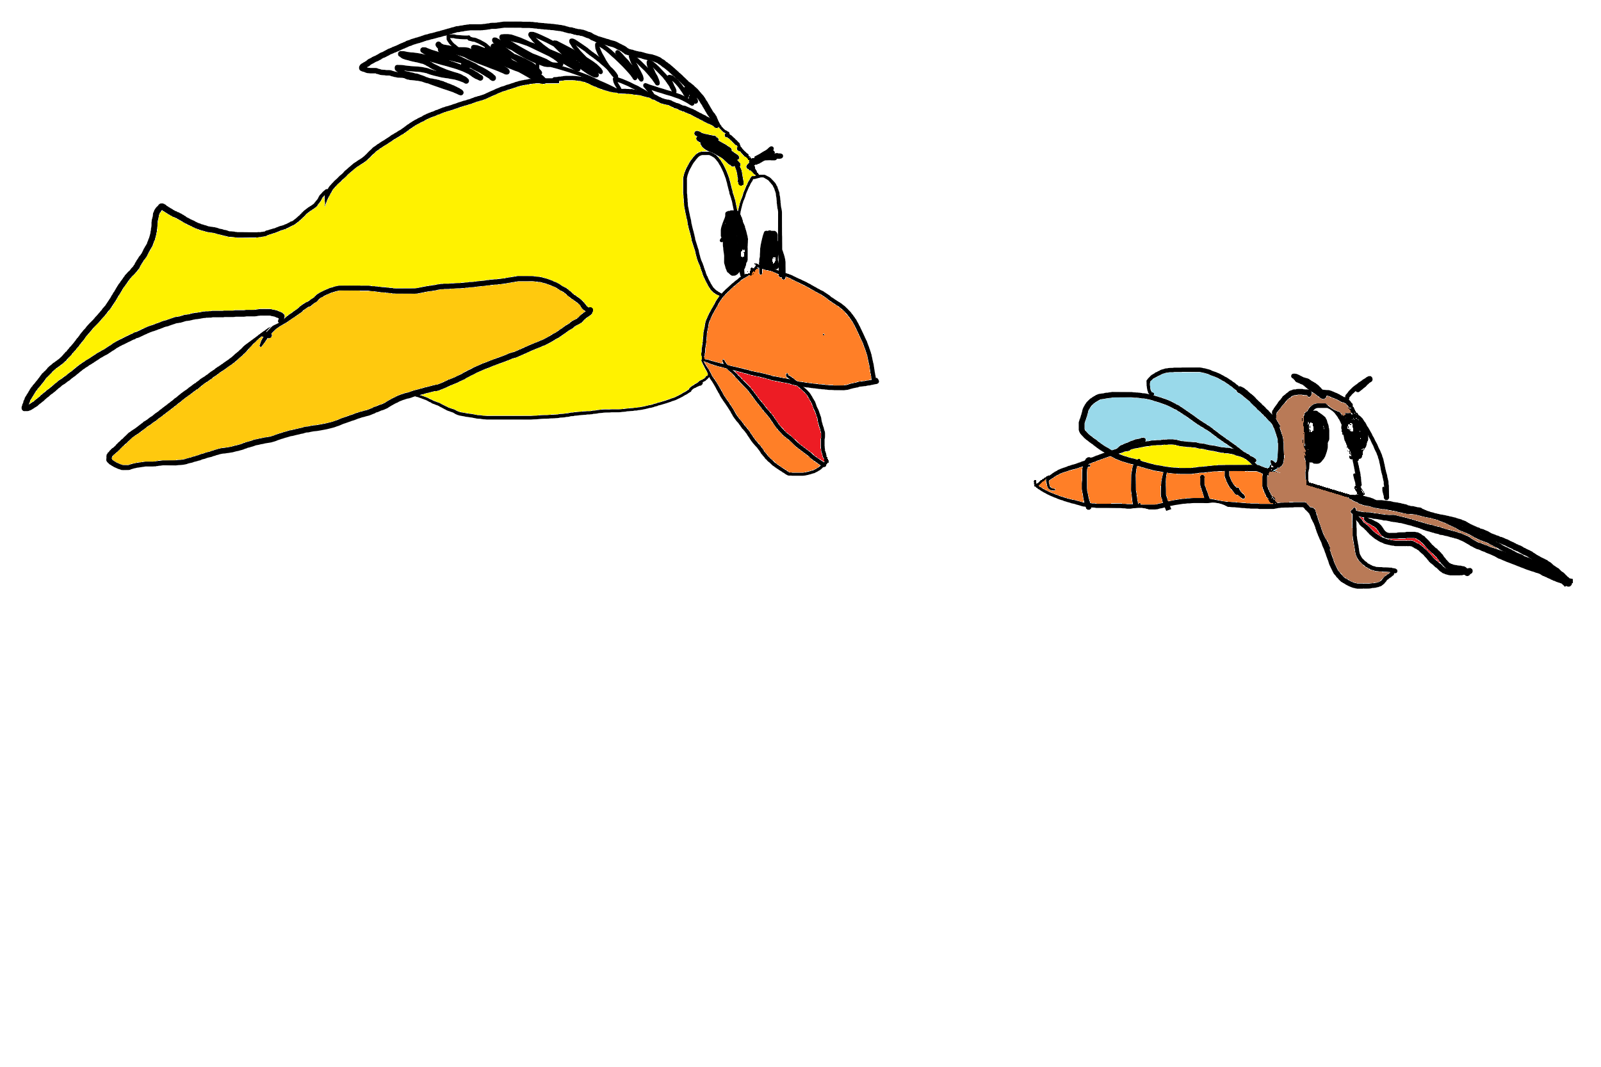

Ninja Bird
By Lucas Martín and Alfredo Martín
Music: https://freesound.org/s/172561/
Eat as many mosquitoes as you can.
Do not crash with the bricks
Game is over when you lose your energy
Press to fly
Press the SPACE key to continue

