Slide 1
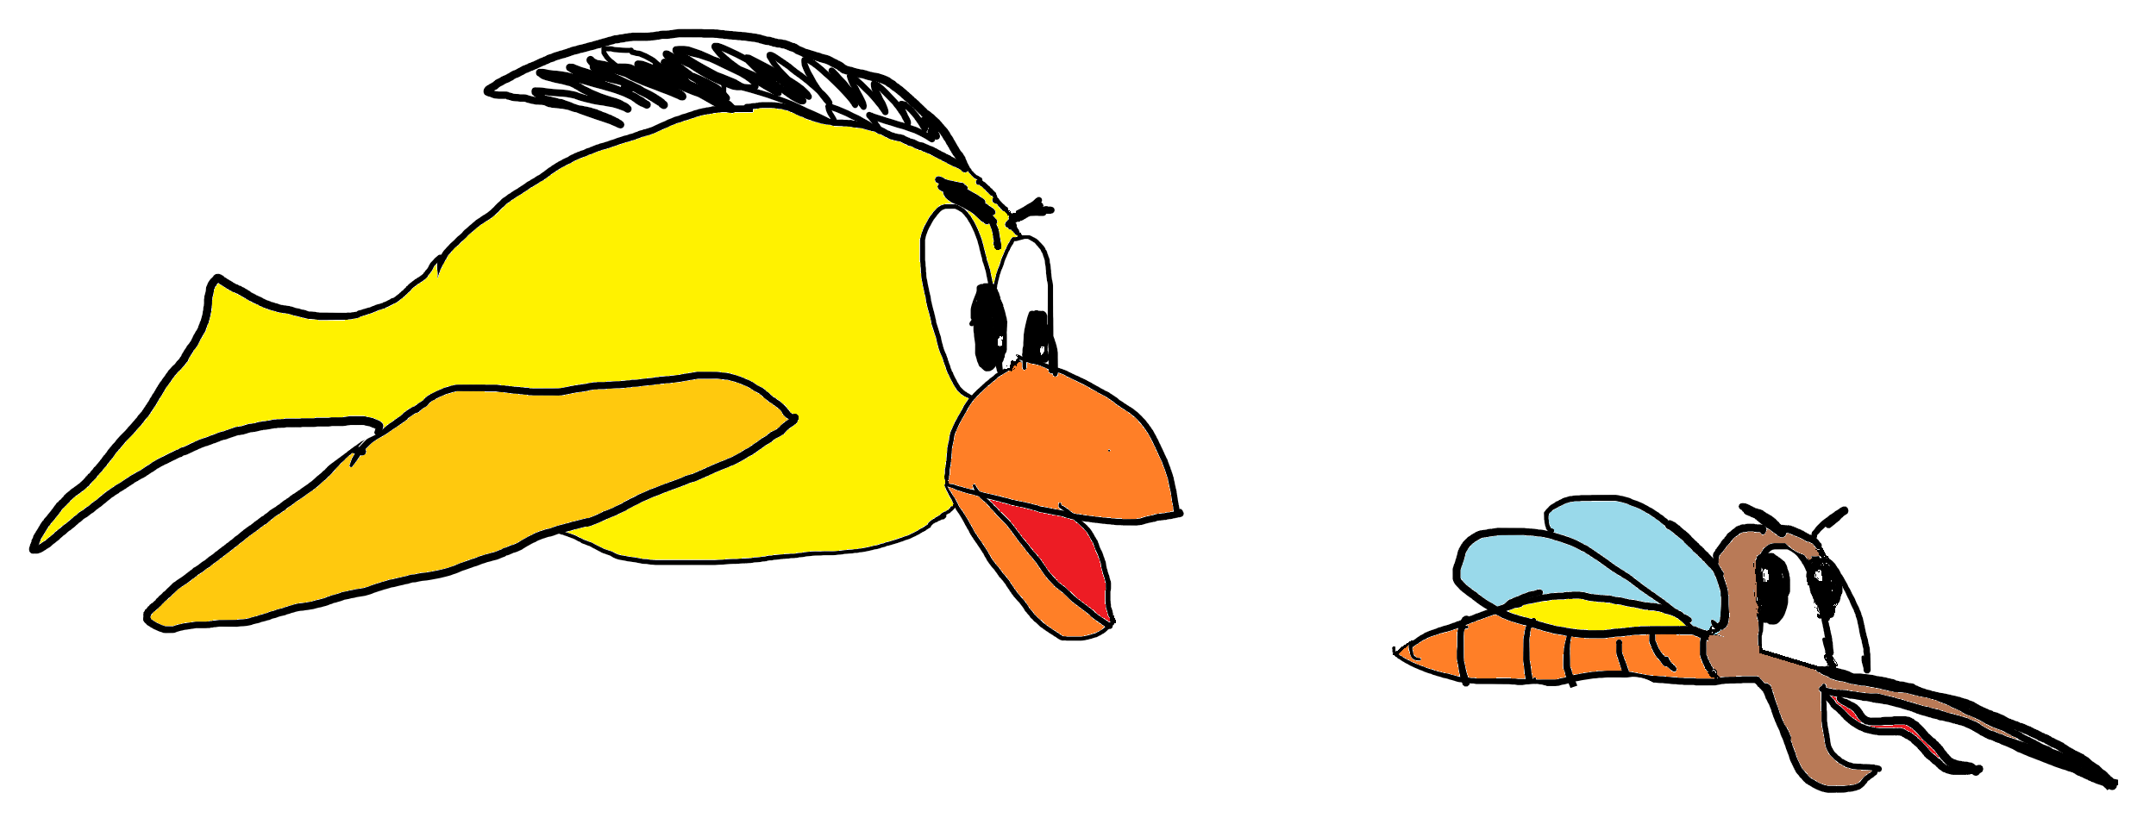

Ninja Bird
By Lucas Martín and Alfredo Martín
Eat as many mosquitoes as you can.
Don’t crash with the bricks
Game is over when you lose your energy
Press to fly
Press any key to continue

