Slide 1
Welcome to USP 597
Jamaal Green
3/15/2020

Slide 2
Class Overview

Slide 3
Basics
I’m Jamaal Green
Doctoral candidate here at USP, specializing in economic development
I’m a baby “data scientist” and avid R user
I work with A LOT of different types of data, particularly census and regional economic data

Slide 4
What I’m hoping for…
That we develop a more sophisticated workflow that will allow us to approach data analysis problems in a consistent way
Make our work more consistent, easier to review and replicable
Use R as our base of operations for this. Not everything we do will or can be done in R, but R is a convenient environment for anchoring for data analytic work

Slide 5
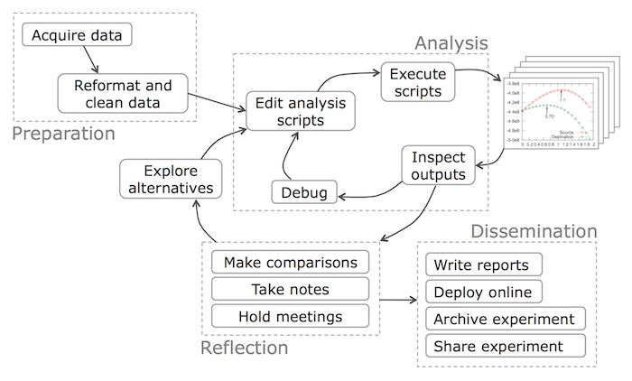
What do you mean by workflow?
Philip Guo, 2013

Slide 6
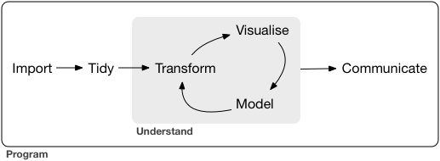
But really more like this…
Grolemund and Wickham, 2018

Slide 7
Okay…but why R? I’m not a coder/scripter/programmer/data scientist etc…
R provides us a platform to do most anything we have to do in the process of our workflow- this includes visualization and report writing.
Even at times when R is not sufficient, we can always come back to R.
Also…R is free.

Slide 8
But why (again)
Scripting allows us to better track what we’ve done…this means
Easier to correct mistakes because every step is documented
Easier to modify analyses without starting over
Scripting is in demand for the jobs you all are aiming for (particularly the planners)
R is free

Slide 9
Intro to Regional Economic Data Sources

Slide 10
What are we trying to do?
What are the economic conditions that exist in my region?
What are the resources that exist to support my regional economy?
Labor and human capital
Businesses/Institutions
Natural resources/infrastructure…even entrepreneurship and innovation

Slide 11
Starting with the question…
What are some questions one would ask in analyzing how important, or not, manufacturing is to your region?
Employment? Change over time? How does this compare to other regions?
Firm structure? Dominated by big or small firms?
How much income can we attribute to manufacturing? What are the good occupations within that industry?

Slide 12
Evaluating usefulness of data sources
Provenance…where is it from? Is it trustworthy?
Collection…how big is the sample? How was it collected?
What are the appropriate geographies and/or time periods?
Is this primary/secondary?

Slide 13
Different data sources
Most of our data will be public…specifically federal
BLS, BEA, Census etc
Proprietary data sources do exist…are usually quite expensive
NETS, InfoUSA (NETS is also longitudinal)
Primary vs secondary sources
a question of convenience, need, flexibility…we may use some in this class

Slide 14
Some types of data we will work with
Administrative records- collected for a specific purpose and often subject to disclosure rules
Surveys- collected to answer some set of research questions
What was the sampling strategy? Overall sample size? Estimated bias?

Slide 15
Some key concepts
Employment vs. jobs
What is a person’s employment status versus what jobs they may hold? People can have more than one job
Place of residence vs place of work…
Seasonal and inflation adjustments

Slide 16
Data Frequency
How often is your data collect? Released?
American Community Survey (ACS)
Collected continuously, rolled up into multiyear samples
Decennial Census: 10 years
Economic Census: 5 years
Quarterly Census of Employment and Wages
What is the time lag on releases? When should you expect them?

Slide 17
Data compatible over time?
Historical data is often very difficult to get
Major barriers include
Basic availability…did the data exist? is it in a machine readable format?
Code Changes…SIC to NAICS and change within NAICS
Changes in how variables are defined over time

Slide 18
How are the data organized?
Classification/organization systems are important to be familiar with
NAICS vs SIC
Standard occupational codes (SOC)
Metropolitan vs micropolitan areas
Race/ethnicity

Slide 19
Geographic Detail
Can you get your data at the scale you need?
Note that bigger units like states/metro areas are easier to get rich economic data than say tracts or even cities (places in census parlance)

Slide 20
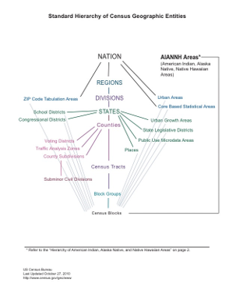
Census geographies

US Census, 2015

Slide 21
Data Sources

Slide 22
The Big Three
US Census
Bureau of Labor Statistics (BLS)
Bureau of Economic Analysis (BEA)

Slide 23
Local Go-To
State Labor Market Information Agency (e.g. Oregon Employment Department)
Other local affiliates…PRC (RIP), IMS for one

Slide 24
Some helpful portals
Social Explorer
HUD State of the Cities
FRED (Federal Reserve Economic Data)
Fedstats.gov
Econdata.net

Slide 25
US Census Bureau
Decennial and ACS
Economic Census (collected on years ending in 2 and 7)
County Business patterns
Longitudinal Household-Employer Dynamics (LEHD) Program

Slide 26
Bureau of Labor Statistics
Primarily statistics related to employment, unemployment and wages
Mix of geographies from national to county
Monthly payroll employment (CES)
Quarterly establishment and employment by industry (QCEW)
Local area unemployment and employment (LAUS)
Annual employment and wages by occupation

Slide 27
Bureau of Economic Analysis
Regional data section
State/metro measures of GDP
Personal income
Employment by industry (based on BLS QCEW)
Commuting pattern data from Census
Regional Input-Output Modeling System (RIMS)

Slide 28
State LMI Agencies
Agencies collect and produce data base don BLS protocols
Oregon Employment department- qualityinfo.org
Similar data points but offer additional info or research, on occasion
Know your state employment data provider: https://www.bls.gov/bls/ofolist.htm

Slide 29
Secondary sites and APIs
Social explorer- PSU has subscription, offers census data and some rudimentary mapping support
API- Application Programming Interface - Query different federal datasets from R over the internet - Remember to applyfor your census API key. Key Request
R packages that query data are often convenience wrappers for APIs (tidycensus, censusapi)

Slide 30
Coming back to our questions?
Answering questions about our economies requires facility and familiarity with multiple data sources. So, it’s important to know where to start looking.

